Slide 1

Study abroad
Course Selection

Slide 2
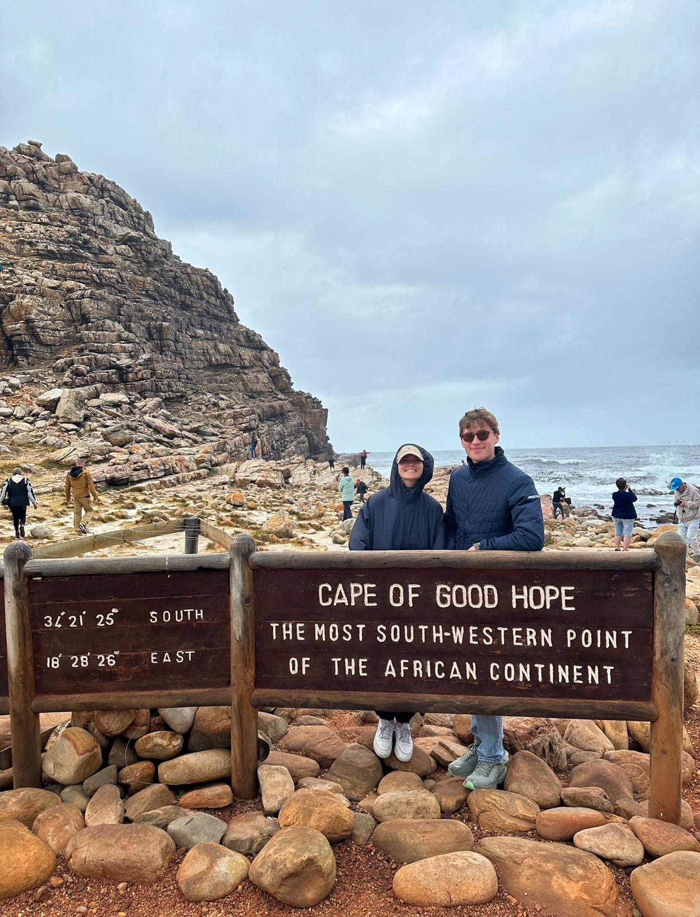
Overview:
Step-by-step Selection
South Africa
Review your degree checklist to match your interests to your needs.
Review host's "Course Calendar"
Q&As - What is your course load & how do you find that information?
Learning Agreement

Slide 3
Are you going into your 4th year?
If you are studying abroad during your 4th year, we would like you to send us an email now, with the subject line: Petition required and your student number.
As you may know those going into their last year must request an Academic Regulation Petition. This petition exempts students from being held to the requirement that says 5 of the last 7 courses must be credited from Trent.
We would like to get these forms processed ASAP.

Slide 4
Reviewing Your Degree Checklist to Match your Interests to your Needs
Step One:

Slide 5

Ask yourself:
France
Do I have any mandatory courses I need to take while abroad, or can I take all electives?
Do I have to take my courses at a specific level? I.e., 1000, 2000, 3000 *4000 level generally not transferrable
Can I take courses outside my discipline?
Are there courses offered at my host institution that I cannot take at Trent?

Slide 6

Mandatory Credits?
England
Next Steps
Send studyabroad@trentu.ca an email that includes:
The course code & name of the required course at Trent.
The course SYLLABUS from the host institution of a course you believe may be a direct equivalent.
Study Abroad will send the information to the appropriate Trent departmental chair for assessment.
*Currently, we are only assessing required courses, NOT electives. We simply don't have the time to assess everyone's courses. If you find an elective that you believe has a Trent equivalent, it may be assessed at a later date.

Slide 7
Reviewing host's
Course Calendar
Step Two:

Slide 8
FINDING THE RIGHT Calendar
Start with our best guess...
It is possible that your host university has NOT posted a course schedule yet.
If this is the case, try to find their course listing from the current academic year and use that as a guide for now. Most of our exchange partners offer many of the same courses every year.
Be aware that different countries often use different terminology.
For example, at some Australian and UK universities, ‘course’ means the program of study (for example, Economics), and what we call courses may be called ‘modules’, ‘units’ or 'papers'. In many other countries, what Canadians refer to as an academic calendar only means a schedule of semester dates, and any additional information about courses is found elsewhere (for example, in Australia, program information and course lists are often found in the university’s ‘handbook.’)

Slide 9
Common Questions & Answers
Step Three:

Slide 10

Q&A
How do I determine the number of classes I need to take while on exchange?
How do I read the course codes?
How do I know what level each course is?
What is a course load at my host institution?
All these answers can be found on the FACT SHEETS!!
In order to receive full-time Trent University credits (2.5 for one semester, 5.0 for two semesters) when you return, you must take your host university’s equivalent of a full-time course load.
For example, in countries that are part of the European Union, universities use the European Credit Transfer System (ECTS). 30 ECTS credits per semester are equal to 2.5 Trent credits. In the UK, many universities use the CATS credit system, and 60 CATS is equal to 2.5 Trent credits.
*Before you email us with your questions please review the fact sheet for your host institution on our website, many of your answers will be there.
Italy

Slide 11
Learning agreements
Step Four:

Slide 12

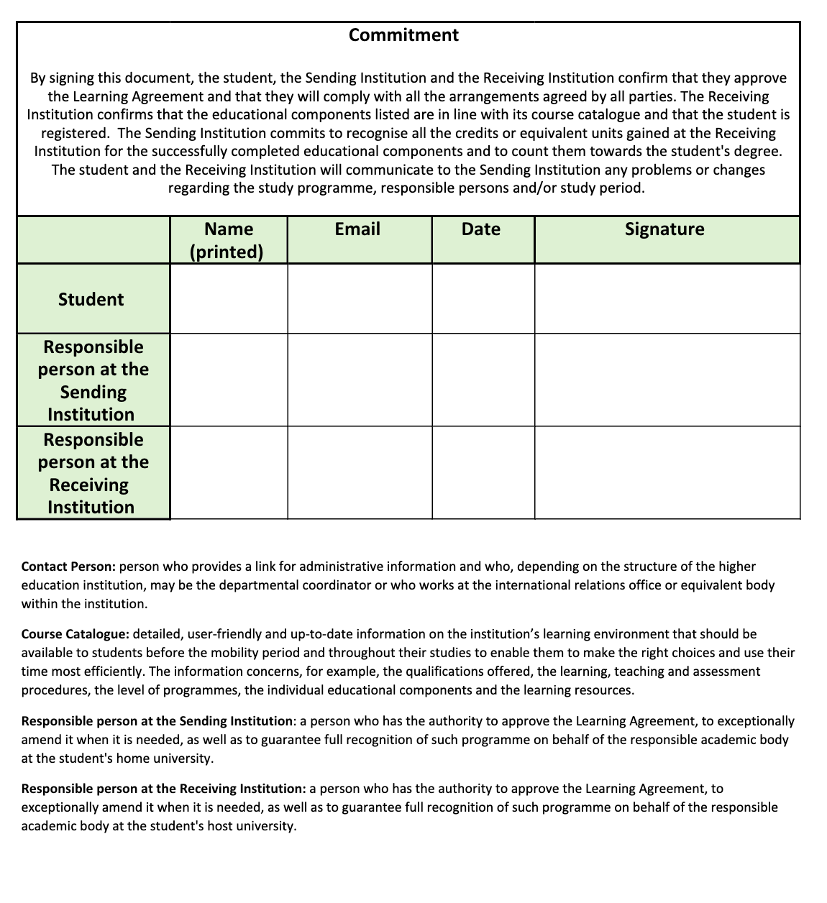
What does the document look like?
You should have received the form through your email.

Slide 13

Why is the Learning Agreement Form so important?
Barbados
The completed and signed Learning Agreement form is your contract with Trent University that states what specific Trent generic course credits you will receive for courses you pass while on exchange.
Your completed and signed Learning agreement form is also used to register you at Trent for the semester(s) you will be on exchange and generates your fees.
If you don’t complete and submit the Learning agreement form, you will not be registered as a Trent student for the semester(s) you are on exchange and you will not receive credit for the courses you take while on exchange.
*We recommended that you choose more courses than you can take while on exchange. Getting back-up courses approved in advance may help you avoid having to contact your program counsellor for last-minute approvals once you’re on exchange.

Slide 14

Completing the form
A) Complete the top part of the form including:
Your name,
ID number,
Academic program (your program here at Trent),
Exchange dates (approximate is fine),
Exchange program name (the host university you will be attending on exchange),
Check the ‘Pre-exchange assessment (courses only)’ box.
B) List the courses that you want to take while on exchange in the left-hand column.
Include the host course number (if possible) and the host university course title.
Austria

Slide 15
Changing courses
You will complete the Learning Agreement form before you go on your exchange as an estimate of the courses you intend to take.
Once you arrive at your host university, you may find that some of the courses that were approved on your Learning Agreement form are not available or that you want to take different courses than you initially planned.
If this happens, don’t panic. It is common for students to make changes to their exchange course selection.
If you decide to change courses after you have handed in the Learning Agreement, simply make sure to e-mail your Study Abroad Advisor to get approval for the new courses (you do not have to complete another Learning Agreement form – the additional approvals can be done via e-mail). You will fill out the Learning Agreement form again when you return from your exchange based on the courses you took, in order to receive credit for these.

Slide 16
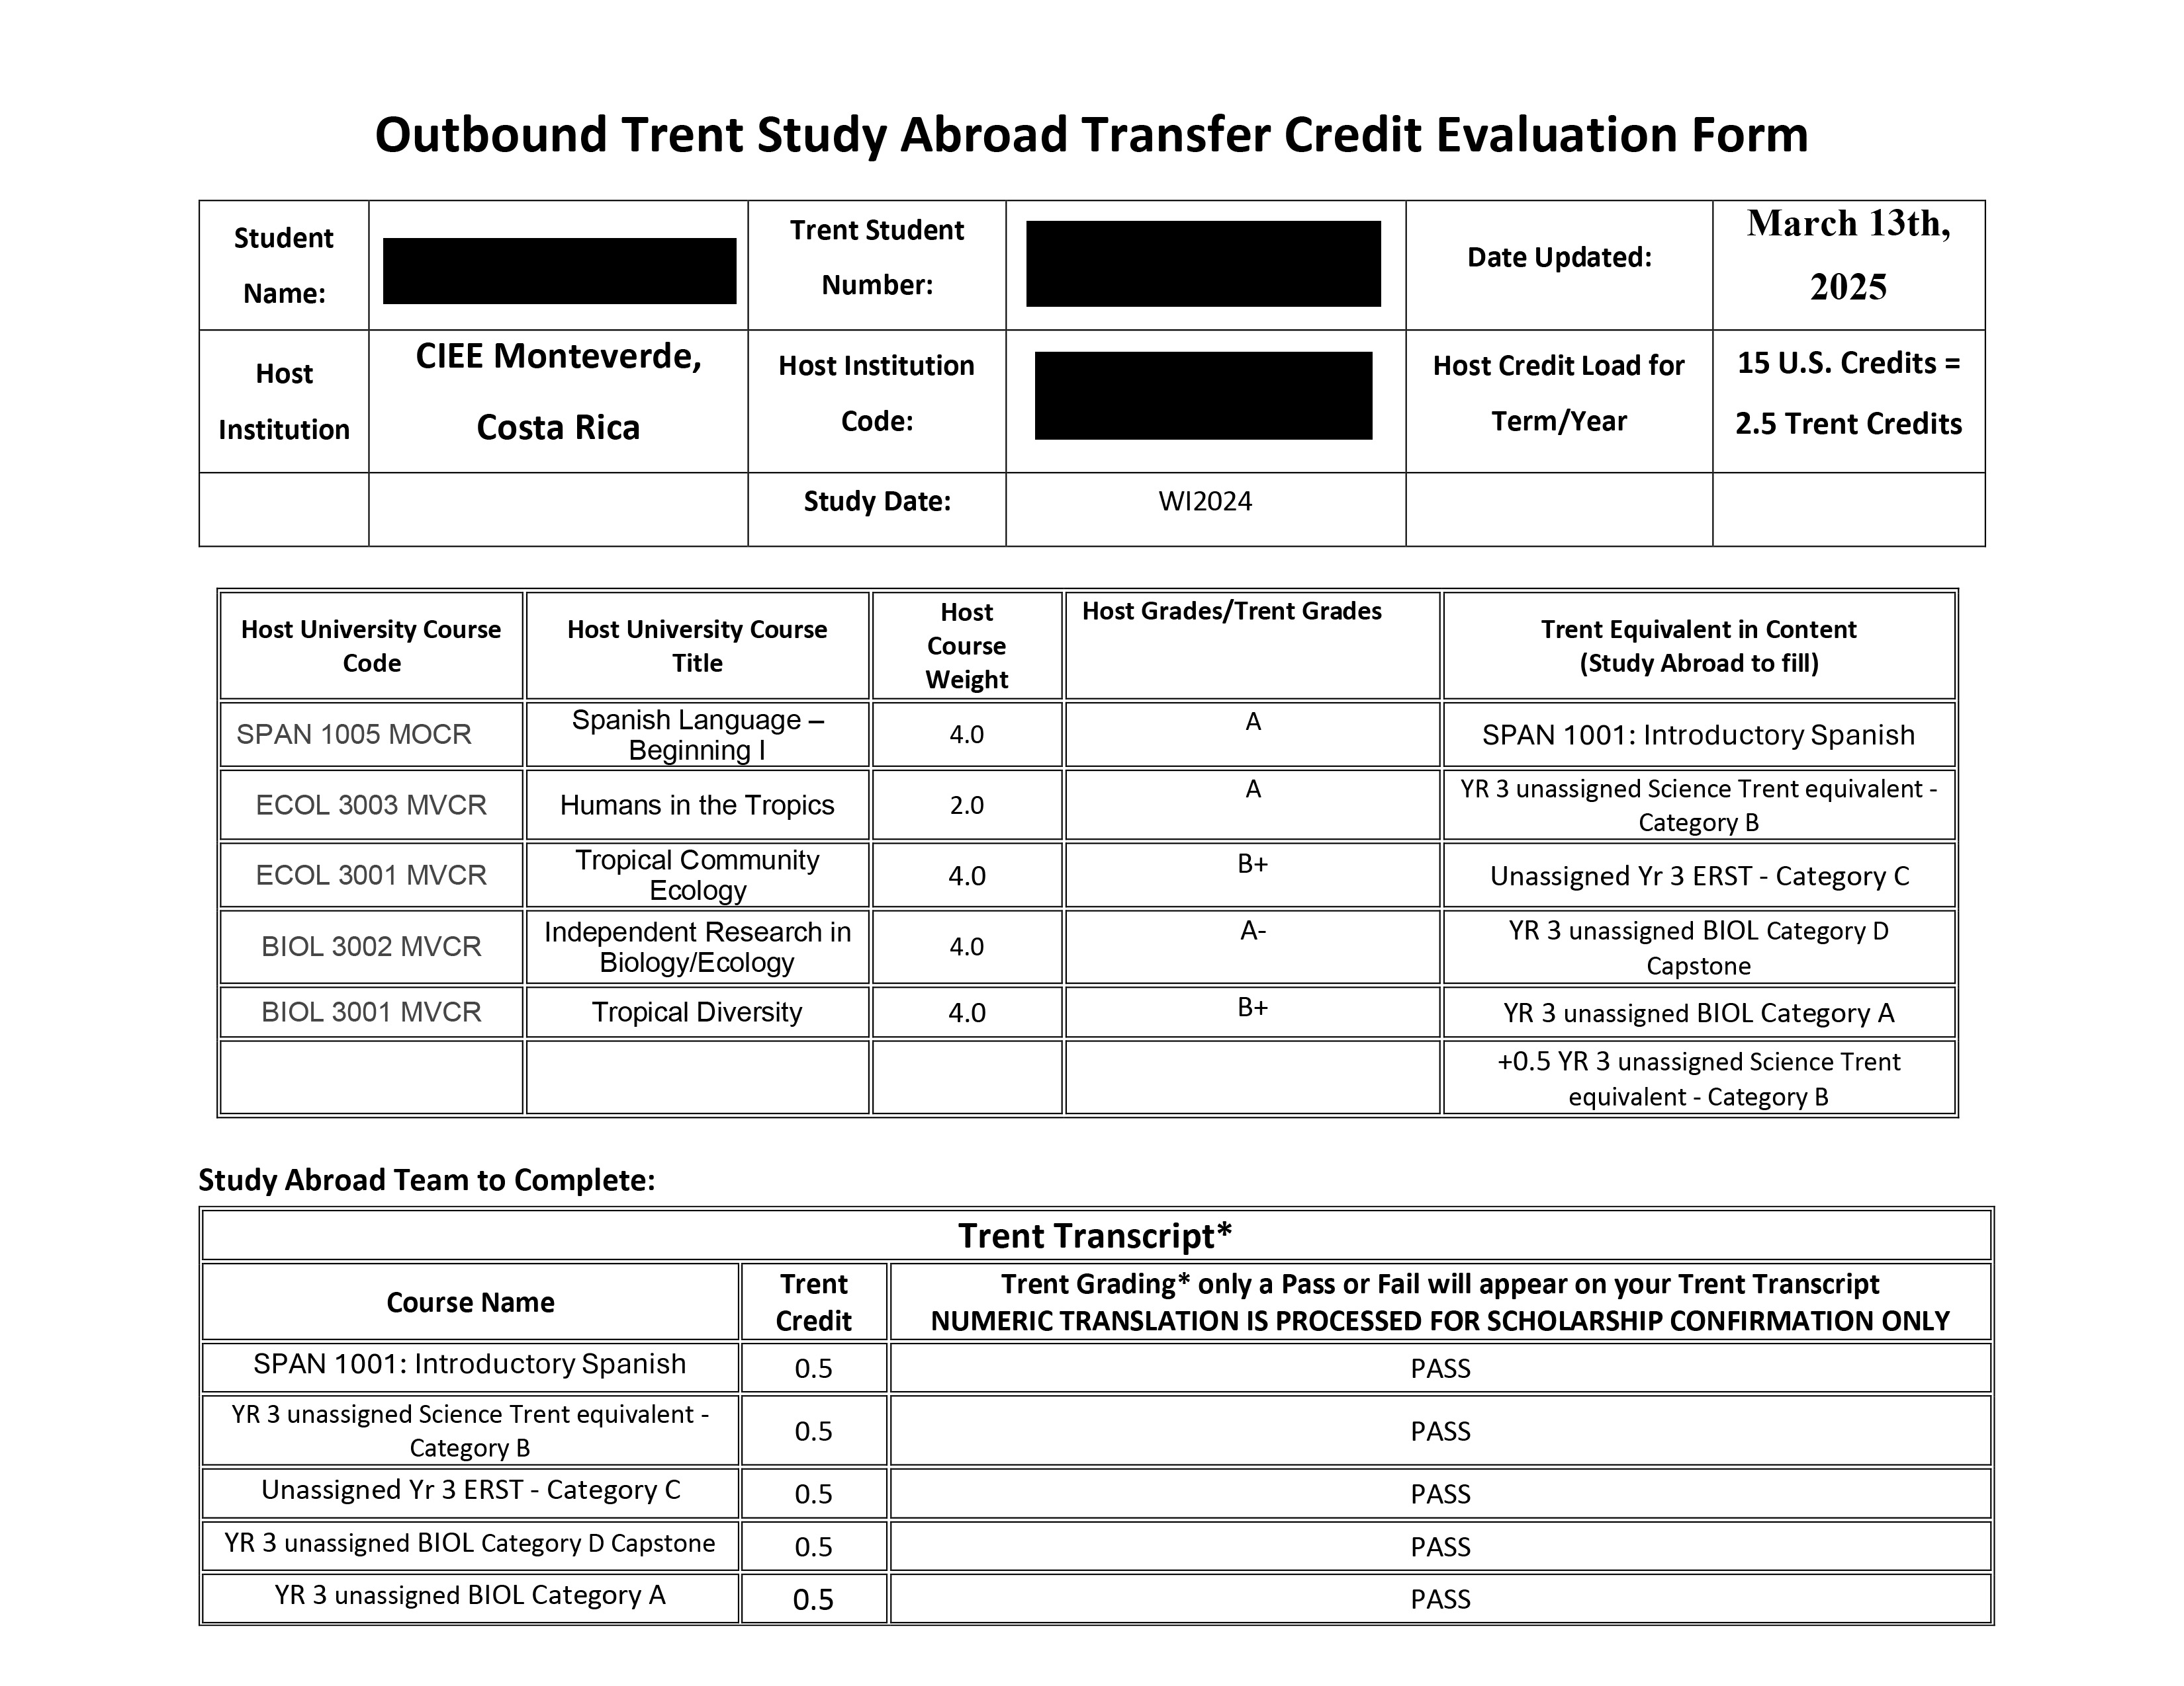
Credit transfer form

Slide 17
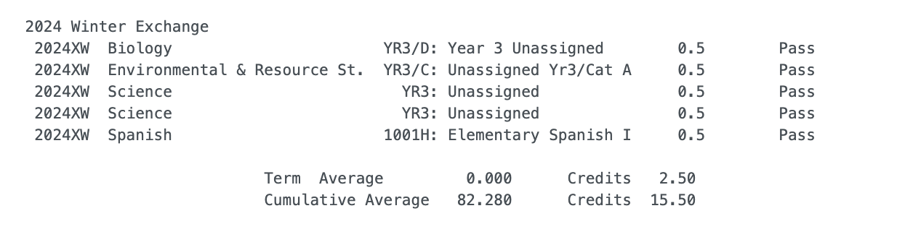
The END GOAL – credit transfer!

Slide 18


Thank you!!
Studyabroad@trentu.ca

