Slide 1


Study Abroad

Slide 2
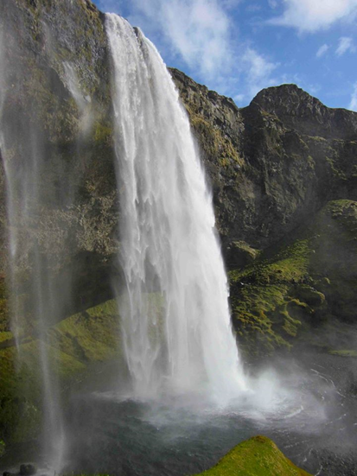
New Country, Culture, and Classroom:
Tips to Thrive while Studying Abroad

Slide 3
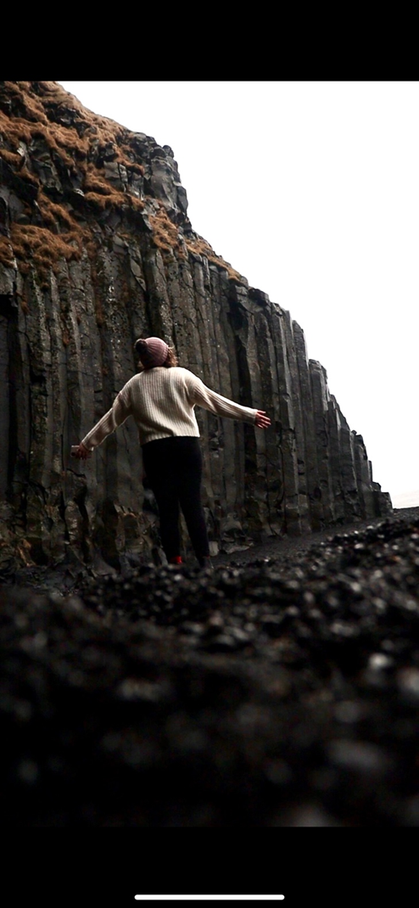
Ways to Understand Culture
Ways to Understand Culture Shock
Tips & Reminders for Staying Safe While Abroad

Slide 4

What
is
Culture?
Notes:
-50+ exchange partners in 40+ countries
-Spend a summer, term or a full year abroad
-Earn credits for your Trent degree
-Pay Trent tuition
-Programs available for almost every major

Slide 5

“Culture is a fuzzy set of basic assumptions and values, orientations to life, beliefs, policies, procedures and behavioral conventions that are shared by a group of people, and that influence (but do not determine) each member’s behavior and his/her interpretations of the ‘meaning’ of other people’s behavior.”
Helen Spencer-Oatey (2008)
Linguist and social psychologist

Slide 6
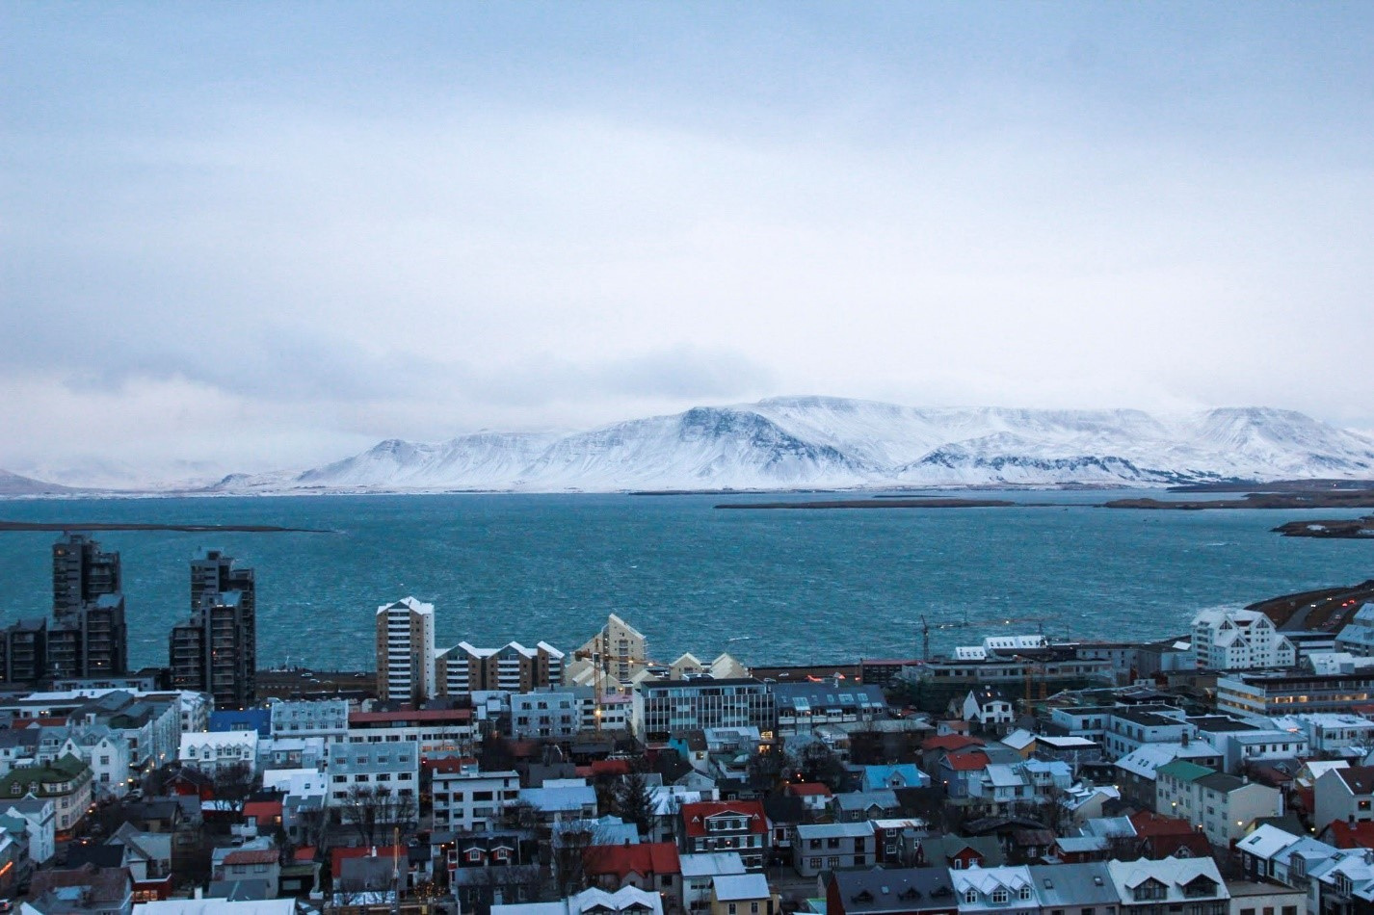
The Cultural Iceberg!

Slide 7

  The Cultural Iceberg
  10% Surface
  90% Hidden/Deep

Slide 8
  What does Surface Culture include?
Language
Food
Architecture
Fashion
Holidays
Games
Literature
Religion
Traditions
And more…

Slide 9
  What does Deep Culture include?
Gestures/body language/facial expressions
Eye contact
Personal space
Tone of voice
Displays of emotion/affection
Metaconcepts:
  Self
  Time
  Fairness & Justice
  Roles related to gender, class, family

Slide 10
We have the tendency to notice difference more that familiarity in others when travelling. This is normal, but it is important to remind yourself to also look for what isn’t so obvious: the underlying reasons for the difference.

Slide 11
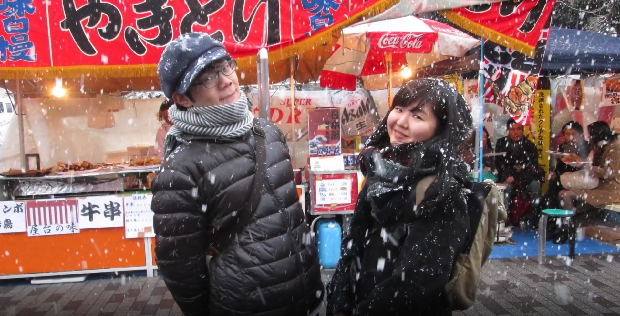
High Context/Low Context Cultures
Another way of understanding difference

Slide 12
High Context/Low Context Cultures
Think of these contexts as the hidden 90% of the cultural iceberg.
I think of these concepts as the amount of background data that is required to establish trust
Note: it is helpful to consider the different aspects of cultures, but remember to not stereotype individuals.
"high context" and "low context" concepts of culture was popularized by anthropologist Edward Hall.
Used to describe broad, general cultural differences that exist in varying societies.

Slide 13
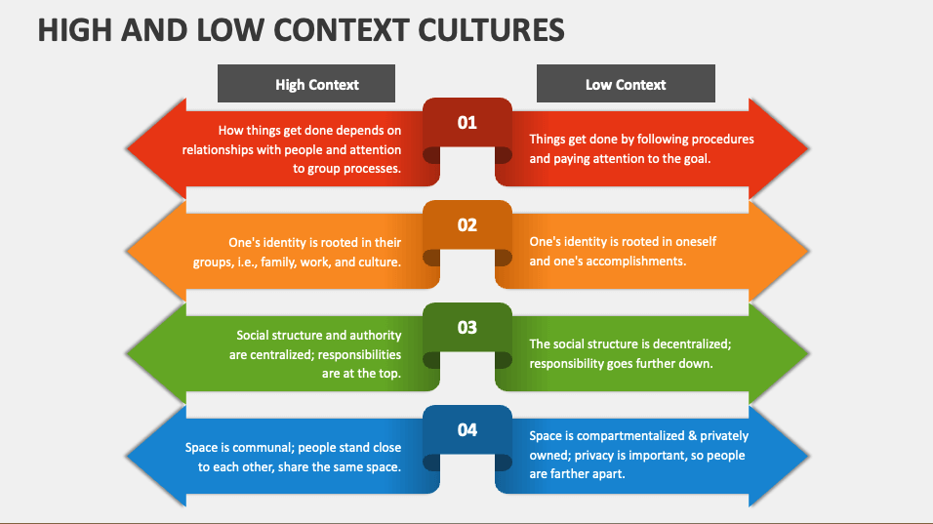


Slide 14
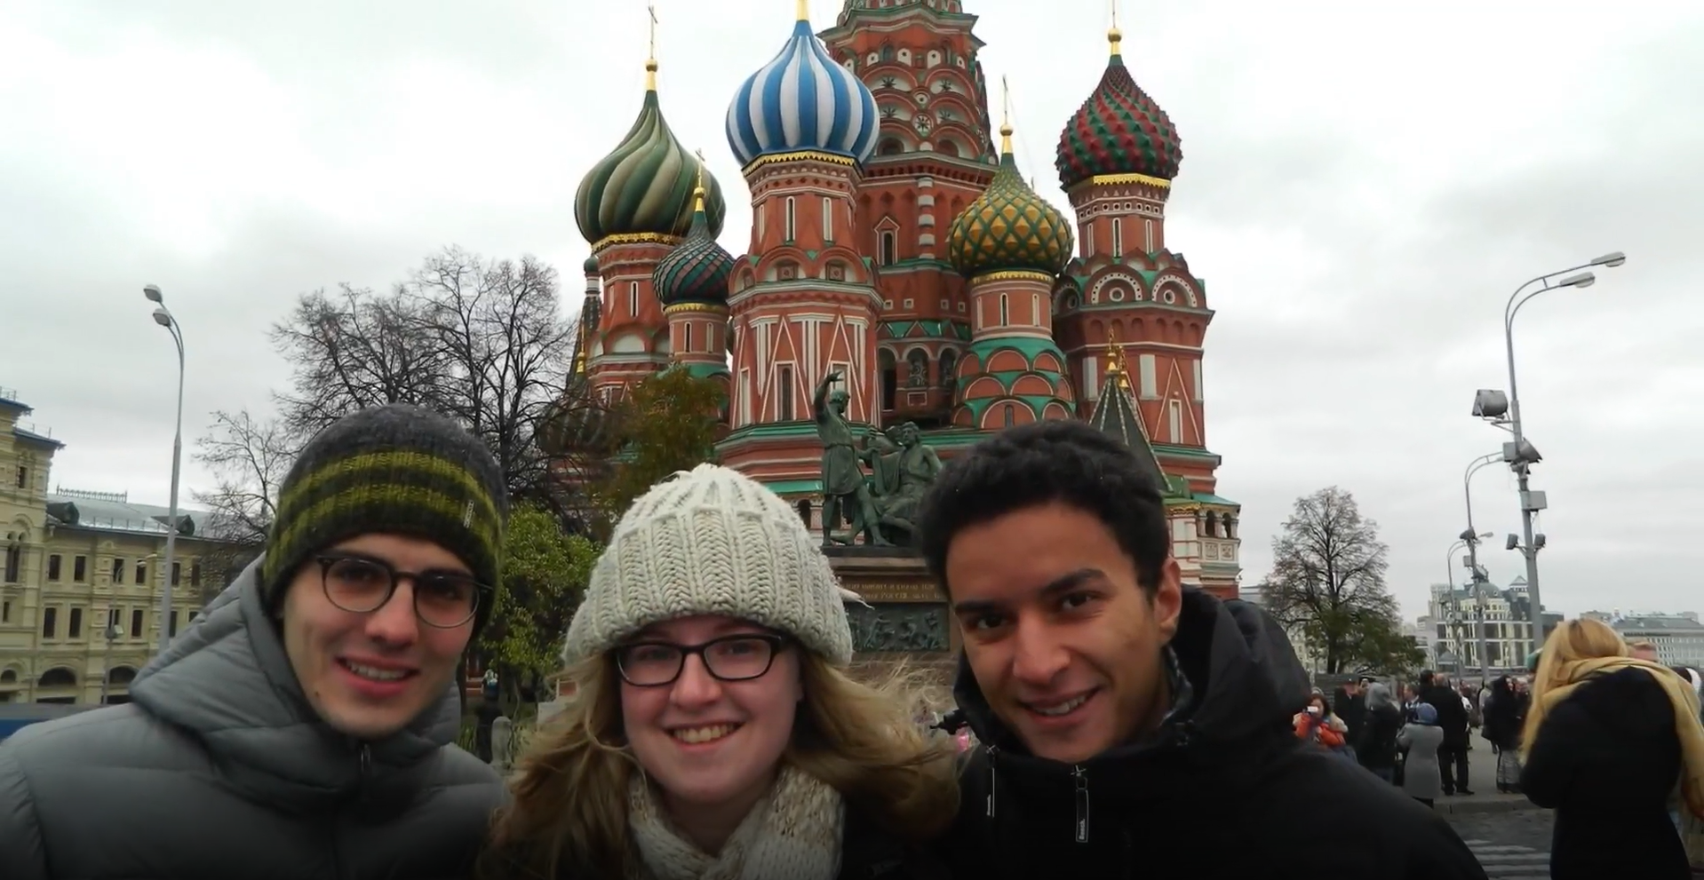
Culture
Shock!

Slide 15

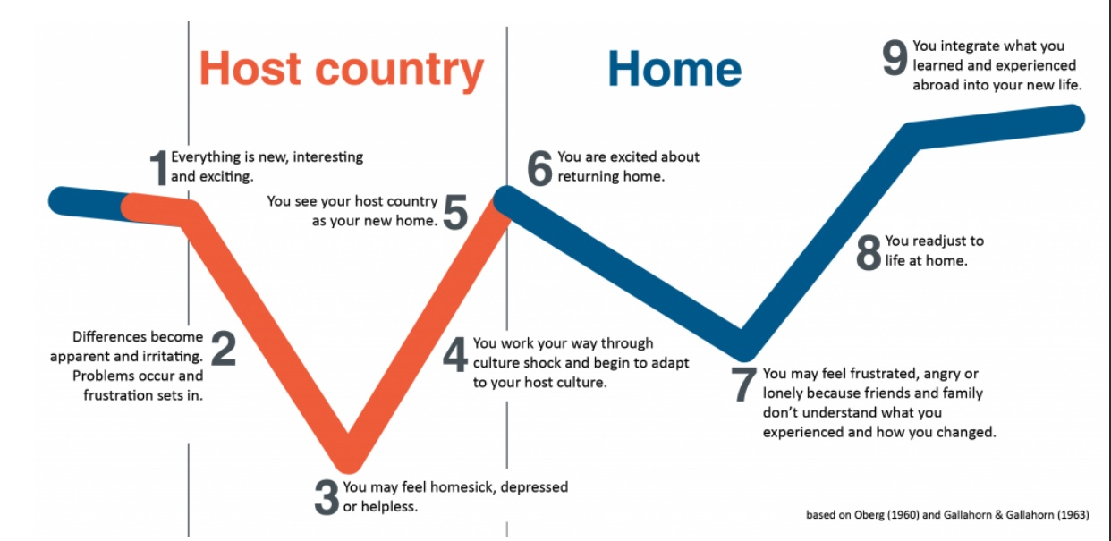
Culture Shock! Surfing the W-wave
Anticipating Departure
Arrival Confusion
The Honeymoon
The Plunge
Initial Adjustment
Confronting Deeper
Issues
Adapting and
Assimilating
Repeat

Slide 16
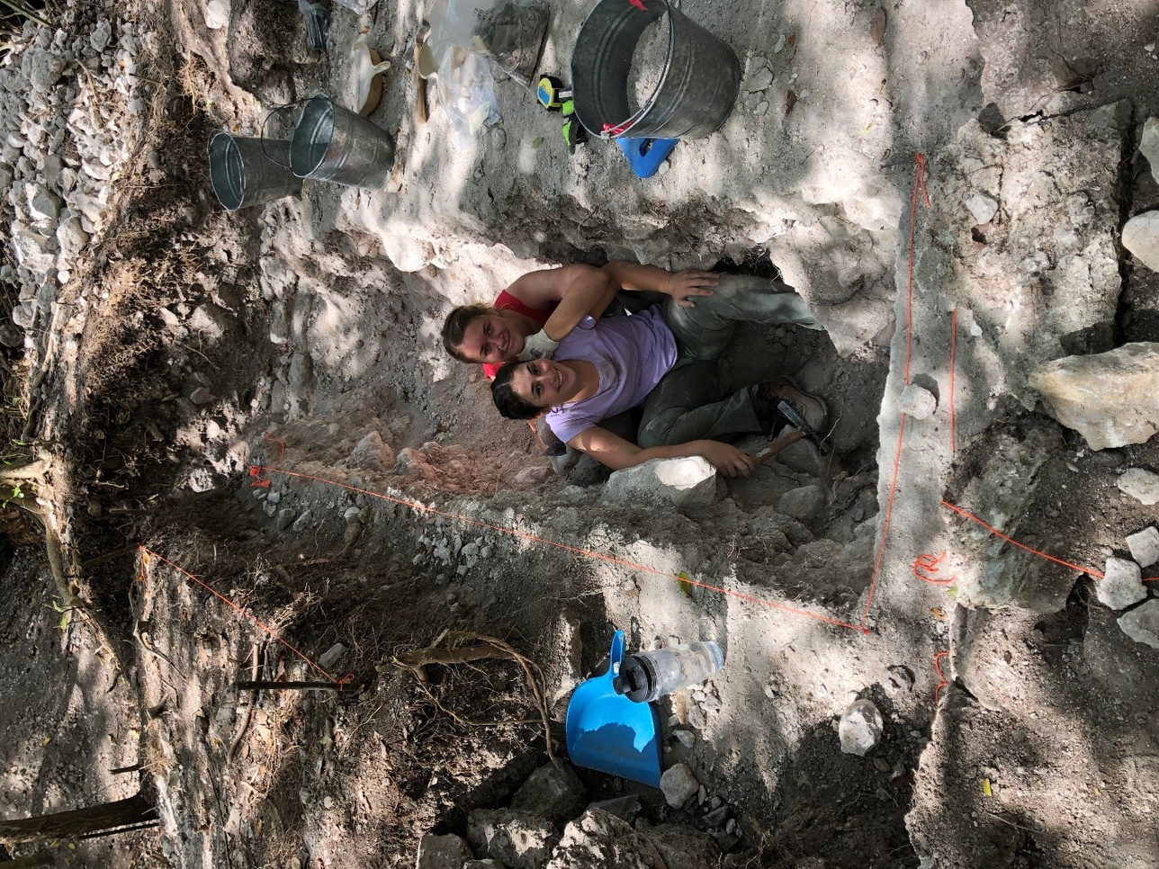
Tips to manage culture shock:
Research your country
Stay connected with home
Understand that your feelings are normal!
Ask for assistance when needed
Talk with others in a similar situation
Do what makes you happy at home
Join an on-campus club or group
Give yourself a break
Eat and sleep well
Make lists and give yourself some easy wins

Slide 17

Safety while abroad

Slide 18
Some tips and reminders…
  Remember that you are a guest in a new university, in a new country, and in a new culture. The best guest are those who are appreciative, respectful, engaged, and gracious.
  Adhere to local laws (even if you disagree with them)
  Respect local customs (even if you disagree with them)
  Ask questions rooted in curiosity, not judgement.
  Be true to yourself, but not reckless. Nobody wants to find themselves in a conflict or in a foreign jail!

Slide 19
Some tips and reminders…
  Use common sense, trust your gut feelings
  Don’t wander alone late at night
  Learn your surroundings
  Tell a friend where you are going and when you plan to return
  Share you location with someone you trust
  If an offer seems too good to be true, be cautions
  Keep your valuables close to you, or locked in your room
  Make a copy of your important documents
  Drink responsibly

Slide 20
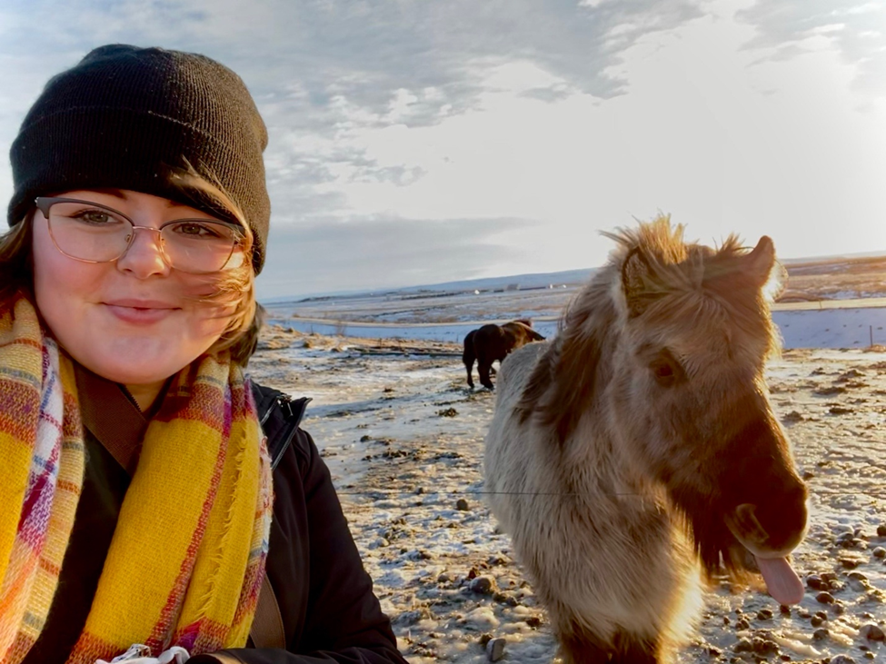
Safe
Travels!

