Slide 1
Field Education Orientation
Field Instructors
Welcome
January 2026
Travis Peck, MSW, RSW Field Education Coordinator PTBO
705-748-1011 or travispeck@trentu.ca
Avery Comeau, MSW, RSW
Field Education Coordinator DUR
705-740-1011 or acomeau@trentu.ca
Department of Social Work

Slide 2
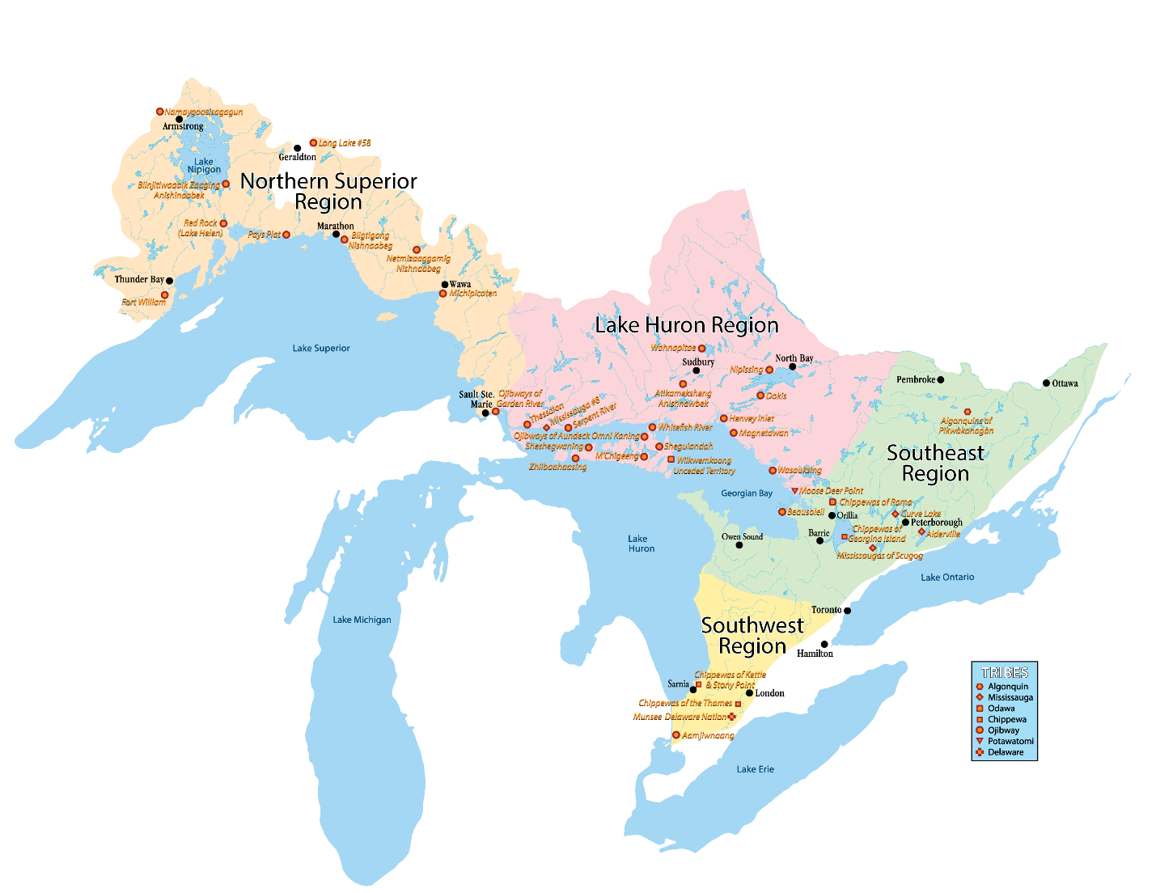
We respectfully acknowledge that Trent University, in Peterborough and Durham, is located on the treaty and traditional territory of the Mississauga (MichiSaagiig) Anishnaabeg, which includes Curve Lake First Nation, Alderville First Nation, Hiawatha First Nation, and the Mississaugas of Scugog Island First Nation. Specific to this region, Treaty 20 was signed in 1818, followed by the Williams Treaties in 1923.
We offer our gratitude to First Peoples for their care for, and teachings about, our earth and our relations.
May we honour those teachings.
First Peoples House of Learning, 2021. Image credit: https://www.anishinabek.ca/who-we-are-and-what-we-do/
Notes:
Personal land acknowledgment verbally, acknowledging the work of FPHL
Mention practice objective- get comfortable with land acknowledgments

Slide 3
What will we cover today?
Overview
Program and Placement Information
Roles
Purpose
Placement requirements
Learning Plan
Template
Purpose
How to fill it out
Progress Review
Template
Purpose
How to fill it out
Student requirements (before and during placement)
Agency requirements
Learning Framework
Learning Plan and Progress Review
Technology
SharePoint
Website – FI resources
Additional resources
Field Practice Days/Hours
Placement Days and Hours
Deviations, Illnesses, and Absences
Grading
Roles and Responsibilities
Student
Field Instructor
Faculty Field Liaison and Field Education Advisor
Field Education Coordinator
Accident and Injury
Making mistakes
Insurance
Supervision
Nature and requirements
Social Work Supervision (Trent)

Slide 4
Program and Placement Overview

Slide 5

BSW Field Program Overview
Combination of academic courses and 700 hours of supervised field practicum
240 in Winter third year and
460 Fall/Winter fourth year
Graduates are eligible to register with the Ontario College of Social Workers and Social Service Workers, and to be members of the Ontario Association of Social Workers

Slide 6
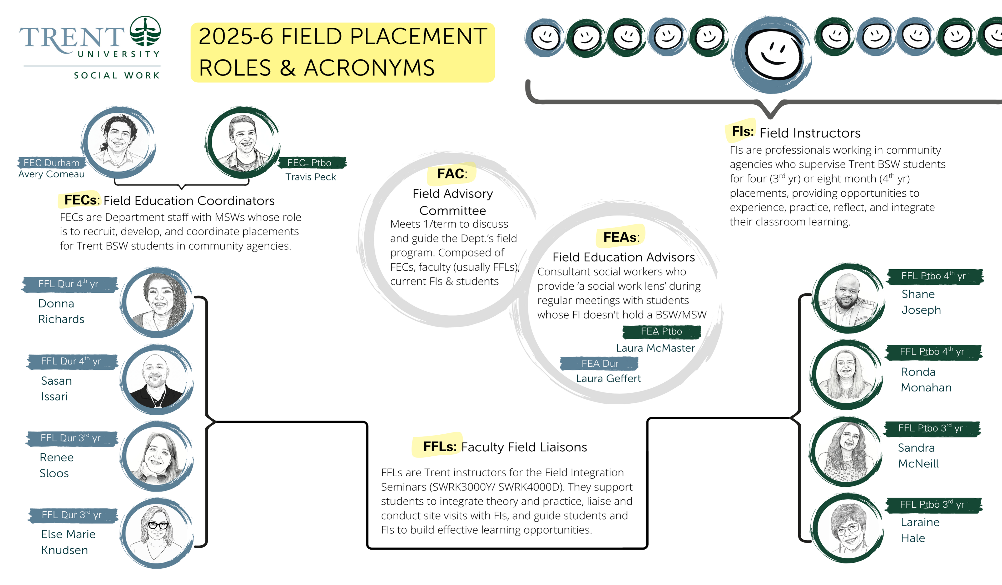
Placement Team

Slide 7
Purpose of Field Education
To explore, develop, and refine a student’s praxis by:
linking and applying theoretical knowledge to practice
learning through practice, reflection, and reflexivity
exploring new ways of doing, being, knowing
gaining first-hand knowledge of social service systems
honing skills (communication, professional, community, etc)
refining their professional identity

Slide 8
Integration Loop
Retrieval
Reflection
Linkage
Professional Response
Information gathering
Exploration of self
Conscious application of
Using knowledge and
about a specific practice
situation
awareness and personal
values, biases &
assumptions
theory to practice
insights to develop plans
and behavioural
responses to inform
future encounters
Bogo & Vayda (1998)

Slide 9
Benefits to taking on BSW students
shape the next generation of Social Workers
offload work (especially as placement progresses)
test out prospective future employees
hone supervision skills
counts towards the Continuing Competency Program if you’re a Registered Social Worker

Slide 10
Affiliation Agreement (5-year validity period)
Purpose:
Outlines our responsibilities to each other
Confirms our legal and insurance agreements (i.e. indemnification)
Confirms that Trent is responsible for providing all student insurance and submitting claims
Process:
Trent drafts the agreement using our standard template (or using your Affiliation Agreement if required by your governing structure)
Placement Agency signs it and returns it to Trent
Trent signs it
Trent forwards fully signed copy to you

Slide 11
Pre-Placement Requirements Students

Slide 12
Student Requirements
Attend orientation events
Interview with Placement Hosts
Complete trainings/workshops required by Trent

Slide 13
Student Training
Submit to the social work department
Health and Safety Awareness
Workplace Hazardous Material Information System (WHMIS)
Accessibility for Ontarians with Disabilities Act (AODA)
Workplace Violence and Harassment
Cybersecurity at Trent
Students no longer submit a Police Check to the Department
Students submit to their agency
Agency directed

Slide 14
Agency Requirements
Indicate interest and confirm capacity to host placement to FEC
Interview student(s)
Confirm placement with students/FEC
Sign Affiliation Agreement (valid for 5 years) if required

Slide 15
Requirements during placement

Slide 16
Main activities
Practicum
January 21 to April 10 (contingent on 240 hours)
With the matched Agency/Supervisor
Wednesday, Thursday, Friday
Classroom-based Field Integration Seminars
January 11 to April 10
With student’s assigned Faculty Field Liaison

Slide 17
Documents
Due within first two weeks:
Safety Orientation Checklist*
Due Diligence Checklist*
Field Instructor Information Sheet*
*FI input is required, but students take the lead. Student may be pulled from placement if not submitted by due date.
Throughout the year (based on FFL deadlines)
Learning Plan
Midterm Progress Review
Final Progress Review
Timesheet and Supervision record

Slide 18
Learning Framework

Slide 19
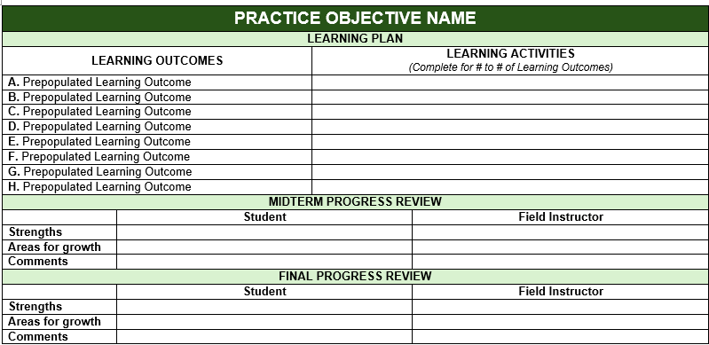
Learning Plan and Progress Review

Slide 20
Learning Plan

Slide 21
Purpose
Guides student’s learning and practice activities
Operationalizes the relationship between Field Instructor and Student
Defines supervision
Offers framework for evaluation

Slide 22
Filling Out the Learning Plan
FIs collaboratively develop learning activities based on student and agency capacity
The LP is a living document and may change over time
Students can and should be engaging in placement activities before their learning plan has been signed by them/their FI/their FFL
Students are responsible for filling out the document and confirming that it is complete
FFL approves or declines the LP

Slide 23
Completion Timeline
Students must complete their Learning Plan within the first two to four weeks of placement (FFL to provide specific deadline)
Students are to sign the document and then let you know it’s ready
FFLs then sign off on the Learning Plan indicating that the plan is generally thought of as being complete

Slide 24
Practice Objectives
Professional Social Work Identity
Reflective Practice
Generalist Practice with Individuals, Families, Groups, and Communities
Engagement, Interviewing, and Documentation
Assessment and Intervention
Closure
Equity, Diversity, and Social Justice
Indigenous Peoples and Communities
Environmental Sustainability and Ecological Practice
Policy
Research

Slide 25
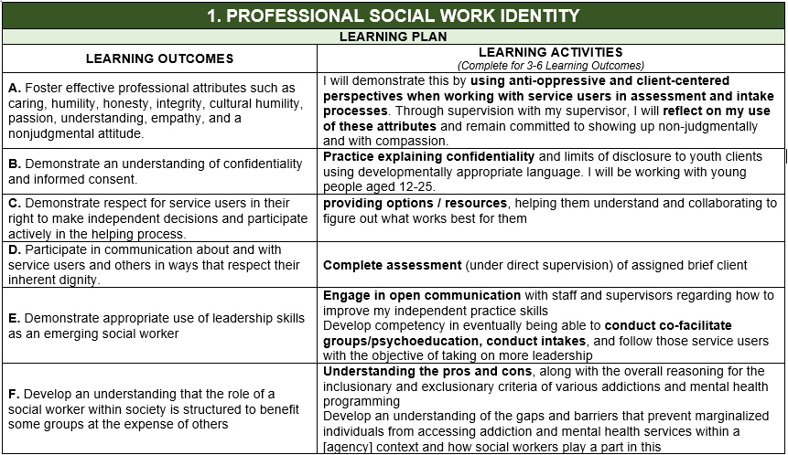

Slide 26
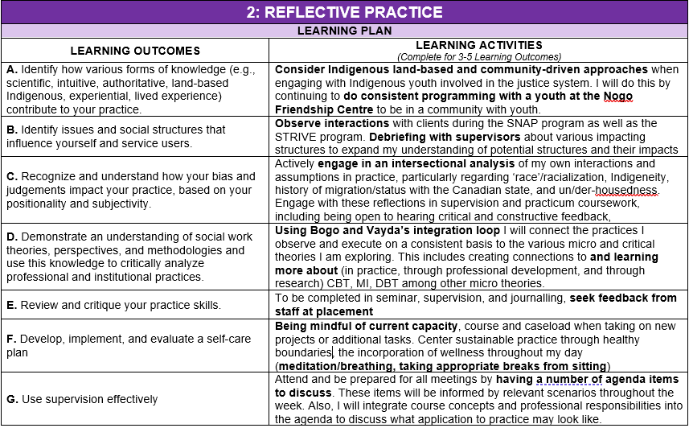

Slide 27
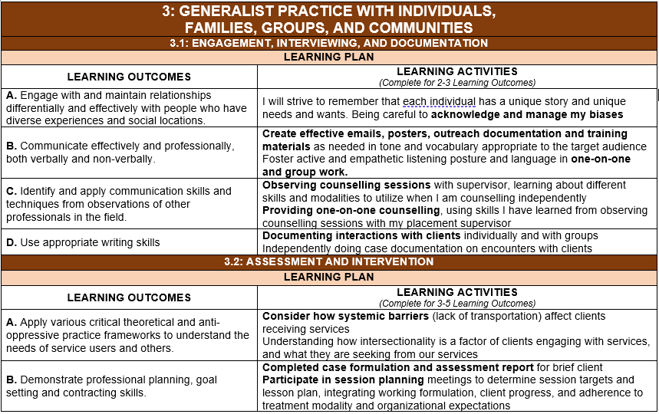

Slide 28
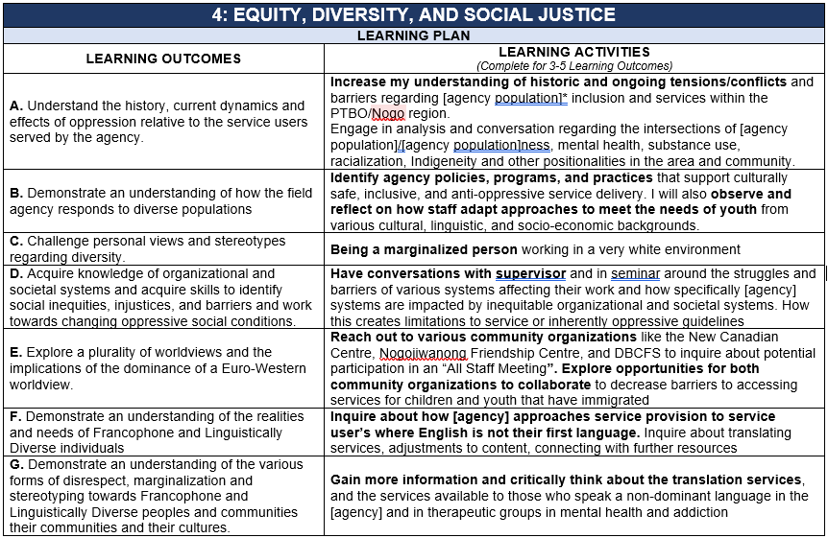

Slide 29
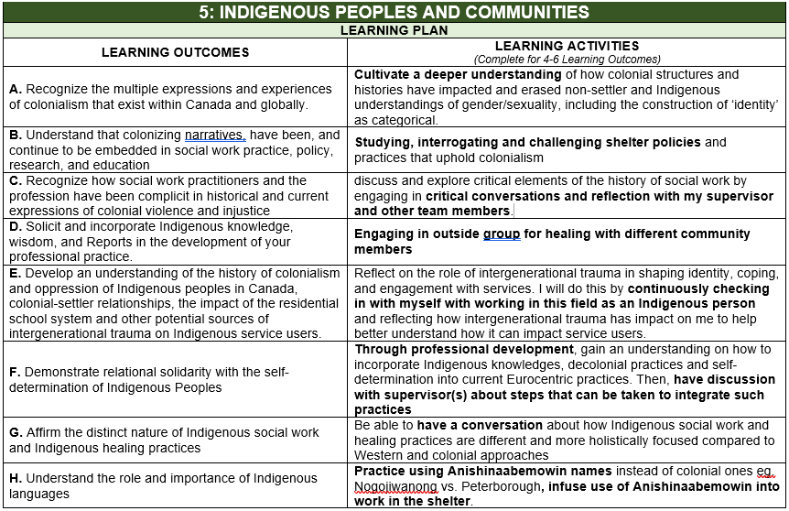

Slide 30
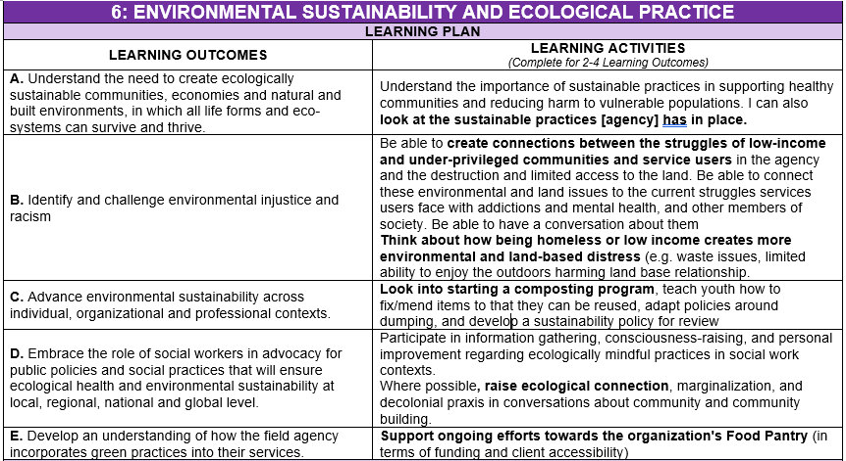

Slide 31
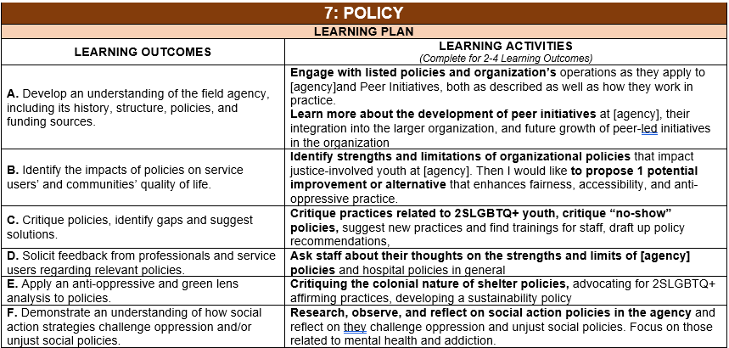

Slide 32
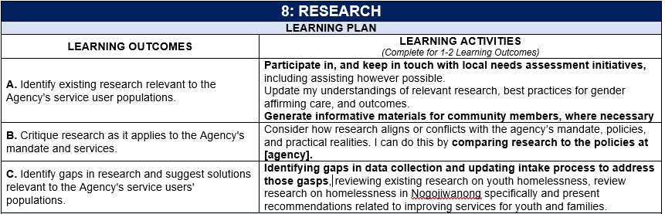

Slide 33
Progress Review

Slide 34
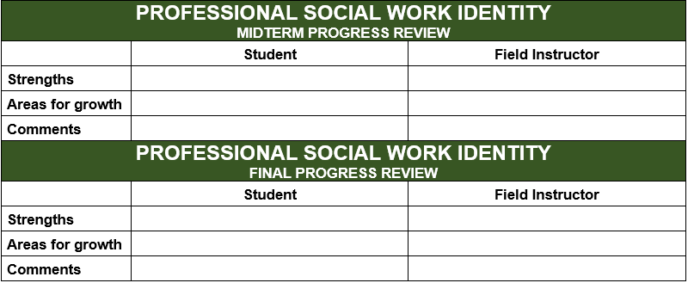

Slide 35
Process
Students should be assessed on the entire Practice Objective not just Learning Outcomes they have corresponding Learning Activities for.
Students fill out their section first, and then confirm with FI it is ready for their input
FIs fill out their section
Students and FIs meet face to face (can be virtual) to discuss

Slide 36
Timeline
Specific dates will be provided by the FFL and may vary based on start dates. Students to inform FIs of due dates.
Generally around the midpoint (mid February) and a week or two before placement ends in late March/early April

Slide 37
Supervision

Slide 38
Supervision
1) FI/Agency provided
1 hour per week (counts towards hours)
Mostly one to one
Group supervision (if more than one Trent student)
2) FEA
If Field Instructor does not have a Social Work Degree
FIs generally not involved in this supervision
Counts towards hours

Slide 39
Technology

Slide 40
SharePoint
Will house the following documents:
Learning Plan and Progress Review
Student Timesheet and Supervision Record
Students and Field Instructors will only have access to the student’s folder
Documents are shared, and updated in real-time
Can complete documents offline/outside of SharePoint, provided students upload them to SharePoint regularly
FIs will be provided with access by first day of placement
Students are responsible for providing additional instructions to Field Instructors. The FEC is always available to answer questions.

Slide 41
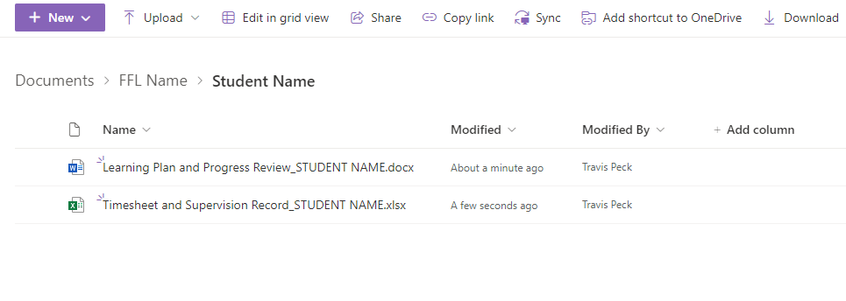
SharePoint Structure

Slide 42
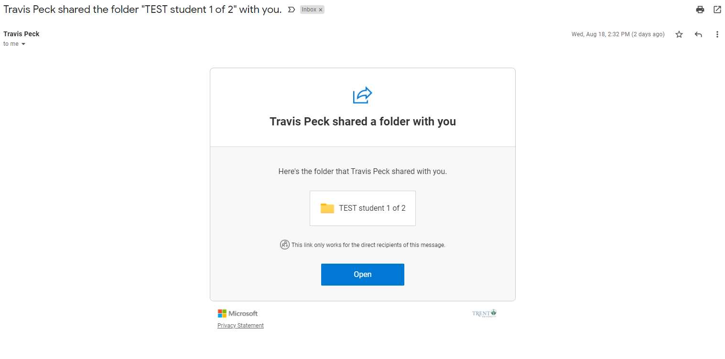
SharePoint Access
A link will be sent to each student and FI by the FEC

Slide 43
Trent Social Work Website
Contains:
Field Instructor resources
This slide deck
Orientation Recording
Access to CASWE Field Instructor Supervision Modules
Placement Schedule
https://www.trentu.ca/socialwork/field-education/agencies-and-field-instructors

Slide 44
Additional Useful Resources
Carleton University Supervision Hub​
National Field Instructor Training Repository (2021) - Google Drive
Field Instructor Handbook
Marion Bogo Educating effective social workers

Slide 45
Canadian Association for Social Work Education (CASWE)
Self paced virtual course
9 Modules
Sections open and close throughout the year (typically every two months)
To register visit https://education.caswe-acfts.ca/
Institution: Trent University
Verification Code: ON18
Field Coordinator Name: Travis Peck
Field Coordinator Email: travispeck@trentu.ca

Slide 46
Field Practicum Days/Hours

Slide 47
Field Hours and Days
Starts January 21, ends April 10
Minimum* of 240 hours (students must complete minimum hours, even if it causes placement to be extended)
3 days a week: Wednesday, Thursday, and Friday
7 hours a day/21 hours a week
Days and daily hours are negotiable. Students must secure FFL approval to deviate from standard schedule.
Students may attend placement during evenings and weekends (should seek FFL approval).
If students have not attained minimum number of hours by April 10, and agency does not have capacity to continue providing activities/supervision, Trent will take over.

Slide 48
Reading week and holidays
Students are not scheduled but are permitted to be in placement during reading week
Students are not permitted to be in placement when Trent is closed (i.e. holidays)

Slide 49
Illness and Absences from Practicum
Occasionally, students may have unexpected absences from practicum
Students are responsible for promptly notifying the Field Instructor in the event of an unavoidable absence
Missed hours must be made up
Students who are absent from their field education practicum without valid reasons may receive a failing grade in the course
Students must notify their Field Instructor in advance if they require an accommodation to the field practicum schedule because of religious, spiritual, cultural, or medical reasons.

Slide 50
Prolonged Absences
It is the students’ responsibility to notify their Field Instructor and Faculty Field Liaison by email and keep them up-to-date about their estimated time of return
Upon return, the student should develop a plan with the Field Instructor for covering the missed time and learning outcomes

Slide 51
Grading
Both seminar- and agency- based learning components are graded on a pass/fail basis
Students must complete all components of the seminar and agency based field practicum to achieve a pass
FI evaluation is one component of grading scheme

Slide 52
Roles and Responsibilities
Student
Field Instructor
Faculty Field Liaison
Field Education Coordinator

Slide 53
Role of Student
Responsible for their own learning
Responsible for communicating appropriately with relevant collaborators regarding their progress; first to the Field Instructor, and second to the Faculty Field Liaison
Engage in meaningful learning and practice, striving for competency and ethical social work knowledge, values, and skills;
Attend supervision meetings prepared with an agenda
When needed, engage in professional conflict resolution

Slide 54
Role of Field Instructors (FI)
Role model for competent and ethical social work practice
Provide: 1-1.5 hours of supervision per week + ad hoc
Develop learning opportunities/activities in collaboration with students
Field Instructors are responsible for ensuring activities are feasible in their agency
Observe students in practice and offer feedback
Evaluate students’ performance
Alert student and Faculty Field Liaison to any concerns/issues

Slide 55
Role of Faculty Field Liaison (FFL)
Facilitates connections between student and Field Instructor
Contributes to and receives student learning plans
Reviews the mid-term and final progress reviews and submits the course credit
Consults and supports students and Field Instructors as needed
Conducts site visits (electronic or in person): typically around the mid-point of term
Assigns the final grade

Slide 56
Role of Field Education Advisor
Provides one on one Social Work Supervision to students whose FI does not have a social work degree

Slide 57
Role of Field Education Coordinator (FEC)
Ensures adherence to CASWE accreditation standards and code of ethics;
Recruitment, selection and retention of field practice organizations;
Recruitment, selection and retention of field instructors;
Oversees and completes the practicum planning process and the placement of students;
Actively supports the practice-theory connection;

Slide 58
Accommodations
Students may request an accommodation for placement.
This must be done through Student Accessibility Services (SAS).
Reduced course loads don’t equate to placement accommodations
Examples:
Extended timeline (reduced days during the week)
Physical accommodations to space
Remote placements
Note: not all placements can provide particular accommodations.

Slide 59
Insurance

Slide 60
The Ministry of Colleges and University provides:
Workplace Accident and Injury
Errors and Omission
Details:
Student’s coverage depends on what coverage the agency has
Requires a signed affiliation agreement + insurance letter
Trent must be notified as soon as possible if an incident occurs
Requires cooperation from Agency as Trent submits the claim

Slide 61
Claims
Claims are processed through The Ministry’s account (Trent acts as the liaison) NOT the agency’s
Agencies must report accidents/injuries to us as soon as possible
Even if students have done so
Trent has three days to report injuries to WSIB/insurance once we’re made aware
Please email/contact both the students FFL and the FEC in the event of an injury

Slide 62
Field Advisory Committee
Interested in shaping Trent’s field practices and policies? Join the field advisory committee
Meet on zoom once per semester for 2ish hours
Some committee work outside of meetings on occasion

Slide 63
Thanks for joining us!
Please reach out to Travis Peck (travispeck@trentu.ca) or Avery Comeau (acomeau@trentu.ca) if you have any questions.

