Slide 1
Field Education Orientation
Field Instructors
Welcome
September 2025
Travis Peck, MSW, RSW
Field Education Coordinator PTBO
705-748-1011 or travispeck@trentu.ca
Avery Comeau, MSW, RSW
Field Education Coordinator DUR
705-740-1011 or acomeau@trentu.ca
Department of Social Work

Slide 2
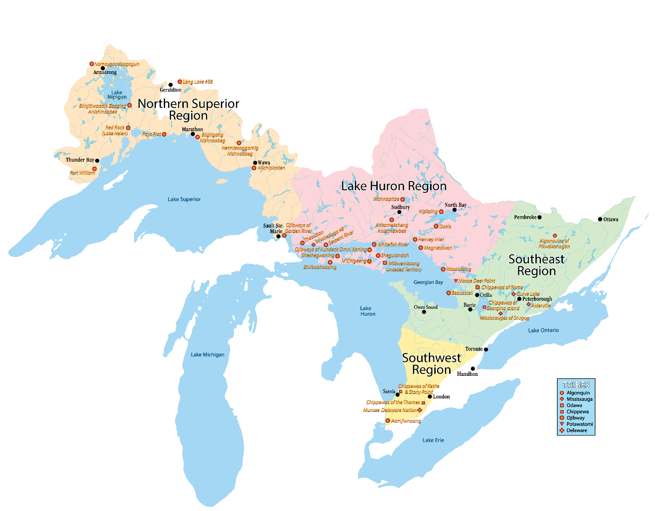
We respectfully acknowledge that we are located on the treaty and traditional territory of the Michi Saagiig Anishinaabeg.
We offer our gratitude to First Peoples for their care for, and teachings about, our earth and our relations.
May we honour those teachings.
Image credit: https://www.anishinabek.ca/who-we-are-and-what-we-do/

Slide 3




Staff Team
Dr. Else Marie Knudsen (she/her) | Kennedie Close (she/her) | Travis Peck (he/him) | Avery Comeau (he/him) | Carolyn Mallory (she/her)
Department Director and Faculty Member | Academic Coordinator (AC) | Field Education Coordinator (FEC) Peterborough | Field Education Coordinator (FEC) Durham | Academic Administrative Assistant (AAA)

Slide 4
Program and Placement Overview

Slide 5

BSW Field Program Overview
Professional Years, full-time basis only
Combination of courses and 700 hours of supervised field practicum (240 in Winter third year and 460 Fall/Winter fourth year)
Graduates are eligible to register with the Ontario College of Social Workers and Social Service Service Workers, and to be members of the Ontario Association of Social Workers

Slide 6
Purpose of Field Education
Theory-Practice Integration
learn through practice, reflection, and reflexivity
explore new ways of doing, being, knowing
link and apply theoretical knowledge to practice
gain first-hand knowledge of social service systems
hone skills (communication, professional, community, etc)
refine their professional identity

Slide 7
Integration Loop
Retrieval
Reflection
Linkage
Professional Response
Information gathering
Exploration of self
Conscious application of
Using knowledge and
about a specific practice
situation
awareness and personal
values, biases &
assumptions
theory to practice
insights to develop plans
and behavioural
responses to inform
future encounters
Bogo & Vayda (1998)

Slide 8
Benefits to taking on BSW students
shape the next generation of Social Workers
offload work (especially as placement progresses)
test out prospective future employees
hone Supervision skills
counts towards the Continuing Competency Program if you’re a Registered Social Worker

Slide 9
Affiliation Agreement (5-year validity period)
Purpose:
Outlines our responsibilities to each other
Confirms our legal and insurance agreements (i.e. indemnification)
Confirms that Trent is responsible for providing all student insurance and submitting claims
Process:
Trent drafts the agreement using our standard template (or using your Affiliation Agreement if required by your governing structure)
Placement Agency signs it and returns it to Trent
Trent signs it
Trent forwards fully signed copy to you

Slide 10
Pre-Placement Requirements Students

Slide 11
Student Requirements
Attend orientation events
Interview with Placement Hosts
Complete trainings/workshops required by Trent

Slide 12
Student Training
Submit to the department
Health and Safety Awareness
Workplace Hazardous Material Information System (WHMIS)
Accessibility for Ontarians with Disabilities Act (AODA)
Workplace Violence and Harassment
Cybersecurity at Trent
Students no longer submit a Police Check to the Department

Slide 13
Agency Requirements
Indicate interest and confirm capacity to host placement to FEC
Interview student(s)
Confirm placement with students/FEC
Sign Affiliation Agreement (valid for 5 years) if required

Slide 14
Requirements during placement

Slide 15
Main activities
Practicum
  September 10, 2025 to March 27 2026 (contingent on 460 hours)
  Will obtain 478 hours if go in every scheduled placement day
  With the matched Agency/Supervisor
  Wednesday, Thursday, Friday
Classroom based Field Integration Seminars
  September 09, 2025 to April 2026
  With student’s assigned Faculty Field Liaison

Slide 16
Documents
Due within first two weeks:
Safety Orientation Checklist*
Due Diligence Checklist*
Field Instructor Information Sheet*
*FI input is required. Student may be pulled from placement if not returned.
Throughout the year (based on FFL deadlines)
Learning Plan
Midterm Progress Review
Final Progress Review
Timesheet and Supervision record

Slide 17
Field Education Practice
Learning Objectives

Slide 18
Practice Objectives
Professional Social Work Identity
Reflective Practice
Generalist Practice with Individuals, Families, Groups, and Communities
  Engagement, Interviewing, and Documentation
  Assessment and Intervention
  Closure
Equity, Diversity, and Social Justice
Indigenous Peoples and Communities
Environmental Sustainability and Ecological Practice
Policy
Research

Slide 19
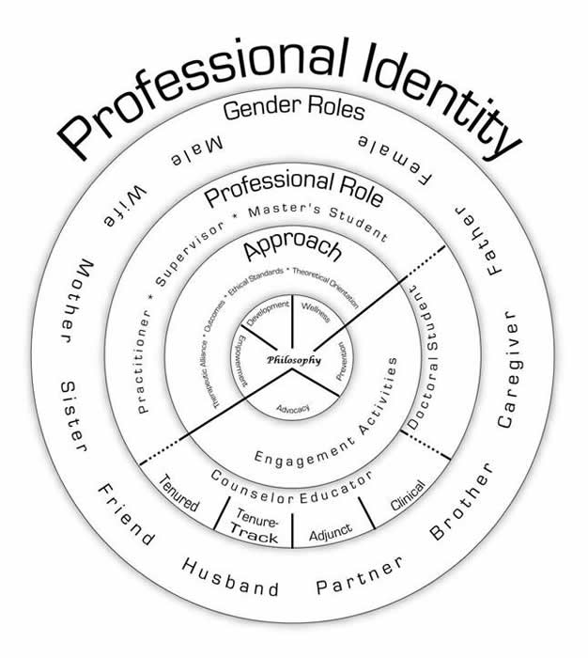
Practice Objective 1: Professional Social Work Identity
Developed to be consistent with social work core values and the ethics of the social work profession:
Engaging with service users
Consent
Ethical dilemmas

Slide 20
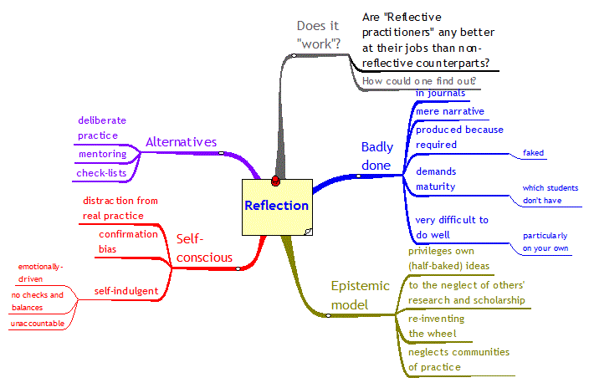
Practice Objective 2: Reflective Practice
Social Work students are expected to practice reflectively and apply methods of critical thinking and inquiry into social work practice.
Personal judgement/bias
Use of self
Self-care

Slide 21
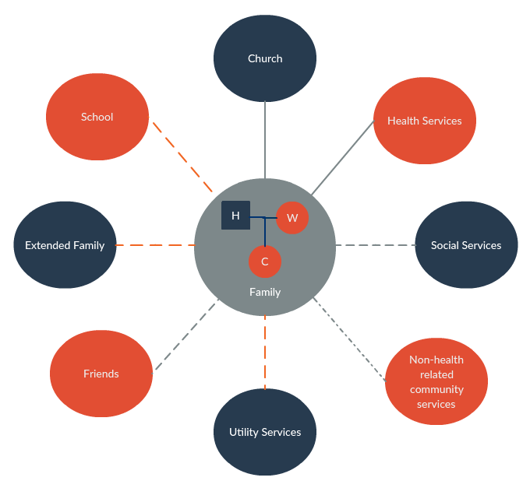
Practice Objective 3: Engagement with Individuals, Families, Groups, and Communities
Develop relationship with service users
Assessments
Intervention

Slide 22

Practice Objective 4: Equity, Diversity, and Social Justice
Students demonstrate knowledge about the ability to provide effective service to individual service users whose identities encompass and intersect a range of social positions
Impacts of marginalization
History of service provision
Colonialism

Slide 23

Practice Objective 5: Indigenous Peoples and Communities
Social workers demonstrate respect and understanding that Indigenous Peoples have treaty, constitutional, human, and self-governance rights.
History of colonization
Understanding of current impacts of
colonization, residential schools and 60s scoop
Understanding the historical and current day
roles of social workers and their impact on
Indigenous communities and peoples

Slide 24

Practice Objective 6: Environmental Sustainability and Ecological Practice
Understand the need to create ecologically sustainable communities, economies and natural and built environments, in which all life forms and eco-systems can survive and thrive
Identify and challenge environmental injustice and racism
Environmental sustainability
Advocacy for political policy change

Slide 25

Practice Objective 7: Policy
How do social policies influence the services provided by the agency?
Funding models
Advocacy inside and outside of the agency
Governmental and organizational policies

Slide 26

Practice Objective 8: Research
Students understand how various forms of research contribute to a holistic understanding or service users’ experiences
What types of research does the Placement Agency Conduct?
What purpose does this research serve?
Who’s voices are counted?
How does research inform policy and vice versa?

Slide 27
Learning Plan

Slide 28
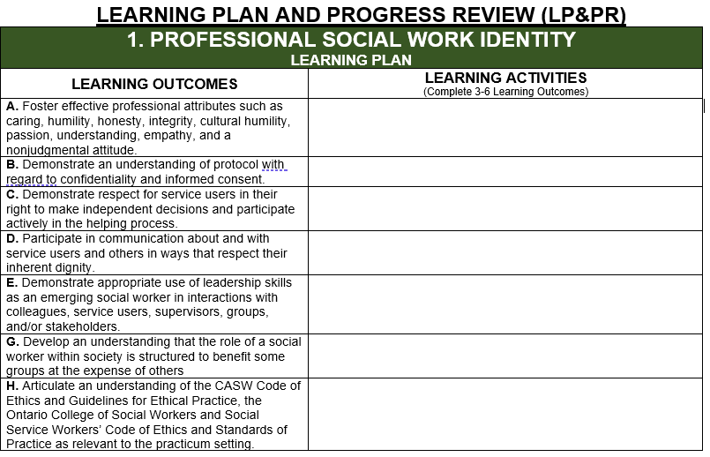

Slide 29
Purpose
Guides student’s learning and practice activities
Operationalizes the relationship between Field Instructor and Student
Defines supervision
Offers framework for evaluation

Slide 30
Filling Out the Learning Plan
FIs collaboratively develop learning activities based on student and agency capacity
  The LP is a living document and may change over time
Students are responsible for filling out the document and confirming that it is complete
FFL approves or declines the LP

Slide 31
Completion Timeline
Students must complete their Learning Plan within the first four to six weeks of placement
Students are to sign the document and then let you know it’s ready
FFLs then sign off on the Learning Plan indicating that the plan is generally thought of as being complete

Slide 32
Progress Review

Slide 33
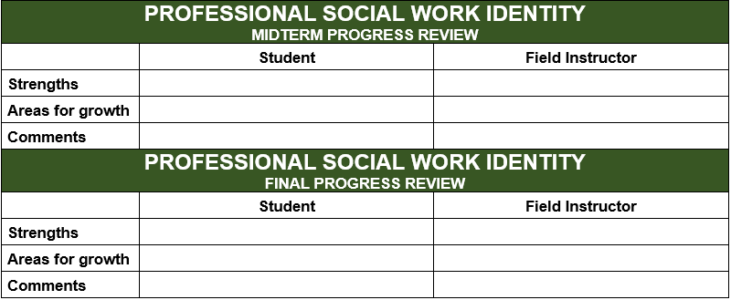

Slide 34
Process
Students should be assessed on the entire Practice Objective not just Learning Outcomes they have corresponding Learning Activities for.
Students fill out their section first, and then confirm with FI it is ready for their input
FIs fill out their section
Students and FIs meet face to face (can be virtual) to discuss

Slide 35
Timeline
Specific dates will be provided by the FFL and may vary based on start dates. Students to inform FIs of due dates.
Generally before December 31st and a week or two before placement ends in late March/early April

Slide 36
Supervision

Slide 37
Supervision
1) FI/Agency provided
  1 hour per week (counts towards hours)
  Mostly one to one
  Group supervision (if more than one Trent student)
2) FEA
  If Field Instructor does not have a Social Work Degree
  FIs generally not involved in this supervision
  Counts towards hours

Slide 38
Technology

Slide 39
SharePoint
Will house the following documents:
  Learning Plan and Progress Review
  Student Timesheet and Supervision Record
Students and Field Instructors will only have access to the student’s folder
Documents are shared, and updated in real-time
Can complete documents offline/outside of SharePoint, provided students upload them to SharePoint regularly
FIs will be provided with access by September 10
Students are responsible for providing additional instructions to Field Instructors. The FEC is always available to answer questions.

Slide 40
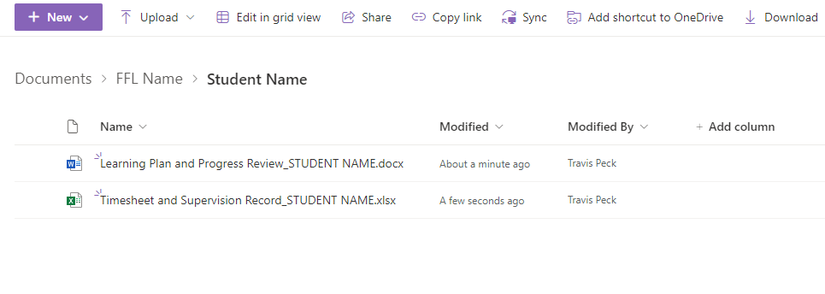
SharePoint Structure

Slide 41
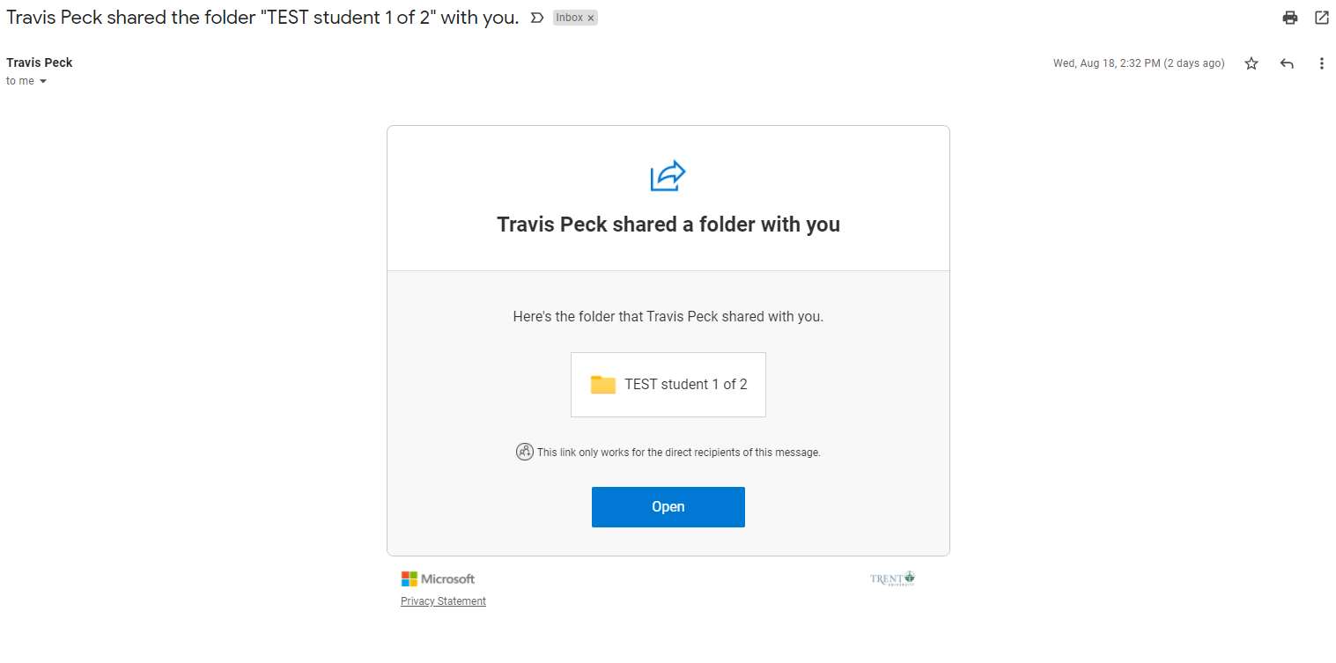
SharePoint Access
A link will be sent to each student and FI by the FEC by September 10

Slide 42
Trent Social Work Website
Contains:
Field Instructor resources
This slide deck
Orientation Recording
Access to CASWE Field Instructor Supervision Modules
Placement Schedule
https://www.trentu.ca/socialwork/field-education/agencies-and-field-instructors

Slide 43
Additional Useful Resources
Carleton University Supervision Hub​
National Field Instructor Training Repository (2021) - Google Drive
Field Instructor Handbook
Marion Bogo Educating effective social workers

Slide 44
Canadian Association for Social Work Education (CASWE)
Self paced virtual course
9 Modules
Sections open and close throughout the year (typically every two months)
To register visit https://education.caswe-acfts.ca/
Institution: Trent University
Verification Code: ON18
Field Coordinator Name: Travis Peck
Field Coordinator Email: travispeck@trentu.ca

Slide 45
Field Practicum Days/Hours

Slide 46
Field Hours and Days
Starts September 10, 2025, ends March 27, 2026
Minimum* of 460 hours (students must complete minimum hours, even if it causes placement to be extended)
3 days a week: Wednesday, Thursday, and Friday
7 hours a day/21 hours a week
Days and daily hours are negotiable. Students must secure FFL approval to deviate from standard schedule.
Students may attend placement during evenings and weekends (should seek FFL approval).
If students have not attained minimum number of hours by March 27, and agency does not have capacity to continue providing activities/supervision, Trent will take over.

Slide 47
Reading week and holidays
Students are not scheduled but are permitted to be in placement during reading week
Students are not permitted to be in placement when Trent is closed (i.e. holidays)

Slide 48
Illness and Absences from Practicum
Occasionally, students may have unexpected absences from practicum
  Students are responsible for promptly notifying the Field Instructor in the event of an unavoidable absence
    Missed hours must be made up
  Students who are absent from their field education practicum without valid reasons may receive a failing grade in the course
  Students must notify their Field Instructor in advance if they require an accommodation to the field practicum schedule because of religious, spiritual, cultural, or medical reasons.

Slide 49
Prolonged Absences
It is the students’ responsibility to notify their Field Instructor, Faculty Field Liaison and Field Education Coordinator by email and keep them up-to-date about their estimated time of return
Upon return, the student should develop a plan with the Field Instructor for covering the missed time and learning outcomes

Slide 50
Grading
Both seminar- and agency- based learning components are graded on a pass/fail basis
Students must complete all components of the seminar and agency based field practicum to achieve a pass
FI evaluation is one component of grading scheme

Slide 51
Roles and Responsibilities
Student
Field Instructor
Faculty Field Liaison
Field Education Coordinator

Slide 52
Role of Student
Responsible for their own learning
Responsible for communicating appropriately with relevant collaborators regarding their progress; first to the Field Instructor, and second to the Faculty Field Liaison
Engage in meaningful learning and practice, striving for competency and ethical social work knowledge, values, and skills;
Attend supervision meetings prepared with an agenda
When needed, engage in professional conflict resolution

Slide 53
Role of Field Instructors (FI)
Role model for competent and ethical social work practice
Provide: 1-1.5 hours of supervision per week + ad hoc
Assign learning opportunities in collaboration with students
Observe students in practice and offer feedback
Evaluate students’ performance
Alert student and Faculty Field Liaison to any concerns/issues

Slide 54
Role of Faculty Field Liaison (FFL)
Facilitates connections between student and Field Instructor
Contributes to and receives student learning plans
Reviews the mid-term and final progress reviews and submits the course credit
Consults and supports students and Field Instructors as needed
Conducts site visits (electronic or in person): typically around the mid-point of term
Assigns the final grade

Slide 55
Role of Field Education Advisor
Provides one on one Social Work Supervision to students whose FI does not have a social work degree

Slide 56
Role of Field Education Coordinator (FEC)
Ensures adherence to CASWE accreditation standards and code of ethics;
Recruitment, selection and retention of field practice organizations;
Recruitment, selection and retention of field instructors;
Oversees and completes the practicum planning process and the placement of students;
Actively supports the practice-theory connection;

Slide 57
Accommodations
Students may request an accommodation for placement.
  This must be done through Student Accessibility Services (SAS).
  Reduced course loads don’t equate to placement accommodations

Slide 58
Examples
Extended timeline (reduced days during the week)
Physical accommodations to space
Remote placements
Note: not all placements can provide particular accommodations.

Slide 59
Insurance

Slide 60
The Ministry of Colleges and University provides:
Workplace Accident and Injury
Errors and Omission
Details:
Student’s coverage depends on what coverage the agency has
Requires a signed affiliation agreement + insurance letter
Trent must be notified as soon as possible if an incident occurs
Requires cooperation from Agency as Trent submits the claim

Slide 61
Claims
Claims are processed through The Ministry’s account (Trent acts as the liaison) NOT the agency’s
Agencies must report accidents/injuries to us as soon as possible
  Even if students have done so
Trent has three days to report injuries to WSIB/insurance once we’re made aware
Please email/contact both the students FFL and the FEC in the event of an injury

Slide 62
Field Advisory Committee
Interested in shaping Trent’s field practices and policies? Join the field advisory committee
Meet on zoom once per semester for 2ish hours (October and Feb/March)
Some committee work outside of meetings on occasion

Slide 63
Thank you.
We welcome your feedback about this material or any aspect of Field Education.

