Slide 1
Lab Hazard Poster Creation Tutorial
Trent University Sciences

Slide 2
The New Poster
This is an updated version of the Lab Hazard Poster. It is a fillable form. It only works properly in Adobe Acrobat or Reader. Other pdf readers may not work properly. It has been tested with both Windows and Macintosh computers.
We are asking all faculty with labs to complete this form. For those who may share a lab space please work together with your colleagues to create an accurate representation of the hazards and PPE required in the lab space.

Slide 3
There are seven sections to each poster.
Lab identification and supervisor information,
Hazardous chemicals, equipment or activities pictographs
NFPA rating most toxic material,
NFPA rating largest volume material,
Additional Hazards (which are not indicated above),
Pictographs of PPE required to work in the lab,
A section for other PPE not indicated above.

Slide 4
Section 1. Lab Identification and Supervisor Information
Select the Building, from the drop down box, in which the lab resides.
In the “Lab Room No.” box enter the wing (ESB and CSB) or block letter (DNA and LHS) and room number. SC and Physics don’t have anything but a number.
In the text box “Supervisors Office”, Enter the 2 or 3 character Building identification (eg, ESB, CSB, DNA, LHS or SC) and room number the Supervisors office is in. (e.g., ESB A 202.3) Please remember that Block A and B are DNA and Blocks C and D are in the LHS Building.
In the box “Phone ext.” Give the Supervisor’s Trent phone extension e.g. 7061.
Enter the Supervisor’s full Trent Email address. The font will adjust to accommodate.

Slide 5
Section 2. Hazardous Materials or activities Pictograms
Chemical and Common Activity Hazards are represented by either the TDG symbols or commonly used hazardous activity pictographs. TDG information is usually found in Section 14 (Transport) of an SDS for Chemical.
To see an inventory of the chemicals in your lab you can access HECHMET, our chemical inventory system (for information on how to access HECHMET see slide 13).
Select icons for “all” the hazardous chemicals or activities in your lab.
To access an SDS for a chemical Use CHEMWATCH which is available free for Trent personnel (see slide 13 for information on how to access)
To display a pictograph simply click on the Yes or No buttons. The pictograph will toggle on or off depending on your selection.
If a pictograph for a hazard in your lab is not here, complete the “Additional Lab Hazards” (Section 5).

Slide 6
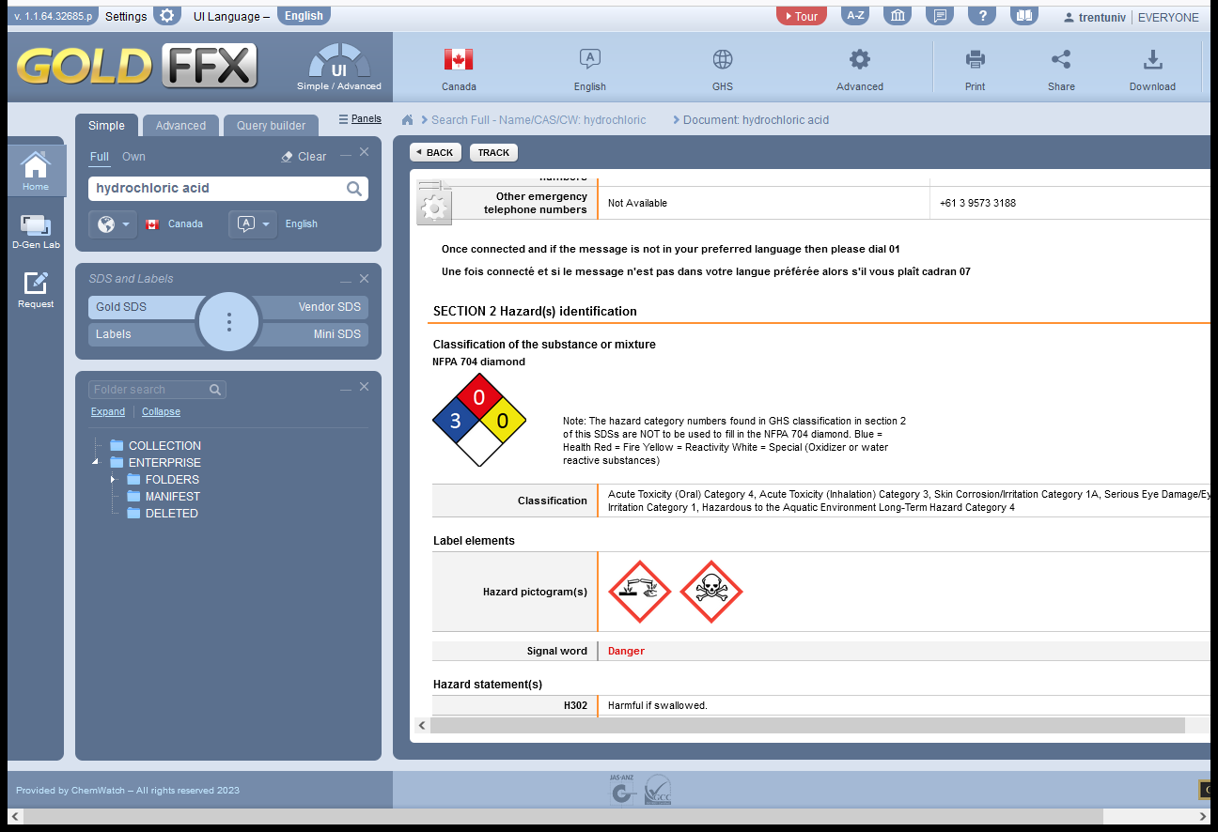
Section 3. NFPA Hazard Rating: Most Toxic Chemical
Figure 1
Review your chemical inventory and determine the most toxic chemical in your lab and enter the name in text box. You can use HECHMET to access an online inventory for your lab space (see slide 13 for access to HECHMET)
Enter the total quantity of the material in the lab including unit of measure. The intent is to give personnel a sense of the amount of the most toxic chemical which is in the room (Figure 1).
Open an SDS for that chemical using Chemwatch. (see slide 13 on how to access Hechmet and Chemwatch)
In the SDS section 2 .”Hazard(s) Identification” you will find the NFPA 704 rating , enter the values for the Health Hazard (blue), Flammability Hazard (red) and Reactivity Hazard (yellow) into each text box in the diamond. (Figure 2)
If the chemical has a “Special Hazard” (the white bottom square of the diamond) Select the symbol by clicking yes next to the appropriate hazard. If there is no special hazard according the SDS, leave this blank.
Figure 2

Slide 7
Most Toxic Chemical?
It is possible that you may have many chemicals that you consider to be very toxic in your lab. Picking just one for the purposes of this poster may seem somewhat arbitrary.
The intent of the poster is to be able to give emergency response personnel a “picture” of the dangerous substances in your lab. Since you are the one who knows the inventory best, ask yourself “if there was a problem in my lab what toxic chemical would I be worried about the most?” Your initial response to that question is likely the biggest hazard.
Remember the intent of the poster is to help keep those who are not familiar with your lab, as safe as possible during an emergency event.
If after considering the above, you still aren’t sure, please feel free to contact Science Facilities or Trent Health and Safety for assistance.

Slide 8
Section 4. NFPA Hazard Identification Largest Quantity Substance
From your inventory, select the chemical which has the largest volume in your lab .
Enter the name of the chemical and volume (including units). The intent of this section is to identify the most common chemical in the lab.
Repeat the steps 3, 4 and 5 from the previous slide to complete the “Hazard Diamond” for that chemical.

Slide 9
Section 5. Additional Hazards in the lab
If an additional chemical, equipment or activity hazard exists in the room but is not represented by the pictographs in Section 2 of the LHP, please type in the Hazard into this text box. Examples of additional hazards might be something like High Voltage above 240 Volt, or Ozone generator etc.

Slide 10
Section 6. PPE required to work in the lab.
Click on the Yes or No buttons to display the PPE required to work in the lab.
Generally speaking for labs with chemical hazards, Eye Protection, Lab Coat, Gloves and Closed Toed Footwear should be the minimum requirement.
Often the SDS will also give recommendations on PPE for various chemicals as well.

Slide 11
Section 7. Additional PPE Required
1. If the PPE you require (as lab supervisor) to be worn while working in the lab is not represented by one of the pictograms in Section 6., enter the required PPE in this text box.

Slide 12
The Printed version of the poster will look something like the image on the right. This is just an example and will depend on the choices you select and the information you enter.

Slide 13
Printing the Poster
Links to Hechmet and Chemwatch
Both Hechmet and Chemwatch are available to access on the Chemical Safety Program Home page at:
https://www.trentu.ca/scienceservices/science-safety-program/chemical-safety-program-rev-2019
Once you complete the poster to your satisfaction, save the file to your computer. Ensure it is saved as a pdf file.
Send an email with the poster as an attached file to cwilliams@trentu.ca or Angelasikma@trentu.ca . In the subject line please include “Lab Hazard Poster”. We will review before sending them on for printing.
The poster will be sent to you within a couple of weeks. It will be on an adhesive vinyl sheet.
Once you receive the poster, install it over top of the existing poster. If you have multiple labs, ensure the proper lab hazard poster for the correct lab room is installed.

Slide 14
Thank-you
Thank you for completing this Safety Information Poster.

