Slide 1
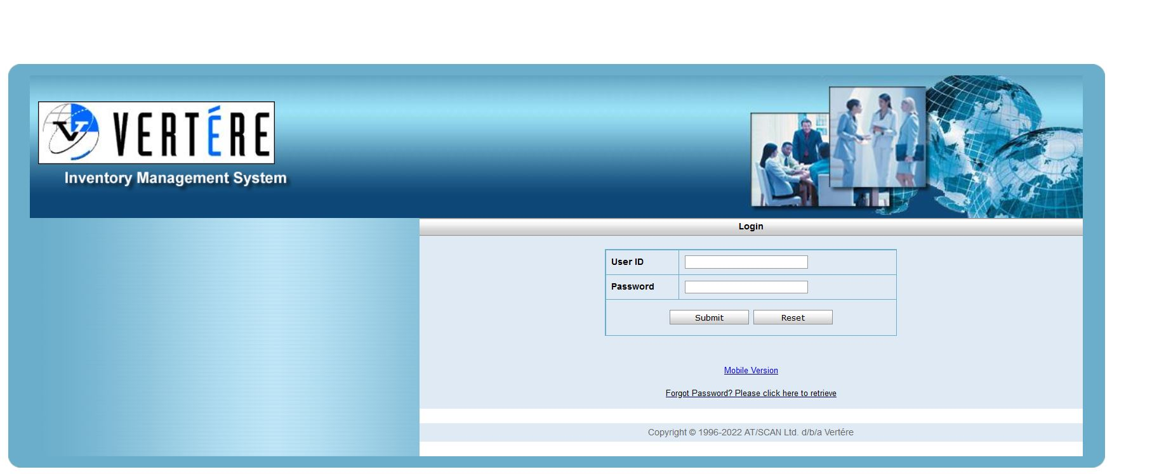
In your browser search bar type https://hechmet.vimenterprise.com/. Using the login name and password you were originally provided, login to Hechmet. Upon your first login it will ask you to change your password. Do so. Then select HOME on the left hand menu bar. In the future it may ask come up with the Password screen again. You do not have to change your password, simply click on the HOME button.

Slide 2
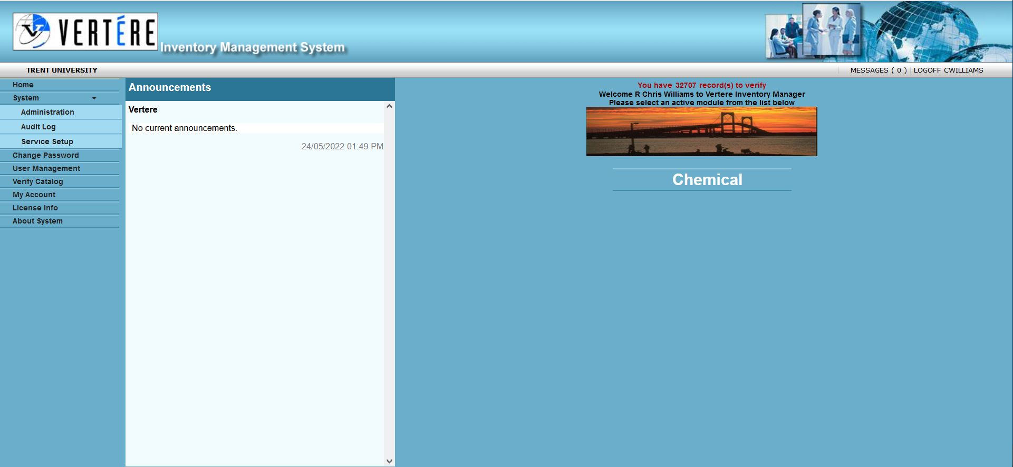
Click here to access the chemical module

Slide 3
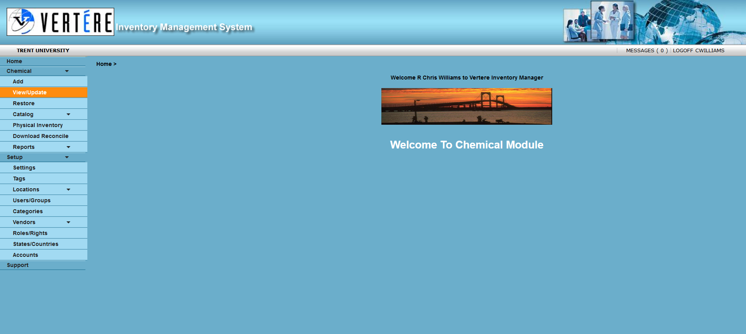
Click here to access the search function for chemicals.

Slide 4
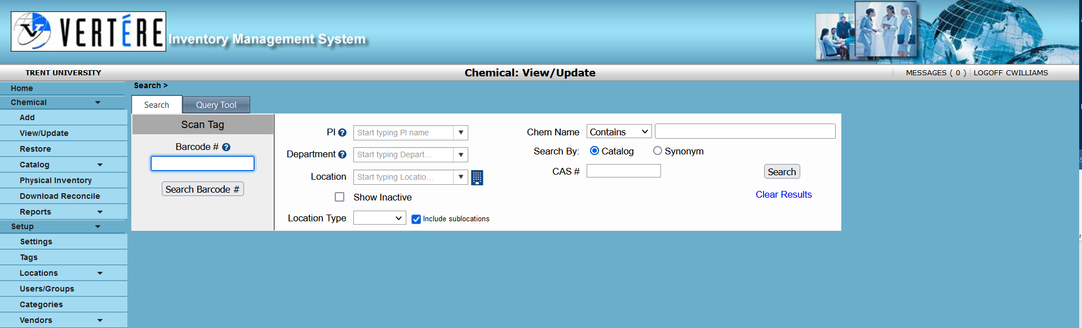
You can search by barcode #, your name, room number or by chemical. CAS # can also be used. Searching by chemical name can be a little more difficult for some chemicals, you may have to try a couple of synonyms. Each PI has limits as to what they can see. Generally they see their own chemicals and can search by room using the View/Update function. In some departments they can see what other PI’s have in their inventories as well. Normally PI’s cannot see what the “Teaching Department” have in their inventory.
Users can only access the View/Update Function. Individual

Slide 5
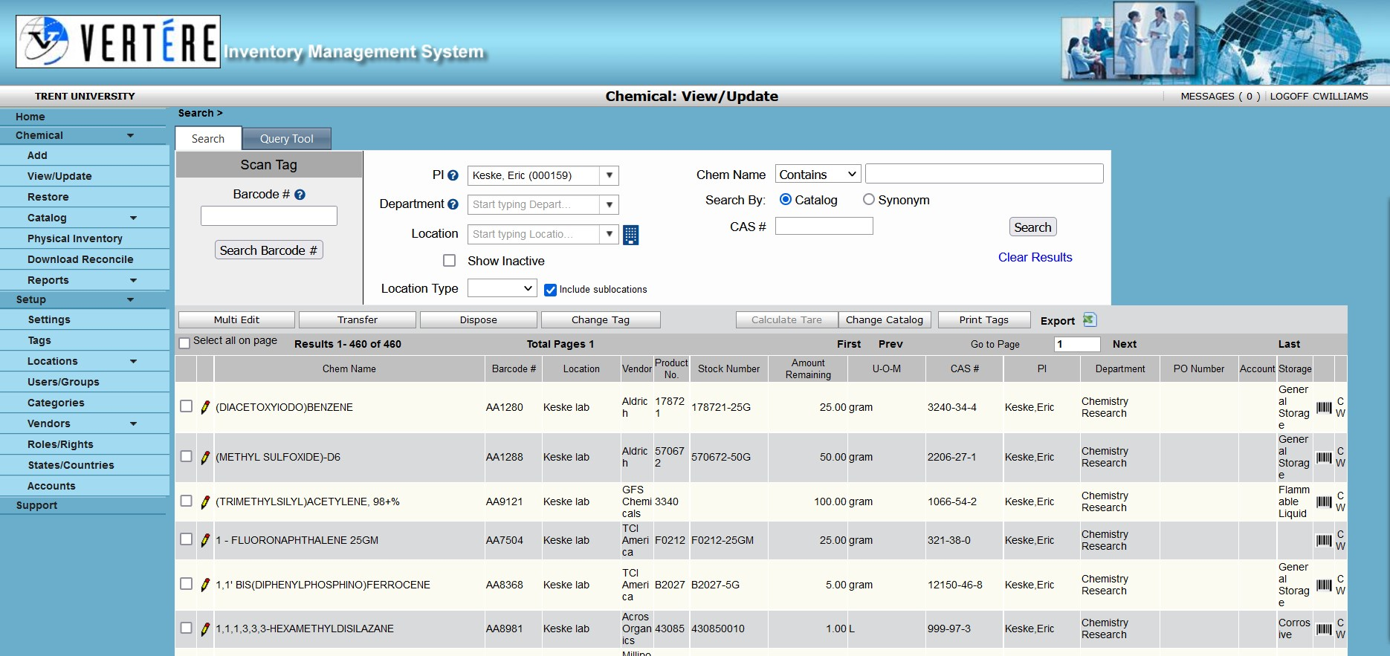
If you just view by PI name then all the chemicals assigned to you will be displayed in a scrollable box.
If you are looking for a specific room in which you have chemicals assigned to you stored then enter the location. Eg CSB E 102. in the location tab. You do not need to fill in all of the tabs.

Slide 6
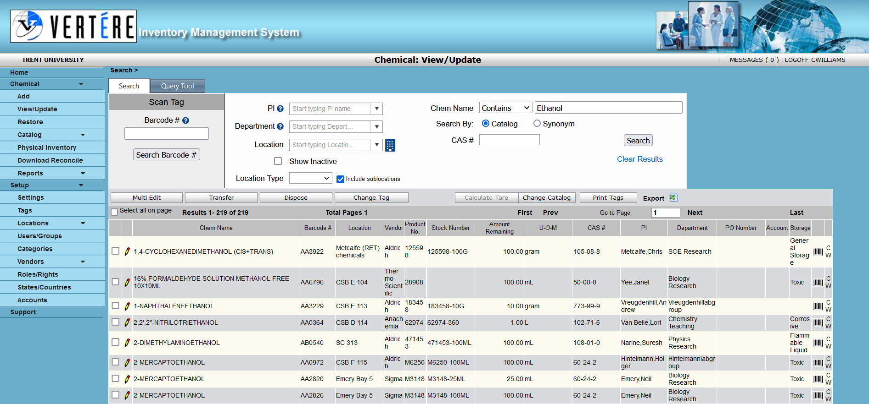
If you wish to search your inventory or an inventory from another departmental colleague (if you are a PI) then you can enter the Chemical name in the Chem Name tab or you can use the Chemical Abstract Service (CAS#) number in the CAS# tab. Hechmet will search available inventories for who has the chemical.

