Slide 1

Psychology Honours Thesis Information Session 2023

Slide 2
Contact Information
Honours Thesis Coordinator:
Dr. Kevin Peters
kevinpeters@trentu.ca
Psychology Department Coordinator:
Laura McMaster
lauramcmaster@trentu.ca
Associate Chair (Durham GTA):
Dr. Nancie Im-Bolter
nimbolter@trentu.ca

Slide 3
The Plan
The Honours Thesis
Admission Requirements
Application Process
Finding a Potential Supervisor
Timeline

Slide 4
The Honours Thesis
Coursework vs. Thesis option for the Honours degree
Honours thesis is more than just a ‘big paper’
Workload is high!
PSYC 4020D = ~16 hours per week for two semesters

Slide 5
An Honours Thesis Student Must:
Participate in thesis seminars throughout year
Search for, read, and review relevant literature
Plan an empirical study
Write a substantial thesis proposal
Collect and analyze data
Report results via written, oral, and poster presentations

Slide 6
PSYC 4010Y vs. 4020D
PSYC 4010Y
Students doing a Joint Honours Thesis with Psychology and another program
1 credit from Psychology, 1 from the other program
Contact Laura McMaster in the PSYC Office if interested
Note: Joint Honours Thesis not required if you are joint PSYC major
You can complete 4020D

Slide 7
The Honours Thesis (cont’d)
Is a must if you are applying to a graduate program in psychology (or other social science-based programs)
If you are unsure of future goals (keep options open)
Not necessary for a professional program (but it depends)

Slide 8
Admission Requirements
For PSYC 4020D
Completed PSYC 3015Y with 75%
At least 0.5 credit from each of A2, B2, A3, B3 categories (see next slide)
75% average over all PSYC courses
Permission of Psychology Department
Some faculty supervisors have specific pre-requisites for content courses, etc.
Notes:
Talk about practicums reading courses etc.

Slide 9
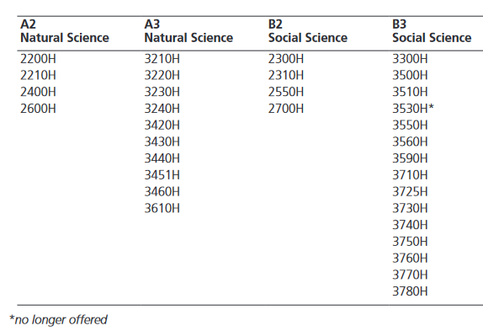
Page 404 of the Academic Calendar (2022-23)

Slide 10
Application Process
You must apply for the Psychology Honours Thesis Program
Forms are available from the Psychology Office and online
Limited space
Application deadline: March 3rd, 2023, by 12:00 noon
email to lauramcmaster@trentu.ca
PSYC Office, DNA/LHS C 104
Notes:
Oshawa, students – Jeff, Laura, Ben & Teresa

Slide 11
Finding a Faculty Supervisor
In general:
Your academic career begins in undergraduate studies
Important - be professional and respectful with colleagues and professors
Networking is an important
skill
In life and in getting into graduate programs – start now!

Slide 12
Finding a Faculty Supervisor
Specifically:
Identify who you are
interested in working with
Look for a ‘good fit’
Go online for faculty research
interests
https://www.trentu.ca/psychology/faculty-research
Drs. Jeff Adams, Ben Bauer, Korri Bickle, & Jennifer Eastabrook (OR Peterborough faculty)
Suggestion: Be open to working with faculty whose research does not match your current interests
Contact faculty to see if they’re taking students

Slide 13
Timeline
Find a faculty supervisor now!
Application forms available (in this meeting, from PSYC Office or online)
https://www.trentu.ca/psychology/programs/undergraduate/honours-thesis-information
Submit application by noon on March 3rd (email to: lauramcmaster@trentu.ca or send to PSYC office, LHS C104)
Notified in late May (when marks are available to ensure you meet course requirements)
If completing course requirements in the summer, can apply after March 3rd deadline
Application considered when summer final grades are available

