Slide 1
Trent’s ROMEO E-System
Applying for Research Ethics Board or Animal Care Committee Certification Researcher User Manual

Slide 2
Accessing the ROMEO System
The ROMEO system can be accessed through the MyTrent Portal
Log-in to MyTrent
Select Services
The ROMEO System can be found on the “Learning and Research” heading

Slide 3
Accessing the ROMEO System Researcher Portal
Trent’s faculty and staff: Use Trent Log-in and password
Trent students and external users: Complete the Self Registration Form prior to login
All users should know how to safeguard their electronics (computers, smartphones etc.) and be familiar with Trent University’s Computer Code of Ethics

Slide 4
Researcher’s Home Page
Applications for human and animal research can be submitted via the “APPLY NEW” button.

Slide 5
Researcher’s Home Page (2)
Any research project involving humans or animals must be approved by a research ethics board before starting.

Slide 6
Your Application - Saving
To save your protocol at any time, click the “Save” button. You can access it later through their Researcher’s Home Page under the “Applications: Drafts” link.
Do Not close your application by closing your browser. This will result in the application being “Locked”, preventing other team members from accessing or editing it. Only the user who locks an application can unlock it.
Instead, close your application by logging out.
If you cannot unlock an application, or contact the team member who locked an application, email the Certifications and Compliance Officer at jmuckle@trentu.ca

Slide 7
Your Application - Project Team Info
Enter the Project Title, Start and End Date, as well as any keywords which describe your project. Keywords can be selected from the drop down menu or typed directly into the text box.

Slide 8
Your Application - Project Team Info (2)
The Project Team Info tab is populated with the protocol user’s information.

Slide 9
Your Application - Project Team Info (3)
Applicants can add additional team members to their projects by scrolling down the page to the “Other Project Member Info” and clicking the “Add New” button. This will open a new window.
Supervisors must be included as team members on all graduate and undergraduate applications.

Slide 10
Your Application – Adding Team Members
The “Search Profiles” button opens the Investigators list in a new window. You can search the Investigator List for the name of the person to be assigned as team member.
If you can’t find the person you are looking for and would like them added to the Investigators list, please email the Compliance and Certification Officer at jmuckle@trentu.ca. Your email should contain the person’s full name, title, and email address.

Slide 11
Your Application - Adding Team Members (2)
You may select the role of the team member from the “Role in Project” drop down menu.
Anyone who materially contributes to your research should be added as a team member.
All listed team members will have access to view and edit the application. Only the Principle Investigator can submit the application once it is ready to be reviewed.

Slide 12
Your Application – Ethics Approval Tab
This is the body of the application, where you can explain to the review committee members what your project is about, who it will benefit, and why it should be done.

Slide 13
Your Application – Attachments Tab
This tab is used to upload templates of study documents such as: consent forms, advertisements, interview scripts, permits, or animal handling protocols. Be sure to include page and version numbers in each document, and a descriptive title and version number in the description.

Slide 14
Your Application – Errors Tab
The Errors tab keeps a log of required questions that weren’t answered. If all required questions are answered, the Errors tab disappears.

Slide 15
Your Application – Submitting
When you feel your application is ready for review, click the “Submit” button to open the Work Flow Action Window.
Enter a comment in the textbox provided. Comment can be a simple sentence (i.e. Submitting application for review).
Click the “Submit” button to send your protocol for review.

Slide 16
Your Application – After Submitting
Once you have submitted the application for review, you will not be able to make changes.
Throughout the review process, the application can be viewed via the “Applications: Under Review” link on the Researcher’s Home Page.
Submitted applications are sent to the Certifications and Compliance Officer, who submits it to the appropriate review committee.
Researcher
Certifications and Compliance Officer
Review Committee

Slide 17
Applications Requiring Revisions
If the review committee decides an application needs revising, the Certifications and Compliance Officer will send the study team a letter detailing any changes or additional information the committee has requested.
The application will then be sent back to the study team for editing in ROMEO.
Researcher
Certifications and Compliance Officer
Review Committee

Slide 18
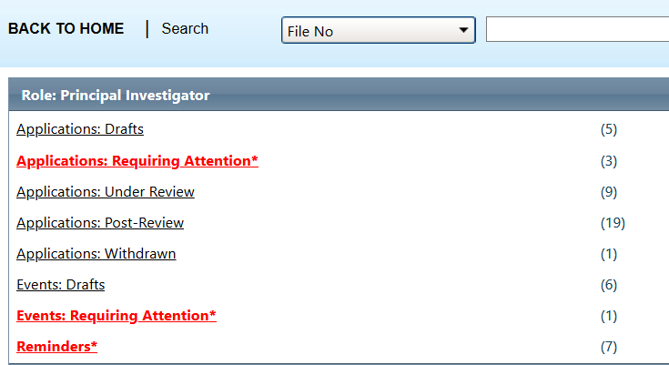
Your Application - Making Changes
Once you application has been sent back to you, edits can be made.
The protocol will appear in “Applications: Requiring Attention”

Slide 19
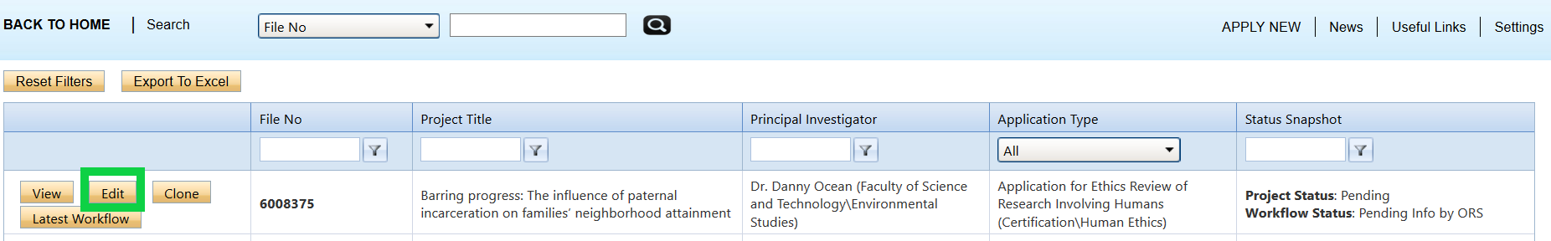
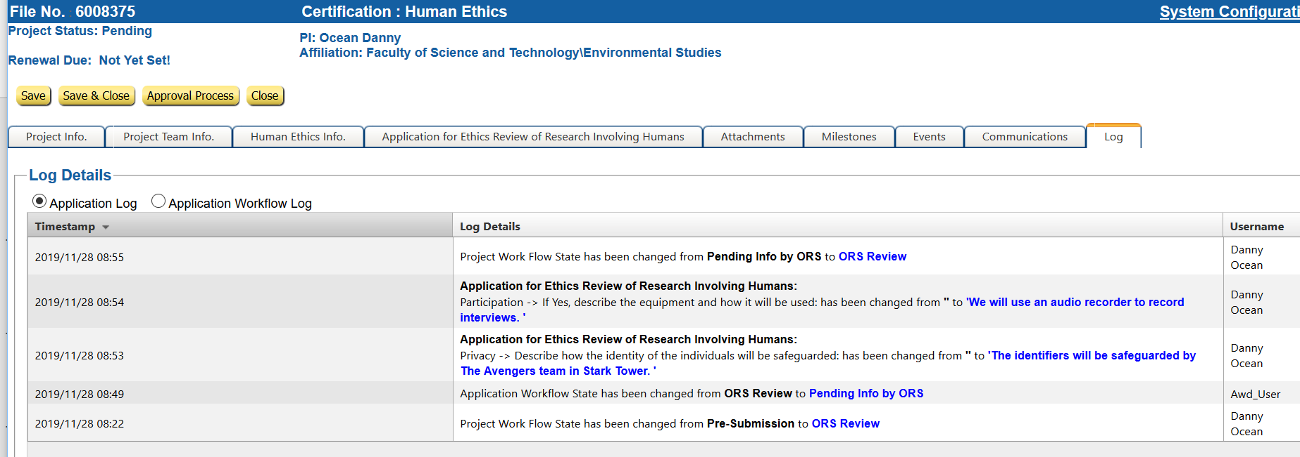
Your Application - Making Changes (2)
Edits are made in the application. The changes you make should reflect the comments of your review committee.
All changes are recorded in the application log, which are visible to your reviewers.

Slide 20
Your Application - Making Changes (3)
If your study documents require editing, delete the old version(s) from your Attachments Tab and upload the edited version(s) using the same title.
Be sure to include the version number in the document title.

Slide 21
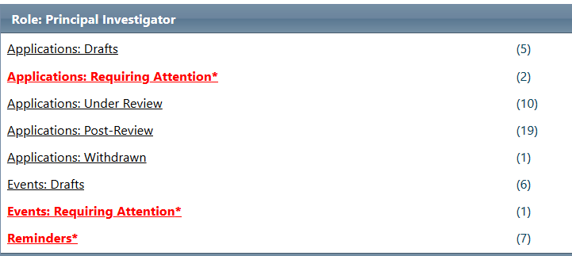
Your Application - Making Changes (4)
Once the application is re-submitted, it appears in the Research Portal as back “Under Review” with no ability to make changes.

Slide 22

Your Application - Approval
Once the application has been approved, the P.I. will receive a formal approval letter through email. A copy of the approval letter will be kept in the ROMEO application.
January 20, 2020
File #: 55555 Title: Road Runners and Coyotes: Animosity in Predator Prey Relationships
Dear Dr. SoAndSo,
The Research Ethics Board (REB) has given approval to your proposal entitled " Road Runners and Coyotes: Animosity in Predator Prey Relationships”.

Slide 23
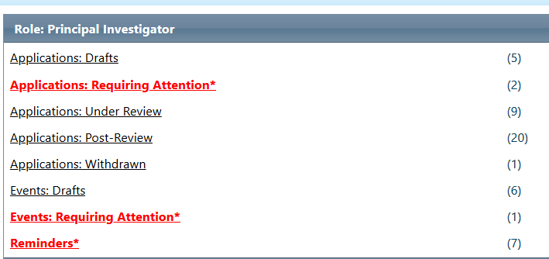
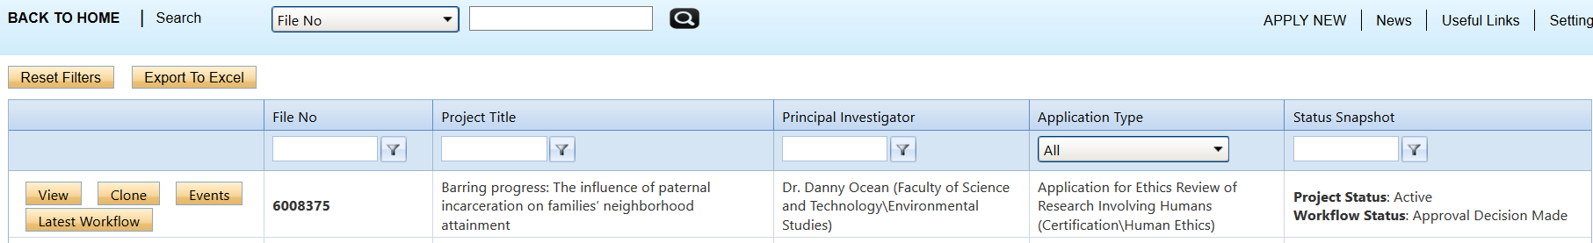
Your Application – Approval (2)
An approved application can no longer be modified but is available for viewing under “Applications – Post Review”
“Active” project status opens the ability to submit Events like project renewals, amendments to the study, and adding new study team members.

Slide 24
Need Help?
The Compliance and Certifications Officer can be reached at:
jmuckle@trentu.ca
(705) 748-1011 x7896
GCS 344

