Slide 1

Program Information: What to Expect in Year one
Kathleen Crook, Academic Coordinator, Trent/Fleming School of Nursing

Slide 2

Land Acknowledgment
Peterborough | Nogojiwanong
We respectfully acknowledge that we are on the traditional territory of the Mississauga Anishinaabeg. We offer our gratitude to the First Nations for their care for, and teachings about, our earth and our relations. May we honour those teachings.

Slide 3
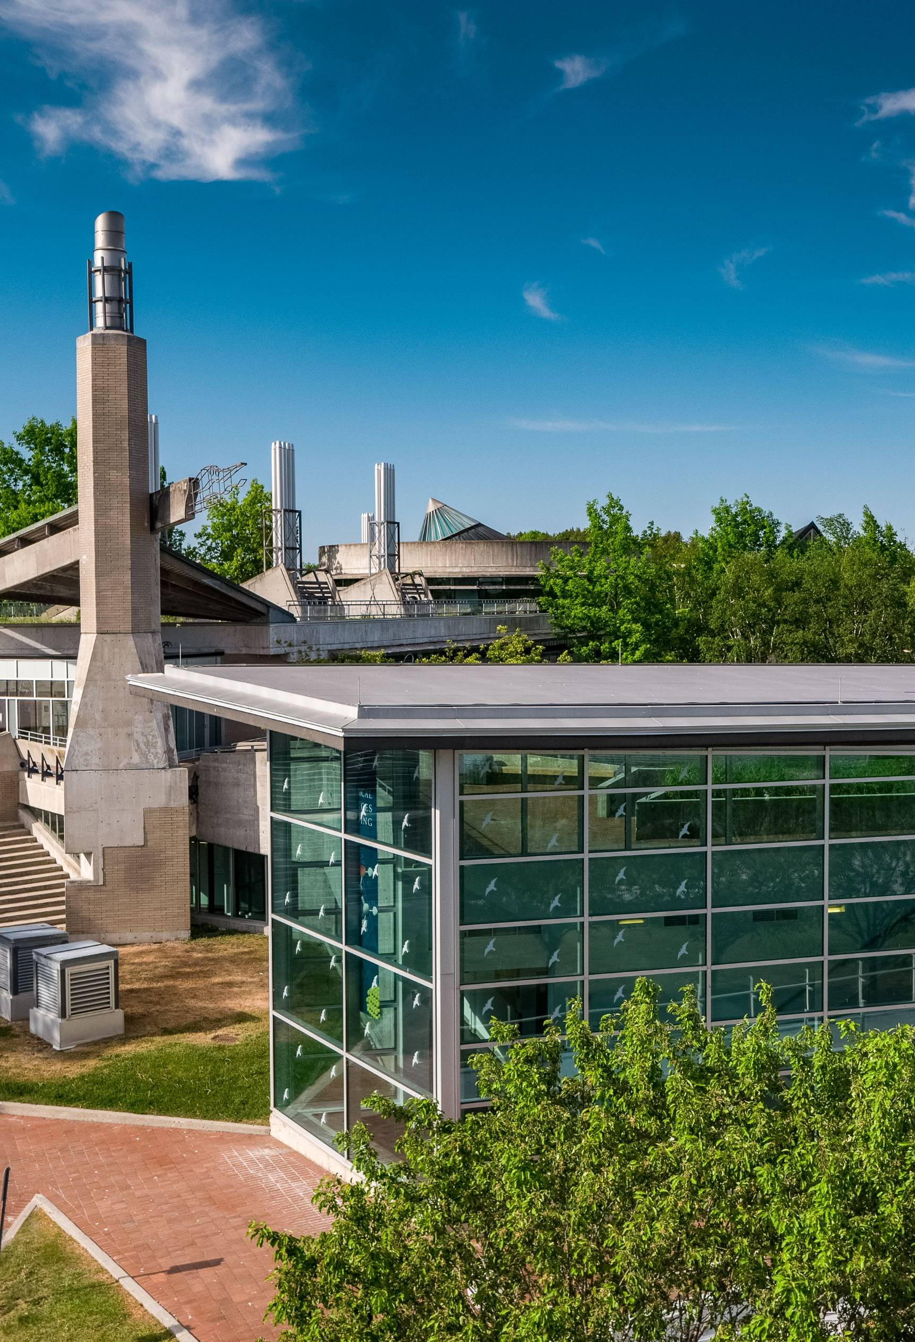
agenda
TFSON & Program Overview
Course Planning & Registration
Resources for Success
First Year Supplies
What to Expect and How to Manage

Slide 4

TFSON & Program Overview

Slide 5



Our School
A diverse community of scholars and educators
Five areas of foci:
Mental health, aging, rural health, Indigenous communities, women’s health and gender
Three entry points, one curriculum:
Collaborative Program (4 Years)
Compressed Program (28 Months)
Post PN to BScN (5 Semesters)

Slide 6
Decoding Course Codes
First four letter indicate the academic subject
Example: NURS = Nursing, PYSC = Psychology, etc.
The numbers identify the course and the academic level
Example NURS 2000H = second year, NURS 3001 = third year
BScN = 20 credits
H = 0.5 credits (I.E. NURS 2000H) = Half Year or 1 Term
Y = 1.0 credits (I.E. INDG 2000Y) = Full Year or 2 Terms
C = 1.5 credits (I.E. NURS 4020C) = Clinical Course, 1 Term, 300 hours

Slide 7
Academic Requirements
65% cumulative average for graduation
Minimum 60% in all required courses
Maximum of 1 repeated NURS theory course
Maximum of 1 repeated NURS practice course
Maximum of 1.5 failed credits

Slide 8

Course Planning & Registration

Slide 9
Program map & Academic Calendar
Program maps: https://www.trentu.ca/nursingorientation/program-planning-registration/program-course-maps
Page 1: Important program information & contacts
Page 2: CHECKLIST
What courses to take when
Academic Calendar
The official University document includes all requirements & important dates:
https://www.trentu.ca/registrar/academic-calendar

Slide 10

Transfer credits
To see what you’ve been awarded go to MyTrent > Academics > Transfer Credits icon
To be evaluated for additional transfer credit, send full course syllabi to nursingadmissions@trentu.ca
Direct transfer vs. general or unassigned transfer
  PSYC 1020H direct Trent credit equivalent
  ARTS YR1 general first year elective
Use transfer credit to satisfy required courses or electives. Ensure they are at the right course code and year level

Slide 11
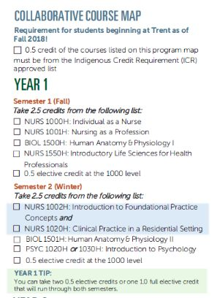
Year one Program overview
Collaborative

Slide 12
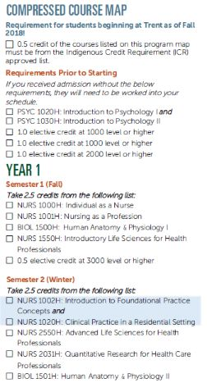
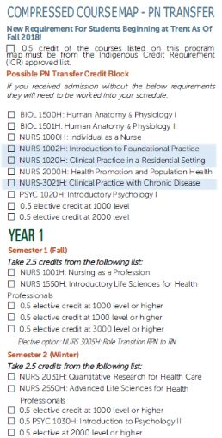
Year one Program overview
Collaborative

Slide 13


Course Planning & Registration
Tips!
Use your Program Map as a guide when planning your schedule in Self-Service
Remember: Adding a course to your plan does not register you in the course
Helpful how-to videos are available on the Advising website: ​https://www.trentu.ca/advising/course-selection-and-registration/register-courses ​
A blue “Register” button will appear under courses on your plan and “Register now” at the top of the screen
  “Register now” MUST be used for winter term and any time you are in a clinical course with a co-requisite theory!

Slide 14
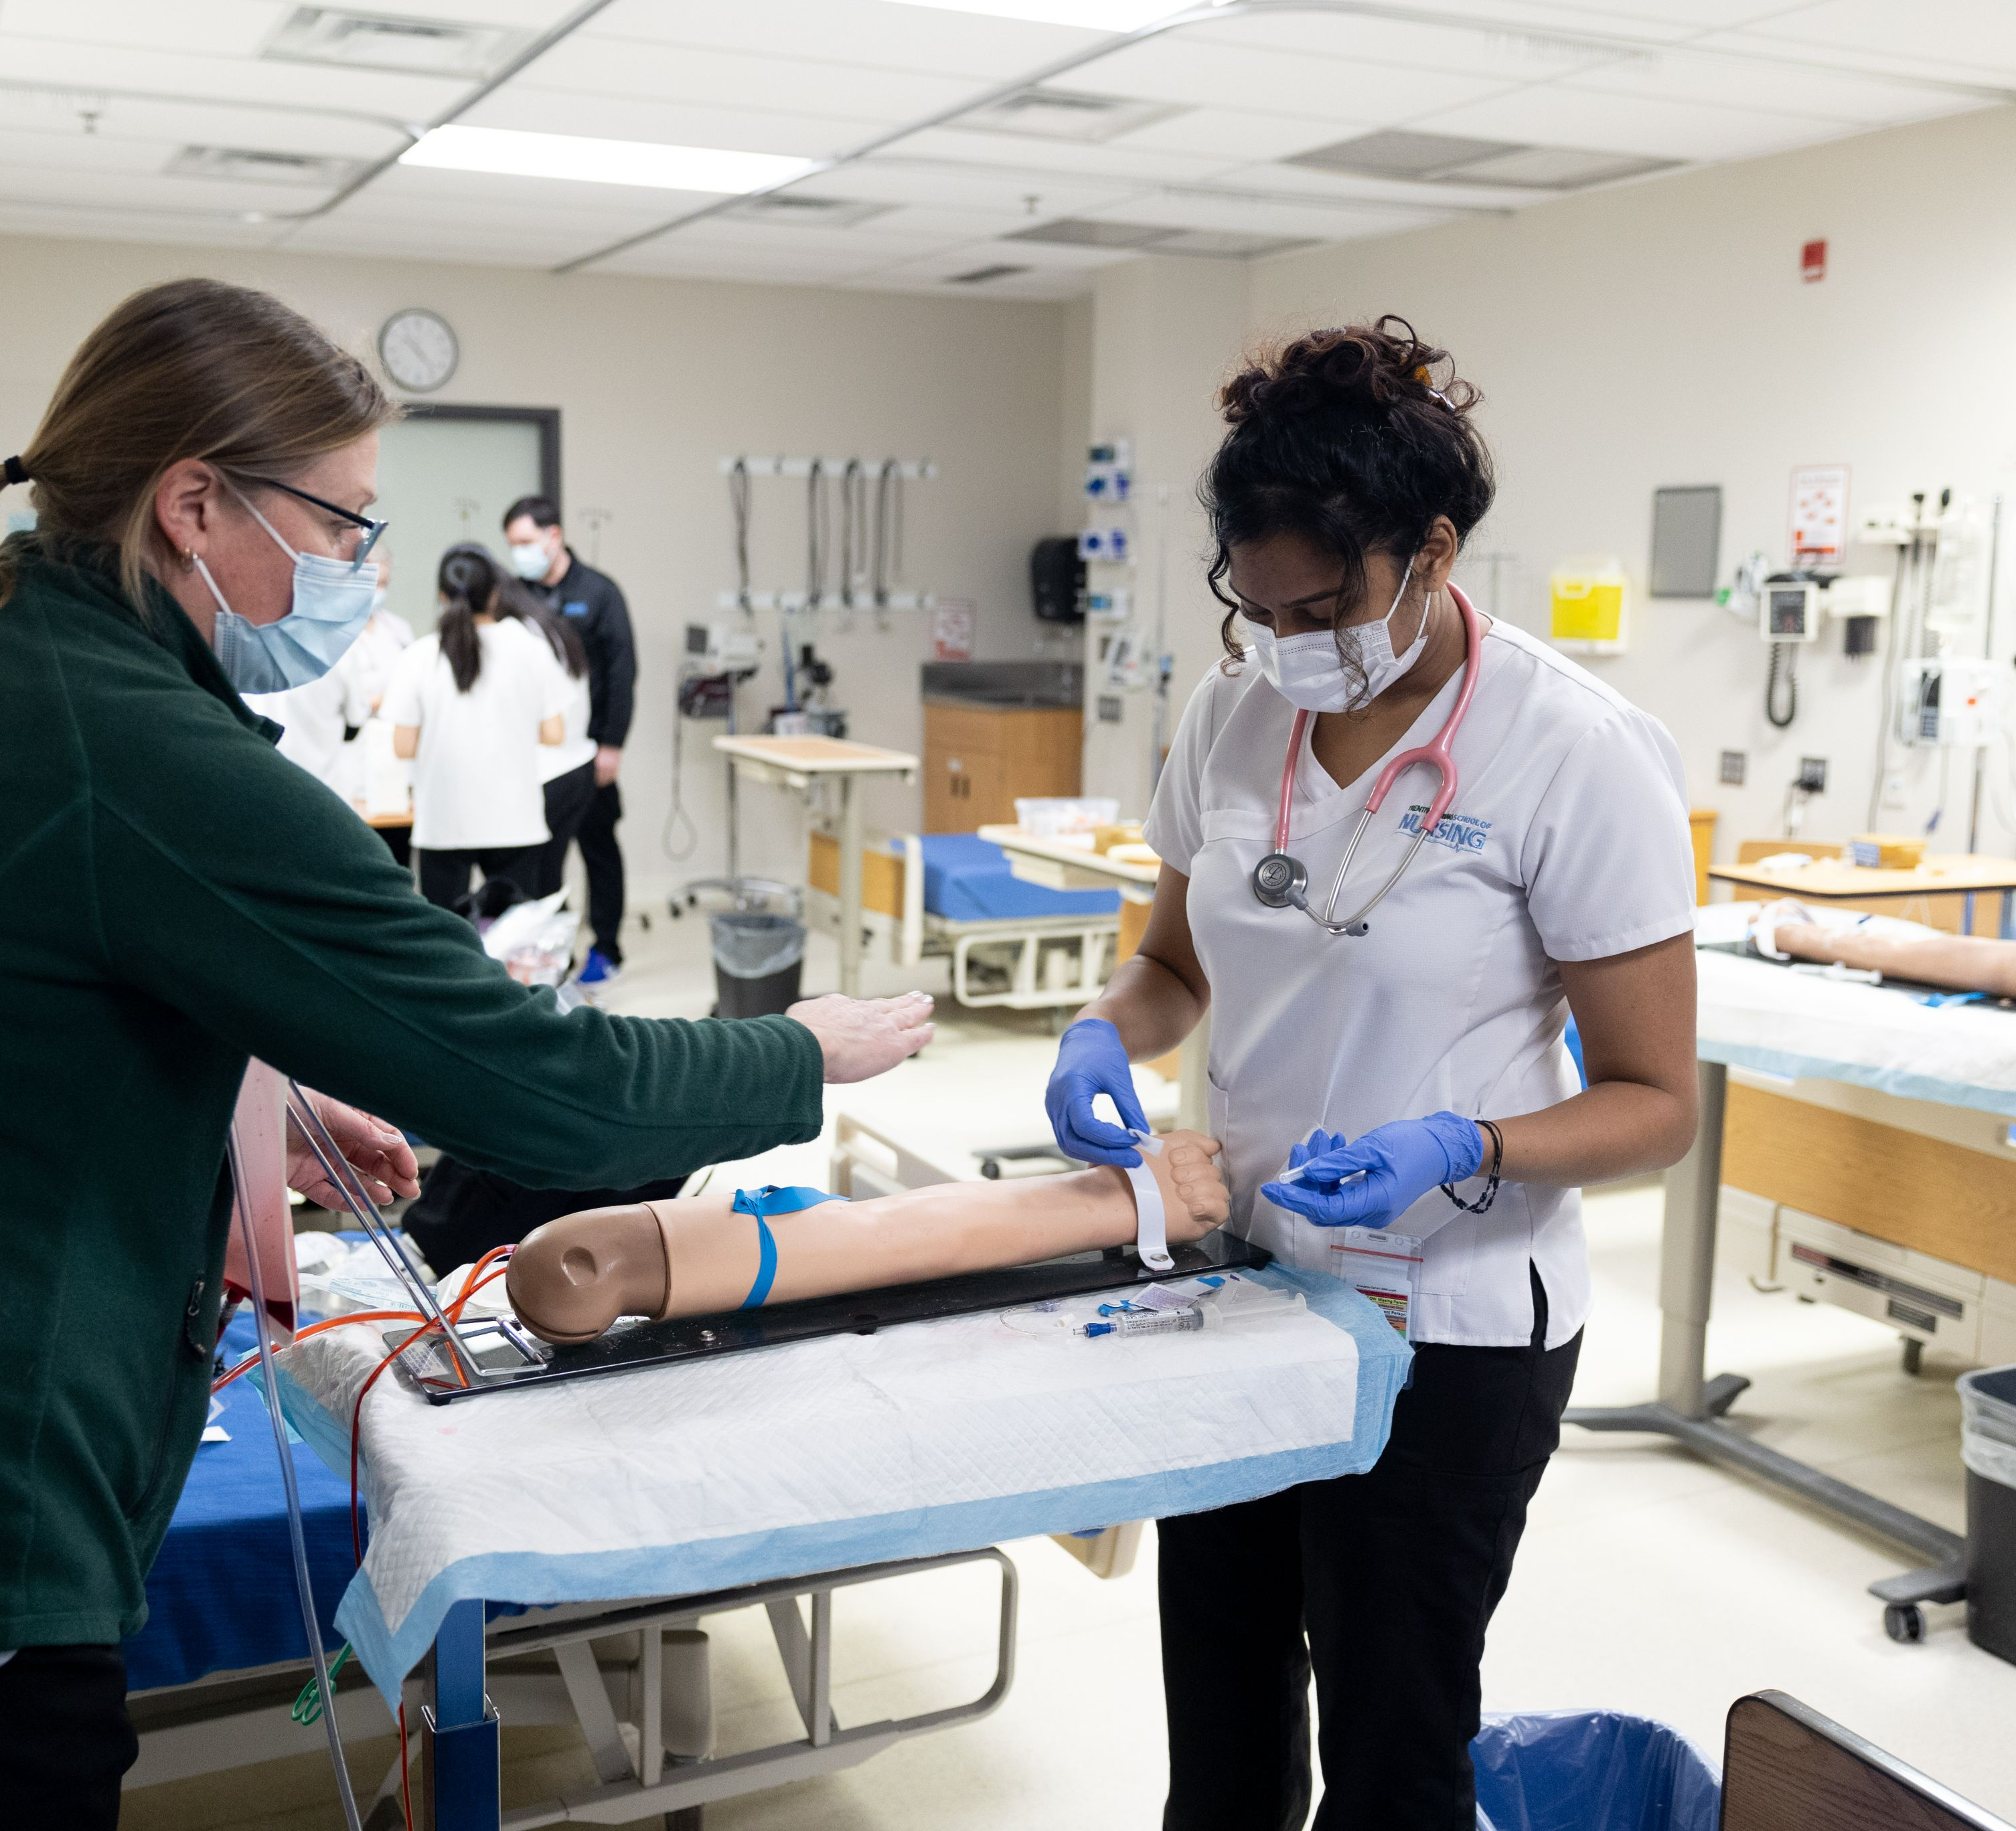
Resources For Success

Slide 15
What to Expect & How to Manage
Bachelor of Science in Nursing a rigorous academic program. Nursing students have unique responsibilities, such as..
Monitoring both the university AND the TFSON Important Dates & Deadlines
Maintaining their non-academic requirements throughout the program
Being available before the start of term for clinical orientation and/or clinical site onboarding
Requiring unique supplies, like uniforms, badges, and lab kits
Clinical placement shifts, which increase in duration as you move through the program
…what are some strategies for how to manage?

Slide 16




Resources for success
Informational Resources
TFSON Student Handbook
Program Map
  Page 1 Important Info & Contacts
  Page 2 Semester-by semester check list
TFSON Intranet through Blackboard
Academic Calendar
Academic Timetable

Slide 17




Resources for success
Campus Resources:
Program Advising with the Academic Coordinator
College Academic Advising
Academic Skills
Student Wellness Centre
Student Accessibility Services
Your faculty & staff in the TFSON!

Slide 18

The University Workload: What to Expect
As a general rule, full-time students should treat their studies like a full-time job, spending 40-50 hours per week in class, doing lab work, reading, reviewing, writing, and thinking.
Some weeks, the workload may be light, while in others, you may have multiple assignments or tests. It is important to plan by day, week and month to manage the ebb and flow of the term.
trentu.ca/academicskills

Slide 19

First Year Supplies

Slide 20




First year & Beyond: Essential Supplies
Textbooks – Bundle for first year texts will be available in the Trent Bookstore
Computer
Calendar, planner, whiteboard…your preferred method for planning & managing time/deadlines!
Watch with second hand
Stethoscope
Trent Student Card
AND Trent Clinical ID Badge

Slide 21

Uniforms
TFSON scrub top
Black full-length scrub pants
Year badge sewn to right arm
Shoes must be closed-toe, closed-heel, and non-porous for infection control and safety purposes. Soles should be slip resistant and non-marking.

Slide 22

Save the date!
Welcome to the TFSON - Fall Orientation
Wednesday, September 3rd, 2025
NARs Fair
Saturday, September 6, 2025
Additional details will be shared as they become available

Slide 23
Contact Information
Advising Questions: nursingadvising@trentu.ca

