Slide 1
Non-Academic Requirements & Placement Orientation
Trent/Fleming School of Nursing

Slide 2
WHAT ARE NARs?
Non-Academic Requirements (NARs) are documents required for your clinical placements.
NARs include:
Criminal Record Check with Vulnerable Sector Screening
Communicable Disease Form and serology
Tetanus immunization within the last 10 years
N95 Mask Fit
CPR certification (BLS, HCP or Level C)
2 Step TB test
Health & Safety training and IPAC modules
Proof of Influenza Immunization
Proof of COVID Immunization

Slide 3

WHY ARE NARs IMPORTANT?
Nurses work with vulnerable populations that are highly prone to illness due to compromised immune systems
NARs protect students, staff and patients
NARs are requirements of the Public Hospitals Act
Students cannot attend clinical practice unless NARs are completed by November 15th
NARS SUPPORT:
Virtual Appointments
Link to schedule an appointemnt can be found on the NARs at Trent U 2023 Blackboard site
Email: nursingnars@trentu.ca

Slide 4


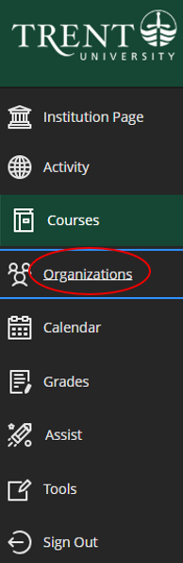

NARs at Trent U Blackboard Site
NARs at Trent U BB Site
Log in to your Trent account
Navigate to Blackboard
Click on the Organizations tab and select “NARs at Trent U”

Slide 5
First-Year Check List
Immunization and Communicable Disease Form
Due November 15 – First Year Only
A 2-step TB test is required in the first year
COVID-19 Vaccine: 2 doses of a Health Canada-approved COVID-19 vaccine at any time from January 2021, or if not previously vaccinated against COVID-19, 1 dose of a Health Canada-approved XBB.1.5 Omicron subvariant COVID-19 vaccine from September 2023 to present. A copy of your government-issued vaccine certificate must also be submitted.
Tetanus must be up to date with a booster received every 10 years
Provide a copy of all childhood to present immunizations
Include Serology Reports for MMR, Varicella and Hep B
Start the form and your Serology right away!

Slide 6
First-Year Check List (continued)
CPR – Level C, HCP, or BLS required
Due Annually
You can either find an agency that provides this service in your hometown (Level C, HCP, or BLS with an in-person component) or choose to have this done on campus during the Fall sessions.

Slide 7
First-Year Check List (continued)
Criminal Record Check with Vulnerable Sector Screening
Due Annually
If you are not 18 years old, a signed declaration is required - email: nursingnars@trentu.ca .
If you turn 18 during the academic year, you must apply for your CRC with VSS on that date and submit it as soon as you receive it. Please keep a copy of your invoice, as it may be requested.
A VSS can take up to 12 weeks to be completed by the Police Detachment.

Slide 8
First-Year Check List (continued)
N95 Mask Fit
Due every two years
You can either find an agency that provides this service in your hometown (N95 Respirator) or choose to have this done on campus during the Fall sessions (Only offered on Peterborough Campus)
Influenza Vaccine
Due December 1st Annually
The influenza vaccine will be available through your MD or at a local pharmacy

Slide 9
First-Year Check List (continued)
Workplace Health & Safety Modules
Due November 15 – First Year Only
The training modules are located on the NARs at Trent U Blackboard Site:
  The Ministry of Health - Health & Safety Awareness Training
  Workplace Violence & Harassment Training
  Workplace Hazardous Materials Information System (WHMIS)
  Accessibility for Ontarians with Disabilities Act.
  Please submit your certificate of completion for each module to Synergy and the First Year DropBox folder found on the NARs at Trent U Blackboard site

Slide 10
First-Year Check List (continued)
IPAC Modules
Due November 15 – First Year Only
You are required to complete the IPAC Core Competency Modules on the Public Health Ontario website with your first-year NARs. The modules are as follows:
IPAC Core Competencies: Chain of Transmission & Risk Assessment
IPAC Core Competencies: Health Care Providers Controls
IPAC Core Competencies: Control of the Environment
4. IPAC Core Competencies: Additional Precautions
IPAC Core Competencies: Administrative Controls
IPAC Core Competencies: Occupational Health and Safety
IPAC Core Competencies:
  Personal Risk Assessment in Acute Care
  Personal Risk in Long-Term Care
  Personal Risk in Community Care- Clinic
  Personal Risk Assessment in Community Care- Home
  Please submit your certificate of completion for each module to Synergy and the First Year DropBox folder found on the NARs at Trent U Blackboard site

Slide 11
First-Year Check List (continued)
Consent Forms
Due November 15 – First Year Only
Found in “Important Forms” on Synergy and on the NARs at Trent U Blackboard site:
  HSPnet Consent Form for Use & Disclosure of Student Information
  Student Declaration of Understanding- Workplace Safety & Insurance Board or Private Insurance Coverage for Students on Program-Related Placements x2
  PRHC Postsecondary Student Unpaid Work Placement Release Form
  Peterborough Regional Health Centre Confidentiality Agreement
  Trent University Photo/Image Release and Waiver
  Lakeridge Health Statement of Confidentiality
  Trent University Consent Form for Use & Disclosure of Student Information
  Please submit your certificate of completion for each module to Synergy and the First Year DropBox folder found on the NARs at Trent U Blackboard site

Slide 12
NEXT STEPS
Get started on your Immunization and Communicable Disease Form as soon as possible!
Apply for your police check with VSS as soon as possible (only if you are a collaborative student). Compressed students should wait until September 1st or if applying through Toronto Police, apply after August 1st.
Wait to start all other requirements until September 1st. This will help students make it through summer clearance without having to renew NARs.

Slide 13
Mandatory NARs Fair
September 6th 9:30 to 1:00 pm.
(More details to follow)
What to Expect:
all NARs will be covered in detail
Students will receive a NARs folder containing printed consent forms, ready to be completed
Students will have the opportunity to sign up for the Fall Hub services: CPR, Mask Fit testing and Tb testing
Mandatory follow up NARs appointments will be booked to review completed immunization and communicable disease forms and other documents

Slide 14
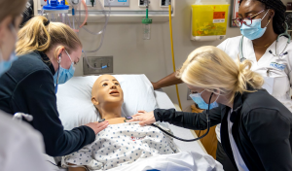

1st YEAR
NURS 1020 – Community
(Winter 2026)
  In person
  Residential or Long term care setting
  Mondays or Tuesdays
  10 weeks, 6 hours/week
  No placement on Reading Week

Slide 15
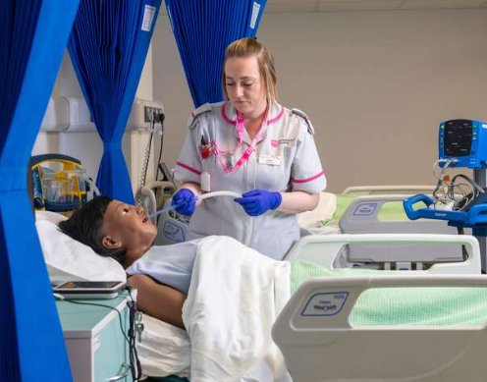

2nd YEAR
  NURS 2020 – Community
  In person with a community agency
  Project-based
  Thursday & Friday
  10 weeks, 16 hours/week
  No placement Reading Week
NURS 2022 – International
or NURS 2020
Application & Interview
Offered Fall ONLY
International Setting- Honduras, Guatemala
Additional cost to student (approx. $2500)
Travel over Reading Week
Project-based
NURS 2021 – Mental Health & Mat/Child
In person in a hospital
Maternal/child and Mental Health placements
10 weeks total – 12 hours shift
5 weeks in each placement
Shifts rotate through Thursday, Friday, Saturday & Sunday
PRHC & Lakeridge Health

Slide 16
3rd YEAR
NURS 3020
  Offered Fall, Winter and Summer
  Acute Hospital Setting
    Medicine or Surgery
  Fall & Winter- 10 weeks, bi-weekly, 2- 12-hour shifts/week
    Thursday and Friday
  Summer- 6 week compressed delivery- Thurs/Fri weekly
  HUB learning during days not in clinical (ie. Simulation)
NURS 3021
  Offered Fall, Winter and Summer
  Sub-acute Hospital Setting
  Rehabilitation, Complex Continuing Care, Palliative, etc
  Fall & Winter- 10 weeks, bi-weekly, 2- 12-hour shifts/week
    Thursday and Friday
  Summer- 6 week compressed delivery- Tues/Wed or Thurs/Fri
  HUB learning during days not in clinical (ie. Simulation)

Slide 17
4th YEAR
NURS 4020
  Offered in all semesters
  Various settings available
  300 hours with RN preceptor, follow their scheduled
  Available all shifts and all days
  Faculty Advisor support
NURS 4021
  Offered in all semesters
  Various settings available
  300 hours with RN preceptor, follow their scheduled
  Available all shifts and all days
  Faculty Advisor support
  Critical Care/ High Acuity settings available (ie. ER, ICU, L&D, PACU, etc.)
  Critical Care approval needed

Slide 18
Placement Process
Student Handbook – TFSON Placement Policy- review
The TFSON placement team arranges all placements; this ensures equal access and a consistent approach.
NURS 1020, NURS 2020, NURS 2022, NURS 3020 and NURS 3021 clinical placements will be in the Peterborough Area
It is important to note that this is a Peterborough-based program and the placements are in hospitals and community agencies in the Peterborough area.
You need to have a plan in place if you are commuting from out of town.
4th year placements- while the Placement Team will do their best to obtain a placement in the student’s area and site of interest, there are no guarantees. The TFSON expects that if a placement cannot be found at the student’s site of interest, the student will complete a placement with an agency near the area of the student’s program campus. All efforts will be made to accommodate location requests
Course Orientation information will be provided, all efforts are made to schedule within the semester, if not possible, it is expected students are available the week before each semester
  This information will be posted to the TFSON Intranet > Placement and Clinical Information

Slide 19

Placement Requirements
Check your TRENT email regularly
Some placements require site selectors, an application and/or interview
Please respond to emails from the Placement Team promptly
Forward any required documents (ie. resume, application, references) by the deadlines provided
Be professional in your email communication internally and externally – email etiquette, this is often your first impression
Prepare for your interview, review the agency's website, dress appropriately (business casual), arrive on time, etc
  Resources available on TFSON Intranet >
Non-Academic Requirements (NARs): must meet deadlines to proceed into placement
  Support available, ASK FOR HELP
  Do not leave things until the last minute. Our team may not be able to provide adequate support if there is not sufficient time to do so
**Every semester you will receive emails from the Placement Team regarding the next semester’s placement and every semester you will have a NARs deadline. It is important to put dates into your calendar and check emails!

Slide 20

Placement Selection and Assignment
Placement Surveys are utilized for NURS 2020, 4020 and 4021
  Complete surveys by the deadline
  Provide accurate answers
HSPnet site selector is used for some of the clinical placements (NURS 1020, NURS 2021, NURS 3020 & NURS 3021)
The system will assign students based on preferences provided and then car pool requests are considered individually
  Special considerations section- carpool requests
Clinical Schedule is provided to students by the Course Coordinator during clinical orientation at the start of the semester
Placement assignments are final. We are not able to guarantee all requests

Slide 21

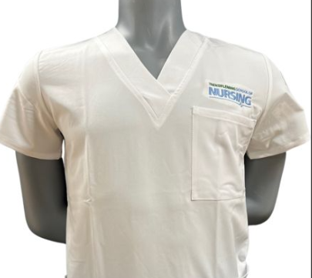
UNIFORMS
Uniforms and year patches are available for sale at the Trent Bookstore.
The Bookstore will be open today from 11:30 am to 3:00 pm.
Beat the September rush!

Slide 22
NARS Questions?
NARs questions can be directed to the Placement Team by emailing: nursingnars@trentu.ca
Placement Questions?
Placement questions can be directed to the Placement Team by emailing: trentclinical@trentu.ca

