Slide 1

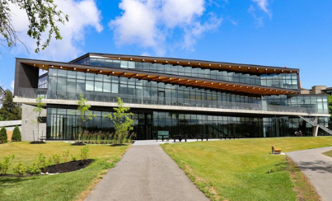
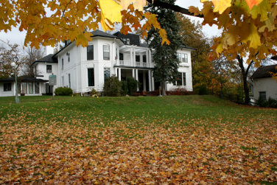
Doctoral Graduate Program Presentation
2025-26
Jane Rennie
Graduate Finance Officer
School of Graduate Studies

Slide 2




Financial Matters
Resources are available and applicants are encouraged to review the School of Graduate Studies website Financial Matters
Headings:
“How to Win Scholarships”
Tri-Council Resources
Graduate Studies Scholarship Application Resources
Many of these resources will assist you with developing your doctoral scholarship application.

Slide 3

Financial Matters

Slide 4
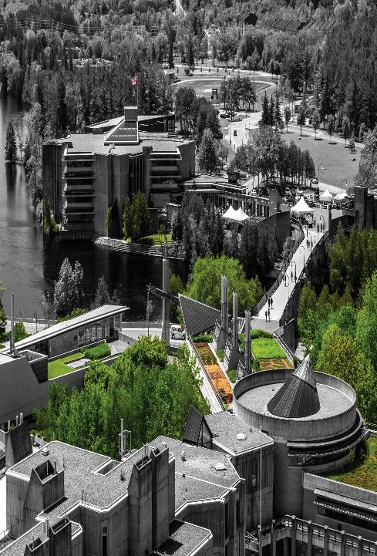
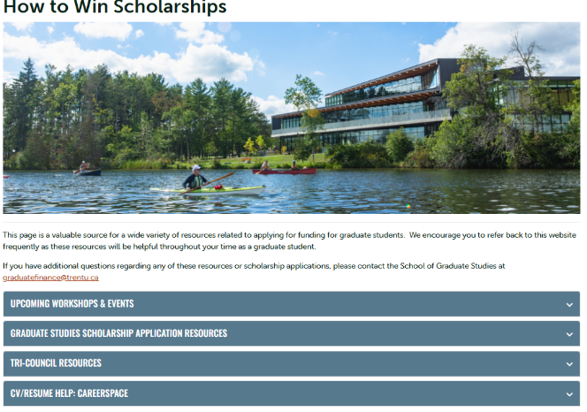
How to Win Scholarships

Slide 5
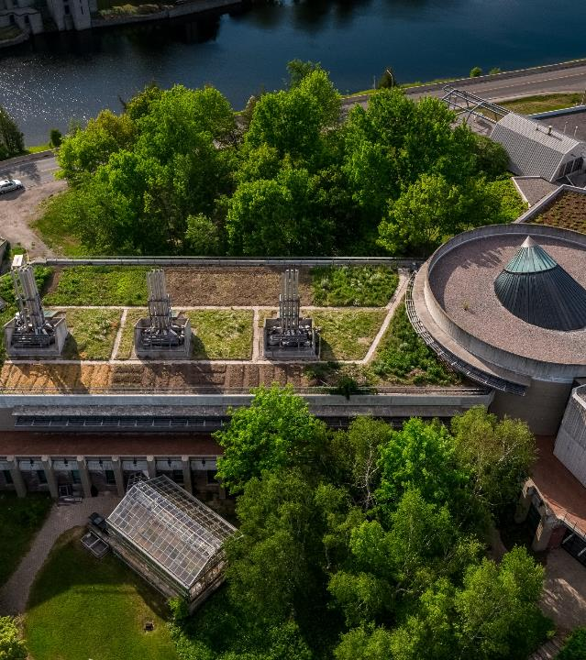
Graduate Studies Scholarship Application Resources
Overview of Graduate Scholarships Slide Deck
Canada Graduate Research Scholarships - Doctoral Program Slide Deck
Outline of Proposed Research Slide Deck
Letters of Reference & Special Circumstances Slide Deck
Ontario Graduate Scholarship Application Tips Slide Deck
Tri-Council Selection Criteria - Detailed Explanation
Faculty Guide: Writing Letters of Recommendation for Scholarship Applications Slide Deck

Slide 6
Tri Council Resources
The Tri-Council agencies include the Canadian Institutes of Health Research (CIHR), Natural Sciences and Engineering Research Council (NSERC), and Social Sciences and Humanities Research Council (SSHRC). These are federal granting agencies that support research, research training and innovation in Canadian postsecondary institutions.
The following resources are useful when applying for scholarships from any of the Tri-Council agencies:
Selecting the Appropriate Federal Granting Agency
Guidelines on the Assessment of Contributions to Research, Training and Mentoring
San Francisco Declaration on Research Assessment (DORA)
Guide for Applicants: Considering Equity, Diversity and Inclusion in Your Application
Equity, Diversity, and Inclusion (Multiple)
How to Integrate Sex and Gender into Research
Gendered Innovations
Guidelines for the Merit Review of Indigenous Research
Health Research Training at CIHR
Training Resources (“Career Hub”)

Slide 7

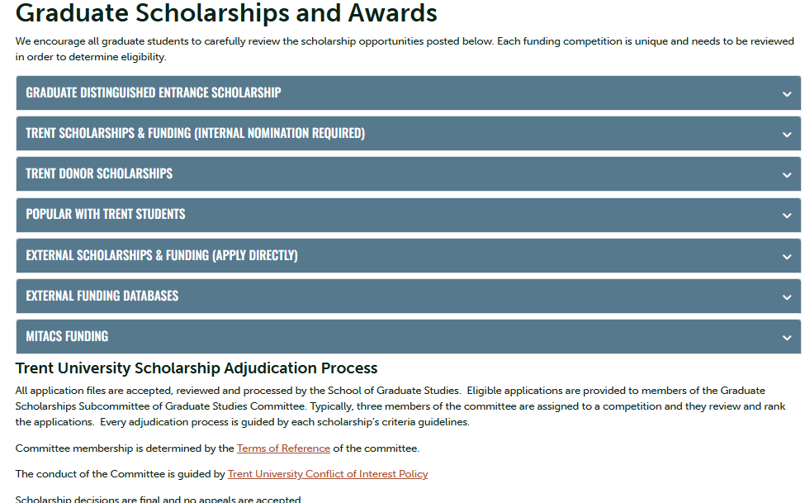
Graduate Scholarships & Awards

Slide 8
Graduate Scholarship Competitions – with internal Trent Deadlines
Graduate Scholarship Competitions with Internal Trent Deadlines, many of which are government-funded scholarships which includes:
Canada Graduate Research Scholarship – Doctoral Program (NSERC, SSHRC & CIHR)
Ontario Graduate Scholarship
Autism Scholars Awards
Mackenzie King Open and Travelling Scholarship
Ontario Women’s Health Scholars Awards
These scholarships applications are initially submitted to the School of Graduate Studies by an internal deadline, which is set several weeks ahead of the national deadline.
All submissions are reviewed for eligibility, and those deemed eligible are then evaluated by the Graduate Scholarships Committee.
Top-ranked applications are forwarded in accordance with Trent’s allocated quota.

Slide 9

Thomas J. Bata Memorial Graduate Scholarship
This fund was established in honour of Thomas J. Bata (1914-2008), by his wife Sonja Bata and their family. Mr. Bata was one of Trent`s original honorary sponsors, a member of Trent’s Board of Governors between 1963 - 1973 and a close friend of Founding President Prof. T. H. B. Symons.
This $5,000 scholarship is intended to support a student that demonstrates leadership qualities such as innovation, entrepreneurship, community responsibility and global citizenship.
FOLLOW THE INSTRUCTIONS
Deadline: October 10, 2025

Slide 10
Ontario Graduate Scholarship
Application Deadline: February 6, 2026
Since 1975, the Ontario government, in partnership with Ontario's publicly assisted universities, has encouraged excellence in graduate studies at the master's and doctoral levels through the awarding of Ontario Graduate Scholarships (OGS). OGS awards are merit-based scholarships available to students in all disciplines of graduate study.
At Trent, applicants can be considered for the OGS through an online application.
Awards are open to School of Graduate Studies graduate programs that have a significant research component. A significant research component is original, autonomous research that leads to the completion of a thesis, major research project, dissertation, and/or scholarly publication, that is merit/expert-reviewed at the institutional level as a requirement for completion of the program.

Slide 11

ALWAYS Confirm your Eligibility before starting

Slide 12

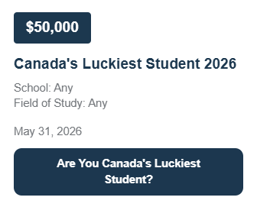


External funding Databases
Students can use these external funding databases to search for further opportunities.
Calgary Foundation Student Awards Portal
International Scholarships
Scholarships Canada
Yconic

Slide 13
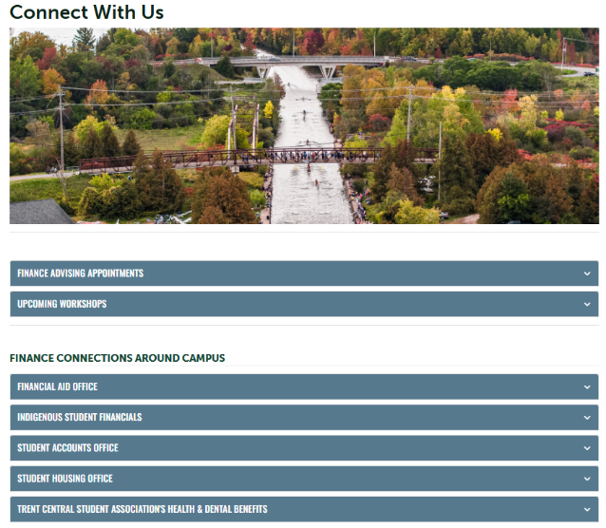
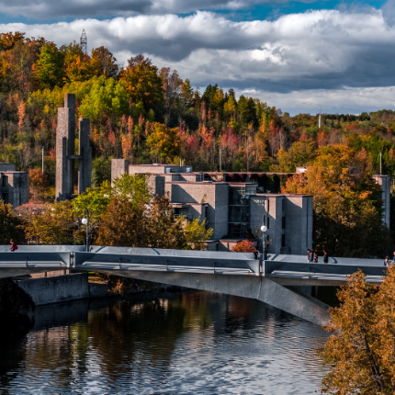
Connect with Us

Slide 14
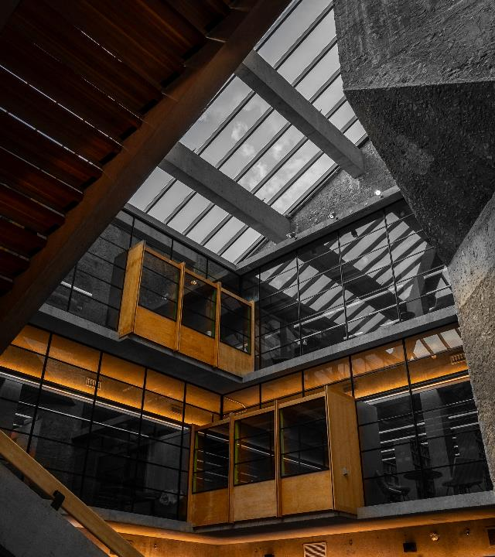
Canada Graduate Research Scholarship ~ Doctoral Program

Slide 15

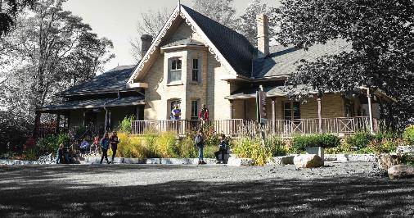
Internal Trent Deadline for:
Canada Graduate Research Scholarship Doctoral Program (CGRS_D)
October 7, 2025, by 11:59 p.m.
The various portals do not allow Trent to “close” access to the portals, but the portals record the last time the portal was accessed by the applicant.
Late applications will not be accepted.

Slide 16
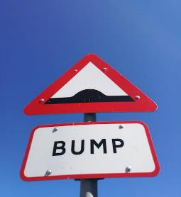



CAUTION:
Information Overload potential
Notes:
Providing the overview, when you go through the application and you get confused, you might reference these slides to get you back on track.
Instructions walk you through the process step by step…

Slide 17

Eligibility
To be eligible to apply, you must have completed no more than 36 months of full-time equivalent study in the doctoral program, for which you are requesting funding by December 31 of the calendar year of your application.
Number of months:
Eligibility for CGRS D is based on the number of months of full-time study, including summer months, you completed by December 31 of the calendar year of your application toward the degree for which you are requesting funding.
Two terms of part-time study count as one term of full-time study.
The agencies count all studies toward the doctoral degree for which funding is requested, whether or not they were completed in the same program or at the same institution.

Slide 18

International Applicants
If you are not a Canadian citizen, permanent resident of Canada or protected person under subsection 95(2) of the Immigration and Refugee Protection Act (Canada), you must be enrolled in your doctoral program of study at an eligible Canadian institution by the application deadline.
Trent Internal Deadline: October 7, 2025 @ 11:59 p.m.
Up to 15% of awards will be available to international applicants at the national level.

Slide 19



Other Restrictions
You can submit a maximum of one Canada Graduate Research Scholarship – Master's (CGRS M), Canada Graduate Research Scholarship – Doctoral (CGRS D), or Canada Postdoctoral Research Award (CPRA) application per academic year to either CIHR, NSERC or SSHRC. If you submit more than one application, only the eligible application submitted first will be retained.
You can apply a maximum of three times to the CGRS D.
You cannot have already received a doctoral-level scholarship from CIHR, NSERC, or SSHRC (including a Vanier Canada Graduate Scholarship).
You cannot hold a tenure or tenure-track appointment or be on leave from such an appointment concurrently with your CGRS D award (some exceptions apply; see the Tri-agency research training award holder’s guide for details).
Notes:
Three times – nominated to go forward to the national competition

Slide 20


Application procedures
Selecting the appropriate agency
Apply to the agency best aligned with your research subject matter to ensure your application will be reviewed by experts in disciplines closest to your field(s) of study. For more information, see Selecting the Appropriate Federal Granting Agency.
If you are applying to CIHR, consider the information on CIHR’s website.
If you are applying to NSERC, see the Addendum to the guidelines for the eligibility of applications related to health, which has additional information and specific examples relating to subject matter.
If you are applying to SSHRC, see the information on SSHRC's Subject Matter Eligibility web page.
It is your responsibility to select the funding agency that best suits your application.
Applications submitted to the incorrect agency may be removed from the competition.

Slide 21
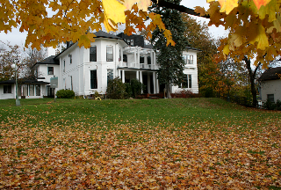

Application process
To complete the application process, see the appropriate agency’s website and instructions:
CIHR: ResearchNET and instructions
NSERC: Online system and instructions
SSHRC: Registration and login and instructions
To be considered in the competition, your application must be complete.
Each funding agency provides specific instructions, including a checklist that outlines all the required components of a complete application.
You must submit your application electronically through the relevant agency’s platform.
If you need help while preparing your application, write to the appropriate program contact well before the application deadline.

Slide 22



SSHRC Instructions
Canada Graduate Research Scholarship—Doctoral
Applicant instructions
Documents to read before applying (Just Reading)
Application process and deadlines (Information overview only)
Application profile (fill in the blanks!)
Program information (likely you select A & you count months)
Areas of study (key words, select discipline fill in the blanks)
Research proposal
Bibliography and citations
Diversity considerations in research design module (just one question)
Transcripts (a task)
Allowable inclusions (if applicable)
Research contributions, relevant experience and activities
Supplement justification (if applicable)
Joint or special initiatives justification (if applicable)
Referees Contact information (a task)
Notes:
Instructions – are helpful and walk you through the application!
Parts are just reading, some tasks don’t apply, some tasks are fill in the blanks with information about you
The process takes some time, and it working through filling in a form. You got this!

Slide 23


Documents to Read
Canada Graduate Research Scholarship—Doctoral program
Definitions of terms SSHRC uses in the application process
Regulations governing applications
Tri-agency research training award holder’s guide
General guidelines for the eligibility of subject matter at SSHRC
Guidelines for the merit review of Indigenous research (if applicable)
Guide to including diversity considerations in research design for doctoral and postdoctoral award applicants
Guidelines for effective research training
Guidelines for research-creation support materials (if applicable)
Letter of Appraisal form—Instructions for referees

Slide 24
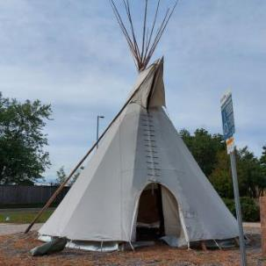
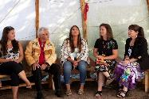
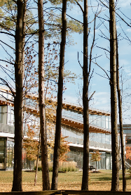
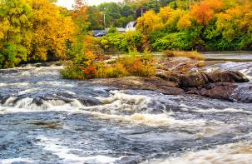
Research Involving and Engaging Indigenous Peoples
Below are SSHRC resources to support applicants working in Indigenous research; merit reviewers assessing applications related to Indigenous research; and communities and other research partners engaged in Indigenous research:
Definition of Indigenous research
Guidelines for the Merit Review of Indigenous Research
Indigenous Leadership Circle in Research
Indigenous Research Statement of Principles
Tri-Council Policy Statement: Ethical Conduct for Research Involving Humans Chapter 9: Research Involving the First Nations, Inuit and Métis Peoples of Canada

Slide 25

Attaching a Document & Presentation Standards
SSHRC Presentation and Attachment Standards
Prepare the documents
Prepare your attachments following the requirements below:
Explain any acronyms and abbreviations fully;
Pages must be 8 ½" x 11" (216mm x 279mm);
Pages must be single-spaced, with no more than six lines of type per inch;
All text must be in black, using the 11 pt Arial font; condensed fonts will not be accepted;
Margins must be set at a minimum of ¾" (1.87 cm); and
For multi-page attachments, pages must be numbered sequentially.
Convert the documents
All attachments must be converted to Portable Document Format (PDF) before they can be attached to the application.
NSERC Presentation Standards
SSHRC Instructions for Attachments and Presentation Standards
Many modules in your application will require you to attach a PDF file.
You must follow the requirements for margins and font size specified in the application portal.
An error message will appear if the file you are trying to attach does not meet the required specifications for page length and/or file size.
Once you have attached the electronic file, we recommend you click “View attached file” to ensure it is the proper file and it is not corrupted.

Slide 26


Joint initiatives & Supplements
The three agencies may offer supplementary funding to award holders, some of which is offered through joint initiatives (collaborations with organizations from across the not-for-profit, private and public sectors to support and promote training, research and connection activities).
Joint initiatives and supplements are designed to reflect the strategic objectives and mandates of each respective agency, inform decision-makers and, in certain cases, address specific needs of their partners.
See the agency websites (CIHR, NSERC, SSHRC) for more information on related opportunities.
May not apply or fit area of research! But they might…

Slide 27

Selection Review Process
The review aims to identify candidates for the award and create a ranked list of alternate meritorious applicants.
Only materials submitted through the Research Portal will be considered.
Any excess pages are removed before the review begins.
Committee members will not refer to external URLs or publications for additional information.
The merit review must adhere to the specified selection criteria, which are weighted. Committee members must consider each criterion when assigning a global score to an application.
No additional criteria may be added.

Slide 28


Understanding Selection Process
Institutional review
The School of Graduate Studies is responsible for coordinating the institutional evaluation of all applications submitted from each agency.
Based on institutional quota, the highest ranked applications are forwarded to the federal competition.
Selection criteria
Research potential (50% weight)
Relevant experience and achievements obtained within and beyond academia (50% weight)
Applicants are encouraged to review the indicators which help articulate the selection criteria
Committee selection guide is also a valuable resource

Slide 29
Selection Criteria
Research Potential 50%
Indicators of research potential: quality of research proposal:
  specific, focused and feasible research question(s) and/or objective(s)
  clear description and soundness of the proposed methodology
  significance and expected contributions to research
demonstration of potential to carry out proposed research relative to the stage of study, lived experience and knowledge systems
quality of contributions and extent to which they advance the field of research–contributions may include publications, patents, reports, posters, abstracts, monographs, presentations, creative outputs, knowledge translation outputs, community products, etc.
demonstration of sound judgment and ability to think critically
demonstration of responsible and ethical research conduct, including honest and thoughtful inquiry, rigorous analysis, commitment to safety and dissemination of research results and adherence to professional standards
demonstration of originality, initiative, autonomy, relevant community involvement and outreach
ability to communicate theoretical, technical and/or scientific concepts clearly and logically in written and oral formats
Relevant Experience and Achievements 50%
relevant training, such as academic training, lived experience and traditional teachings
scholarships, awards and distinctions (amount, duration, and prestige)
academic record:
  transcripts
  duration of previous studies
  program requirements and courses pursued
  course load
  relative standing in program (if available)
professional, academic, and extracurricular activities, as well as collaborations with supervisors, colleagues, peers, students and members of the community, such as:
  teaching, mentoring, supervising and/or coaching
  managing projects
  participating in science and/or research promotion
  participating in community outreach, volunteer work, and/or civic engagement
  chairing committees and/or organizing conferences and meetings
  participating in departmental or institutional organizations, associations, societies and/or clubs

Slide 30

CGRS-D: Objective
The Canada Graduate Research Scholarship — Doctoral (CGRS D) program recognizes and supports the next generation of outstanding innovators, knowledge workers, creative thinkers and researchers. By providing support for a high-quality research training experience to awardees, the program strives to foster impacts within and beyond the research environment.
The Canada Research Training Awards Suite (CRTAS) aims to support the next generation of innovators by providing funding and high-quality research training, cultivating research skills, fostering creativity and empowering awardees to make significant contributions to Canada’s research ecosystem, economy and prosperity.
Value of CGRS – D: $40,000 for up to 3 years

Slide 31
NSERC Doctoral Instructions
Outline of Proposed Research
In the Outline of Proposed Research section of your application, provide the requested information according to the guidelines and format standards outlined in the NSERC online presentation and attachment standards webpage.
Outline:
Provide a detailed yet concise description of your proposed research project for the period during which you are to hold the award.
Be as specific as possible.
Provide background information to position your proposed research within the context of the current knowledge in the field.
State the significance of the proposed research to a field or fields in the Natural Sciences and Engineering.
State the objectives, hypothesis, and outline the experimental or theoretical approach to be taken (citing literature pertinent to the proposal) and the methods and procedures to be used.
If the proposed research is a continuation of your thesis, clearly state the differences between work done for your thesis and the research activities outlined in this proposal.
Write your proposal in clear, plain language, and avoid jargon. Your application will be evaluated by a review committee covering a broad discipline category.
NSERC expects you to write your research proposal independently and to properly reference ideas or text belonging to others.
NSERC encourages you to seek feedback from colleagues and supervisors.
Include all relevant information in the outline. Do not refer review committee members to URLs or other publications for supplemental information. Such additional information will not be reviewed.

Slide 32

SSHRC Doctoral Instructions
Research Proposal
Write your proposal in clear, plain language.
Avoid discipline-specific jargon, acronyms, and highly technical terms.
Your application will be reviewed by members of a multidisciplinary selection committee, not all of whom will be familiar with your area of research.
Ensure that your text includes the following required elements, especially with respect to your research proposal.
If you are not currently enrolled in a doctoral degree program:
clearly state your current level of study;
give the title and a brief description of your master’s thesis or research project, if applicable;
identify the degree program you will pursue, including any relevant courses, and explain why you chose this program; and
provide an outline of your doctoral thesis or research project, including the research question(s), context, objectives, methodology, significance and expected contribution to advancing knowledge, as well as your special interests in the proposed research area.
If you are currently enrolled in a doctoral degree program:
clearly state your current level of graduate study;
indicate what stage you are at in your thesis/research project;
provide the name of your supervisor of doctoral studies, if known;
provide an outline of your thesis or research project, including, for example, the research question(s), context, objectives, methodology, significance and expected contributions to advancing knowledge; and
describe what you hope to accomplish during the award tenure and what will remain for you to complete to obtain your degree.

Slide 33

CIHR Instructions Doctoral
Different Requirements: 2 Parts
1. Training Expectations
Describe their experiences/achievements and how it will contribute to their training success.
Describe how the training they expect to acquire will contribute to their professional development and career goals and to the research goals they hope to achieve.
Describe how their expected training strives to foster impacts within and beyond the research environment and will contribute to the Canadian research ecosystem during and beyond the tenure of the award.
Explain why they decided to obtain training at the proposed institution and what they expect to learn from the training experience.
2. Research Project Summary
Should clearly describe the applicant's role in the project.
Should be written in general scientific language, which is an important skill to acquire for future success in the research environment as applications are being reviewed by multi-disciplinary committees.
Should be specific, focused, include feasible research question(s), objective(s) and provide a clear description of the proposed methodology.

Slide 34
Outline of Proposed Research
Various Proposal Frameworks
Hour-Glass Style
Inverted Triangle
Background of research, broad overview
Introduce important concepts, what is known and what is unknown
Research question
Methodology
Data analysis
Contribution to knowledge in field and broader impact
Big picture, relevance/importance of problem
Theoretical Frame: Situate study in body of theory
Research question
Methodology: Underlying approach to the research
Method: How will you do it?
Data analysis
Dissemination of research

Slide 35
framework Suggestion
Research Outline – Breakdown
Main Challenge or Issue
  What problem are you addressing?
What’s Known and Unknown
  Briefly explain what researchers already know and what gaps still exist.
Research Questions
  What specific questions will your research try to answer?
Theoretical and Methodological Framework
  What theories and methods will guide your research?
Proposed Methods
  What steps or techniques will you use to carry out the research?
Contribution to Knowledge
  How will your findings advance your field or help other areas of research?
Public Good / Social Impact
  How could your research benefit society or make a positive difference?

Slide 36
An outline of proposed research should clearly and concisely communicate a research plan, its significance, and the approach.
🧠 1. Research Problem or Challenge
Clearly state the issue your research addresses.
Explain why it matters—scientifically, socially, or economically.
📚 2. Background and Knowledge Gaps
Summarize what is already known in the field.
Identify gaps in knowledge that your research will fill.
❓ 3. Research Questions or Objectives
Include the key questions your research aims to answer.
These should align with your overall goals and be specific and measurable.
🧪 4. Methodology or Approach
Describe how you will conduct your research.
Include details on data collection, analysis techniques, and tools or models you'll use.
📅 5. Timeline and Milestones
Break down your research into phases.
Include key milestones and estimated completion dates for each stage.
📈 6. Significance and Impact
Explain how your research will contribute to the field.
Discuss potential applications, policy implications, or societal benefits.
📎 8. References and Supporting Literature
List key sources that support your background and methodology.
Ensure they are relevant, credible, and up-to-date. (5 pages)

Slide 37



Diversity Considerations in research Design
After you’ve answered “yes” or “no” to the question “Do diversity considerations apply to your proposed research design?”, indicate in the text box how diversity considerations are applicable or not to your research proposal (maximum 1,700 characters).
Before completing this module, read the Guide to including diversity considerations in research design for doctoral and postdoctoral award applicants.
Note: Although mandatory, this module is not subject to merit review and is not shared with committee members.

Slide 38
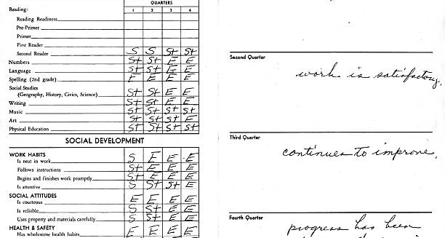
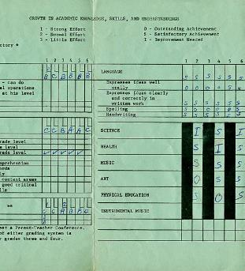

Transcripts
Include up-to-date official transcripts of ALL your undergraduate and graduate studies in the application.
Retain the paper copy of any uploaded transcripts, as you could be asked to provide it for verification purposes.
Up-to-date official transcripts are defined as transcripts issued by the Registrar’s Office and dated or issued in the fall session of the year of application (if currently registered) or after the last term completed (if not currently registered).
Applicants are responsible for collecting, uploading, and confirming legibility of previous and current transcripts and upload them directly on to the application portal.
If you have started your doctoral graduate program Fall 2025 – you must upload transcript from this program, as it indicates months of study in your graduate program.
Review the application instructions.

Slide 39


Canadian Common CV (CCV)
The Tri-Agency CCV refers to the Canadian Common CV (CCV) system used for funding applications submitted to Canada’s three federal research funding agencies. (CGRS-M, CGRS-D CIHR & SSHRC)
What It Is:
The Tri-Agency CCV is a standardized online CV format required for many scholarship, fellowship, and grant applications. It ensures consistency and completeness in how academic and professional information is presented.
Key Features:
Sections: education, employment, research funding history, contributions, activities, and more.
Time-consuming: It can take several hours to complete, especially the first time, so starting early is recommended.
Notes:
Takes some time and can be a wee bit challenging. There are instructions.

Slide 40



Special Circumstances: what to consider
Tri Council applications asks their selection committees to consider special circumstances that could have affected applicants’ research, professional career, record of academic or research achievement, or completion of degrees.
Relevant circumstances could include administrative responsibilities, maternity/parental leave, child rearing, illness, disability, cultural or community responsibilities, socio-economic context, family responsibilities, trauma and loss, the COVID-19 pandemic, or other applicable circumstances.
Links: SSHRC D NSERC D CIHR D Point 4

Slide 41
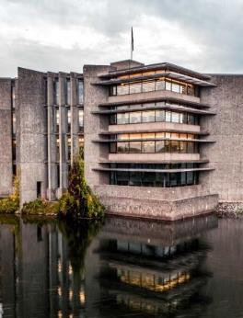
Allowable Inclusions:
1. Special circumstances
2. Indigenous Applicants
Describe the impact of any special circumstances that may have delayed, disrupted or interrupted studies or research or otherwise affected the performance and or productivity on which the assessment for funding will be made.
This includes delays in disseminating research results due to health problems, family responsibilities, parental leave, disabilities, trauma and loss or other applicable circumstances. Explain any gaps in the chronology of your experience (including relevant employment). This section can also be used to describe the impact of COVID-19 on any aspect of the application.
The Special circumstances section should include the following information as needed:
The duration of the delay/interruption and, if applicable, a percentage of reduction in workload.
A clear description of its impact including, if relevant, the type of research contribution impacted (for example, publications, data collection, presentations, etc.).
For delays related to the COVID-19 pandemic, specify the impacts and how they relate to your particular circumstances (for example, lab access, equipment delays, family responsibilities, etc.). Explain what you did to adjust or compensate in response to these impacts.
The review committee members are asked to recognize delays and assess the quality of your performance and productivity during your active period (that is, excluding the period of special circumstances).
If your supervisor is unable to provide you with a reference letter, you may use this section to provide an explanation.
Notes:
Be brief, yet honest, when completing a special circumstances inclusion.
Stay factual and concise.
Assess your full application to determine if there are gaps requiring clarification for the members of the adjudication committee.
Demonstrate how the circumstances may have influenced your research, strengthened your focus, or broadened your academic development.

Slide 42
Overview of Scholarship Application Recommendation Letters
Always review the application instructions and share instructions with your “referee”
Recommendation letters might be called:
Letter of Appraisal
Report on the Applicant
Reference Assessment or Referee Assessment
It is critical that a “referee” relate their comments to the competition’s selection criteria.
They provide a meaningful commentary on an applicant’s skills, knowledge, experience, research potential and contributions.
Adjudication committee members rely on these letters to review their own ranking of the application in comparison to the pool of applicants.

Slide 43


Who? When? How?
Consider
How to ask
Who to ask?
A person who offers authority, depth and who can offer specificity. They are familiar with your research and other abilities:
Supervisor, faculty member, employment supervisor, thesis advisor
When to ask?
… early, 3 weeks before scholarship due date
Email or in-person or phone
What is your comfort level and awareness of your referee?
If in email, first message should:
Be a brief inquiry reminding the faculty member how you know them
Provide clarification as to what scholarship application you are applying for
Clearly ask if they are willing and able to provide an enthusiastic reference for your scholarship application
Provide the scholarship application submission deadline
Notes:
Enthusiastic, robust, positive,

Slide 44

What to provide a referee and what might be helpful
Advise your referee you will provide:
Scholarship overview
Selection criteria
Draft of your outline of proposed research
Referee instructions
Ask, would it would be helpful to provide:
unofficial transcripts;
a resume or CCV;
written blurbs for how your experience or academic background fits the selection criteria of the scholarship competition
Notes:
🌟 The Women's Classical Caucus (WCC)
📘 Commission on the Status of Women – Avoiding Gender Bias in Reference Writing

Slide 45
A strong Reference will:
Confirm the value of your research project while commenting on focus, feasibility, clarity of methodology and significance within your field of research
Indicate a familiarity with your academic achievements to date, comment on your judgement, critical thinking, originality, initiative, autonomy and enthusiasm for research
Endorse your project and your ability to achieve the outcomes of your project
Affirm quality and relevance of your contributions, considering discipline-specific norms and the work advances the field
Share insight into your training, knowledge and lived experience relevant to the research, offering context beyond grades and your CCV
Provide a robust picture of your skills and interest in and outside the lab / classroom
Highlight how you may have overcome challenges or any special circumstances that you have experienced during your academic career

Slide 46
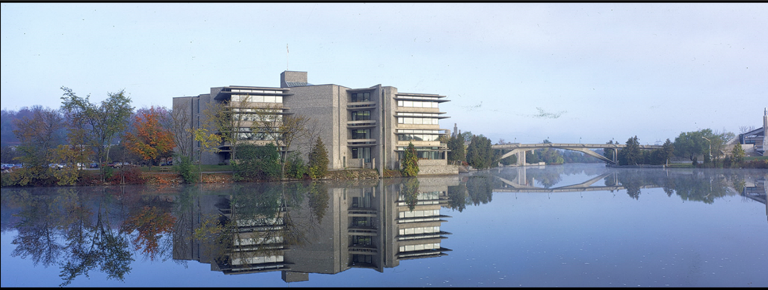
Research Funding concepts

Slide 47



Sex and Gender Based Analysis + (SGBA+)
When applicable, indicate how diversity (gender, sex, age, race, culture, religion, etc.) is considered in your proposed research (from its design to the analysis of the research findings).
Incorporating the principles of SGBA+ in research has the potential to increase the thoroughness and usefulness of the research.
How to Integrate Sex and Gender into Research
What is Gender? What is Sex?
Online training modules:
  Sex and Gender in Biomedical Research
  Sex and Gender in Primary Data Collection with Human Participants
  Sex and Gender in the Analysis of Secondary Data from Human Participants

Slide 48

San Francisco Declaration on research assessment
San Francisco Declaration on Research Assessment
CIHR, NSERC and SSHRC, along with other Canadian research funding agencies, are signatories of the San Francisco Declaration on Research Assessment (DORA).
The agencies are committed to meaningful assessment of excellence in research funding and to ensuring that a wide range of research results and outcomes are considered and valued as part of the assessment process.
The agencies will continue to work to ensure that their strategies, policies and guidance align with DORA.

Slide 49



Knowledge Mobilization
Knowledge mobilization is an umbrella term encompassing a wide range of activities relating to the production and use of research results, including knowledge synesis, dissemination, transfer, exchange, and co-creation or co-production by researchers and knowledge users.
Resources from Tri-Council
What is knowledge mobilization?
Canadian Knowledge Transfer and Exchange Community of Practice website
Mapping the Impact of Research (PDF, 1.07 MB), David Phipps, York University

Slide 50

Guides for Assessment of Contributions
Other guides that help clarify your qualifications include:
Guidelines on the Assessment of Contributions to Research, Training and Mentoring
San Francisco Declaration on Research Assessment (DORA)
* These links are filled with valuable information necessary produce a winning application

Slide 51
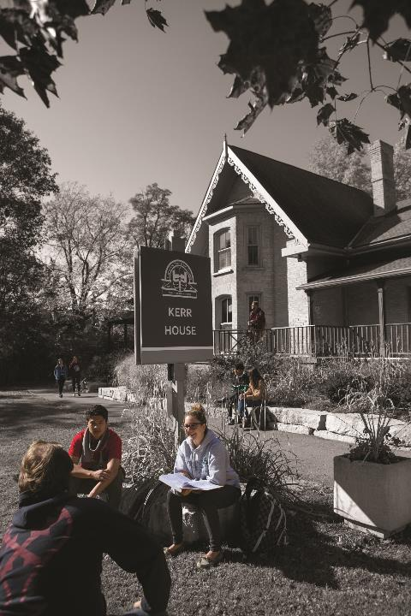
Benefits of Developing Scholarship applications
Boosts your confidence in writing, critical thinking, project management, and navigating government portals.
Improves your academic writing through practice, helping you become more proficient in the writing style specific to your discipline.
Raises your awareness of the complexity and demands of your academic and research plan
Teaches time management by working through a project timeline (like a scholarship application), helping you understand the planning and effort needed to meet deadlines.
Prepares you to mentor others, giving you the experience needed to confidently guide younger researchers through the scholarship application process.
Notes:
Wishing you all the best – and I am available for assistance, Financial Matters / Connect with Us

Slide 52

School of Graduate Studies
Blackburn Hall, Suite 115
All financial inquires direct to: graduatefinance@trentu.ca

