Slide 1

Letters of Recommendation
&
Special Circumstances
2026-27
Jane Rennie
Graduate Finance Officer
School of Graduate Studies
This resource is part of a scholarship application support series and focuses on two important components of a strong application: letters of recommendation and special circumstances statements.

Slide 2

Land Acknowledgement
“We respectfully acknowledge that we are on the treaty and traditional territory of the Michi Saagiig Anishinaabeg.
We offer our gratitude to the First Peoples for their care for, and teachings about, our earth and our relations. May we honour those teachings.”

Slide 3


Scholarship Application Recommendation Letters
Recommendation letters might be called:
Letter of Appraisal
Report on the Applicant
Reference Assessment or Referee Assessment
References provide an informed, credible assessment of the applicant's academic excellence, research potential, and personal qualities in the context of the broader application. Recommendation letters are a significant part of the evaluation of an applicant.
It is critical that a referee relate their comments to the competition’s selection criteria.
Adjudication committee members rely on these letters to review their own ranking of the application in comparison to the pool of applicants.
Always review the instructions for the Reference Assessment
CGRS – M instructions
CIHR Information for Sponsors
NSERC CGRS D Instructions
SSHRC Letter of Appraisal Instructions

Slide 4
SAMPLE: Canada Graduate Research Scholarship – Master’s Program - Instructions for completing the Reference Assessment Form
Reference Assessment Overview
Who Completes It: Individuals familiar with the applicant’s academic or professional abilities (e.g., supervisors, managers, teachers).
Where: Submitted through the Research Portal.
⏰ Important Timing
Account Setup: References must verify their Research Portal account at least 48 hours before the applicant’s deadline to avoid technical issues.
Submission Deadline: References should submit their assessments at least 48 hours before the applicant’s deadline to ensure the applicant can complete and submit their application on time.
No Extensions: Late or missing reference assessments will prevent the applicant from submitting their application, and no deadline extensions will be granted.
For technical issues related to the Research Portal, contact the help desk at least 48 hours in advance of the applicant’s deadline. The agencies aim to respond to inquiries within 48 hours. However, during peak periods the response time may be delayed.

Slide 5


Who? When? How?
Consider
How to ask
Who to ask?
A person who offers authority, depth and who can offer specificity. They are familiar with your research and other abilities:
Supervisor, faculty member, employment supervisor, thesis advisor
When to ask?
… early, 3 weeks before scholarship due date
Consider your comfort level with your reference – will you request a letter of recommendation via email or in-person or phone?
If via email, first message should:
Be a brief inquiry reminding the faculty member how you know them
Provide clarification as to what scholarship application you are applying for
Clearly ask if they are willing and able to provide an enthusiastic reference for your scholarship application
Provide the scholarship application submission deadline

Slide 6

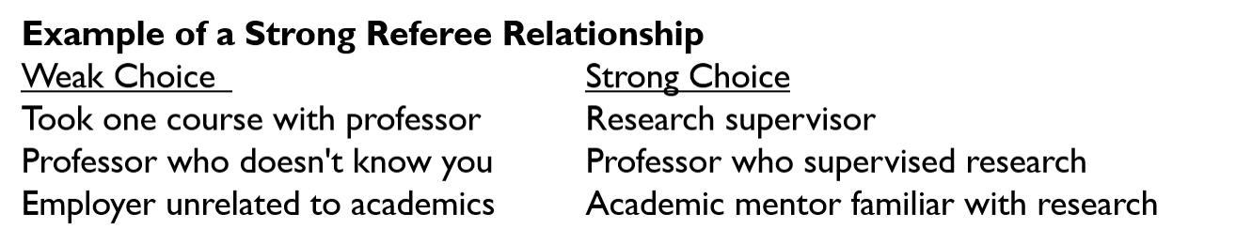
Who Not to ASK
Avoid Asking:
Faculty members who barely know you
Instructors from large classes with little interaction
Personal friends
Family members
Referees who seem hesitant
Faculty member already submitting several letters for same competition
Remember:
A detailed letter from someone who knows you well is usually stronger than a generic letter from a senior academic.

Slide 7

Common Recommendation Letter Mistakes
Asking too close to the deadline
Choosing the most famous professor instead of the most knowledgeable referee
Failing to provide supporting materials
Assuming a referee remembers details of your work
Not following up respectfully
Not realizing that you cannot submit your application if reference is missing for a Tri Agency scholarship

Slide 8

Helping your Referee write a strong letter
Advise your referee you will provide:
Scholarship details & selection criteria
Draft of your outline of proposed research
Referee instructions
Due date for recommendation letter submission
You may also offer:
unofficial transcripts;
a resume or CCV;
written paragraphs outlining how your experience or academic background fits the selection criteria of the scholarship competition (use judgement)

Slide 9

What referees should Highlight
Exceptional research potential: the reviewer wants evidence of the applicant's potential to carry out the proposed research and succeed as an independent scholar.
Originality and innovation
Independence and initiative: more than simply following instructions
Critical thinking and judgment
Research productivity and impact: contextualize contributions
Communication skills: written and oral
Leadership and collaboration: achievements within and beyond academia
Ethics and professionalism
Awards and recognitions

Slide 10
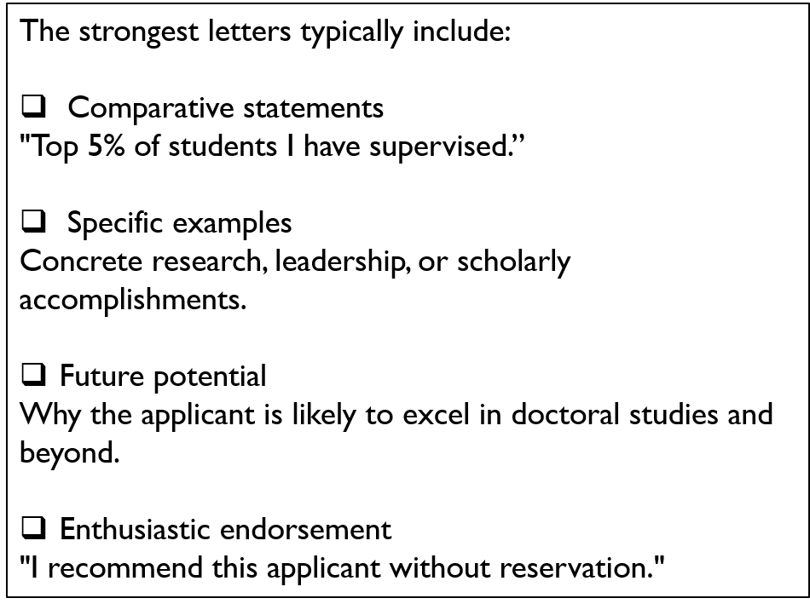
Key elements of a Strong Reference letter
Research Context
  Confirm the relevance of the applicant’s research topic.
  Identify knowledge gaps and affirm that the proposed methodology is appropriate for the discipline.
Originality and Impact
  Emphasize the novelty and potential impact of the applicant’s work.
  Keep in mind that adjudication committees are multidisciplinary—highlight why the research matters broadly.
Strengths and Achievements
  Showcase accomplishments, skills, and qualities that are not visible in transcripts (e.g., leadership, initiative, creativity).
Strong Endorsement
  Demonstrates confidence in the applicant's ability to succeed.
  Supports the proposed research project.
Holistic View of the Applicant
  Describes contributions inside and outside academics
  Highlights mentorship, service, or community involvement.
Resilience and Development
  If applicable, acknowledge any challenges overcome
  Provides context for the applicant’s academic

Slide 11

After you Submit your Scholarship application
Confirm you submitted your application and express gratitude to your reference for their recommendation and time.
Provide a timeline for when the scholarship decision will be made.
Inform your referee of the outcome, whether successful or not, once the results are released.
Keep your referee updated on your successes and academic activities.

Slide 12

Scholarship Applications
Special Circumstances

Slide 13



Special Circumstances: what to consider
Tri Council applications asks their selection committees to consider special circumstances that could have affected applicants’ research, professional career, record of academic or research achievement, or completion of degrees. This section is OPTIONAL and might not apply.
Relevant circumstances could include administrative responsibilities, maternity/parental leave, child rearing, illness, disability, cultural or community responsibilities, socio-economic context, family responsibilities, trauma and loss, the COVID-19 pandemic, or other applicable circumstances.
Link for CGRS M Instructions
Links: SSHRC D NSERC D CIHR D Point 4

Slide 14
Why an applicant would include:
Contextualizes Academic Performance
  Explains any dips in grades, gaps in education, or delays in research progress due to personal, medical, financial, or family-related challenges.
Ensures Fair Evaluation
  Helps reviewers understand the full picture of the applicant’s journey, especially when transcripts or CVs don’t reflect the effort or resilience involved.
Demonstrates Resilience and Growth
  Shows how the applicant overcame adversity, adapted, and continued to pursue academic excellence—qualities highly valued in research environments.
Highlights Non-Academic Strengths
  May include experiences that shaped the applicant’s perspective, motivation, or research interests, contributing to a more holistic evaluation.
Clarifies Gaps or Anomalies
  Addresses any inconsistencies or missing elements in the application that might otherwise raise questions during review.

Slide 15

Common examples of Special Circumstances
Special circumstances may include:
Significant caregiving responsibilities
Medical conditions or disability-related impacts
Family emergencies or bereavement
Choice of referee, if supervisor is away on research, or you just started your graduate program, or someone better able to provide an authoritative review of academic potential and achievements
Impacts of Indigenous community obligations
Interrupted studies or reduced course load
Financial hardship affecting research or studies
Unexpected disruptions beyond the applicant's control
Key message: Focus on circumstances that affected academic progress, research productivity, or opportunities.

Slide 16
Questions
SAMPLE Wording within the application portal:
Do you have any special circumstances to take into consideration that may have affected your research, professional career, record of academic or research achievement or completion of degrees?
If you answered Yes to the above question, the following prompt and text field (5,000 characters maximum, including spaces) will appear:
Describe any special circumstances that have had an effect on your performance or productivity (required).

Slide 17

Include within special Circumstances
Describe the impact of any special circumstances that may have delayed, disrupted or interrupted studies or research or otherwise affected the performance and or productivity on which the assessment for funding will be made.
Where possible, identify the duration of the interruption and quantify the effect on your workload, research productivity, publications, presentations, data collection, or other academic activities.
Note: If your current or past supervisor is unable to provide you with a recommendation letter, you should provide an explanation within the Special Circumstance

Slide 18

Details to include within Special Circumstances Section of your Application
The Special circumstances section should include the following information as needed:
The duration of the delay/interruption and, if applicable, a percentage of reduction in workload.
A clear description of its impact including, if relevant, the type of research contribution impacted (for example, publications, data collection, presentations, etc.).
For delays related to the COVID-19 pandemic, specify the impacts and how they relate to your particular circumstances (for example, lab access, equipment delays, family responsibilities, etc.). Explain what you did to adjust or compensate in response to these impacts.
The review committee members are asked to recognize delays and assess the quality of your performance and productivity during your active period (that is, excluding the period of special circumstances).

Slide 19
What Makes a Strong Special Circumstances Statement?
What Makes a Strong Special Circumstances Statement?
Avoid:
Providing unnecessary personal details
Describing challenges without explaining academic impact
Using emotional or apologetic language
Repeating information already explained elsewhere
Do:
Be factual and concise
Explain the impact on achievements or opportunities
Describe how the circumstance has been resolved or managed, where relevant
This is often the biggest challenge for applicants.
Refer to individual agency instructions for full details:
  CIHR 1 page PDF attachment to full application
  NSERC Special Circumstances Section in application
  SSHRC 1 page PDF attachment to full application (SSHRC refers to this document as Allowable Inclusions)

Slide 20



Writing Tips
Be Brief, Honest, and Respectful
  Share only what is necessary to provide context. Avoid overly emotional language—focus on clarity and sincerity.
Stay Factual and Concise
  Describe the situation using objective language. Include dates or timeframes if relevant and avoid speculation or exaggeration.
Review Your Full Application for Gaps
  Consider whether your transcripts, CV, or research proposal leave questions that this section can help clarify for adjudication committee members.
Connect Circumstances to Your Academic Journey
  Explain how the situation may have impacted your academic performance, research progress, or professional development.
Demonstrate Growth and Resilience
  Highlight how the experience strengthened your focus, shaped your research interests, or contributed to your personal and academic growth.
Maintain a Professional Tone
  Avoid placing blame or venting frustrations. Instead, frame your experience in a way that shows maturity and perseverance.

Slide 21


Applicant Reminder
Applicants are reminded, that the information included in the “Allowable Inclusions "or “Special Circumstances” section of their application will be shared with selection committee members for consideration as part of their application.
Reviewers cannot share this information outside of the merit review process, which is subject to the Tri-Agency Conflict of Interest and Confidentiality Policy.

Slide 22



Before you Submit your Application
Special Circumstances Checklist
✓ Is the circumstance relevant to academic performance or research progress?
✓ Have you clearly explained the impact?
✓ Have you quantified the impact where possible?
✓ Is the statement concise and factual?
✓ Would an adjudicator understand the context without additional explanation?

Slide 23
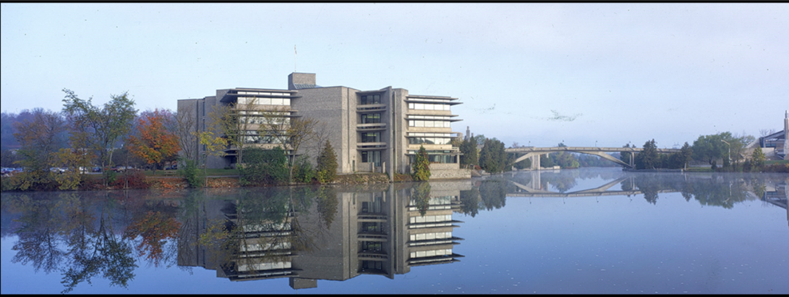
Additional Opportunities
&
Resources

Slide 24
Indigenous Scholars Awards and Supplements Pilot Initiative
Indigenous applicants are encouraged to use the “Allowable Inclusions” section of their application to describe special circumstances that could have impacted their academic or career paths.
The Indigenous Scholars Awards and Supplements Pilot Initiative provides financial support to Indigenous scholars who are meritorious in the CGRS M program.
The Indigenous Scholars Awards and Supplements Pilot Initiative consists of a one-year, non-renewable supplement valued at $5,000 for all meritorious Indigenous CGRS M applicants and a one-year, non-renewable award valued at $27,000 for all alternate candidates, subject to the limit of available funding.
To be considered for this funding opportunity, you must
select the Indigenous Scholars Awards and Supplements Pilot Initiative option from the drop-down menu
self-identify as Indigenous at the time of application for the purposes of this initiative
adhere to the Tri-agency Policy on Indigenous Citizenship and Membership Affirmation and associated Directive if selected for an award
indicate your agreement with the self-identification and consent statement by selecting the appropriate checkbox.
For additional information, consult the description of the Indigenous Scholars Awards and Supplements Pilot Initiative on the SSHRC website.

Slide 25

School of Graduate Studies
Blackburn Hall, Suite 115
All scholarship applications inquires direct to: graduatefinance@trentu.ca

