Slide 1

Letters of Recommendation & Special Circumstances
Canada Graduate Research Scholarship – Master’s Program (CGRS-M 2026-27)
This resource is part of a scholarship application support series and focuses on two important components of a strong application: letters of recommendation and special circumstances statements.

Slide 2

Scholarship Application Recommendation Letters
References provide an informed, credible assessment of the applicant's academic excellence, research potential, and personal qualities in the context of the broader application.
Recommendation letters are a significant part of the evaluation of an applicant.
It is critical that a referee relate their comments to the competition’s selection criteria.
Always review the instructions: Reference Assessment CGRS – M instructions

Slide 3
Canada Graduate Research Scholarship – Master’s Program
Reference Assessment Overview
Reference assessments are a required component of your CGRS-M application and play an important role in how your application is evaluated.
Key Facts
✅ Who completes it?
Faculty members, supervisors, managers, or others familiar with your academic or professional abilities
✅ Where is it submitted?
Through the Tri-Agency Research Portal.
✅ Account required
Referees must create a Research Portal account before submitting their assessment.
⚠️ Important Deadline Reminder
Late or missing reference assessments will prevent submission of your application. No deadline extensions are granted.
A strong reference can strengthen an application.
A weak reference can weaken an otherwise competitive application.

Slide 4

Reference Letters Can Strengthen or Weaken an Application
Strong Letters
✅ Detailed examples
✅ Specific achievements
✅ Comparative statements
✅ Research potential
✅ Enthusiastic endorsement
Weak Letters
❌ Generic comments
❌ Limited knowledge of applicant
❌ Few examples
❌ Focus only on grades
❌ Lukewarm support
Key Message: Strong reference letters provide evidence of research potential. Generic letters can weaken an otherwise competitive application.

Slide 5

Who? When? How?
Consider
How to ask
Who to ask?
A person who offers authority, depth and who can offer specificity. They are familiar with your research and other abilities:
Supervisor, faculty member, employment supervisor, thesis advisor
When to ask?
… early, 4-5 weeks before scholarship due date
Consider your comfort level with your reference – will you request a letter of recommendation via email or in-person or phone?
If via email, first message should:
Be a brief inquiry reminding the faculty member how you know them
Provide clarification as to what scholarship application you are applying for
Clearly ask if they are willing and able to provide an enthusiastic reference for your scholarship application
Provide the scholarship application submission deadline
Applicants should respect a referee's decision if they decline due to limited familiarity with the applicant, workload, or inability to provide a strong assessment.

Slide 6
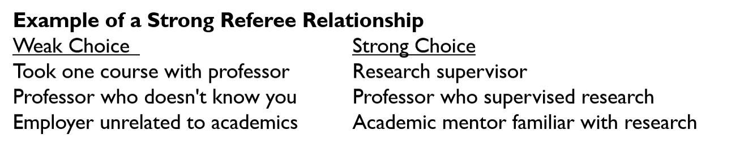
Who Not to ASK
Avoid Asking:
Faculty members who barely know you
Instructors from large classes with little interaction
Personal friends
Family members
Referees who seem hesitant
Faculty member already submitting several letters for same competition
Remember:
A detailed letter from someone who knows you well is usually stronger than a generic letter from a senior academic.

Slide 7
Sample Email Template – for first contact
Dear Professor [Last Name],
I hope you are doing well. I am writing to ask whether you would be willing to provide an enthusiastic reference letter in support of my application for a CGRS-M SSHRC scholarship. The application deadline is December 1.
I greatly valued the three courses I completed with you, in which I earned A grades, and appreciated the opportunity to attend your office hours to discuss course material and strengthen my understanding of the subject matter.
Given your familiarity with my academic work, I was hoping you might be able to provide a strong assessment of my suitability for this award. I also recognize that this is a particularly busy time of year and wanted to ask whether you would have the time to support my application.
To assist with the process, I would be happy to provide:
My CV
Academic transcripts
Research proposal
Scholarship evaluation criteria
A summary of my academic and research experiences
Any additional information you may find helpful
Thank you for considering my request. I would be very grateful for your support and am happy to provide any materials at your convenience.
Notes:
Adapt this template to reflect your own relationship and experiences with the referee.

Slide 8

Common Recommendation Letter Mistakes
Asking too close to the deadline
Choosing the most famous professor instead of the most knowledgeable referee
Failing to provide supporting materials
Assuming a referee remembers details of your work
Not following up respectfully
Not realizing that you cannot submit your application if reference is missing for a Tri Agency scholarship

Slide 9

Supporting your Referee: Materials to Provide
Essential Helpful
Scholarship overview Unofficial transcripts
Selection criteria Resume / CCV
Research proposal Publications
Referee instructions Draft statement of interests
Why This Matters:
Referees often write multiple letters each term. Providing materials helps them write a more detailed, accurate, and competitive assessment of your academic achievements and research potential.

Slide 10

What Strong Referees should Highlight
Reviewers Look for Evidence Of:
🔬 Research Potential 💡 Originality & Innovation
Ability to conduct independent research Creative and novel thinking
Curiosity and scholarly promise Ability to generate new ideas
🚀 Independence & Initiative 🧠 Critical Thinking
Takes ownership of projects Analytical ability
Goes beyond assigned tasks Strong judgment and problem-solving
🗣️ Communication & Collaboration 🏆 Achievements
Written and oral communication Awards, presentations, publications, leadership, ability to work effectively with others and other accomplishments
APPLICANT TIP: Provide examples and supporting materials that help referees speak to these qualities.

Slide 11
What Makes a Strong Reference Letter
Strong Letters Include:
✅ Specific examples of achievements
✅ Evidence of research potential
✅ Comparative statements
✅ Clear discussion of strengths
✅ Confidence in future success
✅ Enthusiastic endorsement
Examples of Strong Endorsements
✅ "Top 5% of students I have supervised.“
✅ "One of the strongest Master's students in my career.“
✅ "I recommend this applicant without reservation."
Comparison
Strong Letter Weak Letter
Specific examples Generic praise
Knows the applicant well Limited interaction
Discusses research potential Focuses only on grades Provides comparisons No benchmark
Enthusiastic support Lukewarm endorsement

Slide 12
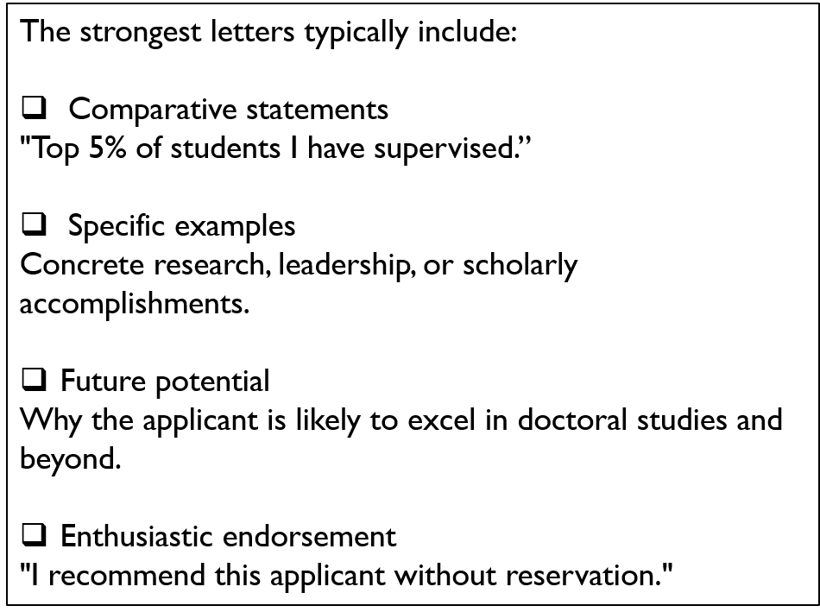
Key elements of a strong reference letter: what referees should discuss

Slide 13
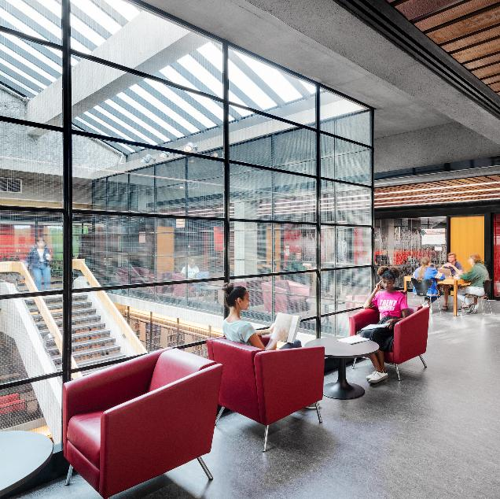
How Adjudicators Read Reference Letters
Is the referee credible?
Does the referee know the applicant well?
Are examples provided?
Does the enthusiasm seem genuine?
Has the referee used comparative language that weakens the reference?
Comments found in Reference Letters:
Top 10% of students
Strongest Master's student in five years
One of the most promising researchers I have supervised

Slide 14
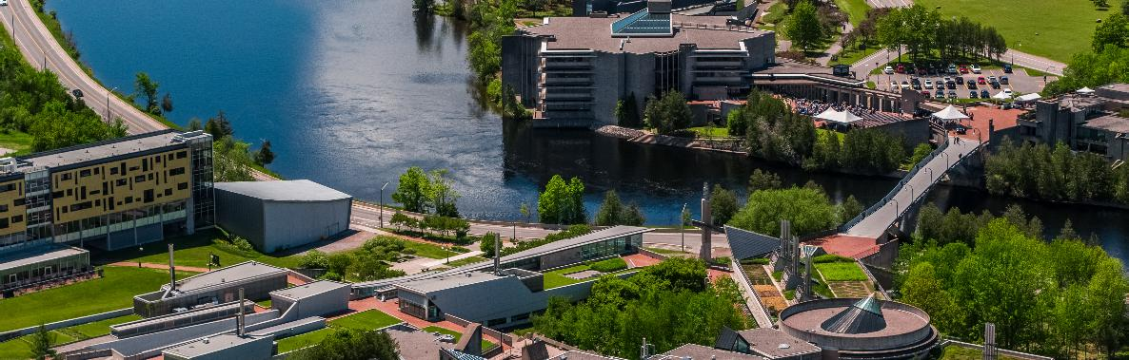
Scholarship Applications
Special Circumstances

Slide 15


Special Circumstances:
What to consider
Tri Agency applications ask their selection committees to consider special circumstances that could have affected applicants’ research, professional career, record of academic or research achievement, or completion of degrees. This section is OPTIONAL and might not apply.
Relevant circumstances may include administrative responsibilities, maternity/parental leave, child rearing, illness, disability, cultural or community responsibilities, socio-economic context, family responsibilities, trauma and loss, the COVID-19 pandemic, or other applicable circumstances.
Link for CGRS M Instructions

Slide 16
Why Include a Special Circumstances Statement?
Contextualizes Academic Performance
Explains any dips in grades, gaps in education, or delays in research progress due to personal, medical, financial, or family-related challenges.
Ensures Fair Evaluation
Helps reviewers understand the full picture of the applicant’s journey, especially when transcripts or CVs don’t reflect the effort or resilience involved.
Demonstrates Resilience and Growth
Shows how the applicant overcame adversity, adapted, and continued to pursue academic excellence—qualities highly valued in research environments.
Highlights Non-Academic Strengths
May include experiences that shaped the applicant’s perspective, motivation, or research interests, contributing to a more holistic evaluation.
Clarifies Gaps or Anomalies
Addresses any inconsistencies or missing elements in the application that might otherwise raise questions during review.

Slide 17

Common examples of Special Circumstances
Family
Bereavement
Caregiving responsibilities
Community obligations
Medical
Illness
Disability-related impacts
Mental health challenges
Academic
Program interruptions
Supervisor unavailable
Disrupted research opportunities
Financial
Significant financial hardship
Employment obligations affecting studies
Notes:
Focus on circumstances that affected academic progress, research productivity, or opportunities.

Slide 18
Question within the CGRS ~ M Application
Wording within the application portal:
Do you have any special circumstances to take into consideration that may have affected your research, professional career, record of academic or research achievement or completion of degrees?
If you answered Yes to the above question, the following prompt and text field will appear:
Describe any special circumstances that have had an effect on your performance or productivity (required).

Slide 19

Include within special Circumstances
Describe the impact of any special circumstances that may have delayed, disrupted or interrupted studies or research or otherwise affected the performance and / or productivity on which the assessment for funding will be made.
Where possible, identify the duration of the interruption and quantify the effect on your workload, research productivity, publications, presentations, data collection, or other academic activities.
Note: If your current or past supervisor is unable to provide you with a recommendation letter, you should provide an explanation within the Special Circumstance

Slide 20

Details to include within Special Circumstances Section of your Application
The Special Circumstances section should include the following information as needed:
The duration of the delay/interruption and, if applicable, a percentage of reduction in workload.
A clear description of its impact including, if relevant, the type of research contribution impacted (for example, publications, data collection, presentations, etc.).
For delays related to the COVID-19 pandemic, specify the impacts and how they relate to your particular circumstances (for example, lab access, equipment delays, family responsibilities, etc.). Explain what you did to adjust or compensate in response to these impacts.
The review committee members are asked to recognize delays and assess the quality of your performance and productivity during your active period (that is, excluding the period of special circumstances).

Slide 21

What Makes a Strong Special Circumstances Statement?
What Makes a Strong Special Circumstances Statement?
Avoid:
Providing unnecessary personal details
Describing challenges without explaining academic impact
Using emotional or apologetic language
Repeating information already explained elsewhere
Do:
Be factual and concise
Explain the impact on achievements or opportunities
Describe how the circumstance has been resolved or managed, where relevant

Slide 22
Example of a Special Circumstances Statement?
Strong Example
My parent passed away unexpectedly during my first year of undergraduate studies, which had a significant impact on my academic performance during that period. I left during the winter term, and I took a one-year leave from my studies. Upon returning, I demonstrated a sustained improvement in academic achievement that more accurately reflects my academic abilities and preparedness for graduate studies.
✅ Clearly identifies the circumstance
✅ Explains academic impact
✅ Provides time frame
✅ Shows recovery
✅ Stays factual and professional
Statement Component Example
Circumstance Parent passed away
Impact Lower academic performance
Duration One-year leave
Recovery Improved grades after return
Purpose Provides context for reviewers

Slide 23
Writing Tips
Be Brief, Honest, and Respectful
Share only what is necessary to provide context
Avoid overly emotional language
Describe the situation using objective language. Include dates or timeframes if relevant and avoid speculation or exaggeration.
Review Your Full Application for Gaps
  Consider whether your transcripts, CV, or research proposal leave questions that this section can help clarify for adjudication committee members.
Connect Circumstances to Your Academic Journey
Demonstrate Growth and Resilience
  Highlight how the experience strengthened your focus, shaped your research interests, or contributed to your personal and academic growth.
  Avoid placing blame or venting frustrations. Instead, frame your experience in a way that shows maturity and perseverance.

Slide 24

Applicant Reminder
Applicants are reminded, that the information included in the “Allowable Inclusions "or “Special Circumstances” section of their application will be shared with selection committee members for consideration as part of their application.
Reviewers cannot share this information outside of the merit review process, which is subject to the Tri-Agency Conflict of Interest and Confidentiality Policy.

Slide 25

Before you Submit your Application
Special Circumstances Checklist
✓ Is the circumstance relevant to academic performance or research progress?
✓ Have you clearly explained the impact?
✓ Have you quantified the impact where possible?
✓ Is the statement concise and factual?
✓ Would an adjudicator understand the context without additional explanation?

Slide 26
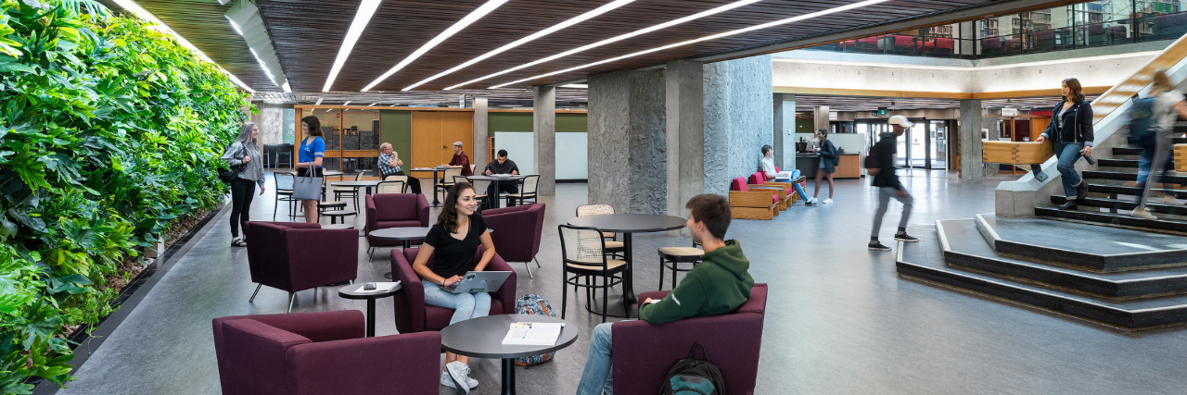
School of Graduate Studies
Blackburn Hall, Suite 115
All scholarship application inquiries: graduatefinance@trentu.ca

