Slide 1

Tri-Council
Canada Graduate Research scholarships – Master’s program 2026-27
A resource for student’s drafting a CGRS –M application.
Jane Rennie
Graduate Finance Officer
janerennie@trentu.ca
School of Graduate Studies

Slide 2
Tri-Council
Canada Graduate Research Scholarship - Master’s Program
(CGRS - M)
Value: $27,000
Direct Deadline: December 1, 2026
The CGS M program supports up to 3,298 students annually in all disciplines and is administered jointly by Canada’s three granting agencies.
The selection process and post-award administration are carried out at the institutional level under the guidance of the three agencies.
Students submit their application to the institution at which they intend to hold their award using the Research Portal.

Slide 3
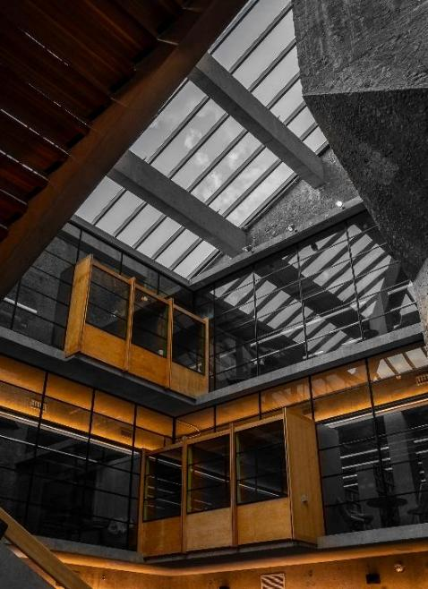
Tri-Council Canada Graduate Research Scholarship - Master’s Program
(CGRS - M)
Value: $27,000
Direct Deadline: December 1, 2026
The CGS M program supports up to 3,298 students annually in all disciplines and is administered jointly by Canada’s three granting agencies.
The selection process and post-award administration are carried out at the institutional level under the guidance of the three agencies.
Students submit their application to the institution at which they intend to hold their award using the Research Portal.
Notes:
Start early – review the various links
Application deadline
The deadline for CGRS M applications is December 1 before 8:00 pm ET.
Complete applications must be submitted by the deadline using the Research Portal.
Note: As the application deadline approaches, delays may occur due to a high volume of users on the Research Portal, which may prevent the timely submission of your application. Submit days early, not hours early.

Slide 4
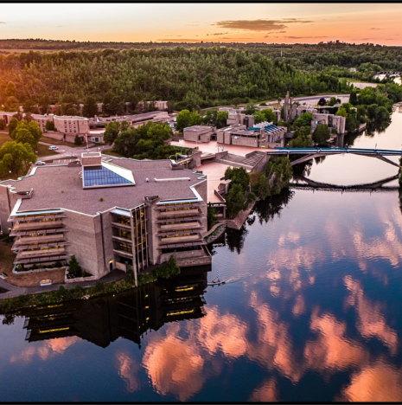
Why apply for a CGRS-M?
Five Reasons to Invest Time in a CGRS - M Application
Funding to support your research
National Recognition of Research Potential
Develop essential scholarship writing skills
Strengthen future scholarship and graduate school applications
Clarify your research direction and refine your academic focus

Slide 5
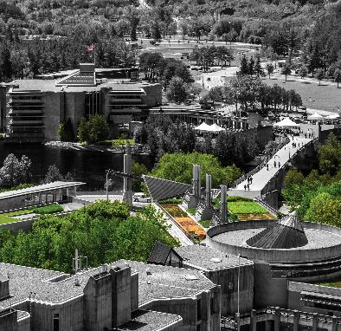
Instructions for completing an Application
General Information
Steps for completing and submitting the application
Application statuses
Notification of results
Each of these links provide key instructions at all stages of the application process.
Other Useful Instructions
Canada Graduate Research Scholarship – Master’s program
Instructions for completing a Canadian Common CV
Instructions for completing the Reference Assessment
Tutorials
Notes:
Valuable slide for links, should review

Slide 6

Application Task List
Review the CGSR- M scholarship description
Review the Instructions for Completing an application
Review applicant eligibility prior to commencing application
Refer to Selecting the appropriate federal granting agency
Create an account within the Research Portal
Review the selection criteria, as you draft and edit, continually ask yourself: Does this information help a reviewer award points under the selection criteria?

Slide 7

Am I Eligible?
You likely qualify if:
You are a Canadian citizen or permanent resident
You plan to start a research-based master's program
You have a strong academic average
You have less than 12 months of graduate study
You have not previously held a CGRS-M award
This is not a complete eligibility assessment. Review instructions.

Slide 8
Application Procedures
Selecting the appropriate agency is one of the most important first steps.
Apply to the agency best aligned with your research subject matter to ensure your application will be reviewed by experts in disciplines closest to your field(s) of study. For more information, see Selecting the Appropriate Federal Granting Agency.
CONSIDER:
If you are applying to CIHR, consider the information on CIHR’s website.
If you are applying to NSERC, see the Addendum to the guidelines for the eligibility of applications related to health, which has additional information and specific examples relating to subject matter.
If you are applying to SSHRC, see the information on SSHRC's Subject Matter Eligibility web page.
It is your responsibility to select the funding agency that best suits your application. Applications submitted to the incorrect agency may be removed from the competition.
Notes:
Clinical Psychology → often CIHR
Cognitive/Behavioural Neuroscience → often CIHR or NSERC
Social, Developmental, Personality Psychology → often SSHRC

Slide 9
What makes a strong applicant?
Strong Applicants Often Have:
High grades 80% Last Academic Period & Second Last Academic Period
Strong Applicant Profile may include:
Research experience, Research Assistant (paid or volunteer)
Data collection, participant recruitment, survey design, or statistical analysis
Literature reviews
Honours thesis or independent study
Conference presentations (if applicable)
Volunteer or leadership experience, event organization
Strong reference letters
Co-authorship on conference abstracts
Knowledge mobilization activities, such as translating research findings for community audiences
Notes:
Scholarly outputs vary significantly between each application – review your own academic activities
Academic excellence –awards, scholarships, dean’s list recognition
Leadership and Service – committee work, peer mentoring or tutoring, orientation leader, residence leadership, student representative
Community Engagement – work with schools, hospitals, clinics or community agencies, volunteer supporting mental health programs
Professional development – workshop attendance, training specialized like crisis line training, behaviour intervention work

Slide 10

Understanding Selection Process
Institutional review
The School of Graduate Studies is responsible for coordinating the institutional evaluation and the selection process for the CGRS M applications.
The review aims to identify candidates for the CGRS M award and create a ranked list of alternate meritorious applicants.
Only materials submitted through the Research Portal will be considered.
Any excess pages must be removed before the review begins – chance application deemed ineligible.
Committee members will not refer to external URLs or publications for additional information.
The merit review must adhere to the specified selection criteria, which are weighted.

Slide 11
CGRS - M Selection Criteria
Academic Excellence, 50% weight
As demonstrated by past academic results, transcripts, awards and distinctions
Indicators of academic excellence:
academic record
scholarships and awards held
duration of previous studies
type of program and courses pursued
relative standing (if available)
Research Potential, 30% weight
As demonstrated by your research history, your interest in discovery, the proposed research, its potential contribution to the advancement of knowledge in the field and any anticipated outcomes
Indicators of research potential:
quality and originality of contributions to research and development
relevance of work experience and academic training to field of proposed research
significance, feasibility and merit of proposed research
sound judgment and ability to think critically
ability to apply skills and knowledge
initiative and autonomy
research experience and achievements relative to expectations of someone with your academic experience
Personal characteristics and interpersonal skills, 20% weight
As demonstrated by your past professional and relevant extracurricular interactions and collaborations
Indicators of personal characteristics and interpersonal skills:
work experience
leadership experience
project management, including organizing conferences and meetings
ability or potential to communicate theoretical, technical or scientific concepts clearly and logically in written and oral formats
involvement in academic life
volunteerism/community outreach
Notes:
As you edit your application, use the selection criteria as your guide.
Your referees should be familiar with the criteria and that every section of your application provides evidence of how you meet them.
Re-read the selection criteria.
Confirm your experiences and achievements align with the selection criteria.
Verify that every section of your application provides evidence of how you meet the selection criteria.

Slide 12

What Reviewers Want to See
Academic Excellence (50%)
Research Potential (30%)
Personal Characteristics & Interpersonal Skills (20%)
Every section of your application should provide evidence supporting one or more of these criteria.

Slide 13

What Reviewers are Looking For:
Clear research question
Feasible project within master’s timeline
Appropriate and well-justified methodology
Consistency across application
Clear evidence of leadership
Well-written proposal
Strong referee letters
Reviewers assess your application against the selection criteria. As you edit, ensure that every section of your application and every reference provides clear evidence of how you meet those criteria.

Slide 14

Common Applicant Mistakes
🚫 | Common Applicant Mistake
📖 | Not reading instructions
⏰ | Starting too late
👥 | Weak referee selection
📏 | Ignoring formatting requirements
✍️ | Underestimating proposal-writing time
❓ | Unclear research questions
📑 | Missing transcripts
🔍 | Not editing
✅❓ | Not confirming eligibility
📤 | Incorrect submission

Slide 15


Steps for completing and submitting the application
Create an application (log into the Research Portal)
Application overview (fill in the blanks and details about Supplements/joint initiatives)
Activity details (clarifying questions, help match to reviewer with key words & section for any special circumstances)
Outline of proposed research (attachment) with bibliography and citations
Transcripts (attachment)
Canadian Common CV
Reference assessments (two reference assessments)
Verify that the application is complete (this is a check the portal does to ensure you have answered all questions)
Extract the application
Submit the application
Accept the terms and conditions of applying
*detailed instructions are provided within each task
Notes:
Focus on Four Priorities
Draft your proposal.
Confirm your referees.
Complete your CCV.
Leave time for editing.

Slide 16
Outline of Proposed Research
EXPECT – this part of your application will take time & you should allow additional time for edits
GUIDE – there are various guides available to assist you with how to organize and what to include in your outline of proposed research.
EDIT - ask your supervisor to review and seek out others in your field to review your outline. It is expected that you will make a multiple edits of your plan until you are satisfied it fully articulates your research.
SEEK – out examples of outline of proposed research
Notes:
Always ensure you consider the selection criteria, when editing review the selection criteria

Slide 17

CGRS~M Instructions
Outline of Proposed Research ~ Key Requirements
Two Sections. Two Pages Total.
Outline of Proposed Research (1 page max) ~ Bibliography & Citations (1 page max)
⚠️ Pages exceeding the permitted limit may be removed before adjudication, placing your application at a disadvantage.
Your One-Page Research Outline Should Include:
Background: Position your research within current knowledge in the field.
Research Question/Objectives: Clearly state what you intend to investigate.
Hypothesis (if applicable): Explain what you expect to find.
Approach and Methods: Describe how you will conduct the research, including relevant literature and methodology.
Significance: Explain why the research matters and how it will contribute to the field.
Artistic Programs: Clearly identify the research component, context, methodology, and contribution to knowledge.

Slide 18

Bibliography and citations (one page maximum)
Think of your proposal as answering five questions:
What is already known?
What gap remains?
What are you trying to discover?
How will you do it?
Why does it matter?
Provide a bibliography that includes citations for all works referenced in the research proposal.
These citations should be in a format used by the primary discipline of the proposed research.
You must ensure that all citations are clear and complete to allow reviewers to easily locate the sources.

Slide 19
Various Proposal Frameworks
Hour-Glass Style
Inverted Triangle
Background of research, broad overview
Introduce important concepts, what is known and what is unknown
Research question
Methodology
Data analysis
Contribution to knowledge in field and broader impact
Big picture, relevance/importance of problem
Theoretical Frame: Situate study in body of theory
Research question
Methodology: Underlying approach to the research
Method: How will you do it?
Data analysis
Dissemination of research
Notes:
Weak
Climate change affects northern ecosystems.
Better
Although climate change impacts on northern ecosystems have been extensively documented, relatively little is known about how changing winter conditions influence microbial nutrient cycling, limiting predictions of ecosystem resilience.
The second example immediately demonstrates: context, gap, significance

Slide 20

Example Structure of an Outline of Proposed Research
Introduction / Background: Brief context of the research area.
Why this topic is important (significance and relevance).
Identify the gap your research addresses.
Research Objectives: State the main goal(s) of your research, include 2–3 specific objectives or research questions.
Methodology: Summarize your approach (qualitative, quantitative, mixed methods).
Why this method is appropriate?
Expected Outcomes: What you aim to discover or achieve.
Potential impact on the field or society.
Significance: How your research contributes to knowledge, policy, or practice.
Any innovative aspects.

Slide 21
Special Circumstances: what to consider
CGRS M APPLICATION Language within the CGRS-M application:
The following question may apply:
Do you have any special circumstances to take into consideration that may have affected your research, professional career, record of academic or research achievement or completion of degrees?
If you answered Yes to the above question, the following prompt and text field will appear:
Describe any special circumstances that have impacted your performance or productivity (required).
The agencies require institutions and reviewers to take into consideration special circumstances that may have affected your research, professional career, record of academic or research achievement or completion of degrees. These may include administrative responsibilities, maternity or parental leave, child-rearing, illness, disability, cultural or community responsibilities, socio-economic context, trauma, loss, family responsibilities or the impact of a pandemic.
Notes:
Detailed slide deck School of Graduate Studies, on the Scholarship Applications Strategies page

Slide 22
Transcripts
If you have started your M.A. or M.Sc. graduate program Fall 2026 – you must upload transcript from this program, as it indicates months of study in your graduate program.
Include up-to-date official transcripts of ALL your undergraduate and graduate studies in the application.
Up-to-date official transcripts are defined as transcripts issued by the Registrar’s Office and dated or issued in the fall session of the year of application (if currently registered) or after the last term completed (if not currently registered).
Applicants are responsible for collecting, uploading, and confirming legibility of previous and current transcripts and upload them directly on to the application portal.
Review the application instructions.

Slide 23
Canada Common CCV
Expect this component of the application to take 2-5 hours to complete to ensure you have included all of your relevant activities and achievements
The Tri-Agency CCV refers to the Canadian Common CV (CCV) system used for funding applications submitted to Canada’s three federal research funding agencies. (CGRS-M, CGRS-D CIHR & SSHRC)
What It Is:
The Tri-Agency CCV is a standardized online CV format required for
many scholarship, fellowship, and grant applications. It ensures
consistency and completeness in how academic and professional
information is presented.
Key Features:
Sections: education, employment, research funding history, contributions, activities, and more.
Time-consuming: It can take time to complete, especially the first time, so starting early is recommended, might take hours ensuring you have included all your activities.
* Canadian Common CV (CGRS-M) – Frequently Asked Questions
Notes:
A strong first-year Psychology MSc applicant may only have:
Honours thesis
RA experience
One poster
TA experience
Volunteer work
That can absolutely be competitive. Publications are not expected.

Slide 24
Overview of Reference Assessments
Always review the application instructions and share instructions with your “referee”
It is critical that a “referee” relate their comments to the competition’s selection criteria.
They provide a meaningful commentary on an applicant’s skills, knowledge, experience, research potential and contributions.
Adjudication committee members rely on these letters to review their own ranking of the application in comparison to the pool of applicants.
Notes:
Students often think:
"I'll just ask two professors."
In reality:
A mediocre reference can eliminate an otherwise competitive application.

Slide 25



Who? When? How?
Consider
How to ask
Email or in-person or phone
What is your comfort level and awareness of your referee?
If in email, first message should:
Be a brief inquiry reminding the faculty member how you know them
Provide clarification as to what scholarship application you are applying for
Clearly ask if they are willing and able to provide an enthusiastic reference for your scholarship application
Provide the scholarship application submission deadline
Who to ask?
A person who offers authority, depth and who is able to offer specificity. They are familiar with your research and other abilities:
Supervisor, faculty member, employment supervisor, thesis advisor
When to ask?
… early, 3 – 4 weeks before scholarship due date
Notes:
Strong Referee
knows your research abilities
supervised your thesis
supervised you as RA
can provide detailed examples
Weak Referee
had you in one course
barely knows you
only comments on grades

Slide 26
Sample Email Template – for first contact
Dear Professor [Last Name],
I hope you are doing well. I am writing to ask whether you would be willing to provide an enthusiastic reference letter in support of my application for a CGRS-M SSHRC scholarship. The application deadline is December 1.
I greatly valued the three courses I completed with you, in which I earned A grades, and appreciated the opportunity to attend your office hours to discuss course material and strengthen my understanding of the subject matter.
Given your familiarity with my academic work, I was hoping you might be able to provide a strong assessment of my suitability for this award. I also recognize that this is a particularly busy time of year and wanted to ask whether you would have the time to support my application.
To assist with the process, I would be happy to provide:
My CV
Academic transcripts
Research proposal
Scholarship evaluation criteria
A summary of my academic and research experiences
Any additional information you may find helpful
Thank you for considering my request. I would be very grateful for your support and am happy to provide any materials at your convenience.

Slide 27

Supporting your Referee: Materials to Provide
Essential Helpful
Scholarship overview Unofficial transcripts
Selection criteria Resume / CCV
Research proposal Publications
Referee instructions Draft statement of interests
Why This Matters:
Referees often write multiple letters each term. Providing materials helps them write a more detailed, accurate, and competitive assessment of your academic achievements and research potential.

Slide 28

What referees should highlight
Exceptional research potential: the reviewer wants evidence of the applicant's potential to carry out the proposed research and succeed as an independent scholar.
Originality and innovation
Independence and initiative: more than simply following instructions
Critical thinking and judgment
Communication skills: written and oral
Leadership and collaboration: achievements within and beyond academia
Awards and recognitions

Slide 29

Presentation Standards
Tri Agency provides online presentation and attachment standards that applicants must follow.
On the page
Prepare your documents
Canada Graduate Research Scholarship – Master’s (CGRS M) program transcript requirements
Convert the documents
Troubleshooting tips for uploading PDF attachments in the Research Portal

Slide 30
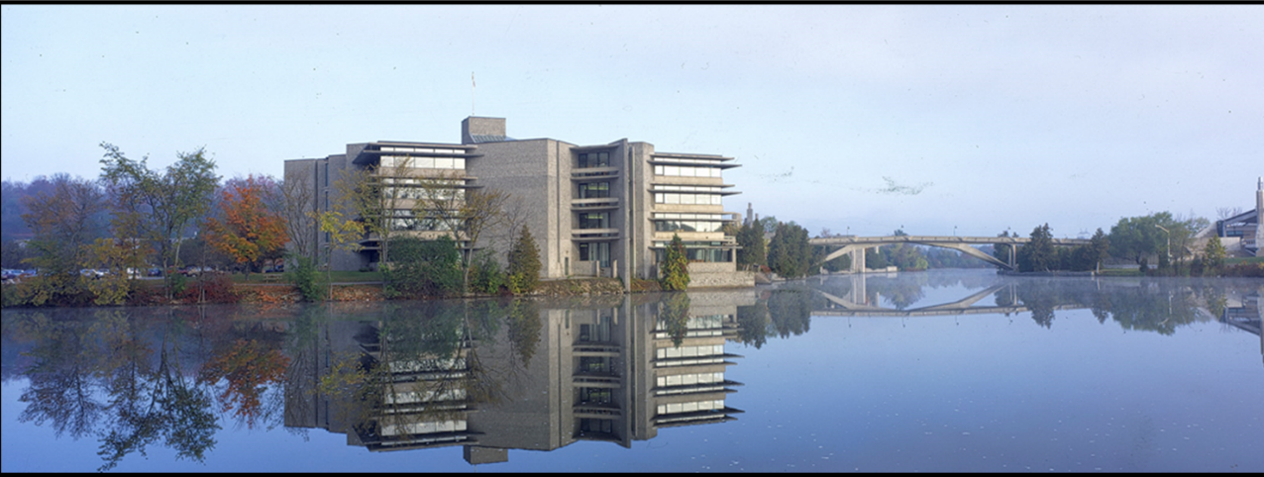
Additional Funding Opportunities

Slide 31
Indigenous Student Researchers
Indigenous Scholars Awards and Supplements
If you identify as an Indigenous student and apply for the CGRS-M, you may be eligible for additional funding.
✅ CGRS-M recipients may receive an additional $5,000 Indigenous Scholars Supplement.
✅ Applicants on the alternate list may receive an Indigenous Scholars Award ($27,000) plus a $5,000 Indigenous Scholars Supplement.
✅ Funding is available while funds last.
✅ Successful applicants must provide documentation confirming Indigenous citizenship or membership in accordance with Tri-Agency requirements.
Key Takeaway: Indigenous students applying for CGRS-M may be eligible for additional funding support beyond the regular scholarship.
For more information refer to the Indigenous Scholars Awards and Supplements Pilot Initiative web page.

Slide 32

Black Scholars
The Government of Canada has provided additional funds to increase direct support for Black student researchers.
CGRS M applicants who self-identify as Black and provide consent in their application to be considered for funds designated for specific groups may be selected to receive this funding.
Each agency has up to 20 additional CGRS M awards reserved for Black student researchers.

Slide 33
Regulations, Policies, and Guidelines

Slide 34
CGRS-M Regulations, Policies, and Guidelines
Within the instructions for the CGRS-M are some key policies I would encourage applicants to review quickly.
Individual development plans
Equity, diversity and inclusion
San Francisco Declaration on Research Assessment
The first point of contact for the CGRS M program is graduatefinance@trentu.ca also a potential supervisor who you are interested in working with for your graduate studies.
For questions about submitting an application:
to CIHR, contact cgrsm-besrcm@cihr-irsc.gc.ca
to NSERC, contact nsercscholarships-boursescrsng@nserc-crsng.gc.ca
to SSHRC, contact fellowships@sshrc-crsh.gc.ca

Slide 35


Sex and Gender Based Analysis + (SGBA+)
When applicable, indicate how diversity (gender, sex, age, race, culture, religion, etc.) is considered in your proposed research (from its design to the analysis of the research findings).
Incorporating the principles of SGBA+ in research has the potential to increase the thoroughness and usefulness of the research.
How to Integrate Sex and Gender into Research
What is Gender? What is Sex?
Online training modules:
  Sex and Gender in Biomedical Research
  Sex and Gender in Primary Data Collection with Human Participants
  Sex and Gender in the Analysis of Secondary Data from Human Participants

Slide 36

Guides for Assessment of Contributions
Other guides that help clarify your qualifications include:
Guidelines on the Assessment of Contributions to Research, Training and Mentoring
San Francisco Declaration on Research Assessment (DORA)
* These links are filled with valuable information necessary produce a winning application

Slide 37

Six Keys to a Strong Application
Keys to a strong application
Apply to the correct agency.
Understand the selection criteria and evaluation process.
Develop a focused and feasible research proposal.
Create an application that showcases your achievements and demonstrates how you meet the selection criteria.
Give referees sufficient time to prepare strong reference letters.
Revise, edit, and seek feedback early.
Key takeaway from presentation:
What reviewers are looking for
How selection criteria are weighted
How to write a strong proposal
How to choose strong referees

Slide 38
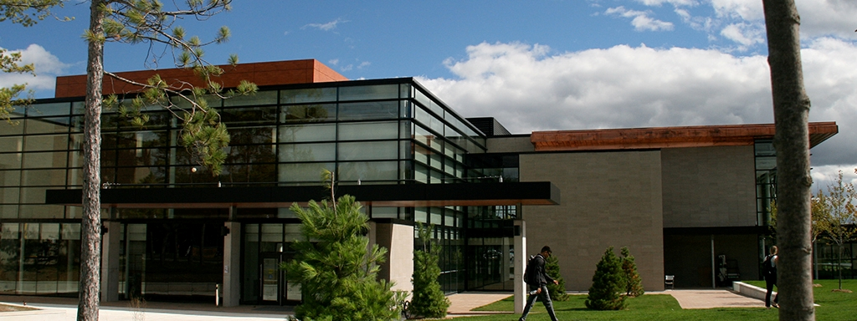
School of Graduate Studies
Blackburn Hall, Suite 115
All scholarship inquires direct to: graduatefinance@trentu.ca

