Slide 1

Scholarship Applications
Outline of Proposed Research
(CGRS-M)
2026-27
Developing a competitive CGRS-M Research Proposal – for first time applicants, new to drafting a proposal
Jane Rennie
Graduate Finance Officer
School of Graduate Studies
Notes:
By the end of this resource, you will understand what must be included in a competitive CGRS-M Outline of Proposed Research.
Competitive CGRS-M proposals are not expected to resemble doctoral grant applications. Reviewers assess research potential relative to an applicant's career stage.

Slide 2


Outline of Proposed Research
A strong proposal answers three questions:
What problem?
How will you study it?
Why does it matter?
Trent Tri Agency Competitions:
Canada Graduate Research Scholarships – Master’s Program instructions, scroll to review Outline of Proposed research
Application deadline
The deadline for CGRS M applications is December 1 before 8:00 pm (ET). Complete applications must be submitted by the deadline using the Research Portal .
Notes:
Topic Research Question
Mental Health How does funding uncertainty affect graduate student mental health?

Slide 3
CGRS M Selection Criteria 50 %
Research Potential 30%
As demonstrated by your research history, your interest in discovery, the proposed research, its potential contribution to the advancement of knowledge in the field and any anticipated outcomes
Indicators of research potential:
quality and originality of research
significance, feasibility and proposed research
sound judgment and critical thinking
ability to apply skills and knowledge
initiative and autonomy
research experience and achievements
Personal characteristics and interpersonal skills 20%
As demonstrated by your past professional and relevant extracurricular interactions and collaborations
Indicators of personal characteristics and interpersonal skills:
work experience
leadership experience
project management
ability or potential to communicate theoretical, technical or scientific concepts clearly and logically
Community engagement
Volunteerism
Notes:
It is important to consider your entire application in relation to the selection criteria. Reviewers assess all components of the application; however, the Outline of Proposal is one of the most significant elements used to evaluate an applicant's research potential and the quality and feasibility of the proposed research.

Slide 4
What Reviewers Want to See
Research Potential (30%) Personal Characteristics (20%)
Strong research idea Leadership
Clear knowledge gap Communication
Feasible methodology Teamwork
Critical thinking Community engagement
Research experience Initiative
Reviewer Questions
✅ Can this applicant do research?
✅ Is the project worth funding?
✅ Will the applicant contribute to the field?

Slide 5

From instructions Step 4. Outline of proposed research (attachment)
Maximum 1 page
Provide a clear and detailed description of your proposed research during the award period.
Include:
  Research background and context within the current literature
  Research objectives and hypothesis/research question
  Experimental, theoretical, or methodological approach
  Key methods and procedures
  Significance and expected contribution to the field
If the degree involves an artistic creation, clearly identify:
  The research component
  Objectives
  Context and methodology
  Contribution to knowledge
If the program is non-thesis based, clearly describe the research component of the degree.
Applicants who have not finalized a specific project must still provide a detailed proposed research plan.

Slide 6
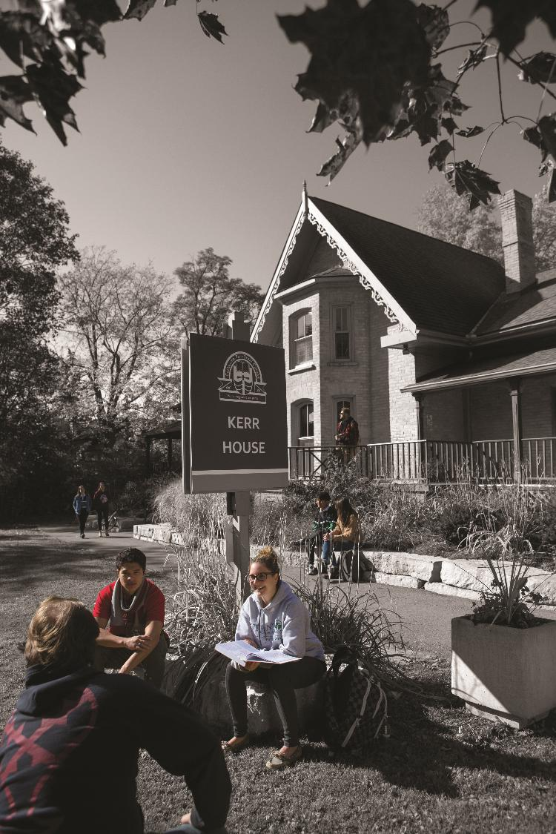
Bibliography and Citations
Maximum 1 page
Include references cited in the research proposal.
Ensure citations are complete, accurate, and relevant to the proposed work.
Important Reminder
One-page research proposal
One-page bibliography/citations
Applications exceeding page limits may have excess pages removed and could be disadvantaged during review.
NOTE
5-9 strong citations are typically sufficient
Use foundational and recent literature
Do not waste space on citing obvious facts
Notes:
Write your research proposal independently and to properly reference ideas or text belonging to others.
Seek feedback from colleagues and supervisors.

Slide 7


From Idea to Research Question
Stage Example
Interest Mental health
Topic Graduate student mental health
Problem Rising psychological distress
Gap Limited evidence on impact of funding uncertainty
Research Question How does doctoral funding uncertainty influence psychological well-being throughout graduate training?
Interest Cancer
Topic Breast cancer detection
Problem False negatives
Gap Limited evaluation in rural populations
Question How does AI-assisted screening affect detection rates in rural healthcare systems?

Slide 8
Building a Compelling Research Proposal Narrative
Demonstrate what is known and, more importantly, what remains unknown.
Move the reader from: Current Knowledge → Limitation → Gap
Summarize relevant research literature.
Highlight limitations, contradictions, or missing evidence.
Clearly state the specific gap your research addresses.
The strongest proposals make reviewers think: "This research needs to be done."
Create a memorable statement that establishes urgency, novelty, or potential impact.
Capture the reviewer's attention by identifying an important challenge, unanswered question, or pressing issue in your field.
Problem → Current Knowledge → Gap → Hook → Research Question → Methods → Impact
Notes:
Weak
Climate change impacts northern ecosystems. This study will investigate climate change and northern ecosystems.
Strong
Although climate change impacts on northern ecosystems have been well documented, little is known about how changing winter conditions influence microbial nutrient cycling. This study will investigate...

Slide 9

How to Identify a Knowledge Gap
A step-by-step process:
Read 5-10 recent articles
Note what they studied
Note limitations authors mention.
Identify populations, contexts, or variables not examined.
Build your question from that gap.
Notes:
Common mistake "Nobody has studied this.“
Vs
Real gap
population not studied
theory not tested
method not compared
context not examined

Slide 10



How much detail is necessary to explain the gap in one page Outline of Proposed Research?
Too Vague
This study examines student well-being.
Better
This study examines how doctoral funding uncertainty influences psychological well-being among Canadian doctoral students.
Strong
This mixed-methods study will investigate how funding uncertainty influences psychological well-being and persistence among doctoral students across Canadian universities through surveys and interviews.

Slide 11

Common Reviewer Critiques
Weak
Topic too broad
No identifiable gap
Method does not answer research question
Significance overstated
Objectives unclear
Strong
Specific gap
Feasible project
Appropriate methods
Clear contribution
Reviewer Comment Examples
"Objectives are insufficiently defined."
"Methodology lacks justification."
“Project is too far reaching, and not feasible.”
“Research question is unclear.”
Notes:
Example: "Methodology lacks justification.“
Fix: "Explain why interviews are preferable to surveys."

Slide 12

Various Frameworks of an Outline of Proposed Research
There is no single correct structure, but successful proposals all tell a coherent research story.

Slide 13
Various Proposal Frameworks
Hour-Glass Style
Inverted Triangle
Background of research, broad overview
Introduce important concepts, what is known and what is unknown
Research question
Methodology
Data analysis
Contribution to knowledge in field and broader impact
Big picture, relevance/importance of problem
Theoretical Frame: Situate study in body of theory
Research question
Methodology: Underlying approach to the research
Method: How will you do it?
Data analysis
Dissemination of research
Notes:
Weak
Climate change affects northern ecosystems.
Better
Although climate change impacts on northern ecosystems have been extensively documented, relatively little is known about how changing winter conditions influence microbial nutrient cycling, limiting predictions of ecosystem resilience.
The second example immediately demonstrates: context, gap, significance

Slide 14

Sample Structure of an Outline of Proposed Research
Introduction / Background
Brief context of the research area.
Why this topic is important (significance and relevance).
Identify the gap your research addresses.
Research Objectives
State the main goal(s) of your research.
Include 2–3 specific objectives or research questions.
Methodology
Summarize your approach (qualitative, quantitative, mixed methods).
Key techniques, tools, or data sources.
Why this method is appropriate.
Expected Outcomes
What you aim to discover or achieve.
Potential impact on the field or society.
Significance
How your research contributes to knowledge, policy, or practice.
Any innovative aspects.

Slide 15
Anatomy of a Strong Opening Paragraph
Problem What is the issue?
Graduate student mental health has become a growing concern across Canadian universities.
Current Knowledge What do we know?
Existing research has identified workload, isolation, and supervisory relationships as important contributing factors.
Gap What remains unknown?
However, little is known about how doctoral funding uncertainty influences psychological well-being throughout graduate training.
Importance Why does that matter?
Addressing this gap may help institutions better support student retention and success.
Research Question What will your study address?
This study will investigate how doctoral funding uncertainty affects graduate student well-being.
Problem → Current Knowledge → Gap → Importance → Research Question
Notes:
Practice Exercise
Weak
Mental health concerns among graduate students have been increasing. Many students experience stress and burnout. Universities have implemented various supports.
The reviewer finishes reading and thinks ok and so now what?
Stronger
Graduate student mental health has become a growing concern across Canadian universities, with increasing attention devoted to stress, burnout, and academic well-being. Existing research has identified several institutional and personal factors associated with these outcomes. However, little is known about how doctoral funding uncertainty influences psychological well-being throughout graduate training. Addressing this gap may improve understanding of factors contributing to student success and retention.
Notice the structure:
Claim → Evidence → Gap → Importance

Slide 16
Simplified Example of a CGRS M Research Proposal
BACKGROUND & CONTEXT
Graduate student mental health has become an increasing concern across Canadian universities. Studies have identified academic workload, isolation, and supervisory relationships as factors contributing to student stress and burnout.
✅ What reviewers see: Demonstrates awareness of the literature and establishes context.
KNOWLEDGE GAP
However, relatively little research has examined how uncertainty regarding doctoral funding influences psychological well-being throughout graduate training. Existing studies have focused primarily on workload and academic performance outcomes.
✅ What reviewers see: A clear gap in knowledge.⭐ Most important sentence in the proposal.
RESEARCH QUESTION
This study will investigate how doctoral funding uncertainty affects student well-being, academic persistence, and perceptions of future career success.
✅ What reviewers see: A focused and answerable question.

Slide 17
Simplified Example of a CGRS M Research Proposal
METHODS
Using a mixed-methods approach, doctoral students from Canadian universities will be surveyed regarding funding security and mental health indicators. Semi-structured interviews will provide additional insight into student experiences. Quantitative data will be analyzed using regression analysis, while interview data will be coded thematically.
✅ What reviewers see: Appropriate methodology ~ Feasible project ~ Methods align with question
SIGNIFICANCE & IMPACT
Findings will improve understanding of factors affecting doctoral student success and may inform institutional funding policies and student support initiatives. The project will contribute to the growing literature on graduate student well-being and retention.
✅ What reviewers see: Clear contribution and broader impact.
Notice how the proposal moves logically from: Background → Gap → Question → Methods → Impact.
This structure is more important than the specific framework chosen.

Slide 18
Research Proposal Checklist
Proposal Component Reviewer Question Answered?
Background Is the applicant familiar with the field? ✅
Gap What is currently unknown? ✅
Research Question What will be studied? ✅
Methodology How will the question be answered? ✅
Feasibility Can this be completed during the award period? ✅
Significance Why does it matter? ✅

Slide 19

Tri Agency Tips
Make sure your application is complete, clear, concise, consistent and free of errors.
Check spelling and grammar;
Use concise and complete sentences;
Avoid jargon and excessive use of acronyms.
Clearly articulate the gap;
Demonstrate strong communication skills as you clearly state your objectives, your research question and the expected results.
Present a clearly defined methodology and demonstrate how you expect to achieve your results.
Your research proposal/program of work should highlight your potential contribution to the advancement of knowledge.
Notes:
Tri-Agency Program Officers review thousands of applications every year, yet they continue to emphasize the same recommendations: avoid jargon and excessive acronyms, use clear and complete sentences, and thoroughly check spelling and grammar. There is a reason this advice continues to appear in official guidance. Applicants repeatedly make these mistakes and continue to lose valuable points as a result. Do not dismiss these comments as basic or obvious. Strong research ideas can be undermined by poor communication. Ask others to review your outline and provide candid feedback. If your proposal is difficult to read or understand, revise it before submission. Clarity is not optional; it is an essential component of a competitive application.

Slide 20
Presentation Standards
Tri Council standards
(NSERC Example)
Presentation Standards Checklist
✅ File name requirements, max 15 characters
✅ Page limits
✅ No password protection
✅ Follow agency standards
✅ Submit complete attachments
Review the instructions and ensure you follow.

Slide 21

Equity, Diversity & Inclusion
The academic research funding ecosystem must create a culture where embedding equity, diversity and inclusion (EDI) considerations into all aspects of research is second nature.
Incorporating EDI considerations in your proposal and throughout your application, where relevant, can strengthen your application. This will be taken into consideration by the selection committee members during the adjudication process.
Tri-Agency Resources:
Guide for Applicants: Considering Equity, Diversity and Inclusion in your Application
Equity, Diversity and Inclusion (multiple)
Only discuss EDI where it is relevant and meaningful.

Slide 22



Research Involving and Engaging Indigenous Peoples
Below are SSHRC resources to support applicants working in Indigenous research; merit reviewers assessing applications related to Indigenous research; and communities and other research partners engaged in Indigenous research:
Definition of Indigenous research
Indigenous Leadership Circle in Research
Indigenous Research Statement of Principles
Tri-Council Policy Statement: Ethical Conduct for Research Involving Humans Chapter 9: Research Involving the First Nations, Inuit and Métis Peoples of Canada
Notes:
Indigenous research is not simply research about Indigenous Peoples.

Slide 23
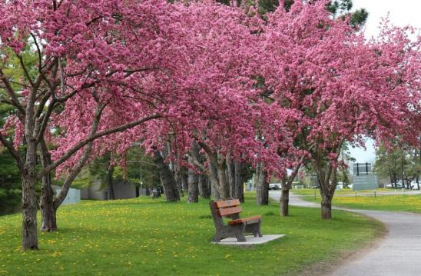

Resources for Scholarship Applications
Guidelines on the Assessment of Contributions to Research, Training and Mentoring
Health Research Training at CIHR: Training Tools
Guidelines for effective research training
Training Resources (“Career Hub”)
OTHER RESOURCES
Academic Skills
Faculty feedback recommendations
Samples of successful proposals

Slide 24
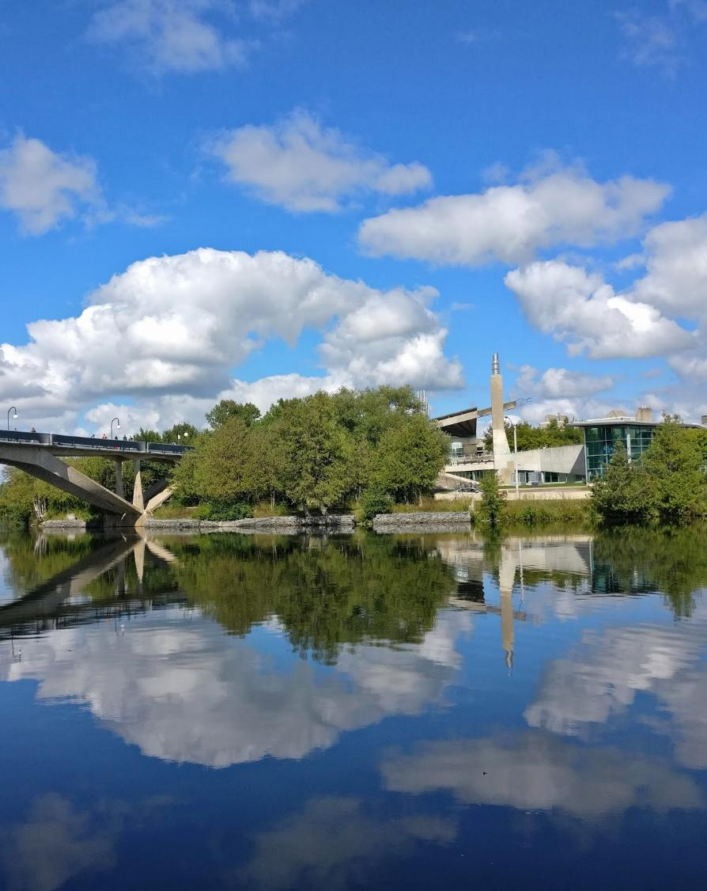
School of Graduate Studies
Blackburn Hall, Suite 115
Scholarship inquires: graduatefinance@trentu.ca
Important: This resource is intended to support planning and self-assessment. It highlights common requirements and best practices but may not capture all program requirements, evaluation criteria, or individual circumstances. Applicants should consult official program guidelines and requirements when preparing their submission.

