Slide 1

Scholarship Applications
Outline of Proposed Research
DOCTORAL (CGRS-D)
2026-27
Developing a competitive CGRS-D Research Proposal
Jane Rennie
Graduate Finance Officer
School of Graduate Studies

Slide 2

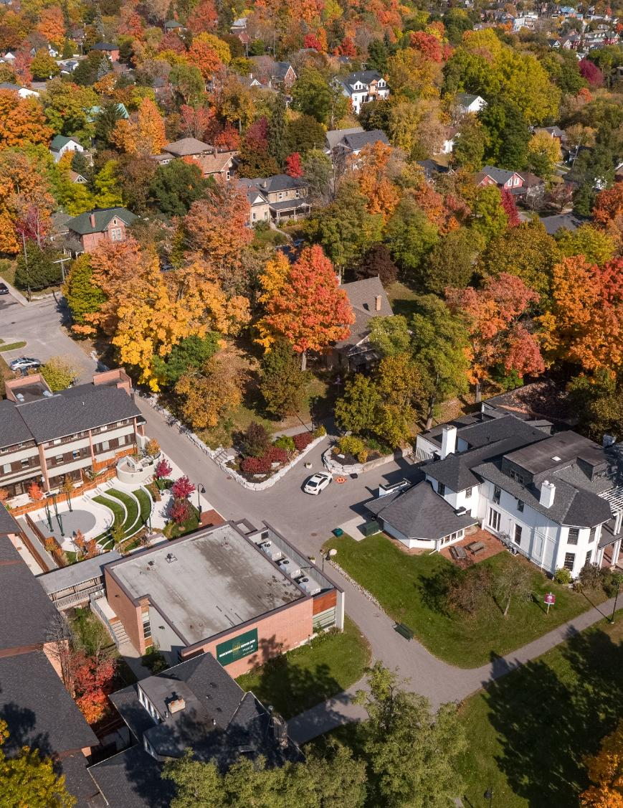
Outline of Proposed Research
It is challenging to develop a winning scholarship application if you do not read the scholarship program description completely first and understand all its required components.
Within the Outline of Proposed Research, it must:
be specific, focused and outline feasible research questions/objectives
include a clear description and soundness of the proposed methodology
outline the significance and expected contributions to research
Trent Tri Agency Competitions:
Canada Graduate Research Scholarships – Master’s Program instructions, scroll to review Outline of Proposed research
Canada Graduate Research Scholarships – Doctoral Program click “Application” then select which agency NSERC, SSHRC, CIHR instruction you need.
Notes:
Before you write, consider how the reviewers evaluate the proposal.

Slide 3
CGRS D Selection Criteria 50 %
Research Potential 50%
Indicators of research potential: quality of research proposal:
  specific, focused and feasible research question(s) and/or objective(s)
  clear description and soundness of the proposed methodology
  significance and expected contributions to research
demonstration of potential to carry out proposed research relative to the stage of study, lived experience and knowledge systems
quality of contributions and extent to which they advance the field of research–contributions may include publications, patents, reports, posters, abstracts, monographs, presentations, creative outputs, knowledge translation outputs, community products, etc.
demonstration of sound judgment and ability to think critically
integration of EDI considerations (if applicable) NEW
demonstration of responsible and ethical research conduct, including honest and thoughtful inquiry, rigorous analysis, commitment to safety and dissemination of research results and adherence to professional standards
demonstration of originality, initiative, autonomy, relevant community involvement and outreach
ability to communicate theoretical, technical and/or scientific concepts clearly and logically in written and oral formats
quality of presentation of application NEW
Notes:
Reviewers ask:
Is the project important?
Is the methodology sound?
Can this applicant accomplish the work?

Slide 4
CGRS D Selection Criteria 50%
Relevant Experience and Achievements obtained within & beyond academia 50%
relevant training, such as academic training, lived experience and traditional teachings
scholarships, awards and distinctions (amount, duration, and prestige)
academic record:
  transcripts, duration of previous studies
  program requirements and courses pursued, course load
  relative standing in program (if available)
professional, academic, and extracurricular activities, as well as collaborations with supervisors, colleagues, peers, students and members of the community, such as:
  teaching, mentoring, supervising and/or coaching
  managing projects
  participating in science and/or research promotion
  participating in community outreach, volunteer work, and/or civic engagement
  chairing committees and/or organizing conferences and meetings
  participating in departmental or institutional organizations, associations, societies and/or clubs
Notes:
When discussing Academic Excellence:
Canadian Studies example: Academic publications, Public engagement activities
Psychology example: Peer-reviewed publication, Poster presentation, Conference presentation, Statistics training
When discussing Research Potential:
Canadian Studies: Community-engaged projects, Knowledge mobilization initiatives
Psychology: Lab involvement, Research assistantships, Data collection leadership, Manuscript preparation, Study design contributions

Slide 5
Presentation Standards
Tri Council standards
(NSERC Example)
Documents that have been password protected cannot be read and, therefore, cannot be attached.
The filename of a document should be fewer than 15 characters long and cannot contain special characters (excluding the underscore).
Any section that is not used for its intended purpose may be redacted or removed from the application.
You are responsible for uploading a complete application that aligns to the NSERC online presentation and attachment standards. (SSHRC Standards)
Incomplete applications and applications that do not meet presentation standards may be rejected or may be at a disadvantage in comparison to those that are complete and respect the presentation standards.
Review the instructions and ensure you follow.

Slide 6



What reviewers expect to find in the two pages of an outline of proposed research.

Slide 7
NSERC Doctoral Instructions
Outline of Proposed Research
An Outline includes:
Provide a detailed yet concise description of your proposed research project for the period during which you are to hold the award.
Be as specific as possible.
Provide background information to position your proposed research within the context of the current knowledge in the field.
State the significance of the proposed research to a field or fields in the Natural Sciences and Engineering.
State the objectives, hypothesis, and outline the experimental or theoretical approach to be taken (citing literature pertinent to the proposal) and the methods and procedures to be used.
If the proposed research is a continuation of your thesis, clearly state the differences between work done for your thesis and the research activities outlined in this proposal.
Write your proposal in clear, plain language, and avoid jargon. Your application will be evaluated by a review committee covering a broad discipline category.
Include all relevant information in the outline. Do not refer review committee members to URLs or other publications for supplemental information. Such additional information will not be reviewed.
Notes:
Write your research proposal independently and to properly reference ideas or text belonging to others.
Seek feedback from colleagues and supervisors.

Slide 8
SSHRC Doctoral Instructions: Research Proposal
If you are not currently enrolled in a doctoral degree program:
clearly state your current level of study;
give the title and a brief description of your master’s thesis or research project, if applicable;
provide an outline of your doctoral thesis or research project, including: research question(s), context, objectives, methodology, significance and expected contribution to advancing knowledge, as well as your special interests in the proposed research area.
If you are currently enrolled in a doctoral degree program:
clearly state your current level of graduate study;
indicate what stage you are at in your thesis/research project;
provide the name of your supervisor of doctoral studies, if known;
provide an outline of your thesis or research project, including, for example, the research question(s), context, objectives, methodology, significance and expected contributions to advancing knowledge; and
describe what you hope to accomplish during the award tenure and what will remain for you to complete to obtain your degree.

Slide 9
CIHR: Research Project Summary
The research project summary (1 page) must:
clearly describe the applicant's role in the project.
be written in general scientific language, which is an important skill to acquire for future success in the research environment as applications are being reviewed by multi-disciplinary committees.
be specific, focused, include feasible research question(s), objective(s) and provide a clear description of the proposed methodology.
Training expectations (2 pages)
Describe their professional, academic and extracurricular experiences/achievements and how it will contribute to their training success.
Describe how the training they expect to acquire will contribute to their professional development and career goals and to the research goals they hope to achieve.
Describe how their expected training strives to foster impacts within and beyond the research environment and will contribute to the research ecosystem during and beyond the tenure of the award.
Explain why they decided to obtain training at the proposed institution and what they expect to learn from the training experience.
Regardless of agency, all successful proposals demonstrate: Question → Methods → Significance → Feasibility
Notes:
CIHR instructions and application is different than NSERC and SSHRC but still need key components included within the application.

Slide 10


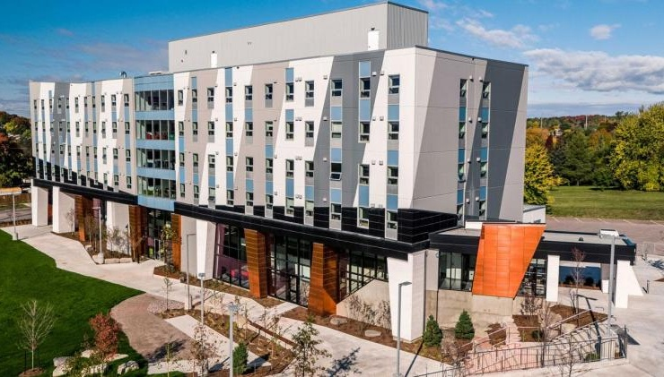
Various Frameworks of an Outline of Proposed Research
There is no single correct structure, but successful proposals all tell a coherent research story.

Slide 11
Various Proposal Frameworks
Hour-Glass Style
Inverted Triangle
Background of research, broad overview
Introduce important concepts, what is known and what is unknown
Research question
Methodology
Data analysis
Contribution to knowledge in field and broader impact
Big picture, relevance/importance of problem
Theoretical Frame: Situate study in body of theory
Research question
Methodology: Underlying approach to the research
Method: How will you do it?
Data analysis
Dissemination of research
Notes:
Weak
Climate change affects northern ecosystems.
Better
Although climate change impacts on northern ecosystems have been extensively documented, relatively little is known about how changing winter conditions influence microbial nutrient cycling, limiting predictions of ecosystem resilience.
The second example immediately demonstrates: context, gap, significance

Slide 12

Framework Breakdown
Research Outline
Main Challenge or Issue: What problem are you addressing?
What’s Known and Unknown: Briefly explain what researchers already know and what research gaps remain unknown.
Research Questions: What specific questions will your research try to answer?
Theoretical and Methodological Framework: What theories and methods will guide your research?
Proposed Methods: What steps or techniques will you use to carry out the research?
Contribution to Knowledge: How will your findings advance your field or help other areas of research?
Public Good / Social Impact: How could your research benefit society or make a positive difference?

Slide 13
An outline of proposed research should clearly and concisely communicate a research plan, its significance, and the approach.
1. Research Problem or Challenge
Clearly state the issue your research addresses.
Explain why it matters—scientifically, socially, or economically.
2. Background and Knowledge Gaps
Summarize what is already known in the field.
Identify gaps in knowledge that your research will fill.
3. Research Questions or Objectives
List the key questions your research aims to answer.
These should align with your overall goals and be specific and measurable.

Slide 14
Continued
4. Methodology or Approach
Describe how you will conduct your research.
Include details on data collection, analysis techniques, and tools or models you'll use.
Justify why this approach is suitable for answering your research questions.
5. Expected Outcomes or Hypotheses
Outline what you expect to find or demonstrate.
Include any hypotheses you’re testing and explain how they relate to the research questions.
6. Timeline and Milestones
Break down your research into phases.
Include key milestones and estimated completion dates for each stage.
7. Significance and Impact
Explain how your research will contribute to the field.
Discuss potential applications, policy implications, or societal benefits.

Slide 15

Sample Structure of an Outline of Proposed Research
Introduction / Background
Brief context of the research area.
Why this topic is important (significance and relevance).
Identify the gap your research addresses.
Research Objectives
State the main goal(s) of your research.
Include 2–3 specific objectives or research questions.
Methodology
Summarize your approach (qualitative, quantitative, mixed methods).
Key techniques, tools, or data sources.
Why this method is appropriate.
Expected Outcomes
What you aim to discover or achieve.
Potential impact on the field or society.
Timeline
High-level milestones (e.g., literature review, data collection, analysis, writing).
Significance
How your research contributes to knowledge, policy, or practice.
Any innovative aspects.

Slide 16
Building a Compelling Research Proposal Narrative
Capture the reviewer's attention by identifying an important challenge, unanswered question, or pressing issue in your field.
Ask yourself:
What problem needs to be solved?
Why is this problem important now?
Who or what is affected if it remains unresolved?
A strong opening convinces reviewers that the problem is significant and worth funding.
Demonstrate what is known and, more importantly, what remains unknown.
Move the reader from: Current Knowledge → Limitation → Gap
Summarize relevant research literature.
Highlight limitations, contradictions, or missing evidence.
Clearly state the specific gap your research addresses.
The strongest proposals make reviewers think: "This research needs to be done."
Create a memorable statement that establishes urgency, novelty, or potential impact.
Problem → Current Knowledge → Gap → Hook → Research Question → Methods → Impact

Slide 17

Anatomy of a Strong Opening Paragraph
Suggestion:
Problem What is the issue?
↓
Current Knowledge What do we know?
↓
Gap What remains unknown?
↓
Importance Why does that matter?
↓
Research Question What will your study address?
Notes:
Practice Writing – EDIT
Weak
Mental health concerns among graduate students have been increasing. Many students experience stress and burnout. Universities have implemented various supports.
The reviewer finishes reading and thinks ok and so now what?
Stronger
Graduate student mental health has become a growing concern across Canadian universities, with increasing attention devoted to stress, burnout, and academic well-being. Existing research has identified several institutional and personal factors associated with these outcomes. However, little is known about how doctoral funding uncertainty influences psychological well-being throughout graduate training. Addressing this gap may improve understanding of factors contributing to student success and retention.
Notice the structure:
Claim → Evidence → Gap → Importance

Slide 18

Tri Agency Tips
Make sure your application is complete, clear, concise, consistent and free of errors.
Check spelling and grammar;
Use concise and complete sentences;
Avoid jargon and excessive use of acronyms.
Not articulating the knowledge gap;
Demonstrate strong communication skills as you clearly state your objectives, your research question and the expected results.
Present a clearly defined methodology and demonstrate how you expect to achieve your results.
Your research proposal/program of work should highlight your potential contribution to the advancement of knowledge.

Slide 19




Research Funding Concepts
Notes:
To draft a written proposal you need to understand the funding concepts that influence the research funding ecosystems and the reviewers.

Slide 20

Equity, Diversity & Inclusion
The academic research funding ecosystem must create a culture where embedding equity, diversity and inclusion (EDI) considerations into all aspects of research is second nature.
Incorporating EDI considerations in your proposal and throughout your application, where relevant, can strengthen your application. This will be taken into consideration by the selection committee members during the adjudication process.
Tri-Agency Resources:
Guide for Applicants: Considering Equity, Diversity and Inclusion in your Application
Equity, Diversity and Inclusion (multiple)
Only discuss EDI where it is relevant and meaningful.

Slide 21


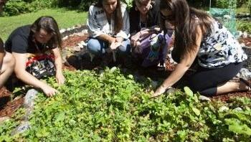
Research Involving and Engaging Indigenous Peoples
Below are SSHRC resources to support applicants working in Indigenous research; merit reviewers assessing applications related to Indigenous research; and communities and other research partners engaged in Indigenous research:
Definition of Indigenous research
Indigenous Leadership Circle in Research
Indigenous Research Statement of Principles
Tri-Council Policy Statement: Ethical Conduct for Research Involving Humans Chapter 9: Research Involving the First Nations, Inuit and Métis Peoples of Canada
Notes:
Indigenous research is not simply research about Indigenous Peoples.

Slide 22



Sex and Gender Based Analysis + (SGBA+)
When applicable, indicate how diversity (gender, sex, age, race, culture, religion, etc.) has been considered in your proposed research (from its design to the analysis of the research findings).
Incorporating the principles of SGBA+ in research has the potential to increase the thoroughness and usefulness of the research.
Multiple resources provided:
How to Integrate Sex and Gender into Research
Online training modules:
  Course 1: Sex and Gender Considerations in Biomedical Research
  Course 2: Sex and Gender in Primary Data Collection with Human Participants
  Course 3: Sex and Gender in the Analysis of Secondary Data from Human Participants

Slide 23



Knowledge Mobilization
Knowledge mobilization is an umbrella term encompassing a wide range of activities relating to the production and use of research results, including knowledge synesis, dissemination, transfer, exchange, and co-creation or co-production by researchers and knowledge users.
Resources from Tri-Council
Guidelines for effective knowledge mobilization
Related policies and web links
Canadian Knowledge Transfer and Exchange Community of Practice website
Mapping the Impact of Research (PDF, 1.07 MB), David Phipps, York University

Slide 24


Resources for Scholarship Applications
Guidelines on the Assessment of Contributions to Research, Training and Mentoring
Health Research Training at CIHR: Training Tools
Guidelines for effective research training
Training Resources (“Career Hub”)
OTHER RESOURCES
Academic Skills
Faculty feedback recommendations
Samples of successful proposals

Slide 25

School of Graduate Studies
Blackburn Hall, Suite 115
All scholarship Applications inquires direct to: graduatefinance@trentu.ca

