Slide 1

Trent Graduate Scholarships
Overview 2026-27
Jane Rennie
Graduate Finance Officer
School of Graduate Studies

Slide 2

Land Acknowledgement
“We respectfully acknowledge that we are on the treaty and traditional territory of the Michi Saagiig Anishinaabeg.
We offer our gratitude to the First Peoples for their care for, and teachings about, our earth and our relations. May we honour those teachings.”

Slide 3
Outline of Overview
Scholarship landscape at Trent
Major funding opportunities
Understanding evaluation criteria
Preparing strong applications
Reference letters and referee support
Research funding considerations
Questions and resources

Slide 4

Which Scholarship should I focus on?
Student Type | Start With
UG, 1st Yr Master’s | CGRS-M, OGS, Donor, Direct funding opportunities
Doctoral | CGRS-D, OGS, Donor, Direct funding opportunities
All Students | Program funding, donor awards and direct funding opportunities

Slide 5

Graduate Scholarship Pathway
Step 1: Identify opportunities
Step 2: Confirm eligibility
Step 3: Review evaluation criteria
Step 4: Prepare application materials
Step 5: Request references
Step 6: Submit and track deadlines

Slide 6

Finding Graduate Funding Opportunities

Slide 7

Various Types of Scholarships
As you begin exploring scholarship and funding opportunities, it is helpful to understand the main funding categories available:
Program Funding
  Entrance scholarships
  Graduate funding packages
  Program-specific awards and bursaries
Major External Scholarships & Awards (Internal Nomination Required)
  Tri-Agency scholarships (CIHR, NSERC, SSHRC)
  Ontario Graduate Scholarship (OGS)
  Agency-specific supplements and special funding opportunities
Trent University Donor-Funded Scholarships and Awards
  Scholarships, awards, and bursaries funded through donor support
External Funding Opportunities (Apply Directly)
  Scholarships and awards offered by external organizations
  Research internships and fellowships (e.g., Mitacs Accelerate)
  Professional association and foundation-based funding

Slide 8
Categories of Donor Scholarships
Program Scholarships
Program scholarships are funding opportunities administered by your graduate program.
Entrance scholarships are awarded as part of the admission process and are outlined in your offer of admission.
Graduate programs may offer additional scholarship, award, or funding opportunities throughout the academic year.
Your graduate program is responsible for promoting these opportunities, receiving applications, and coordinating the adjudication process.
Successful applicants will be notified by their graduate program.
Donor Scholarships
Donor scholarships are funded by individuals, organizations, or foundations to support students who meet eligibility criteria.
Eligibility requirements vary by scholarship and are based on the donor’s terms and priorities.
Carefully review eligibility and application requirement before applying.
Some donor scholarships require a direct application, while others are administered through the School of Graduate Studies.
Tailor your application to the specific criteria and objectives of the scholarship.
Review opportunities: Scholarships and Awards

Slide 9

Sample Trent Donor Scholarship
Thomas J. Bata Memorial Graduate Scholarship
This fund was established by Sonja Bata and the Bata family in honour of Thomas J. Bata (1914-2008), recognizing his longstanding commitment to Trent University. Mr. Bata was one of Trent's original honorary sponsors, served on the University's Board of Governors from 1963 to 1973, and was a close friend and supporter of Trent's Founding President, Professor T.H.B. Symons. Through his leadership, philanthropy, and dedication to education, Mr. Bata made a lasting contribution to the University and its community. This scholarship celebrates his legacy by supporting future generations of Trent students.
The Bata Memorial Graduate Scholarship is a $5,000 scholarship intended to support a student that demonstrates leadership qualities:
Innovation
Entrepreneurship,
Community responsibility
Global citizenship.
Deadline: October 9, 2026

Slide 10
Graduate Scholarship Competitions – with internal Trent Deadlines
External Scholarships and Funding (Internal Trent Competition)
Many major external scholarships are government-funded and require applicants to first compete through an internal Trent University selection process. Examples include:
Canada Graduate Research Scholarship – Doctoral Program (NSERC, SSHRC & CIHR)
Canada Graduate Research Scholarship – Master’s Program (NSERC, SSHRC & CIHR)
Ontario Graduate Scholarship
Queen Elizabeth II Ontario Graduate Scholarship in Science and Technology
Mackenzie King Open and Travelling Scholarship
Applications must be submitted by Trent's internal deadline, which is typically several weeks before the external agency deadline.
All applications are reviewed for eligibility and assessed by the Graduate Scholarships Committee. Top-ranked applications are then forwarded to the external funding agency in accordance with Trent's allocated quota, where applicable.

Slide 11
Tri-Council Scholarship Opportunities
Canada Graduate Research Scholarships – Doctoral Program
The Canada Graduate Research Scholarships – Doctoral (CGRS D) program supports outstanding doctoral students who demonstrate academic excellence and strong research potential. Administered by CIHR, NSERC, and SSHRC, the program helps develop the next generation of researchers and supports research across a wide range of disciplines.
At Trent, applications are first reviewed through an internal competition. Each agency assigns the University a quota, which is the maximum number of applications that can be forwarded to the national competition. Only the top-ranked eligible applications are advanced.
Trent Internal Deadline: October 16, 2026
*Students currently registered in a Trent master's or doctoral program must submit their application through Trent's internal competition process in order to be considered for nomination.
Tri Council Links to the Application Portal & Instructions
                NSERC: Online system and Instructions
                CIHR: ResearchNet and Instructions
                SSHRC: Online system and Instructions

Slide 12

Tri-Council Scholarship Opportunities (Master’s)
The objective of the Canada Graduate Research Scholarship – Master’s (CGRS M) program is to help develop research skills and assist in the training of highly qualified personnel by supporting students who demonstrate a high standard of achievement in undergraduate and early graduate studies.
An eligible graduate program must include a significant research component that leads to the completion of a thesis, major research project, dissertation, scholarly publication, performance, recital and/or exhibit that is merit/expert-reviewed at the institutional level as a requirement for completion of the program.
NSERC hosts the information for this opportunity and the application portal.
National Deadline: December 1, 2026 @ 8:00 p.m.

Slide 13

Before you start a
Tri-Agency application
Review the General Guidelines for Eligibility of Subject Matter as it is critical to submit your application to the correct Agency.
Read the application instructions.
Get organized and plan out a scholarship application timeline noting key task timelines.

Slide 14
Ontario Graduate Scholarship
Application Deadline: February 16, 2027
Since 1975, the Ontario government, in partnership with Ontario's publicly assisted universities, has encouraged excellence in graduate studies at the master's and doctoral levels through the awarding of Ontario Graduate Scholarships (OGS). OGS awards are merit-based scholarships available to domestic and international students in all disciplines of graduate study.
The Queen's Elizabeth II Graduate Scholarships in Science and Technology (QEII-GSST) program is in addition to and harmonized with the OGS program. QEII-GSST awards are merit-based scholarships available to domestic students in graduate studies undertaking research in science and technology fields.
The OGS and QEII-GSST award are annually allocated to eligible universities in Ontario. OGS awards are intended to support graduate students enrolled in all disciplines at the master's and doctoral levels. At Trent, applicants can be considered for both the OGS and QEII-GSST through an online application.
  Awards are open to School of Graduate Studies graduate programs that have a significant research component. A significant research component is original, autonomous research that leads to the completion of a thesis, major research project, dissertation, and/or scholarly publication, that is merit/expert-reviewed at the institutional level as a requirement for completion of the program.

Slide 15

Direct Scholarship Competitions & Funding Opportunities
Direct Scholarship Competitions & Funding Opportunities
It is up to the student’s initiative to research for these opportunities, and they tend to be called scholarships, awards, or fellowships examples include:
Scholarships & Fellowships
Pierre Elliott Trudeau Foundation (November)
Canadian Water Resources Association Scholarships (Winter)
Weston Family Awards in Northern Research (Winter)
Henry Mandelbaum Masters Fellowship Award (March)
Henry Mandelbaum Doctoral Fellowship Award(March)
Laura Bassi Scholarship (July, November & winter)
IODE Ontario Lucy Morrison Memorial Fund for Education (Open)
External organizations may offer direct-application funding to support thesis writing and editing, research travel, and conference participation.
Listing of Graduate Scholarships and Awards

Slide 16


External funding Databases
Students can use these external funding databases to search for further opportunities.
Calgary Foundation Student Awards Portal
International Scholarships
Scholarships Canada
Yconic

Slide 17
Application Planning for Funding Applications
Opportunity | Value | Level | Deadline
Bata Graduate Memorial | $5000 | All level | October 9, 2026
William Reid / Five Sisters | $750-2000 | All level with criteria | Open
Direct Funding Opportunities | Varies | Varies | Varies
ENLS Program Funding Opportunities | $1,000-$2,500 | M & D | Winter
CGRS - D | $40,000 * 3 years | Doctoral | October16, 2026
CGRS - M | $27,000 | MA / MSc | Dec 1, 2026
OGS | $15,000 | Research Programs M & D | February 16, 2027
Travel Funding Applications within Trent | $250-$1,000 | All levels | Winter term – internal for Trent U

Slide 18
How Scholarships are evaluated
Understanding scholarship evaluation criteria is essential because strong students are often separated by how effectively they present their achievements.

Slide 19

Every funding opportunity has five key aspects you must review
Overview
A high-level summary of the funding opportunity, including its purpose, value, duration, and key timelines.
Eligibility
The requirements applicants must meet to be eligible for the competition.
Evaluation Criteria
The criteria used to assess applications and determine rankings.
Instructions for Applicants
Step-by-step instructions outlining the required application components and submission process.
Information for Institutions (if applicable)
Details about internal submission, review, nomination, and adjudication processes.
Information for Referees
Guidance for referees on preparing strong and relevant reference letters. Applicants should review this section and share it with their referees.

Slide 20
The Gold Mine – Vanier Selection guide
Although the Vanier Canada Graduate Scholarship program has been discontinued, the former Selection Committee Guide remains one of the most valuable publicly available resources for understanding how scholarship applications are evaluated.
However, the Vanier Committee Selection Guide remains a goldmine of resources for all applicants drafting a scholarship application as the resources and explanations are all in one place.
This guide is a great tool during the editing stage of drafting your Outline of Proposed Research, as this component of your application is one of the “sources” used to assess the selection criteria.
Criterion - defines the selection criteria
Indicators - explanations of the concepts that demonstrate how the applicant meets the selection criteria
Sources - what component of the application provides an opportunity to demonstrates the applicant meets the selection criteria

Slide 21

What reviewers are looking for:
Academic excellence
Research potential
Leadership
Communication skills
Contributions to the field
EDI awareness where applicable
Other funding concepts and awareness of research practices

Slide 22

Selection Criteria for master’s Level applications for Tri Agency CGRS M & OGS M & QEII-OGGST M
Academic excellence (weight 50%)
As demonstrated by past academic results, transcripts, awards and distinctions
Research potential (weight 30%)
As demonstrated by your research history, your interest in discovery, the proposed research, its potential contribution to the advancement of knowledge in the field and any anticipated outcomes
Personal characteristics and interpersonal skills (weight 20%)
As demonstrated by your past professional and relevant extracurricular interactions and collaborations
Applicants should consider the indicators of the assessment criterion when drafting their winning scholarship application.

Slide 23
Selection Criteria Tri Agency Doctoral
Research Potential 50%
Indicators of research potential: quality of research proposal:
  specific, focused and feasible research question(s) and/or objective(s)
  clear description and soundness of the proposed methodology
  significance and expected contributions to research
demonstration of potential to carry out proposed research relative to the stage of study, lived experience and knowledge systems
quality of contributions and extent to which they advance the field of research–contributions may include publications, patents, reports, posters, abstracts, monographs, presentations, creative outputs, knowledge translation outputs, community products, etc.
demonstration of sound judgment and ability to think critically
demonstration of responsible and ethical research conduct, including honest and thoughtful inquiry, rigorous analysis, commitment to safety and dissemination of research results and adherence to professional standards
demonstration of originality, initiative, autonomy, relevant community involvement and outreach
ability to communicate theoretical, technical and/or scientific concepts clearly and logically in written and oral formats
Relevant Experience and Achievements 50%
relevant training, such as academic training, lived experience and traditional teachings
scholarships, awards and distinctions (amount, duration, and prestige)
academic record:
  transcripts
  duration of previous studies
  program requirements and courses pursued
  course load
  relative standing in program (if available)
professional, academic, and extracurricular activities, as well as collaborations with supervisors, colleagues, peers, students and members of the community, such as:
  teaching, mentoring, supervising and/or coaching
  managing projects
  participating in science and/or research promotion
  participating in community outreach, volunteer work, and/or civic engagement
  chairing committees and/or organizing conferences and meetings
  participating in departmental or institutional organizations, associations, societies and/or clubs

Slide 24

Donor and Direct Funding Opportunities
Donor-funded scholarships and direct funding opportunities are established by individuals, foundations, professional associations, and organizations to support students whose academic interests, research, experiences, or personal characteristics align with the funder's priorities. As a result, eligibility requirements and selection criteria vary significantly from one opportunity to another and are often designed to reflect the donor's values, areas of interest, or intended impact.
Before applying, carefully review the specific eligibility requirements, evaluation criteria, and application instructions for each opportunity. Successful applications clearly demonstrate how the applicant meets the stated criteria and aligns with the goals and objectives of the funding organization.
Tailoring your application to the funder's priorities can significantly strengthen your competitiveness.

Slide 25
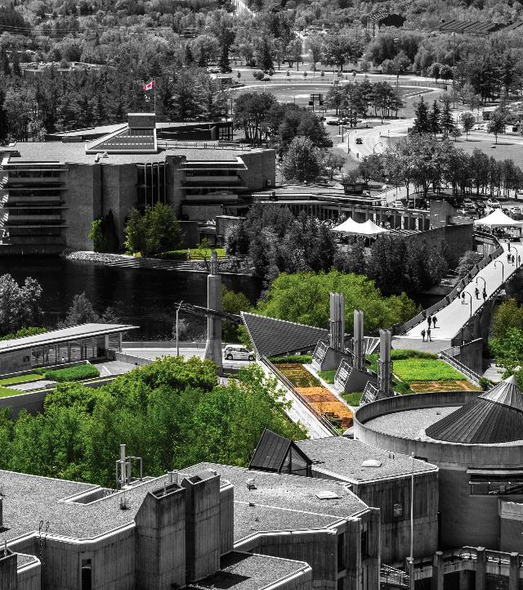
Writing Strong Applications

Slide 26
Outline of Proposed Research
EXPECT – this part of your application will take time & you should allow additional time for edits
GUIDE – there are various guides available to assist you with how to organize and what to include in your outline of proposed research.
EDIT - ask your supervisor to review and seek out others in your field to review your outline. It is expected that you will make a multiple edits of your plan until you are satisfied it fully articulates your research.

Slide 27



Transcripts: what you need to know
Include official, up-to-date transcripts for all undergraduate and graduate studies in your application.
Retain copies of all uploaded transcripts, as you may be asked to provide them for verification.
"Up-to-date" transcripts are those issued by the Registrar's Office during the fall term of the application year (if currently enrolled) or after your most recent completed term (if not currently enrolled).
Applicants are responsible for obtaining, uploading, and ensuring the legibility of all transcripts submitted through the application portal.
If you began your doctoral program in Fall 2026, you must include a transcript from that program to verify your months of study.
Review the application instructions carefully to ensure all transcript requirements are met.

Slide 28
Canadian Common CV (CCV)
The Tri-Agency CCV refers to the Canadian Common CV (CCV) system used for funding applications submitted to Canada’s three federal research funding agencies. (CGRS-M, CGRS-D CIHR & SSHRC)
What It Is:
The Tri-Agency CCV is a standardized online CV format required for many scholarship, fellowship, and grant applications. It ensures consistency and completeness in how academic and professional information is presented.
Key Features:
Sections: education, employment, research funding history, contributions, activities, and more.
Time-consuming: It can take several hours to complete, especially the first time, so starting early is recommended.
Specific for the CGRS-M and SSHRC D application

Slide 29

Tips for CCV Success
Start early: The CCV is detailed and time-consuming. But handy to keep dates, awards and skills all in one place.
Use consistent formatting for publications and contributions.
Keep a backup of your entries in a Word or Excel file for future use.

Slide 30

ALWAYS Confirm your Eligibility before starting

Slide 31



Special Circumstances: what to consider
Tri Council applications ask selection committees to consider special circumstances that could have affected applicants’ research, professional career, record of academic or research achievement, or completion of degrees.
Relevant circumstances could include administrative responsibilities, maternity/parental leave, child rearing, illness, disability, cultural or community responsibilities, socio-economic context, family responsibilities, trauma and loss, the COVID-19 pandemic, or other applicable circumstances.
Links: SSHRC D NSERC D CIHR D Point 4

Slide 32
Overview of Scholarship Application Recommendation Letters
Always review the application instructions and share instructions with your “referee”
Recommendation letters might be called:
Letter of Appraisal
Report on the Applicant
Reference Assessment or Referee Assessment
It is critical that a “referee” relate their comments to the competition’s selection criteria.
They provide a meaningful commentary on an applicant’s skills, knowledge, experience, research potential and contributions.
Adjudication committee members rely on these letters to review their own ranking of the application in comparison to the pool of applicants.

Slide 33

What to provide a referee and what might be helpful
Advise your referee you will provide:
Scholarship overview
Selection criteria
Draft of your outline of proposed research
Referee instructions
Ask, whether it would be helpful to provide:
unofficial transcripts;
a resume or CCV;
written blurbs for how your experience or academic background fits the selection criteria of the scholarship competition
Notes:
🌟 The Women's Classical Caucus (WCC)
📘 Commission on the Status of Women – Avoiding Gender Bias in Reference Writing

Slide 34
A strong Reference will:
Confirm the value of your research project while commenting on focus, feasibility, clarity of methodology and significance within your field of research
Indicate a familiarity with your academic achievements to date, comment on your judgement, critical thinking, originality, initiative, autonomy and enthusiasm for research
Endorse your project and your ability to achieve the outcomes of your project
Affirm quality and relevance of your contributions, considering discipline-specific norms and the work advances the field
Share insight into your training, knowledge and lived experience relevant to the research, offering context beyond grades and your CCV
Provide a robust picture of your skills and interest in and outside the lab / classroom
Highlight how you may have overcome challenges or any special circumstances that you have experienced during your academic career

Slide 35


Common Applicant mistakes
Starting too late
Ignoring eligibility requirements
Generic research proposals
Weak referee selection
Failing to follow instructions
Not including transcripts or when instruction specify official transcripts, providing unofficial student record
Poor proofreading
Missing internal deadlines
Exceeding page limits
Not applying

Slide 36

Research Funding Expectations
The following slides contain advanced guidance and resources that may strengthen competitive scholarship applications. If you are just starting your scholarship application journey – skip ahead.

Slide 37
Equity, Diversity and Inclusion
The academic research funding ecosystem must create a culture where embedding equity, diversity and inclusion (EDI) considerations into all aspects of research is second nature.
Incorporating EDI considerations in your proposal, where relevant, can strengthen your proposal and will be taken into consideration by the selection committee members during their review.
Tri-Agency Resources
They provide a wealth of information to help draft a winning application.
Guide for Applicants: Considering Equity, Diversity and Inclusion in Your Application
Equity, Diversity, and Inclusion (Multiple)

Slide 38
Unconscious Bias
Scholarship opportunities within the research-funding ecosystem are guided by a commitment to promoting equity, diversity and inclusion to ensure equitable access.
Tri-Council has curated a list of resources for selection committee members and valuable resources to review prior to writing reports on applicants, letters of reference, or letters of appraisal
Unconscious bias training module
Reducing bias in the Review Process (specific to writing review)
Selection Committee Guide – Gender-neutral and gender-inclusive language in reviews
CIHR – Sex, Gender & Health Research
San Francisco Declaration on Research Assessment
Status of Women Canada’s Unconscious Bias – Additional Resources webpage

Slide 39




Sex and Gender Based Analysis + (SGBA+)
When applicable, indicate how diversity (gender, sex, age, race, culture, religion, etc.) is considered in your proposed research (from its design to the analysis of the research findings).
Incorporating the principles of SGBA+ in research has the potential to increase the thoroughness and usefulness of the research.
How to Integrate Sex and Gender into Research

Slide 40


Knowledge Mobilization
Knowledge mobilization is an umbrella term encompassing a wide range of activities relating to the production and use of research results, including knowledge synesis, dissemination, transfer, exchange, and co-creation or co-production by researchers and knowledge users.
Resources from Tri-Council
What is knowledge mobilization?
Related policies and web links
Canadian Knowledge Transfer and Exchange Community of Practice website
Mapping the Impact of Research (PDF, 1.07 MB), David Phipps, York University

Slide 41

Research Involving and Engaging Indigenous Peoples
Below are SSHRC resources to support applicants working in Indigenous research; merit reviewers assessing applications related to Indigenous research; and communities and other research partners engaged in Indigenous research:
Definition of Indigenous research
Guidelines for the Merit Review of Indigenous Research
Indigenous Leadership Circle in Research
Indigenous Research Statement of Principles
Tri-Council Policy Statement: Ethical Conduct for Research Involving Humans Chapter 9: Research Involving the First Nations, Inuit and Métis Peoples of Canada

Slide 42

Guides for Assessment of Contributions
Other guides that help clarify your qualifications include:
Guidelines on the Assessment of Contributions to Research, Training and Mentoring
San Francisco Declaration on Research Assessment (DORA)
* These links are filled with valuable information necessary produce a winning application

Slide 43
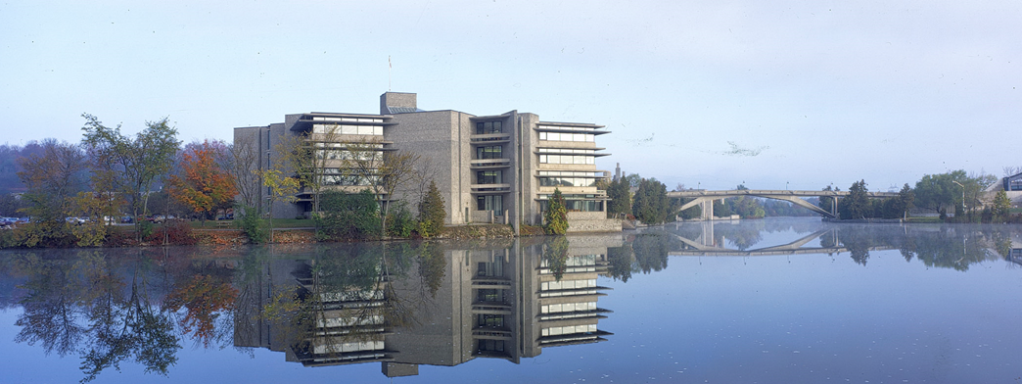
School of Graduate Studies
Blackburn Hall, Suite 115
All financial inquires direct to: graduatefinance@trentu.ca
Financial Matters for Graduate Students
Strategies for Successful Scholarship Applications

