Slide 1
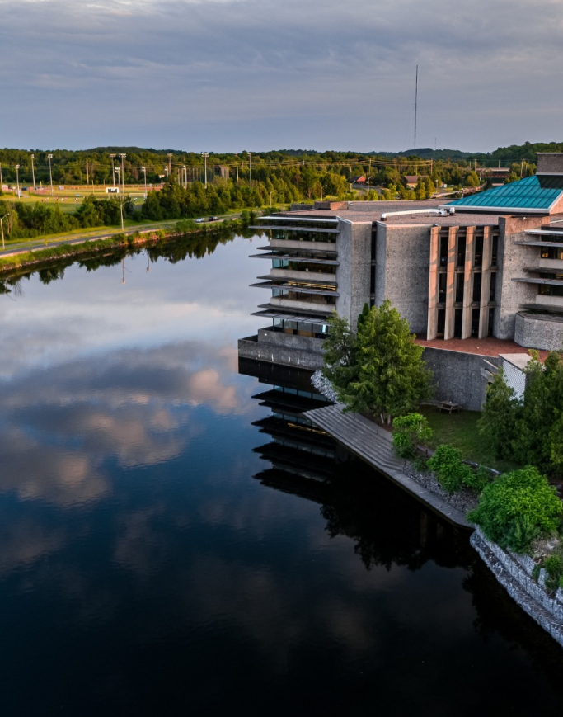
Doctoral
Scholarship Opportunities Resource
&
Workshop: August 27, 2026
Funding Strategies, CGRS-D, OGS & Scholarship Success
Jane Rennie
Graduate Finance Officer
School of Graduate Studies

Slide 2

Land Acknowledgement
“We respectfully acknowledge that we are on the treaty and traditional territory of the Michi Saagiig Anishinaabeg.
We offer our gratitude to the First Peoples for their care for, and teachings about, our earth and our relations. May we honour those teachings.”

Slide 3

Agenda
Welcome & Housekeeping
Funding Landscape
Big-Picture Planning
Application Components
Guidance & Tips

Slide 4

Various Types of Scholarships
As you begin exploring scholarship and funding opportunities, it is helpful to understand the main funding categories available:
Program Funding
  Entrance scholarships
  Graduate funding packages
Trent University Donor-Funded Scholarships and Awards
  Scholarships, awards, and bursaries funded through donor support
Major External Scholarships & Awards (Internal Nomination Required)
  Tri-Agency scholarships (CIHR, NSERC, SSHRC)
  Ontario Graduate Scholarship (OGS)
External Funding Opportunities (Apply Directly)
  Scholarships and awards offered by external organizations (Trudeau)
  Research internships and fellowships (e.g., Mitacs Accelerate)
  Professional association and foundation-based funding
Notes:
It is important to recognize that funding opportunities and application considerations may differ depending on where you are in your academic journey. Whether you are a current master's student transitioning directly into a doctoral program or a professional returning to academia to pursue doctoral studies, you should carefully evaluate the funding options available within each graduate program. Understanding the level and duration of funding support, scholarship opportunities, teaching or research assistantships, and other financial resources can play a significant role in determining which doctoral program is the best fit for your academic and personal circumstances.

Slide 5

Sample Trent Donor Scholarship
Thomas J. Bata Memorial Graduate Scholarship
This fund was established by Sonja Bata and the Bata family in honour of Thomas J. Bata (1914-2008), recognizing his longstanding commitment to Trent University.
The Bata Memorial Graduate Scholarship is a $5,000 scholarship intended to support a student that demonstrates leadership qualities:
Innovation
Entrepreneurship
Community responsibility
Global citizenship.
Deadline: October 9, 2026
Open to all currently registered Trent graduate students.
Application will be posted on the myTrent portal under the Finances tab.
Follow the instructions!!

Slide 6

William B. Reid Graduate Scholarship
The funding support available is between $1,000 and $2,000
Funding supports:
Community-based research.
Unique or hands-on training opportunities.
Opportunities to engage and interact with specialists.
This scholarship is for any Trent graduate students of Indigenous heritage from Canada or U.S.A.
Open Application found on the student myTrent portal

Slide 7
Graduate Bursaries:
Conference, Research & Travel
The applications found on the myTrent portal, under the Finances tab during the winter term annually.
Funding Opportunities
Graduate Jack Mattews Study & Research Abroad Bursary & Lopes Family Award for Study Abroad
Graduate Travel, Conference & Research Support
Trent Graduate Student Association Bursary Funds
Notes:
Part of the academic experience is engagement with others in your field and Trent offers funding opportunities for Conferences, Research & Travel.

Slide 8
Ontario Graduate Scholarship
Application Deadline: February 16, 2027
Value: $15,000 for one year (three terms full-time study)
Ontario Graduate Scholarship (OGS) awards are merit-based scholarships available to domestic and international students in all disciplines of graduate study.
The Queen's Elizabeth II Ontario Graduate Scholarships in Science and Technology (QEII-GSST) program is in addition to and harmonized with the OGS program. QEII-GSST awards are merit-based scholarships available to domestic students in graduate studies undertaking research in science and technology fields.
The OGS and QEII-GSST awards are intended to support graduate students enrolled in all disciplines at the master's and doctoral levels. At Trent, applicants can be considered for both the OGS and QEII-GSST through an online application.

Slide 9
Tri-Agency Doctoral Scholarship
Canada Graduate Research Scholarships – Doctoral Program
The Canada Graduate Research Scholarships – Doctoral (CGRS D) program supports outstanding doctoral students who demonstrate academic excellence and strong research potential. Administered by CIHR, NSERC, and SSHRC, the program helps develop the next generation of researchers and supports research across a wide range of disciplines.
Value: $40,000 for three years
At Trent, applications are first reviewed through an internal competition. Each agency assigns the University a quota, which is the maximum number of applications that can be forwarded to the national competition. Only the top-ranked eligible applications are advanced.
Trent Internal Deadline: October 16, 2026
*Students currently registered in a Trent master's or doctoral program must submit their application through Trent's internal competition process to be considered for nomination.
Tri Agency Links to the Application Portal & Instructions
                NSERC: Online system and Instructions
                CIHR: ResearchNet and Instructions
                SSHRC: Online system and Instructions

Slide 10

Pierre Elliot Trudeau Foundation Scholarship
PhD Scholarships Program
The Pierre Elliott Trudeau Foundation PhD scholarship supports students with an excellent academic record who are engaged in humanities and social sciences research that contributes to the advancement of Canada and society.
The Pierre Elliott Trudeau Foundation PhD Scholarship is designed for doctoral students who want to go beyond academia, grow through mentorship, and contribute to major societal issues through their research.
As a Pierre Elliott Trudeau Foundation Scholar, you will receive:
Up to $50,000 per year for three years
Up to $20,000 per year for research and travel
Mentorship and experiential learning
An engaged multidisciplinary community
A network of more than 500 alumni
2027 competition
The application process for the 2027 Pierre Elliott Trudeau Foundation Scholarship will begin on September 1, 2026.
Notes:
External direct application – does not require a Trent nomination

Slide 11

Where to Submit
Funding Type | Apply Through Trent? | Internal Review?
CGRS-D | Yes | Yes
OGS | Yes | Yes
Trent Donor Scholarships | Yes | Yes
External Scholarships | No | No

Slide 12
Key Doctoral Scholarship Opportunities
Major Funding Competitions for Doctoral Students
Scholarship | Value | Internal Competition
CGRS-D | $40,000/year for up to three years | Yes
OGS | $15,000/year | Yes
QEII-OGSST | $15,000/year | Yes
Trent Donor Awards | Varies | Varies
External Fellowships | Varies | No

Slide 13
Canada Graduate Research Scholarship ~ Doctoral Program
Now that we've reviewed types of scholarship and funding opportunities, let's focus on the Canada Graduate Research Scholarship - Doctoral Program (CGRS-D), one of Canada's most prestigious doctoral awards.
Value $120,000 paid over three years of full-time study

Slide 14

Tri Agency
Priority Research Areas
In Budget 2024 , funding was provided to support an increase in the number of awards, a portion of which will be dedicated to supporting priority research areas. The agencies will make additional award offers for select meritorious applications that align with one or more of the following priority research areas:
Advanced digital technologies (including AI, quantum, and cybersecurity)
Health, including biotechnology
Clean technology and resource value chains
Environment, climate resilience, and the Arctic
Food and water security
Democratic and community resilience
Manufacturing and advanced materials
Defence and dual-use technologies
See agency-specific application instructions for guidance on how to identify your research as being aligned with a priority research area.
Notes:
Key words – if your fits under an area, be sure to indicate within this section, and with your reference

Slide 15


A strong Application
Strong academic record
Clear and feasible research plan
Strong research contributions
Leadership and service
Excellent referee assessments
Addresses the Selection Criteria Directly
Clearly demonstrates how experiences, accomplishments, and outline of research plan aligns with the assessment criteria.
Makes it easy for reviewers to identify evidence of both:
  Research Potential
  Relevant Experience and Achievements
Key Message: The strongest applications do more than list accomplishments. They clearly connect every part of the application to the selection criteria and provide compelling evidence that the applicant is an outstanding future researcher.

Slide 16

BIG Picture
Planning Steps
CGRS D Application Planning Process
Understand award requirements and evaluation criteria
Assess program and funding fit
Review the application portal
Create a timeline and work backward from deadlines
Secure strong referees early
Order transcripts and gather documentation
Write the research proposal and supporting statements
Seek feedback from supervisors, peers, and SGS supports
Revise and refine application materials
Complete final checks and submit before the internal deadline
Key Message: A successful CGRS D application is not built in a few weeks. Start early, plan strategically, and give yourself sufficient time for feedback and revision.

Slide 17
CGRS D Application: Detail Planning 1
1. Understand the Award and Requirements
Read all Tri-Agency program materials and selection criteria.
Review eligibility requirements.
Understand how applications are assessed.
Familiarize yourself with required components and formatting rules.
2. Assess Program and Funding Fit
Confirm eligibility based on your academic stage.
Consider where you will hold the award.
Explore doctoral program funding packages and institutional supports.
Discuss plans with potential supervisors.
3. Explore the Application Portal
Create or access your application account
Review all application sections
Identify required documents and information
Note: technical requirements and submission procedures
4. Develop an Application Timeline
Work backward from the institutional deadline
Build in time for feedback and revisions
Schedule target milestones for each application component
Allow contingency time for unexpected delays
5. Identify and Secure Referees
Determine who can provide the strongest assessments.
Contact referees early.
Provide supporting materials such as:
CV, Research proposal, Program information
Accomplishments and goals
Monitor reference submission progress.
6. Order and Collect Required Documents
Request official transcripts well in advance.
Verify all academic records are complete.
Gather awards, publications, presentations, and employment information.
Update your academic CV.

Slide 18

CGRS D Application: Detail Planning 2
7. Develop your Outline of Proposed Research
Provide background and gaps
Clearly articulate the research questions
Explain significance and impact
Describe methodology and feasibility
8. Prepare support statements
Document research contributions and achievements
Highlight leadership and service activities
Demonstrate training, skills, and future potential.
Connects experiences to research
9. Seek feedback and edit
Obtain supervisor feedback.
Participate in writing workshops if an opportunity within your graduate program.
Use peer review opportunities or Academic Skills
Revise multiple times based on feedback.
10. Final review
Confirm all sections are complete.
Ensure consistency across documents.
Check formatting requirements.
Verify transcripts and references have been uploaded.
11. Submit before the Internal Deadline
Submit before the deadline when possible.
Retain copies of all materials.
Confirm successful submission.
Monitor for any follow-up requests.

Slide 19


Application procedures
Selecting the appropriate agency
Apply to the agency best aligned with your research subject matter to ensure your application will be reviewed by experts in disciplines closest to your field(s) of study. For more information, see Selecting the Appropriate Federal Granting Agency.
If you are applying to CIHR, consider the information on CIHR’s website.
If you are applying to NSERC, see the Addendum to the guidelines for the eligibility of applications related to health, which has additional information and specific examples relating to subject matter.
If you are applying to SSHRC, see the information on SSHRC's Subject Matter Eligibility web page.
It is your responsibility to select the funding agency that best suits your application.
Applications submitted to the incorrect agency may be removed from the competition.

Slide 20
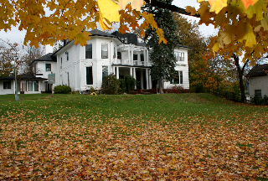

Application Portals
To complete the application process, see the appropriate agency’s website and instructions:
CIHR: ResearchNET and instructions
NSERC: Online system and instructions
SSHRC: Registration and login and instructions
Each funding agency provides specific instructions, including a checklist that outlines all the required components of a complete application.
You must submit your application electronically through the relevant agency’s platform. Trent accesses your application from the agency’s portals

Slide 21
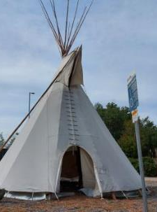

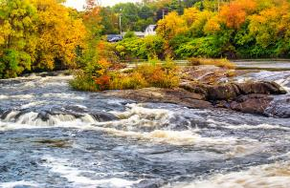
Research Involving and Engaging Indigenous Peoples
Below are SSHRC resources to support applicants working in Indigenous research; merit reviewers assessing applications related to Indigenous research; and communities and other research partners engaged in Indigenous research:
Definition of Indigenous research
Guidelines for the Merit Review of Indigenous Research
Indigenous Leadership Circle in Research
Indigenous Research Statement of Principles
Tri-Council Policy Statement: Ethical Conduct for Research Involving Humans Chapter 9: Research Involving the First Nations, Inuit and Métis Peoples of Canada

Slide 22

Attaching a Document & Presentation Standards
SSHRC Presentation and Attachment Standards
Prepare the documents
Prepare your attachments following the requirements below:
Explain any acronyms and abbreviations fully;
Pages must be 8 ½" x 11" (216mm x 279mm);
Pages must be single-spaced, with no more than six lines of type per inch;
All text must be in black, using the 11 pt Arial font; condensed fonts will not be accepted;
Margins must be set at a minimum of ¾" (1.87 cm); and
For multi-page attachments, pages must be numbered sequentially.
Convert the documents
All attachments must be converted to Portable Document Format (PDF) before they can be attached to the application.
NSERC Presentation Standards
SSHRC Instructions for Attachments and Presentation Standards

Slide 23


Joint initiatives
&
Supplements
The three agencies may offer supplementary funding to award holders, some of which is offered through joint initiatives (collaborations with organizations from across the not-for-profit, private and public sectors to support and promote training, research and connection activities).
Joint initiatives and supplements are designed to reflect the strategic objectives and mandates of each respective agency, inform decision-makers and, in certain cases, address specific needs of their partners.
See the agency websites (CIHR, NSERC, SSHRC) for more information on related opportunities.
May not apply or fit area of research! But they might…

Slide 24
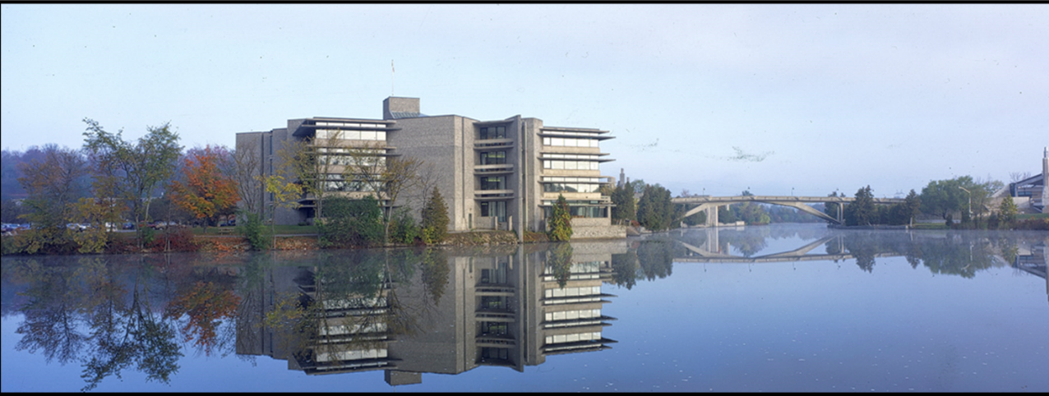
Application components

Slide 25

CGRS – D Application Checklist
Online application
Research proposal
Academic transcripts
Canadian Common CV (if applicable)
Referee assessments
Special circumstances statement (if applicable)
Diversity considerations module
Application requirements vary slightly by agency.
Carefully review your agency's instructions to ensure your application is complete.
Incomplete applications cannot be submitted through the portal.
Special circumstances statements are optional and should only be included when relevant to your situation.

Slide 26
Outline of Proposed Research
EXPECT – this part of your application will take time & you should allow additional time for edits
1
GUIDE – there are various guides available to assist you with how to organize and what to include in your outline of proposed research.
2
EDIT - ask your supervisor to review and seek out others in your field to review your outline. It is expected that you will make a multiple edits of your plan until you are satisfied it fully articulates your research.
3

Slide 27

Outline of Proposed Research
Various Proposal Frameworks
Hour-Glass Style
Inverted Triangle
Background of research, broad overview
Introduce important concepts, what is known and what is unknown
Research question
Methodology
Data analysis
Contribution to knowledge in field and broader impact
Big picture, relevance/importance of problem
Theoretical Frame: Situate study in body of theory
Research question
Methodology: Underlying approach to the research
Method: How will you do it?
Data analysis
Dissemination of research

Slide 28



Diversity Considerations in research Design
After you’ve answered “yes” or “no” to the question “Do diversity considerations apply to your proposed research design?”, indicate in the text box how diversity considerations are applicable or not to your research proposal (maximum 1,700 characters).
Before completing this module, read the Guide to including diversity considerations in research design for doctoral and postdoctoral award applicants.
Note: Although mandatory, this module is not subject to merit review and is not shared with committee members.

Slide 29
Transcripts
Include up-to-date official transcripts of ALL your undergraduate and graduate studies in the application.
Retain the paper copy of any uploaded transcripts, as you could be asked to provide it for verification purposes.
Up-to-date official transcripts are defined as transcripts issued by the Registrar’s Office and dated or issued in the fall session of the year of application (if currently registered) or after the last term completed (if not currently registered).
Applicants are responsible for collecting, uploading, and confirming legibility of previous and current transcripts and upload them directly on to the application portal.
Review the application instructions.
If you have started your doctoral graduate program Fall 2026 – you must upload transcript from this program, as it indicates months of study in your graduate program.

Slide 30



Canadian Common CV (CCV)
The Tri-Agency CCV refers to the Canadian Common CV (CCV) system used for funding applications submitted to Canada’s three federal research funding agencies. (CGRS-M, CGRS-D CIHR & SSHRC)
What It Is:
The Tri-Agency CCV is a standardized online CV format required for many scholarship, fellowship, and grant applications. It ensures consistency and completeness in how academic and professional information is presented.
Key Features:
Sections: education, employment, research funding history, contributions, activities, and more.
Time-consuming: It can take several hours to complete, especially the first time, so starting early is recommended.
START EARLY
Notes:
Update annually – first time, takes time

Slide 31



“Special Circumstances: what to consider”
Tri Agency applications ask their selection committees to consider special circumstances that could have affected applicants’ research, professional career, record of academic or research achievement, or completion of degrees.
Relevant circumstances could include administrative responsibilities, maternity/parental leave, child rearing, illness, disability, cultural or community responsibilities, socio-economic context, family responsibilities, trauma and loss, the COVID-19 pandemic, or other applicable circumstances.
Links: SSHRC D NSERC D CIHR D Point 4

Slide 32
Overview of Scholarship Application Recommendation Letters
Always review the application instructions and share instructions with your “referee”
Recommendation letters might be called:
Letter of Appraisal
Report on the Applicant
It is critical that a “referee” relate their comments to the competition’s selection criteria.
Adjudication committee members rely on these letters to review their own ranking of the application in comparison to the pool of applicants.

Slide 33


Who? When? How?
Consider
How to ask
Who to ask?
A person who offers authority, depth and who can offer specificity. They are familiar with your research and other abilities:
Supervisor, faculty member, employment supervisor, thesis advisor
When to ask?
… early, 4 to 6 weeks before scholarship due date
Email or in-person or phone
What is your comfort level and awareness of your referee?
If in email, first message should:
Be a brief inquiry reminding the faculty member how you know them
Provide clarification as to what scholarship application you are applying for
Clearly ask if they are willing and able to provide an enthusiastic reference for your scholarship application
Provide the scholarship application submission deadline
Notes:
Enthusiastic, robust, positive, - select the work you are comfortable using

Slide 34

What to provide a referee
Advise your referee you will provide:
Scholarship overview
Selection criteria
Draft of your outline of proposed research
Referee instructions
Ask, would it would be helpful to provide:
unofficial transcripts;
a resume or CCV;
written blurbs for how your experience or academic background fits the selection criteria of the scholarship competition

Slide 35
Guidance & Supports

Slide 36




“Common Mistakes Applicants make”
Not reading the instructions
Starting too late
Weak referee selection
Ignoring formatting requirements, going over in allowable space
Underestimating proposal-writing time
Unclear research questions vague or too heavy with jargon
Waiting until transcripts are needed, or not including all transcripts
Not editing
Not eligible and didn’t confirm
Submitting incorrectly so missed deadline

Slide 37
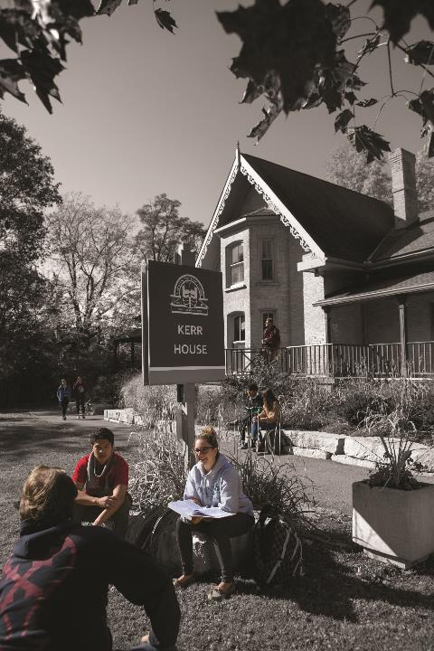
Benefits of Developing Scholarship applications
Boosts your confidence in writing, critical thinking, project management, and navigating government portals.
Improves your academic writing through practice, helping you become more proficient in the writing style specific to your discipline.
Raises your awareness of the complexity and demands of your academic and research plan.
Teaches time management by working through a project timeline (like a scholarship application), helping you understand the planning and effort needed to meet deadlines.
Prepares you to mentor others giving you the experience needed to confidently guide younger researchers through the scholarship application process.
Even unsuccessful applications provide valuable professional development.
Notes:
Wishing you all the best – and I am available for assistance, Financial Matters / Connect with Us

Slide 38

Doctoral Application Journey
Supports Available
Supervisor Support: Feedback on research proposal, application strategy, and reference letters.​
Peer Support: Review drafts, share successful applications, and provide encouragement.​
School of Graduate Studies: Workshops focused on scholarship applications and proposal development.​
One-to-One Sessions: Individual guidance to strengthen applications and address questions.​
Slide Decks & Resources: Access presentation materials, templates, guides, and curated resource links.​

Slide 39


Funding & Tuition website
As you begin exploring scholarship opportunities, this website is an excellent starting point. It provides information on available funding opportunities, award values, eligibility requirements, and resources to support the development of a competitive scholarship application.
Key Links to Review
Graduate Funding
Scholarships & Awards
Scholarship Application Strategies (Graduate Studies Scholarship Application Resources / Tri Agency Resources)
Ontario Graduate Scholarships
Graduate Bursaries
Finance Contacts & Resources
On the main page, you can also:
Schedule a one-to-one advising appointment
Review upcoming workshops and events
Access additional funding and scholarship resources
RECOMMENDATION: Bookmark this page, as it will serve as your central resource throughout the scholarship application process.

Slide 40



Graduate Scholarships & Awards
It is critical to be aware of application deadlines and to PLAN accordingly to ensure you gather all necessary documents and complete all written portions of the application.
Review these pages to organize and plan your applications. Some will be a fit and some won’t.
Opportunities
Major External Scholarships Requiring Trent Nomination (i.e. Tri Agency)
Trent Donor Scholarships
Popular with Trent Students (Apply directly) (Trudeau Elliot Foundation Doctoral Scholarship)
External Scholarships (Apply directly)
External Funding Databases
Mitacs Funding

Slide 41

School of Graduate Studies
Blackburn Hall, Suite 115
All financial inquires direct to: graduatefinance@trentu.ca
Best wishes on your doctoral scholarship application journey … Jane

