Slide 1
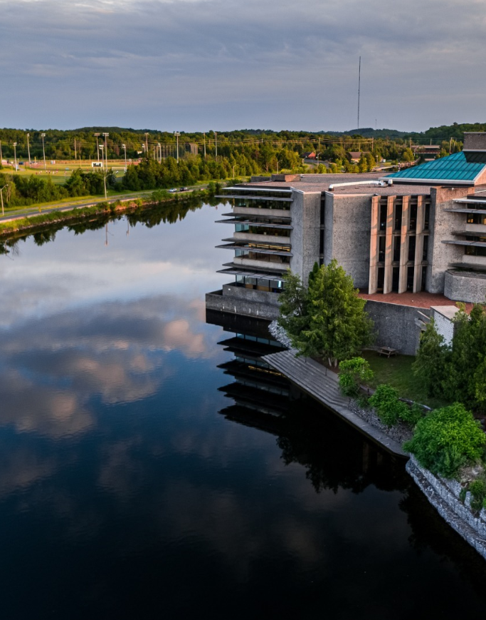
Tri-Council Canada Graduate Research scholarships – Master’s program 2025-26
Jane Rennie
Graduate Finance Officer
School of Graduate Studies

Slide 2



Financial Matters
Resources are available and applicants are encouraged to review the School of Graduate Studies website Financial Matters
Headings:
“How to Win Scholarships”
Tri-Council Resources
Graduate Studies Scholarship Application Resources
Many of these resources will assist you with developing your doctoral scholarship application.

Slide 3
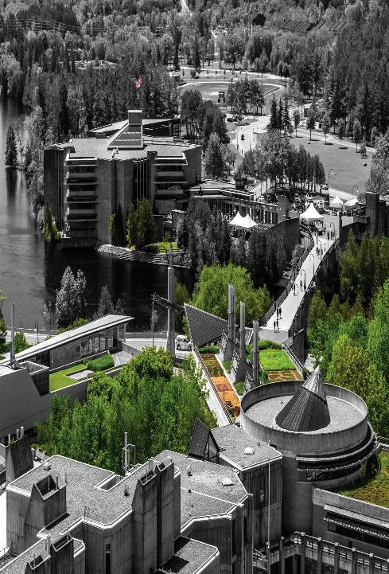
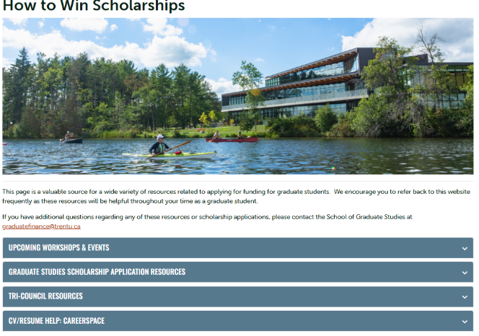
How to Win Scholarships

Slide 4
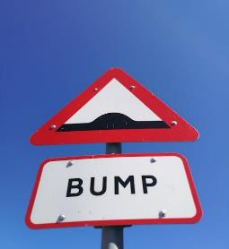




CAUTION Information Overload potential
Notes:
Providing the overview, when you go through the application and you may get confused, or incorrect information. The hope is by providing these slides you will have a reference to review.
Instructions walk you through the process step by step…

Slide 5
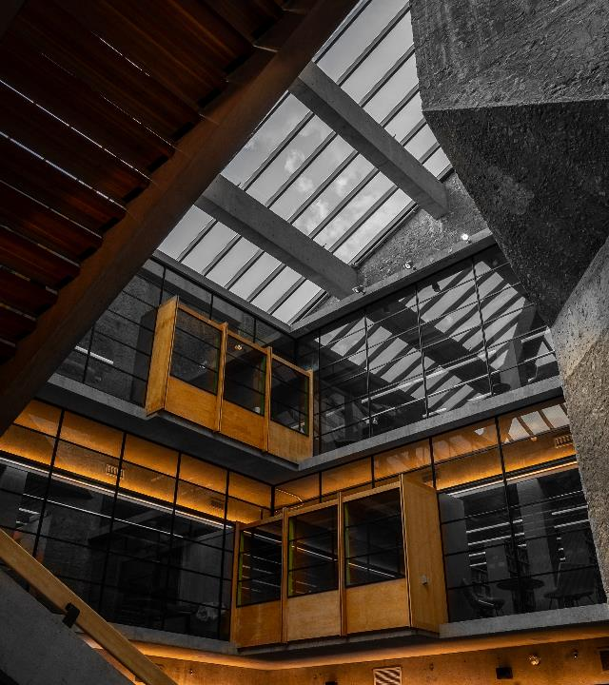
Tri-Council Canada Graduate Research Scholarship ~ Master’s Program (CGRS – M)
Value: $27,000
Direct Deadline: December 1, 2025
DESCRIPTION
The CGS M program supports up to 3,298 students annually in all disciplines and is administered jointly by Canada’s three granting agencies. The selection process and post-award administration are carried out at the institutional level under the guidance of the three agencies.
Students submit their application to the institution at which they intend to hold their award using the Research Portal.
*Portal is hosted by NSERC
Notes:
October 15th
Feb 12, 2025 – changes to OGS

Slide 6
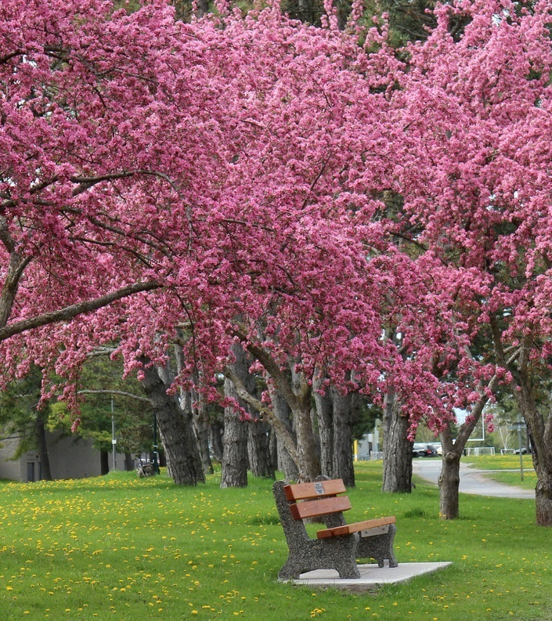
Tri-Council Canada Graduate Research Scholarship ~ Master’s Program (CGRS – M) *Portal is hosted by NSERC
Objective
The objective of the Master’s scholarship funding opportunity is to help develop research skills and assist in the training of highly qualified personnel by supporting students who demonstrate potential to contribute to Canadian research.
Description
The CGRS M is a scholarship in the Canada Research Training Awards Suite (CRTAS) administered by the Canadian Institutes of Health Research (CIHR), the Natural Sciences and Engineering Research Council of Canada (NSERC) and the Social Sciences and Humanities Research Council (SSHRC).
The CRTAS aims to support the next generation of innovators by providing funding and high-quality research training, cultivating research skills, fostering creativity and empowering awardees to make significant contributions to Canada’s research ecosystem, economy and prosperity.

Slide 7
Canadian Graduate Research Scholarship- Masters Program Scholarship Overview
Overview
Value | $27,000 for 12 months, non-renewable
Application deadline | December 1
Application procedures | See below
How to apply | The application platform (Research Portal) will open in early September, within five business days of the launch of the competition To view instructions and other resources, consult the Canada Graduate Research Scholarship – Master’s program resources web page To create or access an application, log in to the Research Portal To create a Canadian Common CV, log in to the Canadian Common CV website
Contact | See below

Slide 8




Suggested First Tasks
Review the CGSR- M scholarship description
Review applicant eligibility prior to commencing application
Review program of study eligibility
Review field of research and subject matter eligibility

Slide 9

Summary Eligibility Checklist
Canadian citizen, permanent resident, or Protected Person
Applied to or enrolled in full-time master’s or doctoral program at a CGRS M-allocated Canadian institution
Met internal application deadline for intended program
As of Dec 31:
0–12 months of full-time study in eligible graduate program or
4–12 months in master’s program transitioning to doctoral program
No prior CIHR, NSERC, or SSHRC Master’s-level scholarship
No prior Indigenous Scholars Award and Supplement
First-class average in each of the last two years of study
Only one application submitted per academic year to CIHR, NSERC, or SSHRC

Slide 10



Program of study eligibility
Program must be predominantly research-oriented
Must lead to a thesis, major research project, dissertation, scholarly publication, performance, recital, or exhibit
Research component must be merit/expert-reviewed at the institutional level
If additional admission is required for the research stream, it must be confirmed before holding the award
Joint professional programs (e.g., MD/PhD, JD/MA, MBA/PhD) are eligible if they include a significant autonomous research component
Clinically oriented programs (e.g., clinical psychology) are eligible if they include significant research
Coursework-only master’s programs are typically not eligible

Slide 11

Selecting the Appropriate Agency
Apply to the agency best aligned with your research subject matter to ensure your application will be reviewed by experts in disciplines closest to your field(s) of study. For more information, see Selecting the Appropriate Federal Granting Agency.
If you are applying to CIHR, consider the information on CIHR’s website.
If you are applying to NSERC, see the Addendum to the guidelines for the eligibility of applications related to health, which has additional information and specific examples relating to subject matter.
If you are applying to SSHRC, see the information on SSHRC's Subject Matter Eligibility web page.
It is your responsibility to select the funding agency that best suits your application.
Applications submitted to the incorrect agency may be removed from the competition.

Slide 12
Equity, Diversity and Inclusion
The three agencies are acting on evidence that achieving a more equitable, diverse and inclusive Canadian research enterprise is essential to creating the excellent, innovative and impactful research necessary to advance knowledge and understanding and to respond to local, national and global challenges.
This principle informs the commitments described in the Tri-agency statement on equity, diversity and inclusion (EDI), and is aligned with the objectives of the Tri-Agency EDI Action Plan.
Self-identification data and consent provided with applications may be used to determine eligibility for additional awards or priority funding opportunities designated for specific underrepresented groups.

Slide 13
Indigenous Student Researchers
The Indigenous Scholars Awards and Supplements Pilot Initiative provides financial support to meritorious Indigenous students who have applied to the CGRS M program.
To the limit of available funding, Indigenous students who are successful in the CGRS M competition will be offered the Indigenous Scholars Supplement, valued at $5,000.
To the limit of available funding, Indigenous Students on the alternate list will be offered an Indigenous Scholars Award valued at $27,000 and an Indigenous Scholars Supplement valued at $5,000.
The Tri-agency Policy on Indigenous Citizenship and Membership Affirmation and the associated directive apply to these awards and supplements; successful applicants must provide documentation as outlined in the Policy and Directive.
For more information refer to the Indigenous Scholars Awards and Supplements Pilot Initiative web page.

Slide 14
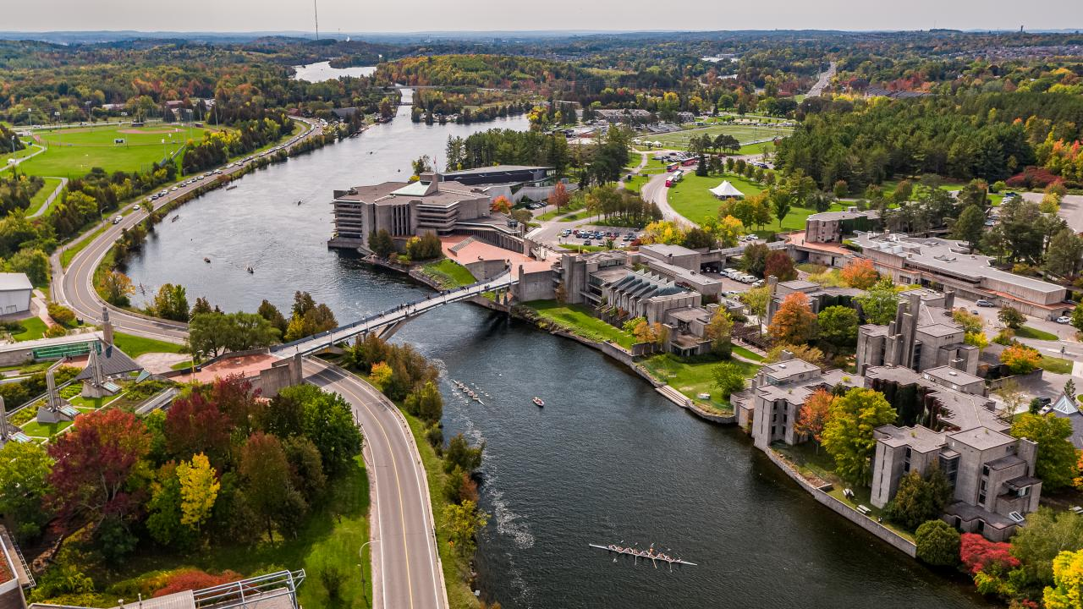
Black Scholars
The Government of Canada has provided additional funds to increase direct support for Black student researchers.
CGRS M applicants who self-identify as Black and provide consent in their application to be considered for funds designated for specific groups may be selected to receive this funding.
Each agency has up to 20 additional CGRS M awards reserved for Black student researchers.

Slide 15
Application Procedures
To apply to the CGRS M program, you must complete and submit your application using the Research Portal.
For more information on how to apply, consult the Canada Graduate Research Scholarship – Master’s program: Instructions for completing an application web page.
Allocations
Eligible Canadian institutions are assigned a separate allocation of awards to offer from each agency.
For a list of allocations by institution and by agency, refer to the Canada Graduate Research Scholarship – Master’s award allocations web page.
Application deadline
The deadline for CGRS M applications is December 1 before 8:00 pm ET. Complete applications must be submitted by the deadline using the Research Portal.
Note: As the application deadline approaches, delays may occur due to a high volume of users on the Research Portal, which may prevent the timely submission of your application.
It is your responsibility to strictly follow all 11 steps in the instructions for completing an application before the portal closes. Late applications will not be accepted.

Slide 16




Understanding Selection Process
Institutional review
The School of Graduate Studies is responsible for coordinating the institutional evaluation and the selection process for the CGRS M applications.
The review aims to identify candidates for the CGRS M award and create a ranked list of alternate meritorious applicants.
Only materials submitted through the Research Portal will be considered.
Any excess pages must be removed before the review begins.
Committee members will not refer to external URLs or publications for additional information.

Slide 17

Selection Review Process
REVIEW PROCESS
The merit review must adhere to the specified selection criteria, which are weighted.
Committee members must consider each criterion when assigning a global score to an application. No additional criteria may be added.
Committee members must also consider special circumstances that may have impacted the applicant’s research, career, academic or research achievements, or degree completion.
Applicants should explain these circumstances in the Special Circumstances section of the application.

Slide 18
Selection Criteria
Academic Excellence, 50% weight
As demonstrated by past academic results, transcripts, awards and distinctions
Indicators of academic excellence:
academic record
scholarships and awards held
duration of previous studies
type of program and courses pursued
course load
relative standing (if available)
Research Potential, 30% weight
As demonstrated by your research history, your interest in discovery, the proposed research, its potential contribution to the advancement of knowledge in the field and any anticipated outcomes
Indicators of research potential:
quality and originality of contributions to research and development
relevance of work experience and academic training to field of proposed research
significance, feasibility and merit of proposed research
sound judgment and ability to think critically
ability to apply skills and knowledge
initiative and autonomy
research experience and achievements relative to expectations of someone with your academic experience
Personal characteristics and interpersonal skills, 20% weight
As demonstrated by your past professional and relevant extracurricular interactions and collaborations
Indicators of personal characteristics and interpersonal skills:
work experience
leadership experience
project management, including organizing conferences and meetings
ability or potential to communicate theoretical, technical or scientific concepts clearly and logically in written and oral formats
involvement in academic life
volunteerism/community outreach

Slide 19


Notification of results
Offers of awards will be available in the Research Portal as of April 1.
Alternate offers may be made up until January 31 of the next calendar year.
It is your responsibility to regularly check the Research Portal between April 1 and January 31 for the results of the competition.
For more information on the notification of results, refer to the instructions for completing an application web page.

Slide 20
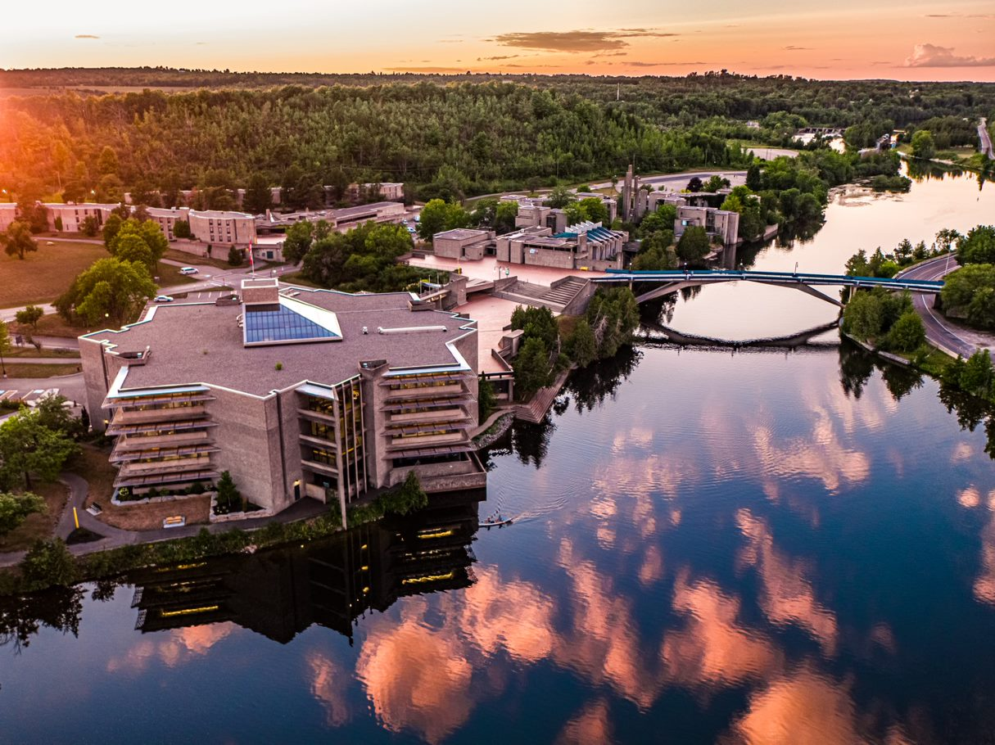
Instructions for completing an Application
General Information
Steps for completing and submitting the application
Application statuses
Notification of results
Each of these links provide key instructions at all stages of the application process.
Other Useful Instructions
Canada Graduate Research Scholarship – Master’s program
Instructions for completing a Canadian Common CV
Instructions for completing the Reference Assessment
Tutorials

Slide 21

Presentation Standards
Tri Agency provides online presentation and attachment standards that applicants must follow.
On the page
Prepare your documents
Canada Graduate Research Scholarship – Master’s (CGRS M) program transcript requirements
Convert the documents
Troubleshooting tips for uploading PDF attachments in the Research Portal

Slide 22


Steps for completing & submitting the application
Create an application (simply logging into the Research Portal)
Application overview (fill in the blanks and details about Supplements/joint initiatives)
Activity details (clarifying questions, help match to reviewer with key words & section for any special circumstances)
Outline of proposed research (attachment) with bibliography and citations
Transcripts (attachment)
Canadian Common CV
Reference assessments (two reference assessments)
Verify that the application is complete (this is a check the portal does to ensure you have answered all questions)
Extract the application
Submit the application
Accept the terms and conditions of applying
*instructions are provided within each task

Slide 23
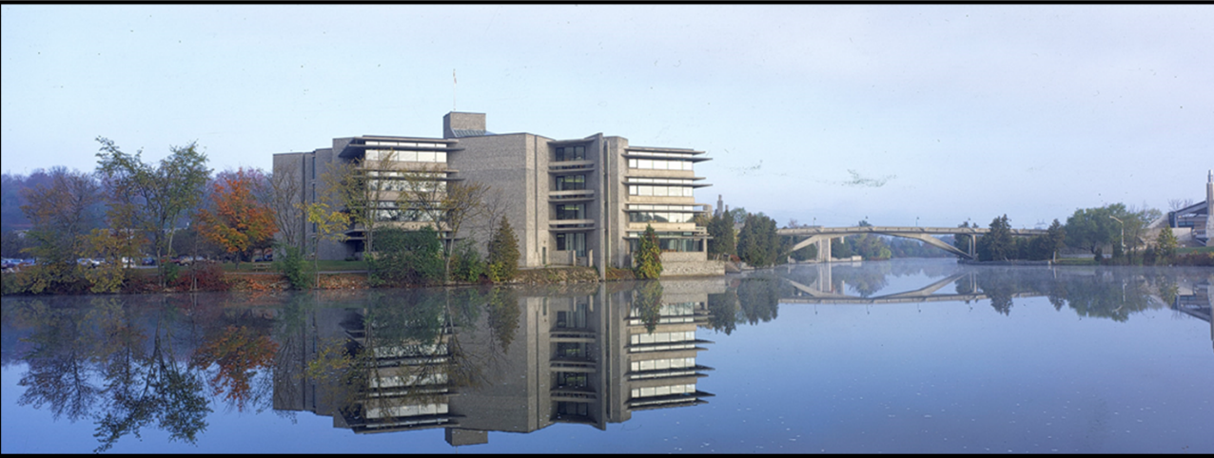
Components of the application & helpful Resources

Slide 24



Special Circumstances: what to consider
Language within the application:
The following question may apply:
Do you have any special circumstances to take into consideration that may have affected your research, professional career, record of academic or research achievement or completion of degrees?
If you answered Yes to the above question, the following prompt and text field (5,000 characters maximum, including spaces) will appear:
Describe any special circumstances that have impacted your performance or productivity (required).
The agencies require institutions and reviewers to take into consideration special circumstances that may have affected your research, professional career, record of academic or research achievement or completion of degrees. These may include administrative responsibilities, maternity or parental leave, child-rearing, illness, disability, cultural or community responsibilities, socio-economic context, trauma, loss, family responsibilities or the impact of a pandemic.

Slide 25

CGRS~M Instructions Outline of Proposed Research
The single attachment consists of two separate sections: Outline of proposed research and Bibliography and citations. Each of these sections must be only one page.
Pages in excess of the number permitted may be removed before the selection process and your application may be at a disadvantage as a result.
Outline of proposed research (one page maximum)
Provide a detailed description of your proposed research project for the period during which you will hold the award. Be as specific as possible.
Provide background information to position your proposed research within the context of current knowledge in the field.
State the objectives and hypothesis and outline the experimental or theoretical approach to be taken (citing literature pertinent to the proposal) and the methods and procedures to be used.
State the significance of the proposed research to a field or fields in the health sciences, natural sciences and/or engineering or social sciences and/or humanities, as appropriate.
If the output of your degree program is an artistic creation rather than a thesis, clearly indicate the research component of your proposed work. Outline the objectives of your research, the context, methodology and contribution to the advancement of knowledge.

Slide 26



Bibliography and citations (one page maximum)
Provide a bibliography that includes citations for all works referenced in the research proposal.
These citations should be in a format used by the primary discipline of the proposed research.
You must ensure that all citations are clear and complete to allow reviewers to easily locate the sources.

Slide 27
Outline of Proposed Research Various Proposal Frameworks
Hour-Glass Style
Inverted Triangle
Background of research, broad overview
Introduce important concepts, what is known and what is unknown
Research question
Methodology
Data analysis
Contribution to knowledge in field and broader impact
Big picture, relevance/importance of problem
Theoretical Frame: Situate study in body of theory
Research question
Methodology: Underlying approach to the research
Method: How will you do it?
Data analysis
Dissemination of research

Slide 28



Transcripts
Include up-to-date official transcripts of ALL your undergraduate and graduate studies in the application.
Retain the paper copy of any uploaded transcripts, as you could be asked to provide it for verification purposes.
Up-to-date official transcripts are defined as transcripts issued by the Registrar’s Office and dated or issued in the fall session of the year of application (if currently registered) or after the last term completed (if not currently registered).
Applicants are responsible for collecting, uploading, and confirming legibility of previous and current transcripts and upload them directly on to the application portal.
If you have started your M.A. or M.Sc. graduate program Fall 2025 – you must upload transcript from this program, as it indicates months of study in your graduate program.
Review the application instructions.

Slide 29
Canadian Common CV (CCV)
The Tri-Agency CCV refers to the Canadian Common CV (CCV) system used for funding applications submitted to Canada’s three federal research funding agencies. (CGRS-M, CGRS-D CIHR & SSHRC)
What It Is:
The Tri-Agency CCV is a standardized online CV format required for many scholarship, fellowship, and grant applications. It ensures consistency and completeness in how academic and professional information is presented.
Key Features:
Sections: education, employment, research funding history, contributions, activities, and more.
Time-consuming: It can take time to complete, especially the first time, so starting early is recommended.
* Canadian Common CV (CGRS-M) – Frequently Asked Questions

Slide 30

San Francisco Declaration on research assessment
San Francisco Declaration on Research Assessment
CIHR, NSERC and SSHRC, along with other Canadian research funding agencies, are signatories of the San Francisco Declaration on Research Assessment (DORA).
The agencies are committed to meaningful assessment of excellence in research funding and to ensuring that a wide range of research results and outcomes are considered and valued as part of the assessment process.
The agencies will continue to work to ensure that their strategies, policies and guidance align with DORA.

Slide 31
Overview of Reference Assessments
Always review the application instructions and share instructions with your “referee”
Recommendation letters might be called:
Letter of Appraisal
Report on the Applicant
Reference Assessment or Referee Assessment
It is critical that a “referee” relate their comments to the competition’s selection criteria.
They provide a meaningful commentary on an applicant’s skills, knowledge, experience, research potential and contributions.
Adjudication committee members rely on these letters to review their own ranking of the application in comparison to the pool of applicants.

Slide 32



Who? When? How?
Consider
How to ask
Who to ask?
A person who offers authority, depth and who is able to offer specificity. They are familiar with your research and other abilities:
Supervisor, faculty member, employment supervisor, thesis advisor
When to ask?
… early, 3 weeks before scholarship due date
Email or in-person or phone
What is your comfort level and awareness of your referee?
If in email, first message should:
Be a brief inquiry reminding the faculty member how you know them
Provide clarification as to what scholarship application you are applying for
Clearly ask if they are willing and able to provide an enthusiastic reference for your scholarship application
Provide the scholarship application submission deadline

Slide 33

Training Sessions
NSERC is hosting the following information sessions for the Canada Graduate Research Scholarship – Master’s Program:
Thursday, November 6th 11:00 a.m. to 1 p.m. (ET)
Link: Join the meeting now
Friday, November 14th 10:00 a.m. to 12 p.m. (ET)
Link: Join the meeting now
Thursday, November 20th 11 a.m. to 1 p.m. (ET)
Link: Join the meeting now
CIHR and SSHRC staff will be present at all sessions. These sessions will be hosted as live Q&A MS teams meetings. Before attending a session, participants must read the relevant program description, watch the tutorial videos on the NSERC YouTube channel and come prepared with their questions.

Slide 34

Benefits of Developing Scholarship applications
Builds confidence in writing, critical thinking, and project management
Strengthens academic and discipline-specific writing skills
Increases awareness of the complexity of your research and study plan
Enhances understanding of timelines and planning through task-based progress
Prepares you to mentor others through the scholarship application process

Slide 35

School of Graduate Studies Blackburn Hall, Suite 115 All financial inquires direct to: graduatefinance@trentu.ca

