Slide 1
Research/Thesis Graduate Programs Overview: Awards & Funding
Jane Rennie
Graduate Finance Officer

Slide 2
Tuition, Awards & Funding
At Trent, all eligible graduate students (Master & PhD) may be offered competitive funding for support in their studies. Sources may include:
Scholarships, fellowships & other merit awards from governmental, industrial and other granting bodies in Canada
Entrance awards & academic scholarships & tuition bursaries
GTA for a maximum of 4 terms (Masters) and 8 terms (PhD) or lab demonstrating
RA with faculty members who hold research grants
Loans from OSAP or other provincial sources.
https://www.trentu.ca/graduatestudies/tuition-awards-funding
Notes:
Read slide

Slide 3
Internal Graduate Funding
As per a student’s letter of offer admission to their graduate program, funding may include:
Research Fellowship
Dean’s PhD Scholarship
Entrance Scholarships – various
Research Fellowship Awards
Graduate International Scholarship
Graduate Teaching Assistantship
Funding is first directed towards tuition fees.

Slide 4
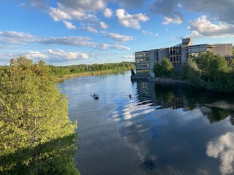
External Funding – Scholarships & Awards
Tri Council Scholarships – Doctoral or Masters
NSERC
SSHRC
CIHR
Ontario Graduate Queen Elizabeth Scholarship in Science and Technology
Ontario Graduate Scholarship
Vanier Scholarship
MITACS

Slide 5
Internal funding is applied in thirds, and posted to student accounts during the third week of the first month of each term. Graduate Teaching Assistantships are a form of employment, processed through Payroll bi-weekly as a electronic funds transfer to a student’s personal Canadian bank account. External Funding is credited to a student’s account, then debited out of the student account in order to be directly deposited to a student’s Canadian bank account. This process spans over a few days and will be completed by the end of the third week of the first month of the term. It is necessary to post and remove funds in order to properly produce tax forms. New external scholarship award holders could experience a delay of their first payment of their award depending on the start date.

Slide 6
Research Fellowship Award (RFA) – Supervisor Financial Support Process
Science Students – Details within Offer of Admission
Students discuss RFA support with their Supervisor
Agree on payment distribution, typically smaller amounts in fall and winter, with final payout in spring term
Supervisor emails Graduate Funding Form 1B to graduatefinance@trentu.ca prior to September 10th, January 10th, or May 10th
The Graduate Finance Officer receives and processes funding forms, sending a complete listing to the Office of Research & Innovation, who review and approve Supervisor RFA support.
Finance Officer is advised that the approval process has been completed and RFA funding is posted to a student’s account.
NOTE: Navigating approval process can take up to three weeks or more, all efforts are taken to ensure the funding is posted to student accounts prior to the tuition deadline.
Review your offer of admission letter

Slide 7
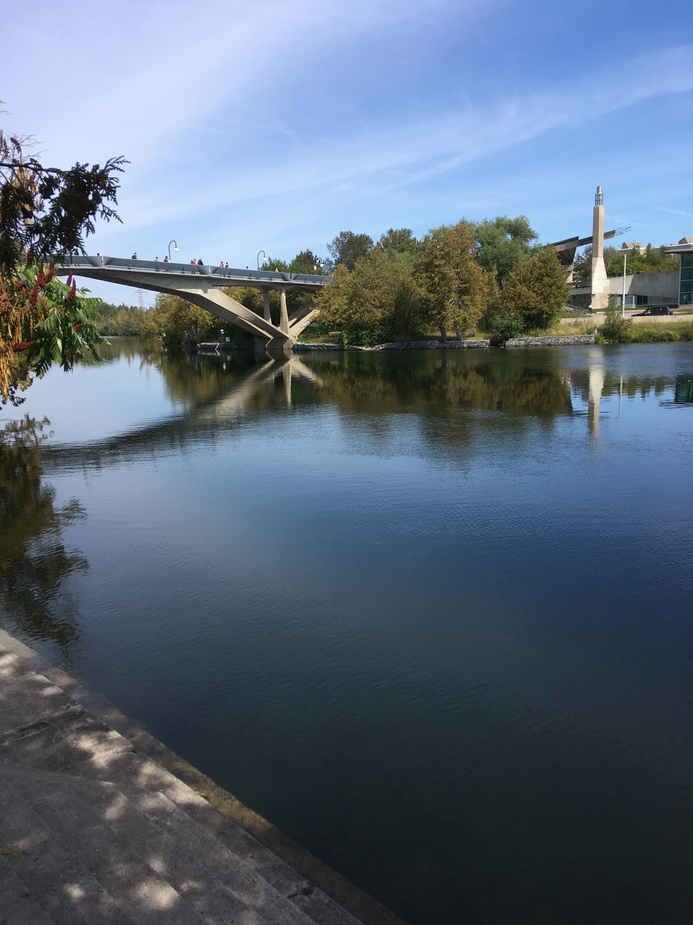
Resources for Assistance for Funding Information
Supervisor or Co-Supervisors (if applicable)
Graduate Program Administrator
Program Coordinator
Graduate Program Director
Graduate Finance Officer
School of Graduate Studies

Slide 8
Challenge the Way You Think

