Slide 1
Graduate Students & Funding your Post Secondary Education
School of Graduate Studies

Slide 2
OSAP
The Ontario Student Assistance Program (OSAP) is a financial aid program.
OSAP offers funding through:
grants: money you don’t have to pay back
a student loan: money you need to repay once you’re done school
When you apply for OSAP, you are automatically considered for both grants and a loan. If you don’t want to take a loan, and you’re a full-time or part-time student, you can decline it after your application is approved.
OSAP can help you pay for:
Tuition, books and equipment
fees charged by your school
living expenses (full-time students only)
child care (for full-time and part-time students with children)
Who can get OSAP
OSAP is open to Ontario residents of any age who are:
Canadian citizens, permanent residents, or protected persons
https://www.ontario.ca/page/learn-about-osap

Slide 3
Graduate Students – all of your OSAP questions will be addressed by Trent University’s Financial Aid Office Location: Registrar’s Office in Blackburn Hall 1600 West Bank DriveK9L 0G2 Peterborough, ON Monday to Thursday 9:00 am – 4:00 pm Friday 10:00 am – 4:00 pm Phone: 705-748-1524 OR 905-435-5102 x1524 Email: financialaid@trentu.ca Graduate funding, student accounts, bursaries and scholarships are coordinated by the School of Graduate Studies.
OSAP Application Deadline Dates
Fall Only – NOVEMBER 1
Fall/Winter – MARCH 1
Summer – JULY 2

Slide 4
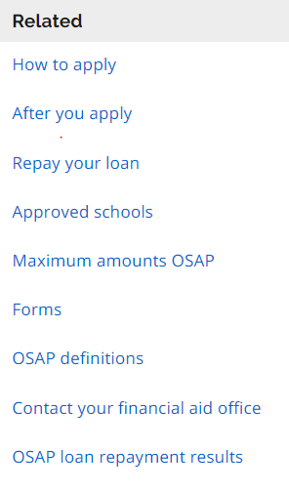
Graduate students should carefully review the details outlined within the OSAP website. By understanding the conditions and terms of your loans and grants, your funding will be processed without delays. CONSIDER: Update your application date for the fall/winter, income relates to your funding for the fall/winter. Funds paid out 60% Fall term and 40% winter term. In April – complete a change form to ask for an OSAP extension in order to receive a Summer term 100% OSAP payment for the term. ALWAYS: Report change of financial circumstances to OSAP. Graduate Tuition Fees vary between research/thesis based programs and professional programs. Please visit Graduate Student Awards page for more information
Learn about OSAP
https://www.ontario.ca/page/after-you-apply-osap#section-0
Notes:
The MyTrent portal is a communication tool and it is where students are directed to for making a payment towards their student account. Clicking on the icons and drilling into allows you to perform the desired function.
I recommend students look around their MyTrent student account and become familiar with the information available.

Slide 5
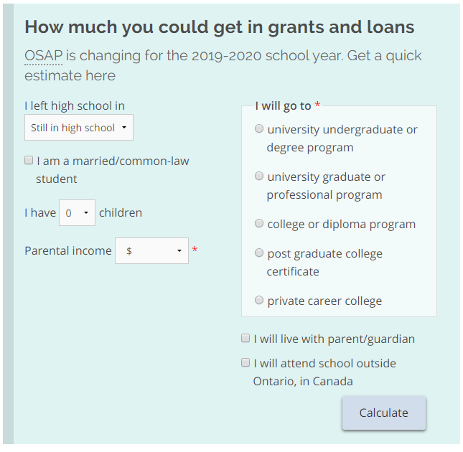
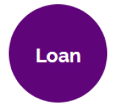
What is OSAP?
Government student assistance program for Ontario residents
Combination of Federal and Provincial Loans and Grants
Amount of funding based on a number of variables: family income, family size, assets, etc.
= Money you keep
= Money you pay back
www.ontario.ca/osap
Funding Your Post Secondary Education

Slide 6
Scholarships/Awards & Income – What do I report to OSAP?
 | Income or Award | Report to OSAP
Scholarships/Fellowships | Award | YES
Supervisor Support/TA | Income | YES
Employment Income | Income | YES
Ontario Graduate Scholarship (OGS) | Award | NO – Trent reports

Slide 7
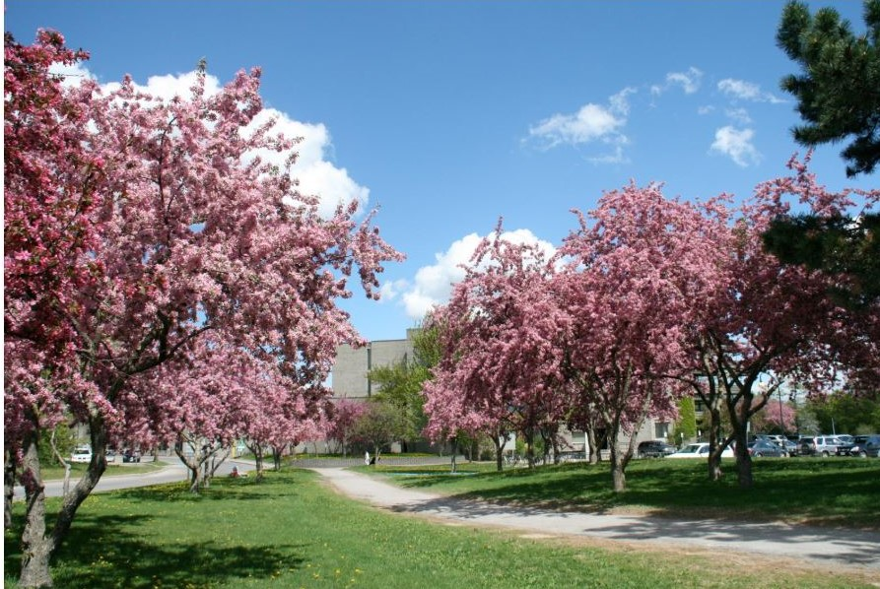
Student Access Guarantee
If you attend a public postsecondary institution in Ontario and you’re a full-time student, you may also be eligible for financial help through the Student Access Guarantee (SAG).
SAG is a partnership program between the ministry and Ontario’s public colleges and universities.
Through SAG, Ontario’s publicly assisted colleges and universities are required to ensure that financial
need is not a barrier to accessing education.
If OSAP doesn’t cover your program costs and you still need money, your school may provide additional financial aid in the form of a:
bursary
scholarship
https://www.ontario.ca/page/how-apply-osap#section-1

Slide 8
Access the OSAP Resources
OSAP Portal - Log in or Register
Learn about OSAP
How to Apply for OSAP
After you Apply
Repay your Loan
Students with Disabilities
OSAP Definitions
Changes to OSAP – submit OSAP Change form online via myTrent portal under FINANCES tab

Slide 9
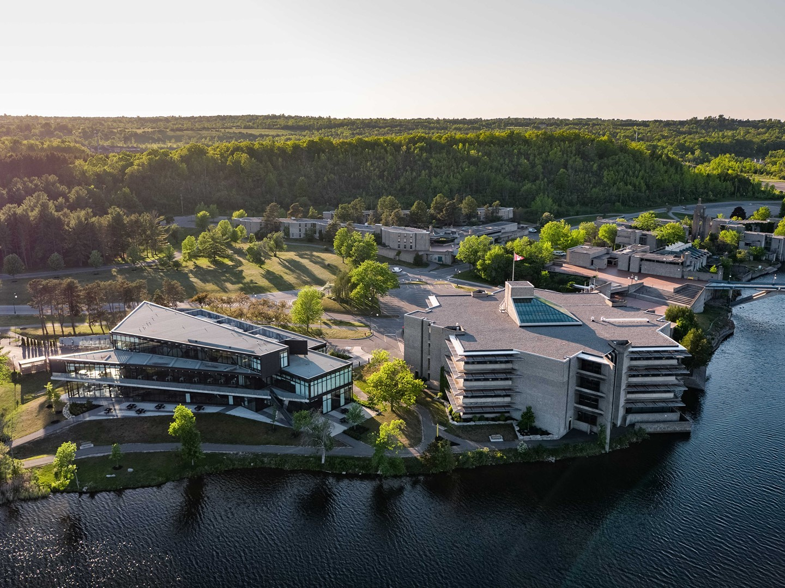
OSAP – Key Points
Program Information – one, two or three terms
Percentage of course load – 100% unless part-time or disability status on OSAP
Current situation – married, single, sole-support
Assets - RRSPs
Include – savings bank accounts including TFSAs, GICs, stocks, Canada Savings Bonds, etc…
DO NOT include – vehicles, principal residence, RRSPs, RESPs, Child Tax Benefit, etc…
Scholarships & Bursaries
Income
Income for prior year
Expected earnings while in school (employment)
Any Government Assistance (OW, ODSP, EI)
Non-taxable income such as child support

Slide 10
National Student Loans Service Centre
Register account online via MFSAA process
Set-up account to receive funds (your bank account)
Track your student loan and grant status
Receive important updates & alerts
Helpful tools, tips and other resources to manager student funding
Loan Repayment
Starts 6 months after you cease to be a full-time student
RAP Program – monthly payments will either be reduced or not expected for 6 month – criteria and application online via NSLSC website

