Slide 1
Graduate Bursaries
School of Graduate Studies
Jane Rennie
Graduate Finance Officer

Slide 2
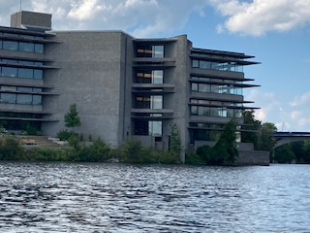
Bursaries
The bursary program for graduate students at Trent University is administrated by the School of Graduate Studies. Bursaries are meant to supplement, not replace, provincial government aid programs and a student’s own resources. Bursaries are awarded each term to students with demonstrated financial need.
All graduate students are encouraged to apply for OSAP, Canada part time student loans, native band funding, or the government financial aid program of their home province.
Government programs may provide grants, which are funds that are not required to be paid back. Student grants generally exceed the bursary funds that the School of Graduate Studies provide.
Please reference the Graduate Studies Academic Calendar for additional award listings.
https://www.trentu.ca/graduatestudies/tuition-awards-funding/graduate-bursaries

Slide 3
The Process
Bursary applications are posted on the MyTrent portal under the Finance Tab, each term during the first week of September, January and May with a deadline around the 28th of the same month.
Bursaries are assessed and finalized within 6-8 weeks.
Students should not rely on bursaries to finance their academics as they are intended to provide a small top up to a student’s own resources.
Please reference the Graduate Studies Academic Calendar for additional award listings.

Slide 4
Commitment to Equity, Diversity and Inclusion
The School of Graduate Studies is actively committed to creating a diverse and inclusive campus community. We encourage bursary applications from all students.
Our bursary application is open to international and domestic students, part-time and full-time students and students in research and professional graduate programs.
The School of Graduate Studies is committed to review every bursary application submitted to determine financial eligibility and need.
Every member of Trent University, faculty, staff or student has a right to freedom from discrimination in the University by another faculty, staff member, or student because of age, ancestry, citizenship, colour, creed, disability, ethnic origin, family status, gender identity/expression, marital status, place of origin, race, sex and sexual orientation.

Slide 5
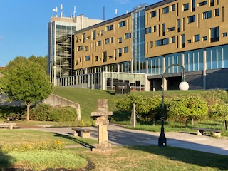
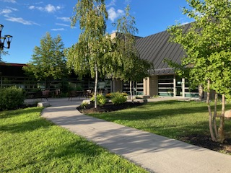
Challenge The Way You Think

