Slide 1

Scholarship Applications
Outline of Proposed Research
Master’s (OGS / QEII-OGSST)
2026-27
Jane Rennie
Graduate Finance Officer
School of Graduate Studies

Slide 2

Ontario Graduate Scholarship
&
Queen Elizabeth II Graduate Scholarship in Science and Technology
Since 1975, the Ontario government, in partnership with Ontario’s publicly assisted universities, has supported excellence in graduate studies at the master’s and doctoral levels through the Ontario Graduate Scholarships (OGS) program. OGS awards are merit-based and available to students in all disciplines of graduate study.
The Queen Elizabeth II Graduate Scholarships in Science and Technology (QEII-GSST) program complements and aligns with the OGS program. QEII-GSST awards are merit-based scholarships for domestic graduate students conducting research in science and technology fields.
Both OGS and QEII-GSST awards are allocated annually to eligible Ontario universities. At Trent, applicants can be considered for both programs through a single online application.
Deadline: February 6, 2026
Value: $15,000

Slide 3
Which
Selection Review Committee should you Select?
If your field of research best aligns with NSERC choose:
Doctoral Sciences / Social Sciences
Master's Science / Social Sciences
If your field of research best aligns with SSHRC choose:
Doctoral Humanities & Arts / Social Sciences
Master's Humanities & Arts / Social Sciences
NSERC – Natural Sciences and Engineering Research Council
The intended objective(s) of the research must primarily be to advance knowledge in one or more of the natural science or engineering disciplines.
------------------------------------------------------------------------------
SSHRC – Social Sciences and Humanities Research Council
The intended outcome of the research must primarily be to add to our understanding and knowledge of individuals, groups, and societies – what we think, how we live and how we interact with each other and the world around us.

Slide 4


OGS / QEII-OGSST:
Program of Study Eligibility
An eligible graduate program must include a significant research component that leads to the completion of a thesis, major research project, dissertation, scholarly publication, performance, recital and/or exhibit that is merit/expert reviewed at the institutional level as a requirement for completion of the program.
Trent applicants may contact: graduatefinance@trentu.ca to clarify program of study eligibility for an Ontario Graduate Scholarship.

Slide 5

Eligibility Time for OGS / QEII-OGSST
Applicants must have enough eligibility time remaining in their current or proposed graduate program to hold the scholarship.
Master’s Level:
Scholarship can be held for up to 2 years.
Must not have exceeded 24 months of full-time graduate study during the award period.
Doctoral Level:
Scholarship can be held for up to 4 years.
Must not have exceeded 48 months of full-time doctoral study during the award period.
Additional Requirements:
Must not have exceeded the 6-year lifetime maximum of government-funded student award support.
Cannot concurrently hold another government-funded scholarship.

Slide 6
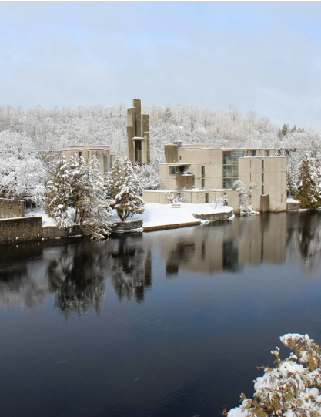
OGS / QEII –OGSST Competition Instructions
2026-27
It is challenging to develop a winning scholarship application if you do not read the scholarship program description completely first and understand all its required components.
Review the instruction on the Ontario Graduate Scholarship website

Slide 7




First Tasks
Before starting your application, make sure to review the website to determine your eligibility.
Review the Ontario Graduate Scholarship webpage.
Check MyTrent: Access the OGS/QEII-OGSST 2026-27 application on your student MyTrent portal under the Finances tab.
Explore Financial Matters: Review "How to Win Scholarships" for valuable resources.
Register for Q&A Sessions: Sign up for OGS Application Question & Answer sessions if you have any further questions.
This will help ensure you have all the information you need!

Slide 8
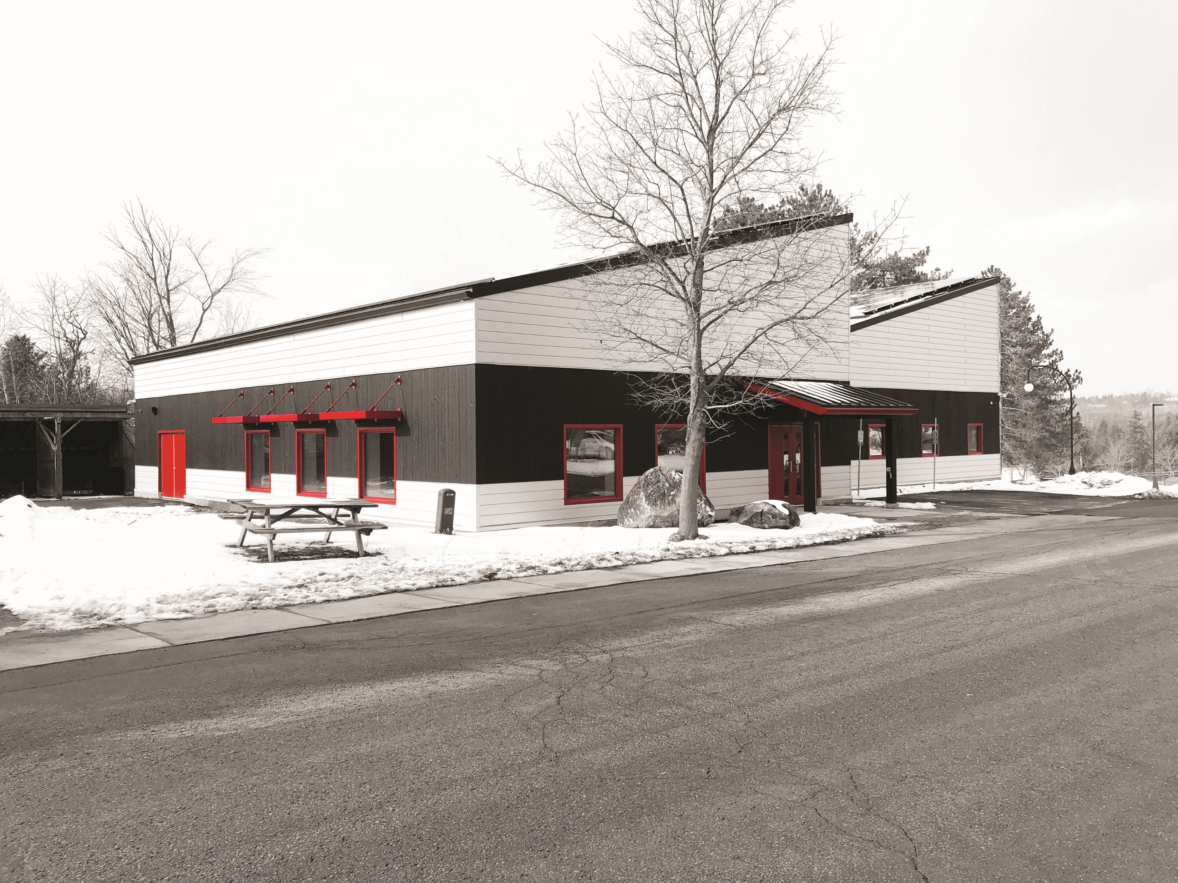
How your First-Class Average (A- 80%) at Trent is Calculated
Typically, if the applicant is in 4th year of their undergraduate studies, the grades used will be:
UG Third year (Last Academic Period)
August 31, 2025 to September 1, 2024
UG Second year (Second Last Academic Period)
August 31, 2024, to September 1, 2023
First year Graduate Student – grades used:
UG fourth year (Last Academic Period)
August 31, 2025, to September 1, 2024
UG third year (Second Last Academic Period)
August 31, 2024, to September 1, 2023
Financial Matters – Upcoming Workshops
Notes:
Task-by-task guidelines

Slide 9

Selection Criteria for Master’s Level applications
Academic excellence (weight 50%)
As demonstrated by past academic results, transcripts, awards and distinctions
Research potential (weight 30%)
As demonstrated by your research history, your interest in discovery, the proposed research, its potential contribution to the advancement of knowledge in the field and any anticipated outcomes
Personal characteristics and interpersonal skills (weight 20%)
As demonstrated by your past professional and relevant extracurricular interactions and collaborations
Applicants should consider the indicators of the assessment criterion when drafting their winning scholarship application.

Slide 10
Selection Criteria
(Trent uses Tri Council CGRS – M Policies for Assessment of OGS / QEII-OGSST)
Academic Excellence, 50% weight
As demonstrated by past academic results, transcripts, awards and distinctions
Indicators of academic excellence:
academic record
scholarships and awards held
duration of previous studies
type of program and courses pursued
course load
relative standing (if available)
Research Potential, 30% weight
As demonstrated by your research history, your interest in discovery, the proposed research, its potential contribution to the advancement of knowledge in the field and any anticipated outcomes
Indicators of research potential:
quality and originality of contributions to research and development
relevance of work experience and academic training to field of proposed research
significance, feasibility and merit of proposed research
sound judgment and ability to think critically
ability to apply skills and knowledge
initiative and autonomy
research experience and achievements relative to expectations of someone with your academic experience
Personal characteristics and interpersonal skills, 20% weight
As demonstrated by your past professional and relevant extracurricular interactions and collaborations
Indicators of personal characteristics and interpersonal skills:
work experience
leadership experience
project management, including organizing conferences and meetings
ability or potential to communicate theoretical, technical or scientific concepts clearly and logically in written and oral formats
involvement in academic life
volunteerism/community outreach

Slide 11
Application Instructions
Section A
Academic Background: List all schools attended and completed degree program(s), including: institution and month/year the degree was awarded or is expected. Maximum one page.
Academic, Research, Relevant Work Experience: Include institutions or organizations, period of employment, and position. Maximum one page.
Awards and Prizes: Please provide name, source, year awarded, duration, and value of awards and prizes received. Start with the most recent award and included up to a maximum of 10 items. Maximum one page.
Special Circumstances: If appropriate, describe any interruptions or delays to the completion of your degree(s). Specify the dates of the interruption or delay. Maximum half page.
Section B
Outline of Proposed Research: Provided a detailed description of your proposed research project, using clear and plain language. Avoid jargon. Exceeding the page limits will result in ineligibility.
Master's Applicants: Maximum one page.
Doctoral Applicants: Maximum two pages.
Bibliography: One page for Master's applicants; up to five additional pages for Doctoral applicants.
Contributions to Research: Include publications, reports, posters, bibliographies, conference presentations, and indicate where publications resulted from work done in the process of completing your undergraduate degree, master's degree, or while working on doctoral studies, or from other relevant work experience. Maximum one page.
Interpersonal/Communication/Leadership Abilities: Describe the activities (professional and relevant extracurricular) in which you are involved that demonstrate your communication, interpersonal, and leadership skills. Maximum one page

Slide 12
Presentation Standards
–for OGS follow Tri Council standards
(NSERC Example)
Documents that have been password protected cannot be read and, therefore, cannot be attached.
The filename of a document should be fewer than 15 characters long and cannot contain special characters (excluding the underscore).
Any section that is not used for its intended purpose may be redacted or removed from the application.
You are responsible for uploading a complete application that aligns to the NSERC online presentation and attachment standards. (SSHRC Standards)
Incomplete applications and applications that do not meet presentation standards may be rejected or may be at a disadvantage in comparison to those that are complete and respect the presentation standards.

Slide 13



Outline of Proposed Research Instructions

Slide 14




OGS ~ QEII-OGSST
Master’s Program Instructions
The single attachment consists of two separate sections: Outline of proposed research and Bibliography and citations.
Each of these sections must be only one page.
Going over allowable pages and your application could be deemed ineligible. Any words over limit will be redacted.
If you have not yet decided on a specific project, you must still provide a detailed description of a proposed research project.

Slide 15


Instructions Master’s
(following Tri-Council CGRS –M Instructions)
Outline of proposed research (one page maximum)
Provide a detailed description of your proposed research project for the period during which you will hold the award.
Be as specific as possible.
Provide background information to position your proposed research within the context of current knowledge in the field.
State the objectives and hypothesis and outline the experimental or theoretical approach to be taken (citing literature pertinent to the proposal) and the methods and procedures to be used.
State the significance of the proposed research to a field or fields in the health sciences, natural sciences and/or engineering or social sciences and/or humanities, as appropriate.
Provide projected timelines for the research, including community consultation, plans for collaboration, and knowledge translation strategies.
Where applicable, address how your research complies with established research-related policies and protocols (e.g., protocols for conducting research respectfully involving and engaging the First Nations, Inuit and Métis Peoples of Canada; approvals for research involving the use of humans, animals or biohazards).

Slide 16
Various Proposal Frameworks
Hour-Glass Style
Inverted Triangle
Background of research, broad overview
Introduce important concepts, what is known and what is unknown
Research question
Methodology
Data analysis
Contribution to knowledge in field and broader impact
Big picture, relevance/importance of problem
Theoretical Frame: Situate study in body of theory
Research question
Methodology: Underlying approach to the research
Method: How will you do it?
Data analysis
Dissemination of research

Slide 17

Key Components to Include
🔍 Research Outline
Main Challenge or Issue: What problem are you addressing?
What’s Known and Unknown: Briefly explain what researchers already know and what gaps still exist.
Research Questions: What specific questions will your research try to answer?
Theoretical and Methodological Framework: What theories and methods will guide your research?
Proposed Methods: What steps or techniques will you use to carry out the research?
Contribution to Knowledge: How will your findings advance your field or help other areas of research?
Public Good / Social Impact: How could your research benefit society or make a positive difference?

Slide 18
An outline of proposed research should clearly and concisely communicate a research plan, its significance, and the approach.
🧪 4. Methodology or Approach
Describe how you will conduct your research.
Include details on data collection, analysis techniques, and tools or models you'll use.
Justify why this approach is suitable for answering your research questions.
📊 5. Expected Outcomes or Hypotheses
Outline what you expect to find or demonstrate.
Include any hypotheses you’re testing and explain how they relate to the research questions.
📅 6. Timeline and Milestones
Break down your research into phases.
Include key milestones and estimated completion dates for each stage.
📈 7. Significance and Impact
Explain how your research will contribute to the field.
Discuss potential applications, policy implications, or societal benefits.
🧠 1. Research Problem or Challenge
Clearly state the issue your research addresses.
Explain why it matters—scientifically, socially, or economically.
📚 2. Background and Knowledge Gaps
Summarize what is already known in the field.
Identify gaps in knowledge that your research will fill.
❓ 3. Research Questions or Objectives
List the key questions your research aims to answer.
These should align with your overall goals and be specific and measurable.

Slide 19


Sample Structure of an Outline of Proposed Research: Includes Key Components
Introduction / Background
Brief context of the research area, why this topic is important .
Identify the gap your research addresses.
Research Objectives
State the main goal(s) of your research.
Include 2–3 specific objectives or research questions.
Methodology
Summarize your approach (qualitative, quantitative, mixed methods).
Key techniques, tools, or data sources.
Why this method is appropriate.
Expected Outcomes
What you aim to discover or achieve.
Potential impact on the field or society.
Timeline
High-level milestones (e.g., literature review, data collection, analysis, writing).
Significance
How your research contributes to knowledge, policy, or practice.
Any innovative aspects.

Slide 20




Research Funding Concepts

Slide 21

Equity, Diversity & Inclusion
The academic research funding ecosystem must create a culture where embedding equity, diversity and inclusion (EDI) considerations into all aspects of research is second nature.
Incorporating EDI considerations in your proposal and throughout your application, where relevant, can strengthen your application. This will be taken into consideration by the selection committee members during the adjudication process.
Tri-Agency Resources:
Guide for Applicants: Considering Equity, Diversity and Inclusion in your Application
Equity, Diversity and Inclusion (multiple)

Slide 22



Sex and Gender Based Analysis + (SGBA+)
When applicable, indicate how diversity (gender, sex, age, race, culture, religion, etc.) has been considered in your proposed research (from its design to the analysis of the research findings).
Incorporating the principles of SGBA+ in research has the potential to increase the thoroughness and usefulness of the research.
Multiple resources provided:
How to Integrate Sex and Gender into Research
Online training modules:
  Course 1: Sex and Gender Considerations in Biomedical Research
  Course 2: Sex and Gender in Primary Data Collection with Human Participants
  Course 3: Sex and Gender in the Analysis of Secondary Data from Human Participants

Slide 23



Knowledge Mobilization
Knowledge mobilization is an umbrella term encompassing a wide range of activities relating to the production and use of research results, including knowledge synesis, dissemination, transfer, exchange, and co-creation or co-production by researchers and knowledge users.
Resources from Tri-Council
What is knowledge mobilization?
Related policies and web links
Canadian Knowledge Transfer and Exchange Community of Practice website
Mapping the Impact of Research (PDF, 1.07 MB), David Phipps, York University

Slide 24


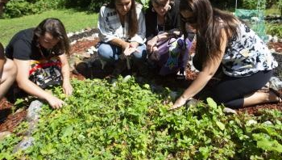
Research Involving and Engaging Indigenous Peoples
Below are SSHRC resources to support applicants working in Indigenous research; merit reviewers assessing applications related to Indigenous research; and communities and other research partners engaged in Indigenous research:
Definition of Indigenous research
Indigenous Leadership Circle in Research
Indigenous Research Statement of Principles
Tri-Council Policy Statement: Ethical Conduct for Research Involving Humans Chapter 9: Research Involving the First Nations, Inuit and Métis Peoples of Canada

Slide 25
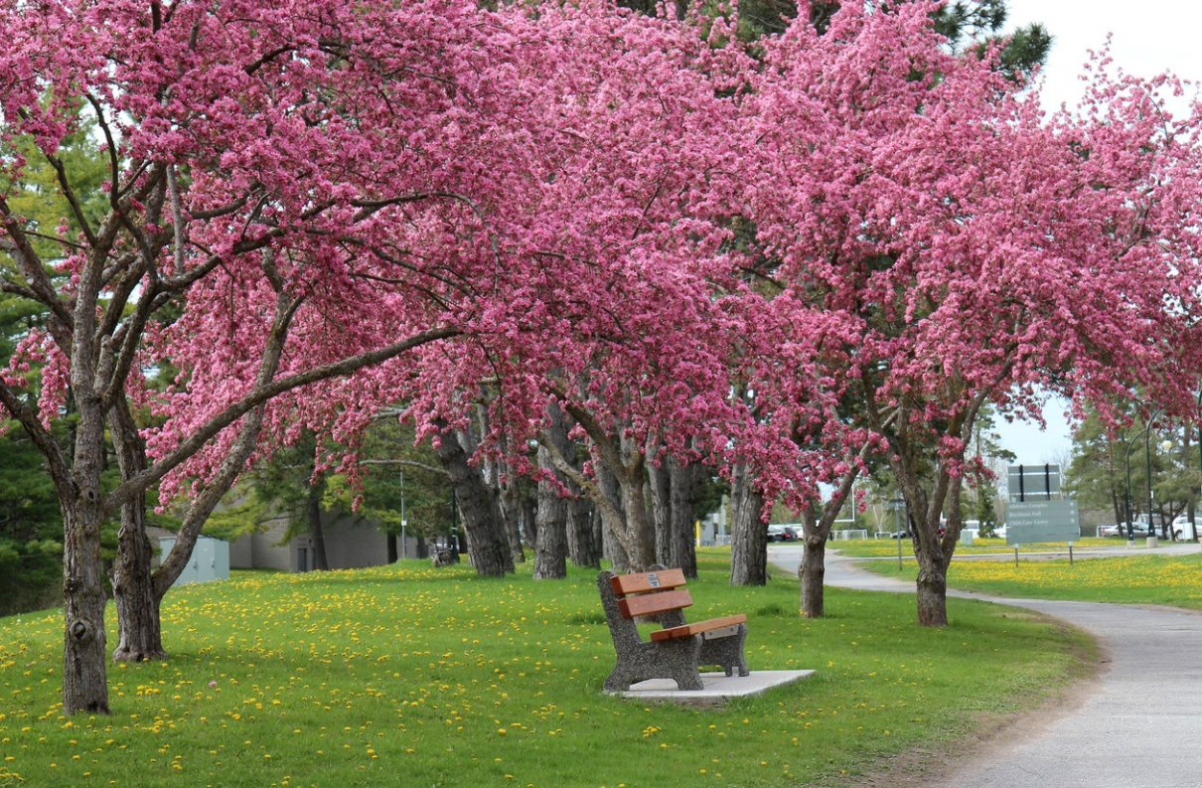
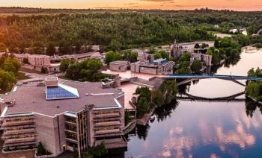
Resources for Scholarship Applications
Guidelines on the Assessment of Contributions to Research, Training and Mentoring
Health Research Training at CIHR: Training Tools
Guidelines for effective research training
Training Resources (“Career Hub”)
San Francisco Declaration on Research Assessment (DORA)

Slide 26


Quick Tips
Read all instructions, ensure you are eligible prior to starting
Start early and create a timeline to complete tasks
Edit, review, and edit again
Concisely show how your research is innovative and valuable
Demonstrate that your research is feasible and will impact your field and beyond
Demonstrate familiarity with principles of equity, diversity, inclusivity, sex and gender-based analysis, knowledge mobilization/ transfer
Submit early to allow time for any technology difficulties

Slide 27
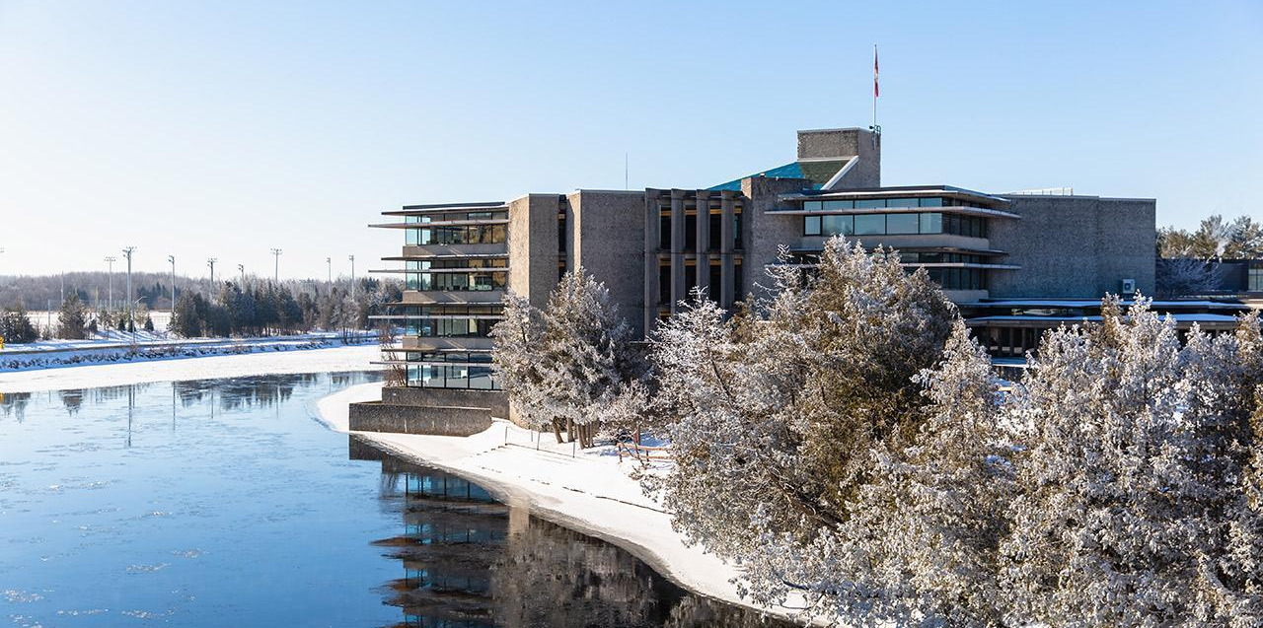
School of Graduate Studies
Blackburn Hall, Suite 115
All scholarship Applications inquires direct to: graduatefinance@trentu.ca

