Slide 1
Graduate Students & Funding your Post Secondary Education
*Domestic Students
School of Graduate Studies

Slide 2

Graduate Students – all of your OSAP questions will be addressed by Trent University’s Financial Aid Office Location: Registrar’s Office in Blackburn Hall 1600 West Bank Drive K9L 0G2 Peterborough, ON Monday to Thursday 9:00 am – 4:00 pm Friday 10:00 am – 4:00 pm Phone: 705-748-1524 OR 905-435-5102 x1524 Email: financialaid@trentu.ca Graduate funding, student accounts, scholarships are coordinated by the School of Graduate Studies.
OSAP Application Deadline Dates
Fall Only – NOVEMBER 1
Fall/Winter – MARCH 1
Summer – JULY 2

Slide 3
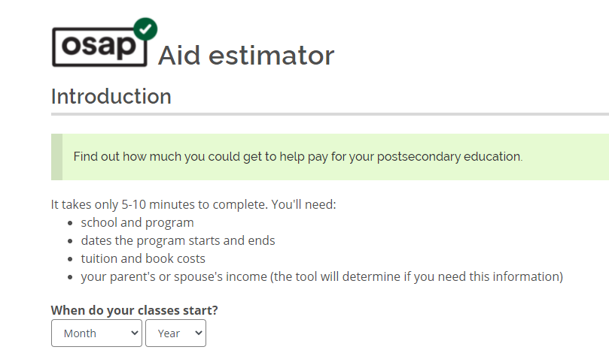
What is OSAP?
Ontario Student Assistance Program
Combination of Federal and Provincial Loans and Grants
Amount of funding based on a number of variables: family income, family size, assets, etc.
You do not have to take the loan
OSAP can help you pay for:
Tuition, books and equipment
fees charged to your Student Account
living expenses (full-time students only)
child care (for full-time and part-time students with children)
OSAP is open to Ontario residents of any age who are:
Canadian citizens, permanent residents, or protected persons
Loans = Money you pay back
Grants = Money you keep

Slide 4
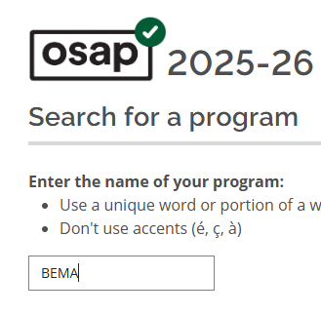
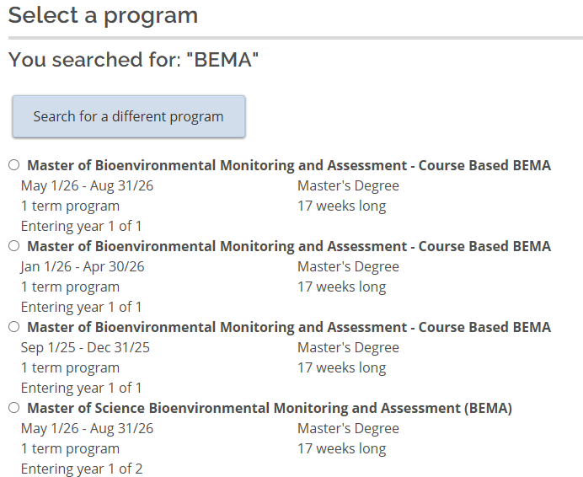
OSAP – How to Find your Program

Slide 5
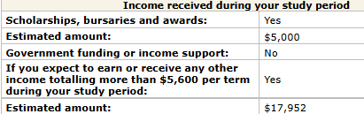
OSAP – Key Points
Program Information – one term at a time
Percentage of course load – 100% unless part-time or disability status on OSAP
Current situation – married, single, sole-support
Assets - RRSPs
Include – savings bank accounts including TFSAs, GICs, stocks, Canada Savings Bonds, etc…
DO NOT include – vehicles, principal residence, RRSPs, RESPs, Child Tax Benefit, etc…
Scholarships & Bursaries
Income
Income for prior year (verified by CRA)
Expected earnings while in school (employment)
Any Government Assistance (OW, ODSP, EI)
Non-taxable income such as child support

Slide 6
Scholarships/Awards & Income – What do I report to OSAP?
Why?
OSAP requires you report all resources
Students who incorrectly report are at risk of large overpayments and possible OSAP restriction
OSAP is designed to help supplement your own resources
Potentially reduce the amount of loans and reduce your overall student debt
Need to change what you have reported to OSAP? Use the OSAP Change of Information form on myTrent
 | Income or Award | Report to OSAP
Scholarships/Fellowships | Award | YES
Supervisor Support/TA | Income | YES
Employment Income | Income | YES
Ontario Graduate Scholarship (OGS) | Award | NO – Trent reports

Slide 7
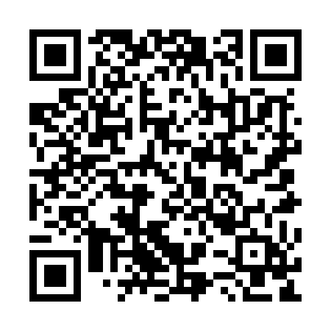
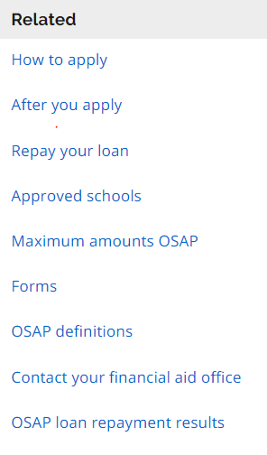

Graduate Student Specific Information
ALWAYS: Report any changes to OSAP
Change form online via myTrent portal under FINANCES - status changes - income/scholarship changes - Leave of Absence - part time/full time change - tuition refunds or changes Graduate students should carefully review the details outlined within the OSAP website. By understanding the conditions and terms of your loans and grants, your funding will be processed without delays. Graduate Tuition Fees vary between research/thesis-based programs and professional programs. The amount you pay in tuition is related to how much OSAP you may receive.
https://www.ontario.ca/page/after-you-apply-osap#section-0

Slide 8

National Student Loans Service Centre
Register account online via MFSAA process if necessary
Set-up account to receive funds (your bank account)
Track your student loan and grant status
Receive important updates & alerts
Helpful tools, tips and other resources to manager student funding
Loan Repayment
Starts 6 months after you cease to be a full-time student
RAP Program – monthly payments will either be reduced or not expected for 6 month – criteria and application online via NSLSC website

Slide 9
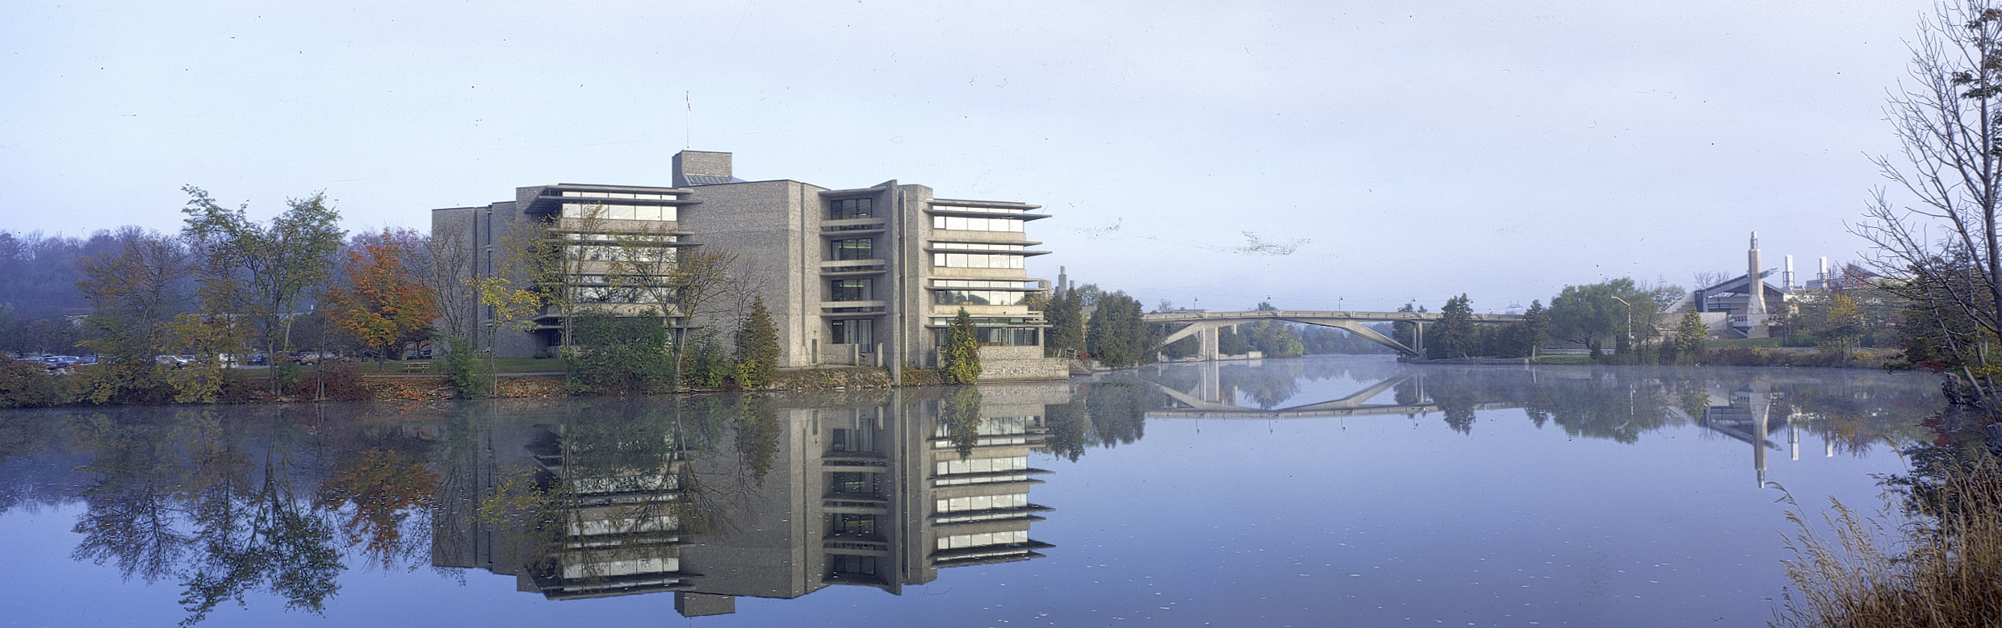
Financial Aid Office
Phone: 705-748-1524 • Email: financialaid@trentu.ca

