Slide 1

Scholarship Applications Fall 2025 Outline of Proposed Research for Canada Graduate Research Scholarship~ Master’s Program
Jane Rennie
Graduate Finance Officer
School of Graduate Studies

Slide 2
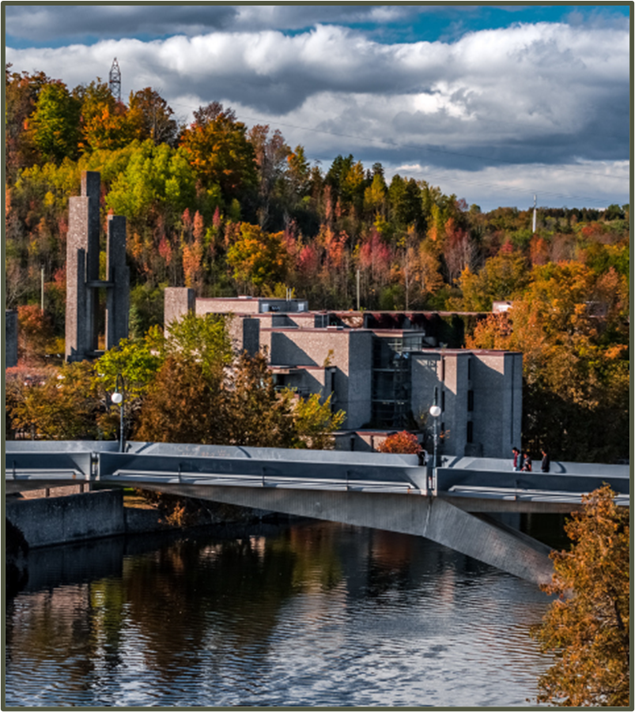
Competition Instructions
It is challenging to develop a winning scholarship application if you do not read the scholarship program description completely first and understand all its required components.
Every Tri-Agency competition has a “General Information” section with key points for an applicant’s review.
In the Outline of Proposed Research section of a scholarship application, review guidelines, presentation standards, and required inclusions prior to commencing your application.
Trent Tri Agency Competitions:
Canada Graduate Research Scholarships – Master’s Program instructions, scroll to review Outline of Proposed research
Canada Graduate Research Scholarships – Doctoral Program scroll to “Application forms and instructions” and the instructions are provided for each agency NSERC, SSHRC, CIHR

Slide 3
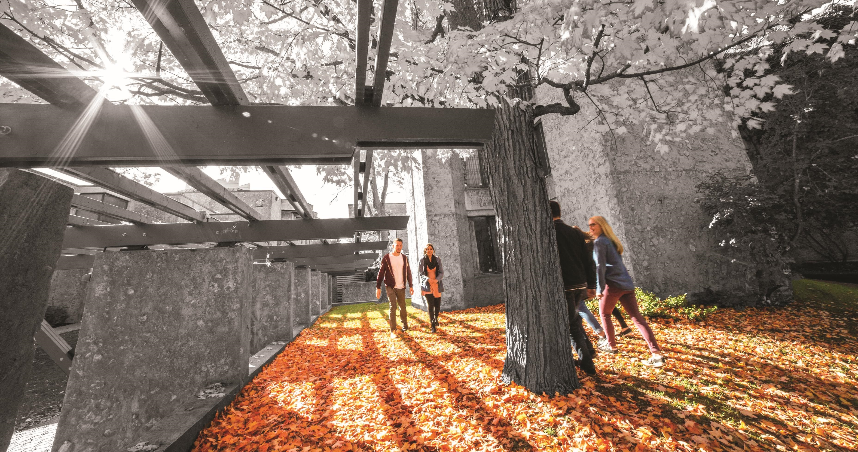
National Deadline: Canada Graduate Research Scholarship Master’s Program (CGRS_M)
December 1, 2025 @ 8:00 P.m.
Late applications will not be accepted.

Slide 4
Canadian Graduate Research Scholarship- Masters Program Scholarship Overview
Overview
Value | $27,000 for 12 months, non-renewable
Application deadline | December 1
Application procedures | See below
How to apply | The application platform (Research Portal) will open in early September, within five business days of the launch of the competition To view instructions and other resources, consult the Canada Graduate Research Scholarship – Master’s program resources web page To create or access an application, log in to the Research Portal To create a Canadian Common CV, log in to the Canadian Common CV website

Slide 5

Application procedures
Selecting the appropriate agency
Apply to the agency best aligned with your research subject matter to ensure your application will be reviewed by experts in disciplines closest to your field(s) of study. For more information, see Selecting the Appropriate Federal Granting Agency.
If you are applying to CIHR, consider the information on CIHR’s website.
If you are applying to NSERC, see the Addendum to the guidelines for the eligibility of applications related to health, which has additional information and specific examples relating to subject matter.
If you are applying to SSHRC, see the information on SSHRC's Subject Matter Eligibility web page.
It is your responsibility to select the funding agency that best suits your application.
Applications submitted to the incorrect agency may be removed from the competition.
Notes:
Google Quota’s

Slide 6
Presentation Standards
On each page of the online application, you will find instructions and tips on how to complete your application.
Some of the sections require free-form text and must be converted to portable document format (PDF) and appended electronically to the application. Documents that have been password protected cannot be read and, therefore, cannot be attached.
The filename of a document should be fewer than 15 characters long and cannot contain special characters (excluding the underscore).
Any section that is not used for its intended purpose may be redacted or removed from the application.
You are responsible for submitting a complete application that conforms to the presentation standards.
Incomplete applications and applications that do not meet presentation standards may be rejected or may be at a disadvantage in comparison to those that are complete and respect the presentation standards.

Slide 7
PRESENTATION STANDARDS CONT’d
Tri Agency provides online presentation and attachment standards that applicants must follow.
Resource Instruction Links:
Prepare your documents
Canada Graduate Research Scholarship – Master’s (CGRS M) program transcript requirements
Convert the documents
Troubleshooting tips for uploading PDF attachments in the Research Portal

Slide 8

Tri-Council Canada Graduate Research Scholarship ~ Master’s Program (CGRS – M) *Portal is hosted by NSERC
Objective
The objective of the Master’s scholarship funding opportunity is to help develop research skills and assist in the training of highly qualified personnel by supporting students who demonstrate potential to contribute to Canadian research.
Description
The CGRS M is a scholarship in the Canada Research Training Awards Suite (CRTAS) administered by the Canadian Institutes of Health Research (CIHR), the Natural Sciences and Engineering Research Council of Canada (NSERC) and the Social Sciences and Humanities Research Council (SSHRC).
The CRTAS aims to support the next generation of innovators by providing funding and high-quality research training, cultivating research skills, fostering creativity and empowering awardees to make significant contributions to Canada’s research ecosystem, economy and prosperity.
Value of CGRS – M $27,000 for 12 months

Slide 9
Selection Criteria
Academic Excellence, 50% weight
As demonstrated by past academic results, transcripts, awards and distinctions
Indicators of academic excellence:
academic record
scholarships and awards held
duration of previous studies
type of program and courses pursued
course load
relative standing (if available)
Research Potential, 30% weight
As demonstrated by your research history, your interest in discovery, the proposed research, its potential contribution to the advancement of knowledge in the field and any anticipated outcomes
Indicators of research potential:
quality and originality of contributions to research and development
relevance of work experience and academic training to field of proposed research
significance, feasibility and merit of proposed research
sound judgment and ability to think critically
ability to apply skills and knowledge
initiative and autonomy
research experience and achievements relative to expectations of someone with your academic experience
Personal characteristics and interpersonal skills, 20% weight
As demonstrated by your past professional and relevant extracurricular interactions and collaborations
Indicators of personal characteristics and interpersonal skills:
work experience
leadership experience
project management, including organizing conferences and meetings
ability or potential to communicate theoretical, technical or scientific concepts clearly and logically in written and oral formats
involvement in academic life
volunteerism/community outreach

Slide 10
NSERC / SSHRC / CIHR CGrS M Instructions
Outline of proposed research (one page maximum)
Provide a detailed description of your proposed research project for the period during which you will hold the award.
Be as specific as possible.
Provide background information to position your proposed research within the context of current knowledge in the field.
State the objectives and hypothesis and outline the experimental or theoretical approach to be taken (citing literature pertinent to the proposal) and the methods and procedures to be used.
State the significance of the proposed research to a field or fields in the health sciences, natural sciences and/or engineering or social sciences and/or humanities, as appropriate.
Provide projected timelines for the research, including community consultation, plans for collaboration, and knowledge translation strategies.
Where applicable, address how your research complies with established research-related policies and protocols (e.g., protocols for conducting research respectfully involving and engaging the First Nations, Inuit and Métis Peoples of Canada; approvals for research involving the use of humans, animals or biohazards).
Notes:
When you review the various instructions, they indicate similar details and confirm that key information must be included within the Outline of Proposed Research

Slide 11

Canada Graduate Scholarship – Master’s Program Instructions
The single attachment consists of two separate sections: Outline of proposed research and Bibliography and citations.
Each of these sections must be only one page. Going over allowable pages and your application could be deemed ineligible. Any words over limit will be redacted.
If you have not yet decided on a specific project, you must still provide a detailed description of a proposed research project.
You are expected to write your outline of proposed research independently. Ideas and text belonging to others must be properly referenced.
Include all relevant information in the outline. Do not refer reviewers to URLs or other publications for supplemental information.
In the outline of proposed research, provide the requested information according to the guidelines and format standards outlined in the presentation standards.

Slide 12
BIBLIOGRAPHY AND CITATIONS (ONE PAGE MAXIMUM)
Provide a bibliography that includes citations for all works referenced in the research proposal.
These citations should be in a format used by the primary discipline of the proposed research.
You must ensure that all citations are clear and complete to allow reviewers to easily locate the sources.

Slide 13
Various Proposal Frameworks
Hour-Glass Style
Inverted Triangle
Background of research, broad overview
Introduce important concepts, what is known and what is unknown
Research question
Methodology
Data analysis
Contribution to knowledge in field and broader impact
Big picture, relevance/importance of problem
Theoretical Frame: Situate study in body of theory
Research question
Methodology: Underlying approach to the research
Method: How will you do it?
Data analysis
Dissemination of research

Slide 14

Elements to include
🔍 Research Outline
Main Challenge or Issue: What problem are you addressing?
What’s Known and Unknown: Briefly explain what researchers already know and what gaps still exist.
Research Questions: What specific questions will your research try to answer?
Theoretical and Methodological Framework: What theories and methods will guide your research?
Proposed Methods: What steps or techniques will you use to carry out the research?
Contribution to Knowledge: How will your findings advance your field or help other areas of research?
Public Good / Social Impact: How could your research benefit society or make a positive difference?

Slide 15

Elements to include within Outline of Proposed Research
Background & Context
Briefly explain the problem or gap your research addresses.
Include relevant literature or theoretical framework.
Research Question(s) or Hypothesis
State your central question(s) or hypothesis clearly.
Ensure they are focused and researchable within a 12-month timeline.
Objectives
List 2–4 specific goals.
Use action verbs (e.g., analyze, evaluate, develop).
Methodology
Describe your approach: qualitative, quantitative, mixed methods, etc.
Include data sources, tools, techniques, and analysis plans.
Significance & Impact
Explain how your research contributes to your field, community, or society.
Mention potential applications or policy relevance.
Timeline
Outline major milestones (e.g., literature review, data collection, analysis, writing).
Show feasibility within the 1-year CGRS-M period.
References
Include 3–5 key citations in a compact format (e.g., APA or MLA).

Slide 16

Equity, Diversity & Inclusion
The academic research funding ecosystem must create a culture where embedding equity, diversity and inclusion (EDI) considerations into all aspects of research is second nature.
Incorporating EDI considerations in your proposal and throughout your application, where relevant, can strengthen your application. This will be taken into consideration by the selection committee members during the adjudication process.
Tri-Agency Resources:
Guide for Applicants: Considering Equity, Diversity and Inclusion in your Application
Equity, Diversity and Inclusion (multiple)

Slide 17

Research Involving and Engaging Indigenous Peoples
Below are SSHRC resources to support applicants working in Indigenous research; merit reviewers assessing applications related to Indigenous research; and communities and other research partners engaged in Indigenous research:
Definition of Indigenous research
Guidelines for the Merit Review of Indigenous Research
Indigenous Leadership Circle in Research
Indigenous Research Statement of Principles
Tri-Council Policy Statement: Ethical Conduct for Research Involving Humans Chapter 9: Research Involving the First Nations, Inuit and Métis Peoples of Canada

Slide 18



Sex and Gender Based Analysis + (SGBA+)
When applicable, indicate how diversity (gender, sex, age, race, culture, religion, etc.) has been considered in your proposed research (from its design to the analysis of the research findings).
Incorporating the principles of SGBA+ in research has the potential to increase the thoroughness and usefulness of the research.
Multiple resources provided:
How to Integrate Sex and Gender into Research
Online training modules:
Course 1: Sex and Gender Considerations in Biomedical Research
Course 2: Sex and Gender in Primary Data Collection with Human Participants
Course 3: Sex and Gender in the Analysis of Secondary Data from Human Participants

Slide 19



Knowledge Mobilization
Knowledge mobilization is an umbrella term encompassing a wide range of activities relating to the production and use of research results, including knowledge synesis, dissemination, transfer, exchange, and co-creation or co-production by researchers and knowledge users.
Resources from Tri-Council
What is knowledge mobilization?
Related policies and web links
Canadian Knowledge Transfer and Exchange Community of Practice website
Mapping the Impact of Research (PDF, 1.07 MB), David Phipps, York University

Slide 20
Quick Tips
Read all instructions, ensure you are eligible prior to starting
Start early and create a timeline to complete tasks
Edit, review, and edit again
Concisely show how your research is innovative and valuable
Demonstrate that your research is feasible and will impact your field and beyond
Submit early to allow time for any technology difficulties

Slide 21
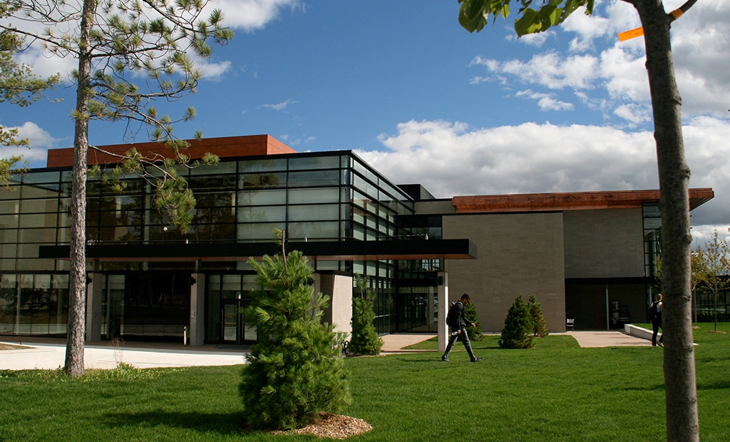
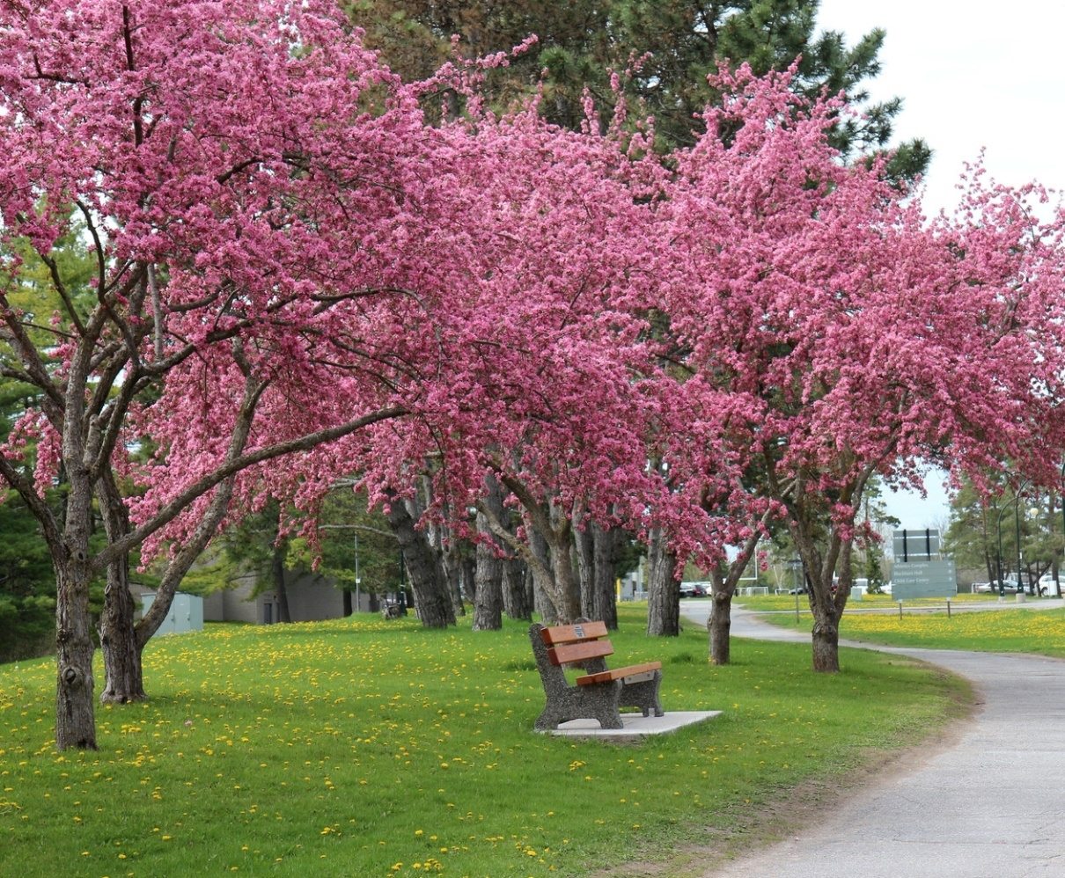
Resources for Scholarship Applications
Guidelines on the Assessment of Contributions to Research, Training and Mentoring
Health Research Training at CIHR: Training Tools
Guidelines for effective research training
Training Resources (“Career Hub”)
San Francisco Declaration on Research Assessment (DORA)

Slide 22

School of Graduate Studies Blackburn Hall, Suite 115 All scholarship Applications inquires direct to: graduatefinance@trentu.ca

