Slide 1

Trent Graduate Scholarships
Overview 2025-26
Jane Rennie
Graduate Finance Officer
School of Graduate Studies

Slide 2

Land Acknowledgement
“We respectfully acknowledge that we are on the treaty and traditional territory of the Michi Saagiig Anishinaabeg.
We offer our gratitude to the First Peoples for their care for, and teachings about, our earth and our relations. May we honour those teachings.”

Slide 3
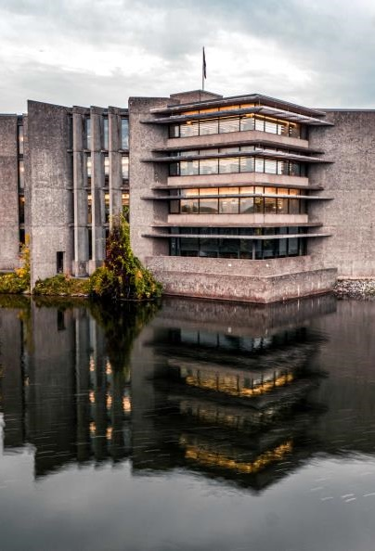
Various Types of Scholarships
As you begin your scholarship application activities it is important to understand the various types of scholarships available:
Program Scholarships: entrance scholarships, awards and funding applications.
Trent Scholarships & Funding (internal nomination required) includes Tri-Council scholarships, supplements, and the Ontario Graduate Scholarship
Trent University Donor Scholarships
External scholarships & funding – (apply directly) includes paid Internships /fellowships – such as MITACS Accelerate

Slide 4

Categories of Donor Scholarships
Program Scholarships
These types of scholarships are opportunities coordinated by your graduate program.
Entrance scholarships are a form of program scholarship and are offered within the Offer of Admission letter.
Your graduate program may have funds to award each academic year, and they will promote these opportunities.
Your graduate program will receive the applications and coordinate the adjudication of all eligible applications.
Your graduate program will advise the successful award recipients.
Donor Scholarships
Donor scholarships have eligibility terms specific to the donor’s area of interest they wish to financially support.
Application eligibility and criteria are unique to the terms of the reference for the fund. It is important to review these criteria to ensure your qualifications fit the eligibility.
These funds might be direct applications and or coordinated by the School of Graduate Studies.
Draft your application specific to the criteria of the scholarship.
Review opportunities: Scholarships and Awards

Slide 5

Thomas J. Bata Memorial Graduate Scholarship
This fund was established in honour of Thomas J. Bata (1914-2008), by his wife Sonja Bata and their family. Mr. Bata was one of Trent`s original honorary sponsors, a member of Trent’s Board of Governors between 1963 - 1973 and a close friend of Founding President Prof. T. H. B. Symons.
This $5,000 scholarship is intended to support a student that demonstrates leadership qualities such as innovation, entrepreneurship, community responsibility and global citizenship.
Deadline: October 10, 2025

Slide 6
Graduate Scholarship Competitions – with internal Trent Deadlines
Graduate Scholarship Competitions with Internal Trent Deadlines, many of which are government-funded scholarships which includes:
Canada Graduate Research Scholarship – Doctoral Program (NSERC, SSHRC & CIHR)
Canada Graduate Research Scholarship – Master’s Program (NSERC, SSHRC & CIHR)
Ontario Graduate Scholarship
Queen Elizabeth II Ontario Graduate Scholarship in Science and Technology
Autism Scholars Awards
Mackenzie King Open and Travelling Scholarship
Ontario Women’s Health Scholars Awards
These scholarships applications are initially submitted to the School of Graduate Studies by an internal deadline, which is set several weeks ahead of the national deadline.
All submissions are reviewed for eligibility, and those deemed eligible are then evaluated by the Graduate Scholarships Committee.
Top-ranked applications are forwarded in accordance with Trent’s allocated quota.
Notes:
October 15th
Feb 12, 2025 – changes to OGS

Slide 7
Updates about New Harmonized Tri-Agency Scholarships and Fellowships Program
(NSERC, SSHRC & CIHR)
In alignment with the Tri-Agency Research Training Strategy and as announced in Budget 2024, the three federal research funding agencies, the Canadian Institutes of Health Research (CIHR), the Natural Sciences and Engineering Research Council (NSERC), and the Social Sciences and Humanities Research Council (SSHRC) have launched a new harmonized talent program called the Canada Research Training Awards Suite.
A summary of the key updates to help you prepare for this change.
Notes:
*currently no CIHR or SSHRC applicants Aug 28th

Slide 8
Tri-Council Scholarship Opportunities
Canada Graduate Research Scholarships – Doctoral Program
The objective of the Canada Graduate Research Scholarships – Doctoral (CGRS D) program is to promote continued excellence in Canadian research by rewarding and retaining high-calibre doctoral students at Canadian institutions.
The CGS D program is a federal program of scholarships administered by the Natural Sciences and Engineering Research Council of Canada(NSERC), the Canadian Institutes of Health Research (CIHR) and the Social Sciences and Humanities Research Council (SSHRC).
Quota refers to the maximum number of applications an institutions can forward to each agency’s national competition. Trent University has a separate quota for each agency at the doctoral level.
Trent University Internal Deadline: Tuesday October 7, 2025 @ 11:59 p.m.
                NSERC: Online system and Instructions
                CIHR: ResearchNet and Instructions
                SSHRC: Online system and Instructions

Slide 9

Tri-Council Scholarship Opportunities (Master’s)
The objective of the Canada Graduate Research Scholarship – Master’s (CGRS M) program is to help develop research skills and assist in the training of highly qualified personnel by supporting students who demonstrate a high standard of achievement in undergraduate and early graduate studies.
An eligible graduate program must include a significant research component that leads to the completion of a thesis, major research project, dissertation, scholarly publication, performance, recital and/or exhibit that is merit/expert-reviewed at the institutional level as a requirement for completion of the program.
NSERC hosts the information for this opportunity and the application portal.
National Deadline: December 1, 2025 @ 8:00 p.m.

Slide 10
Ontario Graduate Scholarship
Application Deadline: February 6, 2026
Since 1975, the Ontario government, in partnership with Ontario's publicly assisted universities, has encouraged excellence in graduate studies at the master's and doctoral levels through the awarding of Ontario Graduate Scholarships (OGS). OGS awards are merit-based scholarships available to students in all disciplines of graduate study.
The Queen's Elizabeth II Graduate Scholarships in Science and Technology (QEII-GSST) program is in addition to and harmonized with the OGS program. QEII-GSST awards are merit-based scholarships available to domestic students in graduate studies undertaking research in science and technology fields.
The OGS and QEII-GSST award are annually allocated to eligible universities in Ontario. OGS awards are intended to support graduate students enrolled in all disciplines at the master's and doctoral levels. At Trent, applicants can be considered for both the OGS and QEII-GSST through an online application.
Awards are open to School of Graduate Studies graduate programs that have a significant research component. A significant research component is original, autonomous research that leads to the completion of a thesis, major research project, dissertation, and/or scholarly publication, that is merit/expert-reviewed at the institutional level as a requirement for completion of the program.

Slide 11
Direct Scholarship Competitions & Funding Opportunities
Direct Scholarship Competitions & Funding Opportunities
It is up to the student’s initiative to research for these opportunities, and they tend to be called scholarships, awards, or fellowships examples include:
Scholarships & Fellowships
Pierre Elliott Trudeau Foundation (November)
Canadian Water Resources Association Scholarships (Winter)
Weston Family Awards in Northern Research (Winter)
Henry Mandelbaum Masters Fellowship Award (March)
Henry Mandelbaum Doctoral Fellowship Award(March)
Laura Bassi Scholarship (July, November & winter)
IODE Ontario Lucy Morrison Memorial Fund for Education (Open)
Another type of direct application funding opportunities are from external organizations that offer financial support for thesis writing and editing, or to cover expenses associated with research travel, and conference participation.

Slide 12
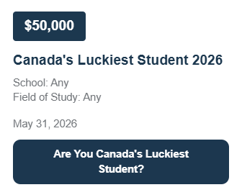

External funding Databases
Students can use these external funding databases to search for further opportunities.
Calgary Foundation Student Awards Portal
International Scholarships
Scholarships Canada
Yconic

Slide 13

Research Funding Ecosystem

Slide 14

What to consider when Reviewing Graduate Funding Applications
Overview
A high-level summary of the funding opportunity, including its purpose, scope, value, duration and key timelines.
Eligibility
The specific criteria that applicants must meet to qualify, as well as guidelines for adjudicators to assess an applicant’s eligibility.
Instructions for Applicants
A step-by-step guide outlining the tasks and documents required to complete a successful application.
Information for Institutions (if applicable)
Details to help applicants understand the internal processes at their institution.
Information for Referees
Important guidance for referees. Reminder: review as the applicant and be sure to share this section with your referee.

Slide 15

ALWAYS Confirm your Eligibility before starting

Slide 16

Before you start a
Tri-Agency application
Review the General Guidelines for Eligibility of Subject Matter as it is critical to submit your application to the correct Agency.
Read the application instructions.
Get organized and plan out a scholarship application timeline noting key task timelines.
Notes:
Google Quota’s

Slide 17

Research Funding concepts

Slide 18
Equity, Diversity and Inclusion
The academic research funding ecosystem must create a culture where embedding equity, diversity and inclusion (EDI) considerations into all aspects of research is second nature.
Incorporating EDI considerations in your proposal, where relevant, can strengthen your proposal and will be taken into consideration by the selection committee members during their review.
Tri-Agency Resources
They provide a wealth of information to help draft a winning application.
Guide for Applicants: Considering Equity, Diversity and Inclusion in Your Application
Equity, Diversity, and Inclusion (Multiple)

Slide 19
Resources
Resources:
Unconscious bias training module (19 minutes) This training module focuses on unconscious bias in the evaluation process.
Further reading includes:
Unconscious Bias [ PDF (208 KB) - external link ]
Harvard tests on Implicit Association (recommended: Gender – Science, and Gender – Career tests)
Global Research Council: Statement of Principles and Actions Promoting the Equality and Status of Women in Research [ PDF ( 93 KB) - external link ]
Canada Research Chair's Program: Equity and Diversity within the Program's Peer Review Process
Status of Women Canada's Unconscious Bias – Additional Resources webpage.
Tips on reducing unconscious bias in the review process
Stanford University Gendered Innovations project

Slide 20




Sex and Gender Based Analysis + (SGBA+)
When applicable, indicate how diversity (gender, sex, age, race, culture, religion, etc.) is considered in your proposed research (from its design to the analysis of the research findings).
Incorporating the principles of SGBA+ in research has the potential to increase the thoroughness and usefulness of the research.
How to Integrate Sex and Gender into Research

Slide 21


Knowledge Mobilization
Knowledge mobilization is an umbrella term encompassing a wide range of activities relating to the production and use of research results, including knowledge synesis, dissemination, transfer, exchange, and co-creation or co-production by researchers and knowledge users.
Resources from Tri-Council
What is knowledge mobilization?
Related policies and web links
Canadian Knowledge Transfer and Exchange Community of Practice website
Mapping the Impact of Research (PDF, 1.07 MB), David Phipps, York University

Slide 22

Guides for Assessment of Contributions
Other guides that help clarify your qualifications include:
Guidelines on the Assessment of Contributions to Research, Training and Mentoring
San Francisco Declaration on Research Assessment (DORA)
* These links are filled with valuable information necessary produce a winning application

Slide 23
The Gold Mine – Vanier Selection guide
The Vanier Scholarship program is no longer active.
However, the Vanier Committee Selection Guide remains a goldmine of resources for all applicants drafting a scholarship application as the resources and explanations are all in one place.
This guide is a great tool during the editing stage of drafting your Outline of Proposed Research, as this component of your application is one of the “sources” used to assess the selection criteria.
Criterion - defines the selection criteria
Indicators - explanations of the concepts that demonstrate how the applicant meets the selection criteria
Sources - what component of the application provides an opportunity to demonstrates the applicant meets the selection criteria

Slide 24

Research Involving and Engaging Indigenous Peoples
Below are SSHRC resources to support applicants working in Indigenous research; merit reviewers assessing applications related to Indigenous research; and communities and other research partners engaged in Indigenous research:
Definition of Indigenous research
Guidelines for the Merit Review of Indigenous Research
Indigenous Leadership Circle in Research
Indigenous Research Statement of Principles
Tri-Council Policy Statement: Ethical Conduct for Research Involving Humans Chapter 9: Research Involving the First Nations, Inuit and Métis Peoples of Canada

Slide 25

Application portal

Slide 26


Tasks to Start
Log into the Portal to start your application
Review the instructions & recommended reading
Answer the demographical information
Start working on your Outline of Proposed Research
Consider who to ask for Letters of Recommendation
Order transcripts

Slide 27
Outline of Proposed Research
EXPECT – this part of your explanation will take time & you should allow additional time for edits
GUIDE – there are various guides available to assist you with how to organize and what to include in your outline of proposed research.
EDIT - ask your supervisor to review and seek out others in your field to review your outline. It is expected you will make a multiple edits of your plan until you are satisfied it fully articulates your research.

Slide 28
Canadian Common CV (CCV)
The Tri-Agency CCV refers to the Canadian Common CV (CCV) system used for funding applications submitted to Canada’s three federal research funding agencies. (CGRS-M, CGRS-D CIHR & SSHRC)
What It Is:
The Tri-Agency CCV is a standardized online CV format required for many scholarship, fellowship, and grant applications. It ensures consistency and completeness in how academic and professional information is presented.
Key Features:
Sections: education, employment, research funding history, contributions, activities, and more.
Time-consuming: It can take several hours to complete, especially the first time, so starting early is recommended.

Slide 29

Tips for CCV Success
Start early: The CCV is detailed and time-consuming. But handy to keep dates, awards and skills all in one place.
Use consistent formatting for publications and contributions.
Keep a backup of your entries in a Word or Excel file for future use.

Slide 30



Transcripts: what you need to know
Include official, up-to-date transcripts for all undergraduate and graduate studies in your application.
Keep paper copies of any uploaded transcripts—you may be asked to provide them for verification.
"Up-to-date" means transcripts issued by the Registrar’s Office during the fall session of the application year (if currently enrolled) or after your last completed term (if not currently enrolled).
Applicants are responsible for collecting, uploading, and ensuring the legibility of all transcripts via the application portal.
If you began your doctoral program in Fall 2025, you must include a transcript from this program to show your months of study.
Review the application instructions carefully to ensure compliance.

Slide 31

Benefits of Developing Scholarship applications
Enhances your confidence in key skills such as writing, critical thinking, project management, and navigating government funding portals.
Strengthens academic and discipline-specific writing—consistent practice leads to greater proficiency and clarity.
Deepens your understanding of the complexity and demands of your academic and research plan.
Develops time management skills by guiding you through a structured project timeline (i.e., the scholarship application), helping you grasp the planning and effort required to meet deadlines.
Provides valuable experience that enables you to confidently mentor emerging researchers through the scholarship application process.

Slide 32
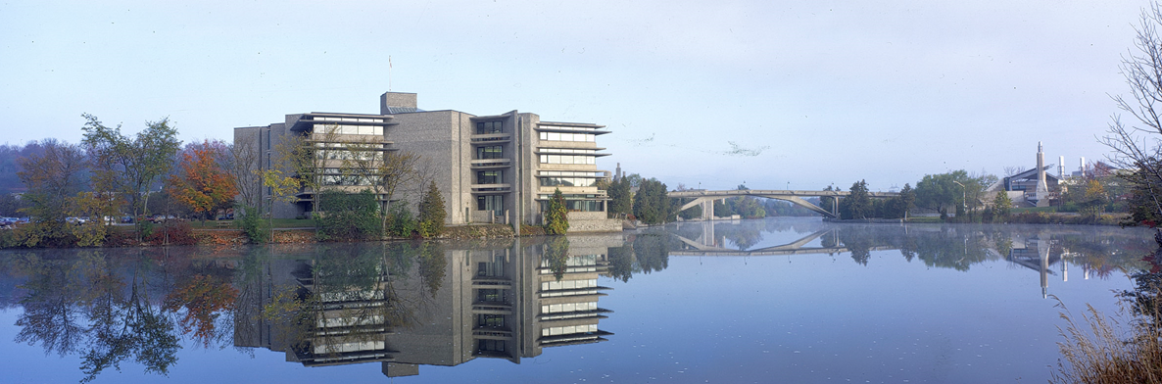
School of Graduate Studies
Blackburn Hall, Suite 115
All financial inquires direct to: graduatefinance@trentu.ca

