Slide 1
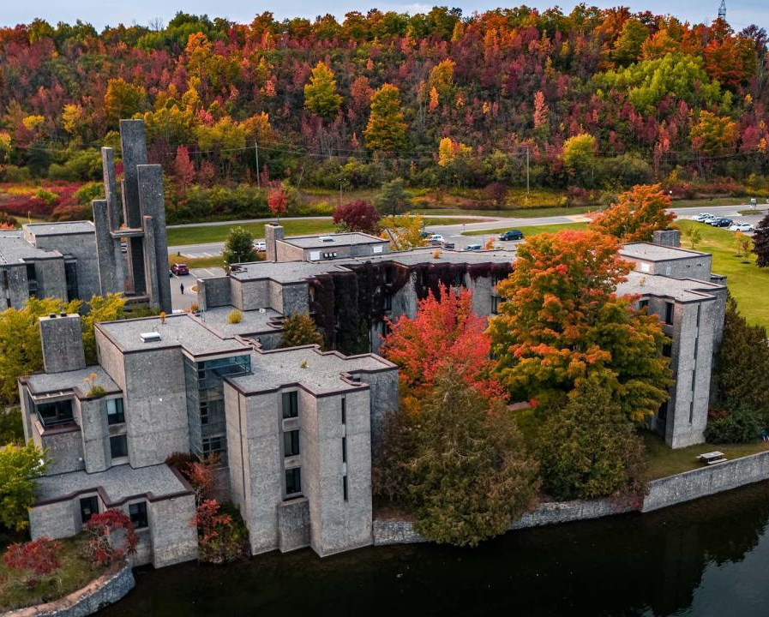
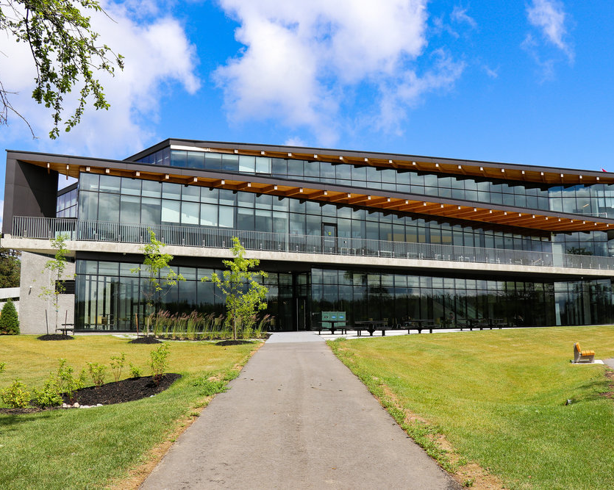

Canada Graduate Research Scholarships
Doctoral Program Overview 2025-26
Jane Rennie
Graduate Finance Officer
School of Graduate Studies

Slide 2

Land Acknowledgement
“We respectfully acknowledge that we are on the treaty and traditional territory of the Michi Saagiig Anishinaabeg.
We offer our gratitude to the First Peoples for their care for, and teachings about, our earth and our relations. May we honour those teachings.”

Slide 3




Financial Matters
Resources are available and applicants are encouraged to review the School of Graduate Studies website Financial Matters
Headings:
“How to Win Scholarships”
Tri-Council Resources
Graduate Studies Scholarship Application Resources
Many of these resources will assist you with developing your doctoral scholarship application.

Slide 4
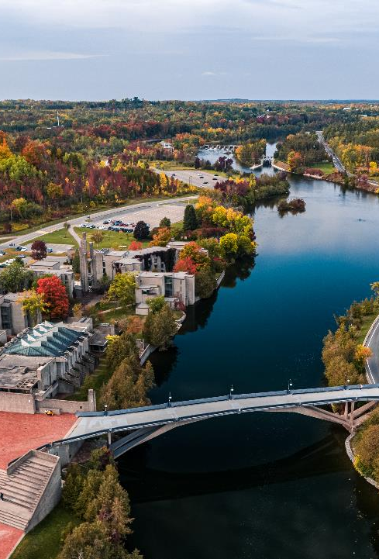
Canada Graduate Research Scholarship – doctoral Program

Slide 5

Objective
The Canada Graduate Research Scholarship — Doctoral (CGRS D) program recognizes and supports the next generation of outstanding innovators, knowledge workers, creative thinkers and researchers. By providing support for a high-quality research training experience to awardees, the program strives to foster impacts within and beyond the research environment.
The CGRS D is a scholarship in the Canada Research Training Awards Suite (CRTAS) administered by the Canadian Institutes of Health Research (CIHR), the Natural Sciences and Engineering Research Council of Canada (NSERC) and the Social Sciences and Humanities Research Council (SSHRC).
The CRTAS aims to support the next generation of innovators by providing funding and high-quality research training, cultivating research skills, fostering creativity and empowering awardees to make significant contributions to Canada’s research ecosystem, economy and prosperity.

Slide 6

Eligibility
To be eligible to apply, you must have completed no more than 36 months of full-time equivalent study in the doctoral program, for which you are requesting funding by December 31 of the calendar year of your application.
Number of months:
Eligibility for CGRS D is based on the number of months of full-time study, including summer months, you completed by December 31 of the calendar year of your application toward the degree for which you are requesting funding.
Two terms of part-time study count as one term of full-time study.
The agencies count all studies toward the doctoral degree for which funding is requested, whether or not they were completed in the same program or at the same institution.

Slide 7

International Applicants
If you are not a Canadian citizen, permanent resident of Canada or protected person under subsection 95(2) of the Immigration and Refugee Protection Act (Canada), you must be enrolled in your doctoral program of study at an eligible Canadian institution by the application deadline.
Trent Internal Deadline: October 7, 2025 @ 11:59 p.m.
Up to 15% of awards will be available to international applicants at the national level.

Slide 8

Proposed locations of tenure
You may take up your CGRS D at any eligible Canadian degree-granting institution (or eligible CIHR institution paid). To be eligible to hold your award at an international degree-granting institution, you must:
be a Canadian citizen, permanent resident of Canada or protected person under subsection 95(2) of the Immigration and Refugee Protection Act (Canada) as of the application deadline; and
have completed at least one previous undergraduate or graduate degree at a Canadian institution.
Up to 20% of all doctoral awards will be available to be held abroad.
When considering locations of tenure outside of Canada, and to help you plan for safe travels and to safeguard your research abroad, you are encouraged to consult the Government of Canada’s resources related to travel and research security.

Slide 9



Other Restrictions
You can submit a maximum of one Canada Graduate Research Scholarship – Master's (CGRS M), Canada Graduate Research Scholarship – Doctoral (CGRS D), or Canada Postdoctoral Research Award (CPRA) application per academic year to either CIHR, NSERC or SSHRC. If you submit more than one application, only the eligible application submitted first will be retained.
You can apply a maximum of three times to the CGRS D.
You cannot have already received a doctoral-level scholarship from CIHR, NSERC, or SSHRC (including a Vanier Canada Graduate Scholarship).
You cannot hold a tenure or tenure-track appointment or be on leave from such an appointment concurrently with your CGRS D award (some exceptions apply; see the Tri-agency research training award holder’s guide for details).
Notes:
Three times – nominated to go forward to the national competition

Slide 10


Application procedures
Selecting the appropriate agency
Apply to the agency best aligned with your research subject matter to ensure your application will be reviewed by experts in disciplines closest to your field(s) of study. For more information, see Selecting the Appropriate Federal Granting Agency.
If you are applying to CIHR, consider the information on CIHR’s website.
If you are applying to NSERC, see the Addendum to the guidelines for the eligibility of applications related to health, which has additional information and specific examples relating to subject matter.
If you are applying to SSHRC, see the information on SSHRC's Subject Matter Eligibility web page.
It is your responsibility to select the funding agency that best suits your application.
Applications submitted to the incorrect agency may be removed from the competition.
Notes:
Google Quota’s

Slide 11
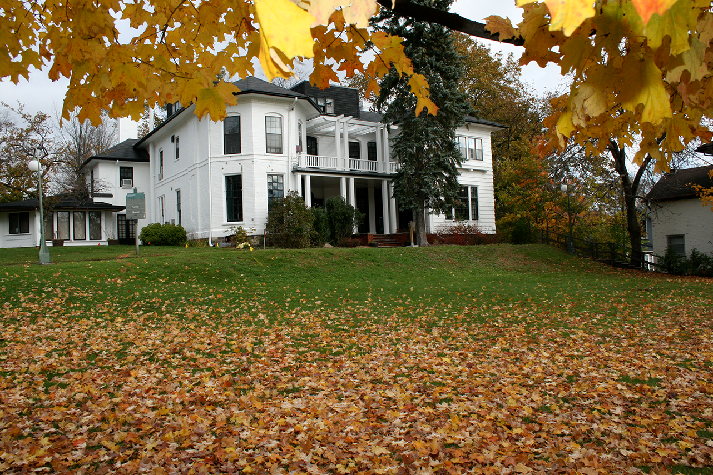

Application process
To complete the application process, see the appropriate agency’s website and instructions:
CIHR: ResearchNET and instructions
NSERC: Online system and instructions
SSHRC: Registration and login and instructions
To be considered in the competition, your application must be complete.
Each funding agency provides specific instructions, including a checklist that outlines all the required components of a complete application.
You must submit your application electronically through the relevant agency’s platform.
If you need help while preparing your application, write to the appropriate program contact well before the application deadline.

Slide 12
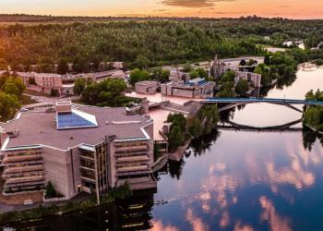
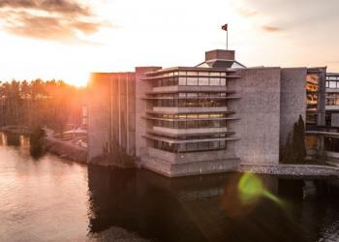
Internal Trent Deadline
October 7, 2025, by 11:59 p.m.
The various portals do not allow Trent to “close” access to the portals, but the portals record the last time the portal was accessed by the applicant.
Late applications will not be accepted.

Slide 13

Joint initiatives & Supplements
San Francisco Declaration on Research Assessment
CIHR, NSERC and SSHRC, along with other Canadian research funding agencies, are signatories of the San Francisco Declaration on Research Assessment (DORA).
The agencies are committed to meaningful assessment of excellence in research funding and to ensuring that a wide range of research results and outcomes are considered and valued as part of the assessment process.
The agencies will continue to work to ensure that their strategies, policies and guidance align with DORA.
The three agencies may offer supplementary funding to award holders, some of which is offered through joint initiatives (collaborations with organizations from across the not-for-profit, private and public sectors to support and promote training, research and connection activities).
Joint initiatives and supplements are designed to reflect the strategic objectives and mandates of each respective agency, inform decision-makers and, in certain cases, address specific needs of their partners.
See the agency websites (CIHR, NSERC, SSHRC) for more information on related opportunities.

Slide 14

Equity, Diversity and Inclusion
The three agencies are acting on evidence that achieving a more equitable, diverse and inclusive Canadian research enterprise is essential to creating the excellent, innovative and impactful research necessary to advance knowledge and understanding and to respond to local, national and global challenges.
This principle informs the commitments described in the Tri-Agency Statement on Equity, Diversity and Inclusion (EDI) and is aligned with the objectives of the Tri-Agency EDI Action Plan.
Tri-Agency Resources:
Guide for Applicants: Considering Equity, Diversity and Inclusion in your Application
Equity, Diversity and Inclusion (multiple)
Self-identification data and consent provided with applications may be used to determine eligibility for additional awards or priority funding opportunities designated for specific underrepresented groups.

Slide 15
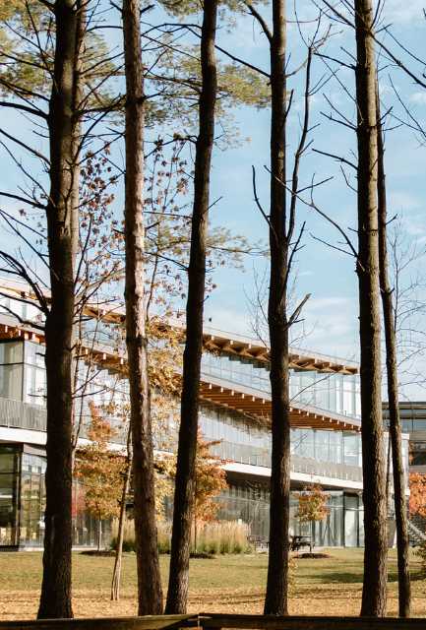
Research Involving and Engaging Indigenous Peoples
Below are SSHRC resources to support applicants working in Indigenous research; merit reviewers assessing applications related to Indigenous research; and communities and other research partners engaged in Indigenous research:
Definition of Indigenous research
Guidelines for the Merit Review of Indigenous Research
Indigenous Leadership Circle in Research
Indigenous Research Statement of Principles
Tri-Council Policy Statement: Ethical Conduct for Research Involving Humans Chapter 9: Research Involving the First Nations, Inuit and Métis Peoples of Canada

Slide 16


Understanding Selection Process
Institutional review
The School of Graduate Studies is responsible for coordinating the institutional evaluation of all applications submitted from each agency.
Based on institutional quota, the highest ranked applications are forwarded to the federal competition.
Selection criteria
Research potential (50% weight)
Relevant experience and achievements obtained within and beyond academia (50% weight)
Applicants are encouraged to review the indicators which help articulate the selection criteria
Committee selection guide is also a valuable resource

Slide 17

Selection Review Process
The review aims to identify candidates for the award and create a ranked list of alternate meritorious applicants.
Only materials submitted through the Research Portal will be considered. Any excess pages are removed before the review begins. Committee members will not refer to external URLs or publications for additional information.
The merit review must adhere to the specified selection criteria, which are weighted. Committee members must consider each criterion when assigning a global score to an application. No additional criteria may be added.
Committee members must also consider special circumstances that may have impacted the applicant’s research, career, academic or research achievements, or degree completion. Applicants should explain these circumstances in the Special Circumstances section of the application.

Slide 18
Selection Criteria
Research Potential 50%
Indicators of research potential: quality of research proposal:
  specific, focused and feasible research question(s) and/or objective(s)
  clear description and soundness of the proposed methodology
  significance and expected contributions to research
demonstration of potential to carry out proposed research relative to the stage of study, lived experience and knowledge systems
quality of contributions and extent to which they advance the field of research–contributions may include publications, patents, reports, posters, abstracts, monographs, presentations, creative outputs, knowledge translation outputs, community products, etc.
demonstration of sound judgment and ability to think critically
demonstration of responsible and ethical research conduct, including honest and thoughtful inquiry, rigorous analysis, commitment to safety and dissemination of research results and adherence to professional standards
demonstration of originality, initiative, autonomy, relevant community involvement and outreach
ability to communicate theoretical, technical and/or scientific concepts clearly and logically in written and oral formats
Relevant Experience and Achievements 50%
relevant training, such as academic training, lived experience and traditional teachings
scholarships, awards and distinctions (amount, duration, and prestige)
academic record:
  transcripts
  duration of previous studies
  program requirements and courses pursued
  course load
  relative standing in program (if available)
professional, academic, and extracurricular activities, as well as collaborations with supervisors, colleagues, peers, students and members of the community, such as:
  teaching, mentoring, supervising and/or coaching
  managing projects
  participating in science and/or research promotion
  participating in community outreach, volunteer work, and/or civic engagement
  chairing committees and/or organizing conferences and meetings
  participating in departmental or institutional organizations, associations, societies and/or clubs

Slide 19

List for a Complete Application
CGRS- D application (NSERC example)
Application profile
Personal profile
Addresses
Academic background
Academic, research and other relevant work experience
Awards
Proposed location(s) of tenure
Scholarship information
Theses completed or in progress
Keywords and research subject code
Equity, diversity and inclusion considerations in the research process
Outline of proposed research (attachment; two pages)
Bibliography (optional attachment; five pages)
Justification for eligibility of proposed research (optional attachment; one page)
Contributions and statements (attachment; two pages)
Special circumstances (optional attachment)
Transcripts and proof of registration (attachment)
Reference letters

Slide 20

Presentation Standards
Tri Agency provides online presentation and attachment standards that applicants must follow.
NSERC Presentation Standards
SSHRC Instructions for Attachments and Presentation Standards
Do not password protect your attachments
Filename of a document should be fewer than 15 characters long.
Go beyond allowable space and your application may be deemed ineligible

Slide 21
Outline of Proposed Research
Various Proposal Frameworks
Hour-Glass Style
Inverted Triangle
Background of research, broad overview
Introduce important concepts, what is known and what is unknown
Research question
Methodology
Data analysis
Contribution to knowledge in field and broader impact
Big picture, relevance/importance of problem
Theoretical Frame: Situate study in body of theory
Research question
Methodology: Underlying approach to the research
Method: How will you do it?
Data analysis
Dissemination of research

Slide 22
framework Suggestion
Research Outline – Breakdown
Main Challenge or Issue
  What problem are you addressing?
What’s Known and Unknown
  Briefly explain what researchers already know and what gaps still exist.
Research Questions
  What specific questions will your research try to answer?
Theoretical and Methodological Framework
  What theories and methods will guide your research?
Proposed Methods
  What steps or techniques will you use to carry out the research?
Contribution to Knowledge
  How will your findings advance your field or help other areas of research?
Public Good / Social Impact
  How could your research benefit society or make a positive difference?

Slide 23
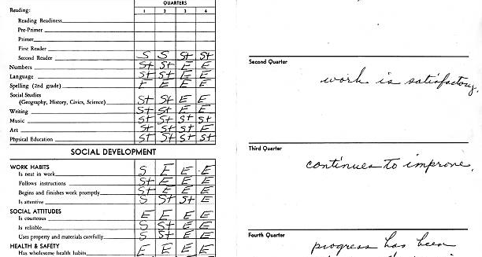
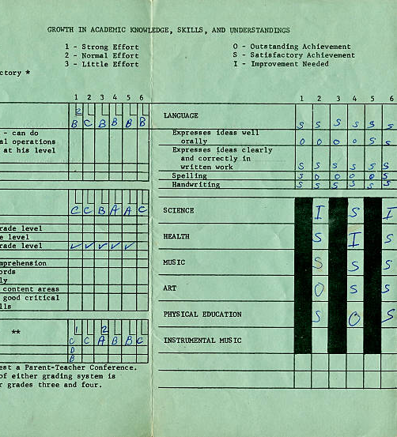
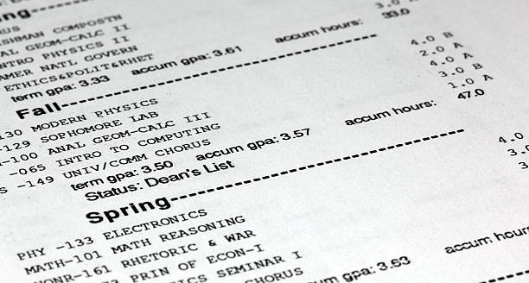
Transcripts
Include up-to-date official transcripts of ALL your undergraduate and graduate studies in the application.
Retain the paper copy of any uploaded transcripts, as you could be asked to provide it for verification purposes.
Up-to-date official transcripts are defined as transcripts issued by the Registrar’s Office and dated or issued in the fall session of the year of application (if currently registered) or after the last term completed (if not currently registered).
Applicants are responsible for collecting, uploading, and confirming legibility of previous and current transcripts and upload them directly on to the application portal.
If you have started your doctoral graduate program Fall 2025 – you must upload transcript from this program, as it indicates months of study in your graduate program.
Review the application instructions.

Slide 24
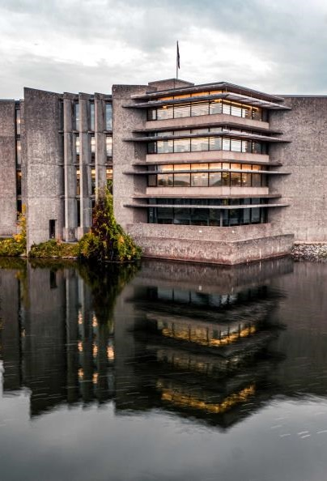
Special circumstances (optional)
Describe the impact of any special circumstances that may have delayed, disrupted or interrupted studies or research or otherwise affected the performance and or productivity on which the assessment for funding will be made.
This includes delays in disseminating research results due to health problems, family responsibilities, parental leave, disabilities, trauma and loss or other applicable circumstances. Explain any gaps in the chronology of your experience (including relevant employment). This section can also be used to describe the impact of COVID-19 on any aspect of the application.
The Special circumstances section should include the following information as needed:
The duration of the delay/interruption and, if applicable, a percentage of reduction in workload.
A clear description of its impact including, if relevant, the type of research contribution impacted (for example, publications, data collection, presentations, etc.).
For delays related to the COVID-19 pandemic, specify the impacts and how they relate to your particular circumstances (for example, lab access, equipment delays, family responsibilities, etc.). Explain what you did to adjust or compensate in response to these impacts.
The review committee members are asked to recognize delays and assess the quality of your performance and productivity during your active period (that is, excluding the period of special circumstances).
If your supervisor is unable to provide you with a reference letter, you may use this section to provide an explanation.
Notes:
Be brief, yet honest, when completing a special circumstances inclusion.
Stay factual and concise.
Assess your full application to determine if there are gaps requiring clarification for the members of the adjudication committee.
Demonstrate how the circumstances may have influenced your research, strengthened your focus, or broadened your academic development.

Slide 25
Overview of Scholarship Application Recommendation Letters
Always review the application instructions and share instructions with your “referee”
Recommendation letters might be called:
Letter of Appraisal
Report on the Applicant
Reference Assessment or Referee Assessment
It is critical that a “referee” relate their comments to the competition’s selection criteria.
They provide a meaningful commentary on an applicant’s skills, knowledge, experience, research potential and contributions.
Adjudication committee members rely on these letters to review their own ranking of the application in comparison to the pool of applicants.

Slide 26

Who? When? How?
Consider
How to ask
Who to ask?
A person who offers authority, depth and who can offer specificity. They are familiar with your research and other abilities:
Supervisor, faculty member, employment supervisor, thesis advisor
When to ask?
… early, 3 weeks before scholarship due date
Email or in-person or phone
What is your comfort level and awareness of your referee?
If in email, first message should:
Be a brief inquiry reminding the faculty member how you know them
Provide clarification as to what scholarship application you are applying for
Clearly ask if they are willing to provide an enthusiastic reference for your scholarship application
Provide the scholarship application submission deadline

Slide 27
What to provide a referee and what might be helpful
Advise your referee you will provide:
Scholarship overview
Selection criteria
Draft of your outline of proposed research
Referee instructions
Ask, would it would be helpful to provide:
unofficial transcripts;
a resume or CCV;
written blurbs for how your experience or academic background fits the selection criteria of the scholarship competition
Notes:
🌟 The Women's Classical Caucus (WCC)
📘 Commission on the Status of Women – Avoiding Gender Bias in Reference Writing

Slide 28
A strong Reference will:
Confirm the value of your research project while commenting on focus, feasibility, clarity of methodology and significance within your field of research
Indicate a familiarity with your academic achievements to date, comment on your judgement, critical thinking, originality, initiative, autonomy and enthusiasm for research
Endorse your project and your ability to achieve the outcomes of your project
Affirm quality and relevance of your contributions, considering discipline-specific norms and the work advances the field
Share insight into your training, knowledge and lived experience relevant to the research, offering context beyond grades and your CCV
Provide a robust picture of your skills and interest in and outside the lab / classroom
Highlight how you may have overcome challenges or any special circumstances that you have experienced during your academic career

Slide 29

Research Funding concepts

Slide 30



Sex and Gender Based Analysis + (SGBA+)
When applicable, indicate how diversity (gender, sex, age, race, culture, religion, etc.) is considered in your proposed research (from its design to the analysis of the research findings).
Incorporating the principles of SGBA+ in research has the potential to increase the thoroughness and usefulness of the research.
How to Integrate Sex and Gender into Research
What is Gender? What is Sex?
Online training modules:
  Sex and Gender in Biomedical Research
  Sex and Gender in Primary Data Collection with Human Participants
  Sex and Gender in the Analysis of Secondary Data from Human Participants

Slide 31

Knowledge Mobilization
Knowledge mobilization is an umbrella term encompassing a wide range of activities relating to the production and use of research results, including knowledge synesis, dissemination, transfer, exchange, and co-creation or co-production by researchers and knowledge users.
Resources from Tri-Council
What is knowledge mobilization?
Canadian Knowledge Transfer and Exchange Community of Practice website
Mapping the Impact of Research (PDF, 1.07 MB), David Phipps, York University

Slide 32

Guides for Assessment of Contributions
Other guides that help clarify your qualifications include:
Guidelines on the Assessment of Contributions to Research, Training and Mentoring
San Francisco Declaration on Research Assessment (DORA)
* These links are filled with valuable information necessary produce a winning application

Slide 33
Vanier Selection guide
The Vanier Scholarship program is no longer active.
However, the Vanier Committee Selection Guide remains a goldmine of resources for all applicants drafting a scholarship application as the resources and explanations are all in one place.
This guide is a great tool during the editing stage of drafting your Outline of Proposed Research, as this component of your application is one of the “sources” used to assess the selection criteria.
Criterion - defines the selection criteria
Indicators - explanations of the concepts that demonstrate how the applicant meets the selection criteria
Sources - what component of the application provides an opportunity to demonstrate that the applicant meets the selection criteria

Slide 34

Benefits of Developing Scholarship applications
Boosts your confidence in writing, critical thinking, project management, and navigating government portals.
Improves your academic writing through practice, helping you become more proficient in the writing style specific to your discipline.
Raises your awareness of the complexity and demands of your academic and research plan
Teaches time management by working through a project timeline (like a scholarship application), helping you understand the planning and effort needed to meet deadlines.
Prepares you to mentor others, giving you’re the experience needed to confidently guide younger researchers through the scholarship application process.

Slide 35

“Financial Matters”
Jane Rennie
Graduate Finance Officer
Coordinator of all Graduate Scholarships janerennie@trentu.ca

Slide 36
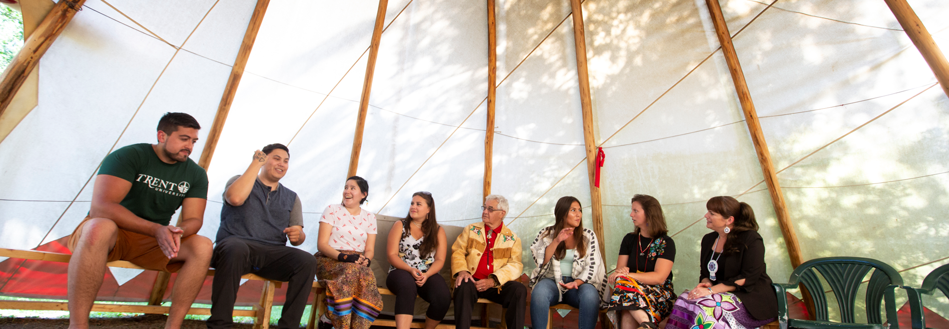
School of Graduate Studies
Blackburn Hall, Suite 115
All financial inquires direct to: graduatefinance@trentu.ca

