Slide 1


Physics 2093H
Put on your
speakers or earphones first
Trent University
Then, up on the top
tool bar of your screen
click on:
“Slide Show” and then
“View Show”…..
Then hit the “space bar” once
The audio part of this presentation was recorded for an earlier semester and so it may not make complete sense for our course...

Slide 2
Welcome to
Physics 2093H:
Physical Science for Elementary Teachers – Elect.
& LPG, 2021

Slide 3
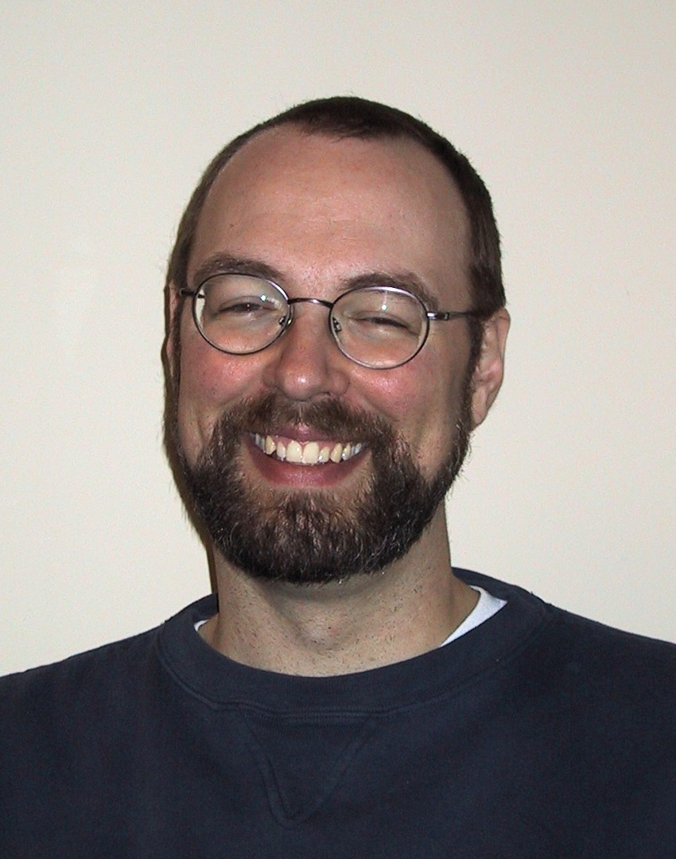
First: let’s get to know who I am; that’s me
Instructor at Trent since 2003….
- taught at UIUC, McMaster, Trent
- Research interests in Physics Education
Johann Beda

Slide 4
First: let’s get to know who I am; that’s me
Instructor at Trent since 2003….
- taught at UIUC, McMaster, Trent
- Research interests in Physics Education
Research
- High Energy Theory (Particle Physics)
- Physics Education
Interested in how people learn science...
Johann Beda

Slide 5
I would like you to jot down (on the worksheets) three or
four ideas about what type of person would get the most
out of this class.
1)
2)
3)
4)

Slide 6
Now share your list of ideas
with your neighbour for a few minutes.
Do they have different ideas from you?

Slide 7
Who would you like to be?
Your name here

Slide 8
Who would you like to be?
Write that name on your fancy new
journal.
Your name here

Slide 9
I would like you to jot down (on the worksheets) three or
four items about you… anything you think might
interest others
1)
2)
3)
4)

Slide 10
Now share your list (and your name)
with your neighbour for a few minutes.
Meet a classmate.
(Don’t worry, you will not have to share with everyone)

Slide 11
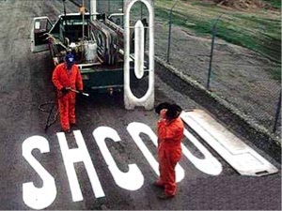
We all do it sometimes, don’t we?

Slide 12
Again on the worksheets, I’d like you to jot down
three or four ideas about your expectations for
the course….
1)
2)
3)
4)

Slide 13
Again on the worksheets, I’d like you to jot down
three or four ideas about your expectations for
the course….
1) Eat dough-nuts each class
2)
3)
4)

Slide 14
Now share your list with your neighbour
for a few minutes.
Are your expectations the same as theirs?

Slide 15
Now here are some of my ideas
about my expectations for the course….
1)
2)
3)
4)

Slide 16
Now here are some of my ideas
about my expectations for the course….
1) Safe Classroom
2)
3)
4)

Slide 17
Now here are some of my ideas
about my expectations for the course….
1) Safe Classroom
2) Restraint
3)
4)

Slide 18
Now here are some of my ideas
about my expectations for the course….
1) Safe Classroom
2) Restraint
3) Ontario 1-8 Curriculum
4)

Slide 19
Now here are some of my ideas
about my expectations for the course….
1) Safe Classroom
2) Restraint
3) Ontario 1-8 Curriculum
4) Have Some Fun Together

Slide 20
Text / Workbook:
“Powerful Ideas
in
Physical Science”
“PIPS”
Course Pack
$20

Slide 21
“PIPS” presents Case Studies that will ….

Slide 22
“PIPS” presents Case Studies that will ….
- clarify things you already know

Slide 23
“PIPS” presents Case Studies that will ….
- clarify things you already know
- reveal differences among the class

Slide 24
“PIPS” presents Case Studies that will ….
clarify things you already know
- reveal differences among the class
- get you to predict outcomes

Slide 25
“PIPS” presents Case Studies that will ….
- clarify things you already know
- reveal differences among the class
- get you to predict outcomes
- lead you to experiment and discover
PIPS

Slide 26
“PIPS” presents Case Studies that will ….
- clarify things you already know
- reveal differences among the class
- get you to predict outcomes
- lead you to experiment and discover
- document what you have discovered

Slide 27
“PIPS” presents Case Studies that will ….
- clarify things you already know
- reveal differences among the class
- get you to predict outcomes
- lead you to experiment and discover
- document what you have discovered
- examine scientific learning processes

Slide 28
“PIPS ...
a) elicits students' existing notions in writing and in groups.
b) presents disequilibrating experiences which prompt reexaminations and reevaluations of existing notions.
c) engages students in carefully designed collaborative activities.
d) leads students to constructing their own new notions and improved conceptual understanding. “
Source: “PIPS instructor’s guide”

Slide 29
Engaged Learning in…..
- Light & Colour
- Electricity
- Motion
- Pulleys, Levers and Gears

Slide 30
Let’s examine an example taken from…..
- Light & Colour
- Electricity
- Motion
- Pulleys, Levers and Gears

Slide 31
What do you think?

Slide 32
What does the group think?

Slide 33
What do you think?
What does the group think?
Making Observations
Making Sense

Slide 34
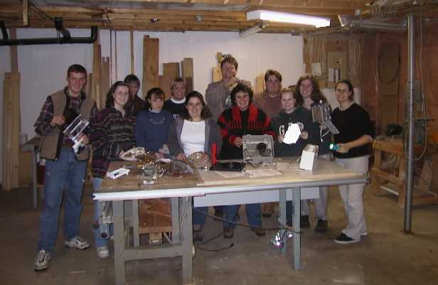

Slide 35
Other aspects of Physics 2091H...
- Journals
- Ontario’s 1-8 Science Curriculum
- How we learn most effectively
- E-mail & other communications

Slide 36
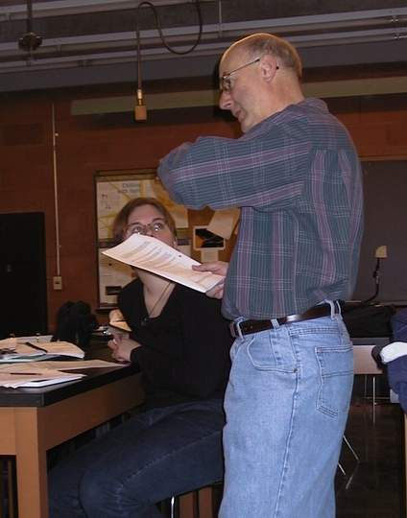
That’s John
Earnshaw
facilitating
someone’s
learning
in the
Physics 209x
lab

Slide 37
Your tasks before the next class:
Get your “trentu.ca” accounts activated and
complete the myLearningSystem demographics survey.
nb: If you wish to use another e-mail address, set your
“trentu.ca” e-mail to be automatically forwarded.

Slide 38
Your tasks before the next class:
Get your “trentu.ca” accounts activated and
complete the myLearningSystem demographics survey.
nb: If you wish to use another e-mail address, set your
“trentu.ca” e-mail to be automatically forwarded.
If you had an account previously,
but have not used it recently,
you may have to logon to
https://www.trentu.ca/mytrent/activate.php

Slide 39
Your tasks before the next class:
Get your “trentu.ca” accounts activated and
complete the myLearningSystem demographics survey.
- Upload a short computer file to myLearningSystem with
your response to the "Everything You Thought You
Knew About Learning Is Wrong” article.
With SafeAssign

Slide 40
Your tasks before the next class:
Get your “trentu.ca” accounts activated and
complete the myLearningSystem demographics survey.
- Upload a short computer file to myLearningSystem with
your response to the "Everything You Thought You
Knew About Learning Is Wrong” article.
- Send me a short e-mail message (under 100 words, with “Physics
2093H Intro” in the subject line) from your trentu.ca email account
introducing yourself, and telling me your expectations
for the course. (Do this soon, but at least a day before your next class.)

Slide 41
Your tasks before the next class:
Get your “trentu.ca” accounts activated and
complete the myLearningSystem demographics survey.
- Upload a short computer file to myLearningSystem with
your response to the "Everything You Thought You
Knew About Learning Is Wrong” article.
- Send me a short e-mail message from your trentu.ca
email account introducing yourself, and telling me your
expectations for the course.
- Post a message in the online class discussion forum.
(Use the topic “Homework 01/Assignment 0” in the category “Homework and
Assignments”. Make it under 100 words, with the subject “HW01 - Intro
Messages”. Include something interesting - maybe your favourite cookie recipe. )

Slide 42
Your tasks before the next class:
Get your “trentu.ca” accounts activated and
complete the myLearningSystem demographics survey.
- Upload a short computer file to myLearningSystem with
your response to the "Everything You Thought You
Knew About Learning Is Wrong” article.
- Send me a short e-mail message from your trentu.ca
email account introducing yourself, and telling me your
expectations for the course.
- Post a message in the online class discussion forum.
- Bring $20 to the next class.
(You will be given a journal and a weekly PIPS course pack)

Slide 43
Your tasks before the next class:
Get your “trentu.ca” accounts activated and
complete the myLearningSystem demographics survey.
- Upload a short computer file to myLearningSystem with
your response to the "Everything You Thought You
Knew About Learning Is Wrong” article.
- Send me a short e-mail message from your trentu.ca
email account introducing yourself, and telling me your
expectations for the course.
- Post a message in the online class discussion forum.
- Bring $20 to next class in room ESC 305.
- Look at Assignment #1 – it will be due soon!

Slide 44
PHYSICS 2093H…
“constructivist learning” by
“engaged interactions”
Get your network ID at https://www.trentu.ca/mytrent/activate.php
My name is Johann Beda
My e-mail address is jbeda@trentu.ca
The course WEB page is at:
http://www.trentu.ca/physics/jbeda/PHYS209x/
https://learn.trentu.ca/

