Slide 1
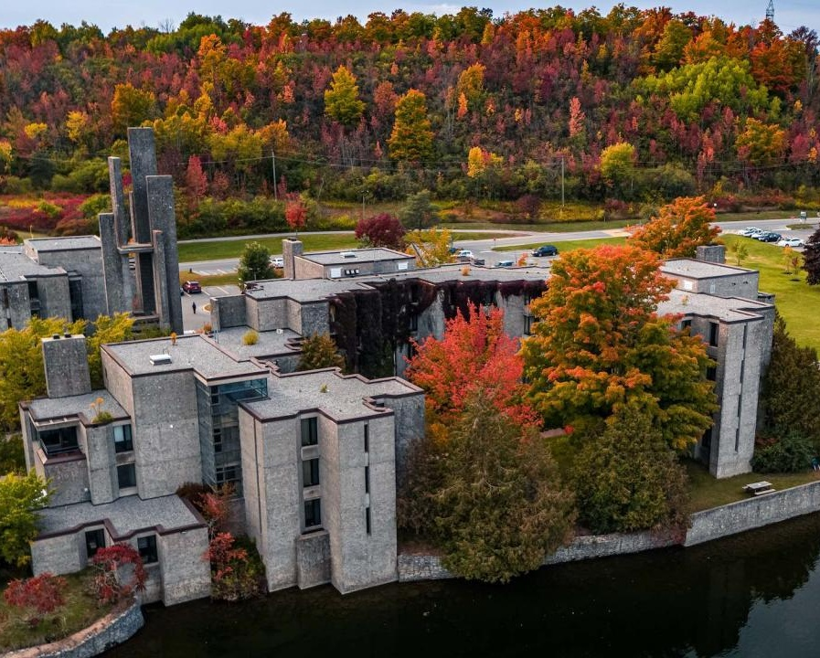
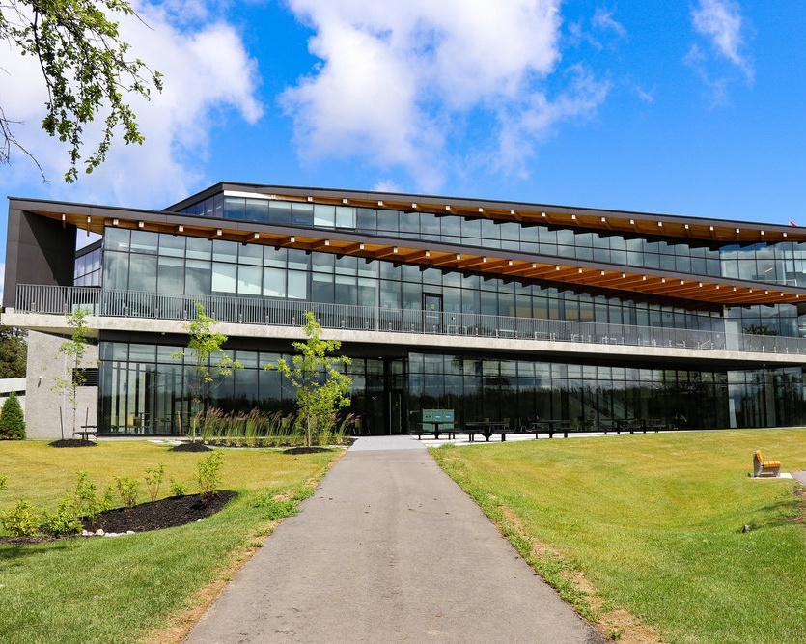

Canada Graduate Research Scholarship
Doctoral Program
2026-27
Jane Rennie
Graduate Finance Officer
School of Graduate Studies
Notes:
Canada Graduate Research Scholarship (Doctoral) Workshop & Resource Guide
This presentation was developed to support prospective applicants preparing a CGRS-D application.
Applying for a major doctoral scholarship can feel overwhelming, but it is also an opportunity to reflect on your research, articulate your contributions, and develop skills that will benefit you throughout your academic career. This workshop and resource guide will walk you through:
*Learn how applications are evaluated
*Develop a stronger research proposal
*Identify common application challenges and strategies for success
*Access key resources, policies, and support services
This resource is intended to complement, not replace, agency application instructions and program guidelines.

Slide 2
Description
The Canada Graduate Research Scholarship — Doctoral (CGRS D) program is part of the Tri-Agency Canada Research Training Awards Suite (CRTAS).
The CRTAS recognizes and empowers the next generation of highly qualified innovators, knowledge workers and creative thinkers. It supports outstanding graduate students and postdoctoral researchers in developing their research skills and provides the funding and flexibility needed to support their contributions to building world-class research capacity and to Canada’s prosperity and competitiveness.
The CGRS D supports outstanding doctoral students conducting research in health, natural sciences and engineering, and social sciences and humanities.
Award value: $40,000 per year, up to 36 months
Quotas
The term “quota” refers to the maximum number of applications an institution can forward to each agency. Institutions receive separate quotas from each agency (CIHR , NSERC and SSHRC ).

Slide 3

Canada Graduate Research Scholarship – doctoral Program
Trent Internal Deadline:
October 16, 2026 @ 11:59 p.m.
NSERC portal DOES NOT allow Trent to “close” access to the portal, but the portal records the last time accessed by the applicant.
Late applications will not be accepted.
CIHR: ResearchNET and instructions
NSERC: Online system and instructions
SSHRC: Registration and login and instructions
Notes:
More Than a Scholarship Application
Preparing a CGRS-D application is also an opportunity to strengthen skills that will benefit you throughout your academic and professional career. Developing a scholarship application encourages critical reflection on your research program, helps you articulate the significance of your work, strengthens academic writing skills, and provides valuable experience communicating your research to diverse audiences.
Whether you are preparing your first major scholarship application or seeking to improve a previous submission, this resource is designed to support you in presenting the strongest possible case for funding and research excellence.

Slide 4

Benefits of Developing Scholarship applications
Boosts your confidence in writing, critical thinking, project management, and navigating government portals.
Improves your academic writing through practice, helping you become more proficient in the writing style specific to your discipline.
Raises your awareness of the complexity and demands of your academic and research plan
Teaches time management by working through a project timeline (like a scholarship application), helping you understand the planning and effort needed to meet deadlines.
Prepares you to mentor others, giving you the experience needed to confidently guide younger researchers through the scholarship application process.

Slide 5
Eligibility
To be eligible to apply, you must have completed no more than 36 months of full-time equivalent study in the doctoral program, for which you are requesting funding by December 31 of the calendar year of your application.
Number of months:
Eligibility for CGRS D is based on the number of months of full-time study, including summer months, you completed by December 31 of the calendar year of your application toward the degree for which you are requesting funding.
Two terms of part-time study count as one term of full-time study.
The agencies count all studies toward the doctoral degree for which funding is requested, whether or not they were completed in the same program or at the same institution.
How many months of study have I completed?
Start Date Eligibility Status
Sept 2024 Eligible
Sept 2023 Check Months
Sept 2022 Likely Ineligible

Slide 6
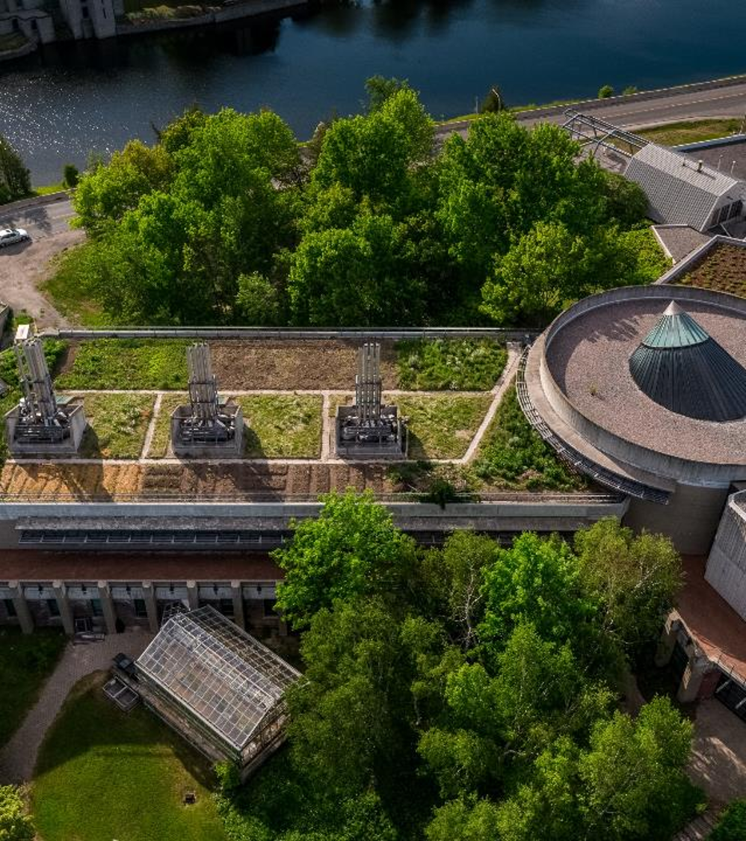
Other Restrictions
One application per year: Apply to only one CRTAS program (CIHR, NSERC, or SSHRC) per academic year.
Maximum three attempts: You may apply to CGRS D up to three times.
No prior doctoral award: Must not have previously held a CIHR, NSERC, SSHRC, or Vanier doctoral scholarship.
CIHR/NSERC recipients: Cannot hold a tenure or tenure-track position (or be on leave from one) while receiving the award.

Slide 7
International Applicants
If you are not a Canadian citizen, permanent resident of Canada or protected person under subsection 95(2) of the Immigration and Refugee Protection Act (Canada), you must be enrolled in your doctoral program of study at an eligible Canadian institution by the application deadline.
Trent Internal Deadline: October 16, 2026 @ 11:59 p.m.
Up to 15% of awards will be available to international applicants at the national level, this is split between CIHR, SSHRC, NSERC.

Slide 8
Proposed locations of tenure
Can I hold an award outside Canada?
You may take up your CGRS D at any eligible Canadian degree-granting institution (or eligible CIHR institution paid). To be eligible to hold your award at an international degree-granting institution, you must:
be a Canadian citizen, permanent resident of Canada or protected person under subsection 95(2) of the Immigration and Refugee Protection Act (Canada) as of the application deadline; and
have completed at least one previous undergraduate or graduate degree at a Canadian institution.
Up to 20% of all doctoral awards will be available to be held abroad.
When considering locations of tenure outside of Canada, and to help you plan for safe travels and to safeguard your research abroad, you are encouraged to consult the Government of Canada’s resources related to travel and research security.
Yes, if:
Canadian citizen/permanent resident/protected person
Previous Canadian degree completed

Slide 9
Understanding How Applications are Evaluated

Slide 10

Understanding Selection Process
Institutional review
The School of Graduate Studies is responsible for coordinating the institutional evaluation of all applications submitted from each agency.
Based on institutional quota, the highest ranked applications are forwarded to the federal competition.
Applicants compete first at Trent, and if selected compete at national level.
Selection criteria
Research potential (50% weight)
Relevant experience and achievements obtained within and beyond academia (50% weight)
Applicants are encouraged to review the indicators which help articulate the selection criteria
Committee selection guide is also a valuable resource

Slide 11
Selection Criteria 50 %
Research Potential 50%
Indicators of research potential: quality of research proposal:
  specific, focused and feasible research question(s) and/or objective(s)
  clear description and soundness of the proposed methodology
  significance and expected contributions to research
demonstration of potential to carry out proposed research relative to the stage of study, lived experience and knowledge systems
quality of contributions and extent to which they advance the field of research–contributions may include publications, patents, reports, posters, abstracts, monographs, presentations, creative outputs, knowledge translation outputs, community products, etc.
demonstration of sound judgment and ability to think critically
integration of EDI considerations (if applicable) NEW
demonstration of responsible and ethical research conduct, including honest and thoughtful inquiry, rigorous analysis, commitment to safety and dissemination of research results and adherence to professional standards
demonstration of originality, initiative, autonomy, relevant community involvement and outreach
ability to communicate theoretical, technical and/or scientific concepts clearly and logically in written and oral formats
quality of presentation of application NEW

Slide 12
Selection Criteria 50%
Relevant Experience and Achievements obtained within & beyond academia 50%
relevant training, such as academic training, lived experience and traditional teachings
scholarships, awards and distinctions (amount, duration, and prestige)
academic record:
  transcripts, duration of previous studies
  program requirements and courses pursued, course load
  relative standing in program (if available)
professional, academic, and extracurricular activities, as well as collaborations with supervisors, colleagues, peers, students and members of the community, such as:
  teaching, mentoring, supervising and/or coaching
  managing projects
  participating in science and/or research promotion
  participating in community outreach, volunteer work, and/or civic engagement
  chairing committees and/or organizing conferences and meetings
  participating in departmental or institutional organizations, associations, societies and/or clubs
Notes:
Indicators of relevant experience and achievements obtained within and beyond academia:

Slide 13
Where Reviewers Find Evidence in Your Application
Have I fully emphasized my research potential in all areas of my application?
Academic Excellence
Training
Transcripts
Awards
Research Experience
Publications
Projects
Quality of research dissemination
Leadership & Engagement
Teaching & mentoring
Community involvement
Activities & collaborations
Criterion | Indicator | Source
Research Potential | Quality of methodology | Research proposal
Research Potential | Publications | Contributions section
Experience & Achievements | Awards | Awards section
Experience & Achievements | Leadership | Activities section

Slide 14
Internal Trent
Selection Review Process
The review committee identifies the strongest applications and creates a ranked list of alternates.
Only materials submitted through the Research Portal are reviewed.
Reviewers do not consult external websites, URLs, or publications.
Applications must follow all page limits and formatting requirements. Excess pages may be removed, and non-compliant applications may be deemed ineligible.
Applications are evaluated only against the published selection criteria and their assigned weightings.
No additional criteria may be used in the evaluation process.
Reviewers consider all required criteria when assigning an overall score.
Special circumstances that have affected research productivity, academic achievement, or degree progress are considered during the review process.
Applicants should explain relevant circumstances in the Special Circumstances section of the application.

Slide 15

Six Keys to a Strong Application
Apply to the correct agency.
Understand the selection criteria and evaluation process.
Develop a focused and feasible research proposal.
Create an application that showcases your achievements and demonstrates how you meet the selection criteria.
Give referees sufficient time to prepare strong reference letters.
Revise, edit, and seek feedback early.

Slide 16
Developing a strong Research Proposal

Slide 17
Outline of Proposed Research
Various Proposal Frameworks
Hour-Glass Style
Inverted Triangle
Background of research, broad overview
Introduce important concepts, what is known and what is unknown
Research question
Methodology
Data analysis
Contribution to knowledge in field and broader impact
Big picture, relevance/importance of problem
Theoretical Frame: Situate study in body of theory
Research question
Methodology: Underlying approach to the research
Method: How will you do it?
Data analysis
Dissemination of research

Slide 18
Framework Suggestion
Research Outline – Breakdown
Main Challenge or Issue
  What problem are you addressing?
What’s Known and Unknown
  Briefly explain what researchers already know and what gaps still exist.
Research Questions
  What specific questions will your research try to answer?
Theoretical and Methodological Framework
  What theories and methods will guide your research?
Proposed Methods
  What steps or techniques will you use to carry out the research?
Contribution to Knowledge
  How will your findings advance your field or help other areas of research?
Public Good / Social Impact
  How could your research benefit society or make a positive difference?

Slide 19
Research Design Considerations

Slide 20



Sex and Gender Based Analysis + (SGBA+)
When applicable, indicate how diversity (gender, sex, age, race, culture, religion, etc.) is considered in your proposed research (from its design to the analysis of the research findings).
Incorporating the principles of SGBA+ in research has the potential to increase the thoroughness and usefulness of the research.
How to Integrate Sex and Gender into Research
What is Gender? What is Sex?
Online training modules:
  Sex and Gender in Biomedical Research
  Sex and Gender in Primary Data Collection with Human Participants
  Sex and Gender in the Analysis of Secondary Data from Human Participants

Slide 21

Knowledge Mobilization
Knowledge mobilization is an umbrella term encompassing a wide range of activities relating to the production and use of research results, including knowledge synesis, dissemination, transfer, exchange, and co-creation or co-production by researchers and knowledge users.
Resources from Tri-Council
What is knowledge mobilization?
Canadian Knowledge Transfer and Exchange Community of Practice website
Mapping the Impact of Research (PDF, 1.07 MB), David Phipps, York University

Slide 22
An outline of proposed research should clearly and concisely communicate a research plan, its significance, and the approach.
🧠 1. Research Problem or Challenge
Clearly state the issue your research addresses.
Explain why it matters—scientifically, socially, or economically.
📚 2. Background and Knowledge Gaps
Summarize what is already known in the field.
Identify gaps in knowledge that your research will fill.
❓ 3. Research Questions or Objectives
Include the key questions your research aims to answer.
These should align with your overall goals and be specific and measurable.
🧪 4. Methodology or Approach
Describe how you will conduct your research.
Include details on data collection, analysis techniques, and tools or models you'll use.
📅 5. Timeline and Milestones
Break down your research into phases.
Include key milestones and estimated completion dates for each stage.
📈 6. Significance and Impact
Explain how your research will contribute to the field.
Discuss potential applications, policy implications, or societal benefits.
Knowledge Mobilization / Expected Outcomes
Outline your plan to disseminate your research and what you expect to discover.
📎 8. References and Supporting Literature
List key sources that support your background and methodology.
Ensure they are relevant, credible, and up-to-date. (5 pages)

Slide 23
Vanier Selection guide
The Vanier Scholarship program is no longer active.
However, the Vanier Committee Selection Guide remains a goldmine of resources for all applicants drafting a scholarship application as the resources and explanations are all in one place.
This guide is a great tool during the editing stage of drafting your Outline of Proposed Research, as this component of your application is one of the “sources” used to assess the selection criteria.
Criterion - defines the selection criteria
Indicators - explanations of the concepts that demonstrate how the applicant meets the selection criteria
Sources - what component of the application provides an opportunity to demonstrate that the applicant meets the selection criteria

Slide 24
Application Components

Slide 25
List for a Complete Application: CGRS- D application (NSERC example)
Application profile & Personal profile
Addresses
Academic background
Academic, research and other relevant work experience
Awards
Proposed location(s) of tenure
Scholarship information
Theses completed or in progress
Keywords and research subject code
Equity, diversity and inclusion considerations in the research process
Outline of proposed research (attachment; two pages)
Bibliography (optional attachment; five pages)
Justification for eligibility of proposed research (optional attachment; one page)
Contributions and statements (attachment; two pages)
Special circumstances (optional attachment)
Transcripts and proof of registration (attachment)
Reference letters

Slide 26



Canadian Common CV (CCV)
The Tri-Agency CCV refers to the Canadian Common CV (CCV) system used for funding applications submitted to Canada’s three federal research funding agencies. (CGRS-M, CGRS-D CIHR & SSHRC)
What It Is:
The Tri-Agency CCV is a standardized online CV format required for many scholarship, fellowship, and grant applications. It ensures consistency and completeness in how academic and professional information is presented.
Key Features:
Sections: education, employment, research funding history, contributions, activities, and more.
Time-consuming: It can take several hours to complete, especially the first time, so starting early is recommended.
START EARLY
Notes:
Update annually. The first setup can be time-consuming.

Slide 27
Transcripts
Include up-to-date official transcripts of ALL your undergraduate and graduate studies in the application.
Retain the paper copy of any uploaded transcripts, as you could be asked to provide it for verification purposes.
Up-to-date official transcripts are defined as transcripts issued by the Registrar’s Office and dated or issued in the fall session of the year of application (if currently registered) or after the last term completed (if not currently registered).
Applicants are responsible for collecting, uploading, and confirming legibility of previous and current transcripts and upload them directly on to the application portal.
Review the application instructions.
If you have started your doctoral graduate program Fall 2026 – you must upload transcript from this program, as it indicates months of study in your graduate program.

Slide 28
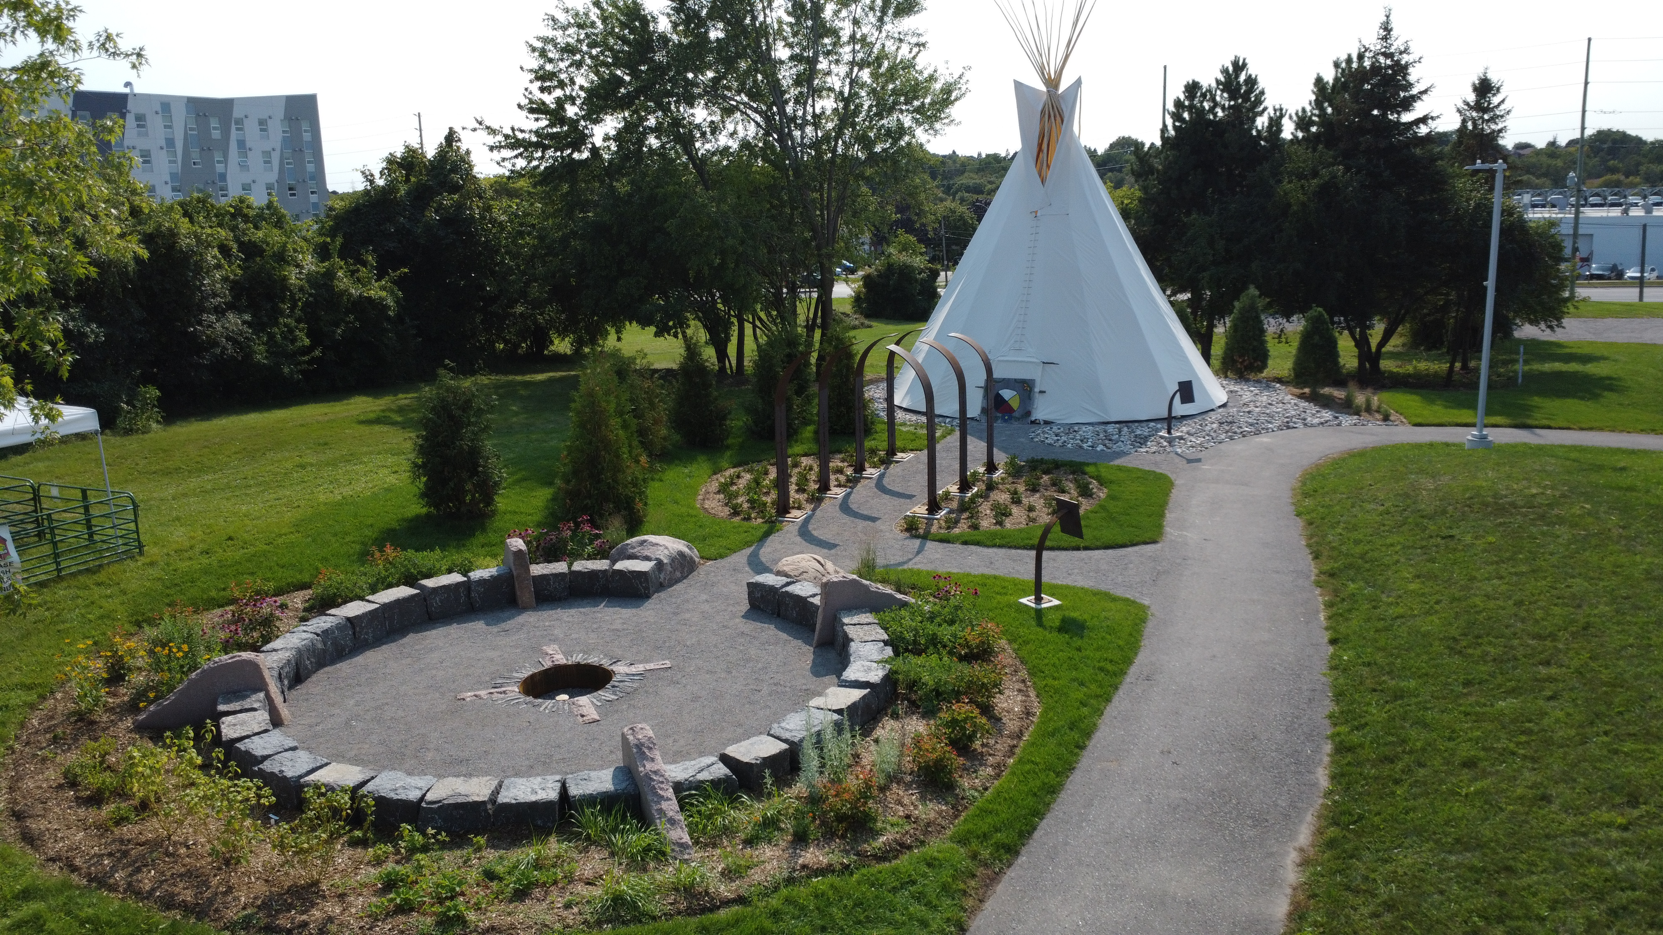
Special circumstances (optional)
Describe the impact of any special circumstances that may have delayed, disrupted or interrupted studies or research or otherwise affected the performance and or productivity on which the assessment for funding will be made.
Tips for writing
Be brief, yet honest, when completing a special circumstances inclusion.
Stay factual and concise.
Assess your full application to determine if there are gaps requiring clarification for the members of the adjudication committee.
Demonstrate how the circumstances may have influenced your research, strengthened your focus, or broadened your academic development.
Links: SSHRC D NSERC D CIHR D Point 4

Slide 29


“Special Circumstances: what to consider”
The Special circumstances section should include the following information as needed:
The duration of the delay/interruption and, if applicable, a percentage of reduction in workload.
A clear description of its impact including, if relevant, the type of research contribution impacted (for example, publications, data collection, presentations, etc.).
For delays related to the COVID-19 pandemic, specify the impacts and how they relate to your particular circumstances (for example, lab access, equipment delays, family responsibilities, etc.). Explain what you did to adjust or compensate in response to these impacts.
The review committee members are asked to recognize delays and assess the quality of your performance and productivity during your active period (that is, excluding the period of special circumstances).
If your supervisor is unable to provide you with a reference letter, you may use this section to provide an explanation.

Slide 30
Overview of Scholarship Application Recommendation Letters
Always review the application instructions and share instructions with your “referee”
Recommendation letters might be called:
Letter of Appraisal
Report on the Applicant
Reference Assessment or Referee Assessment
It is critical that a “referee” relate their comments to the competition’s selection criteria.
They provide a meaningful commentary on an applicant’s skills, knowledge, experience, research potential and contributions.
Adjudication committee members rely on these letters to review their own ranking of the application in comparison to the pool of applicants.

Slide 31

Who? When? How?
Consider
How to ask
Who to ask?
A person who offers authority, depth and who can offer specificity. They are familiar with your research and other abilities:
Supervisor, faculty member, employment supervisor, thesis advisor
When to ask?
… early, 3 to 4 weeks before scholarship due date
Email or in-person or phone
What is your comfort level and awareness of your referee?
If in email, first message should:
Be a brief inquiry reminding the faculty member how you know them
Provide clarification as to what scholarship application you are applying for
Clearly ask if they are willing to provide an enthusiastic reference for your scholarship application
Provide the scholarship application submission deadline

Slide 32
What to provide a referee and what might be helpful
Advise your referee you will provide:
Scholarship overview
Selection criteria
Draft of your outline of proposed research
Referee instructions
Ask, would it would be helpful to provide:
unofficial transcripts;
a resume or CCV;
written blurbs for how your experience or academic background fits the selection criteria of the scholarship competition
Notes:
🌟 The Women's Classical Caucus (WCC)
📘 Commission on the Status of Women – Avoiding Gender Bias in Reference Writing

Slide 33
A strong Reference will:
Confirm the value of your research project while commenting on focus, feasibility, clarity of methodology and significance within your field of research
Indicate a familiarity with your academic achievements to date, comment on your judgement, critical thinking, originality, initiative, autonomy and enthusiasm for research
Endorse your project and your ability to achieve the outcomes of your project
Affirm quality and relevance of your contributions, considering discipline-specific norms and the work advances the field
Share insight into your training, knowledge and lived experience relevant to the research, offering context beyond grades and your CCV
Provide a robust picture of your skills and interest in and outside the lab / classroom
Highlight how you may have overcome challenges or any special circumstances that you have experienced during your academic career

Slide 34
Application Submission Process

Slide 35


Application procedures
Selecting the appropriate agency
Apply to the agency best aligned with your research subject matter to ensure your application will be reviewed by experts in disciplines closest to your field(s) of study. For more information, see Selecting the Appropriate Federal Granting Agency.
If you are applying to CIHR, consider the information on CIHR’s website.
If you are applying to NSERC, see the Addendum to the guidelines for the eligibility of applications related to health, which has additional information and specific examples relating to subject matter.
If you are applying to SSHRC, see the information on SSHRC's Subject Matter Eligibility web page.
It is your responsibility to select the funding agency that best suits your application.
Applications submitted to the incorrect agency may be removed from the competition.

Slide 36
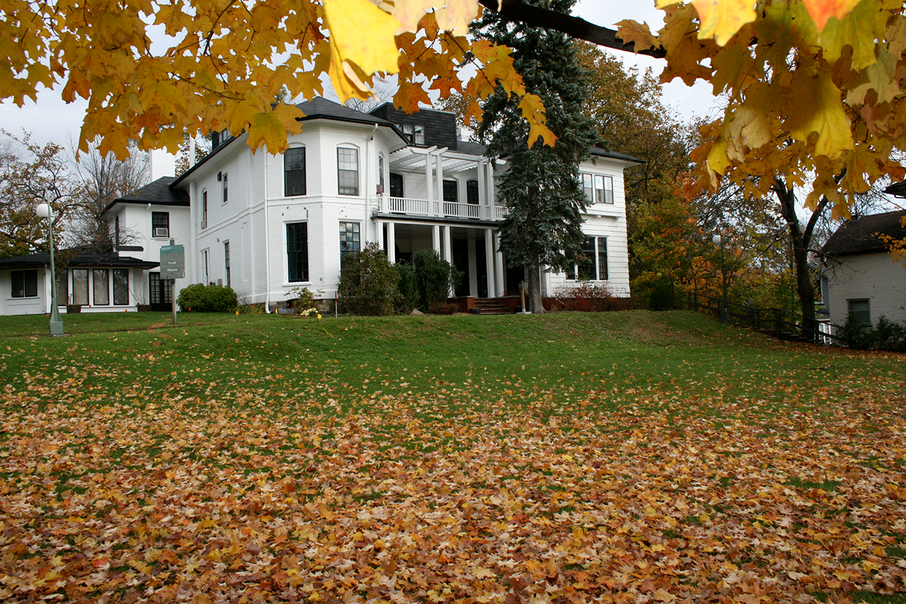

Application Portals
To complete the application process, see the appropriate agency’s website and instructions:
CIHR: ResearchNET and instructions
NSERC: Online system and instructions
SSHRC: Registration and login and instructions
To be considered in the competition, your application must be complete.
Each funding agency provides specific instructions, including a checklist that outlines all the required components of a complete application.
You must submit your application electronically through the relevant agency’s platform.
If you need help while preparing your application, write to the appropriate program contact well before the application deadline.

Slide 37

Presentation Standards
Tri Agency provides online presentation and attachment standards that applicants must follow.
NSERC Presentation Standards
SSHRC Instructions for Attachments and Presentation Standards
Do not password protect your attachments
Filename of a document should be fewer than 15 characters long.
Go beyond allowable space and your application may be deemed ineligible

Slide 38


“Common Mistakes Applicants make”
Not reading the instructions
Starting too late
Weak referee selection
Ignoring formatting requirements, going over in allowable space
Underestimating proposal-writing time
Unclear research questions vague or too heavy with jargon
Waiting until transcripts are needed, or not including all transcripts
Not editing
Not eligible and didn’t confirm
Submitting incorrectly so missed deadline

Slide 39

Tri Agency Tips
Make sure your application is complete, clear, concise, consistent and free of errors.
To this end:
Check spelling and grammar;
Use concise and complete sentences;
Avoid jargon and excessive use of acronyms.
Demonstrate strong communication skills as you clearly state your objectives, your research question and the expected results.
Present a clearly defined methodology and demonstrate how you expect to achieve your results.
You must demonstrate in your application that you have excellent potential to conduct research
Your research proposal/program of work should highlight your potential contribution to the advancement of knowledge.
This research potential can also be demonstrated by any relevant training and experience you have acquired, not only within but also outside academia and related achievements.

Slide 40
Priority Research Areas
In Budget 2024 , funding was provided to support an increase in the number of awards, a portion of which will be dedicated to supporting priority research areas.
The agencies will make additional award offers for select meritorious applications that align with one or more of the following priority research areas:
Advanced digital technologies (including AI, quantum, and cybersecurity)
Health, including biotechnology
Clean technology and resource value chains
Environment, climate resilience, and the Arctic
Food and water security
Democratic and community resilience
Manufacturing and advanced materials
Defence and dual-use technologies
Applications do not require alignment with a priority area.
See agency-specific application instructions for guidance on how to identify your research as being aligned with a priority research area.

Slide 41


Additional Funding Opportunities
Joint Initiatives & Supplements
The three agencies may offer supplementary funding to award holders, some of which is offered through joint initiatives (collaborations with organizations from across the not-for-profit, private and public sectors to support and promote training, research and connection activities).
Joint initiatives and supplements are designed to reflect the strategic objectives and mandates of each respective agency, inform decision-makers and, in certain cases, address specific needs of their partners.
See the agency websites (CIHR, NSERC, SSHRC) for more information on related opportunities.
May not apply or fit area of research! But they might…

Slide 42
Indigenous Scholars
& Black Student Researchers
Indigenous Scholars Awards and Supplements Pilot Initiative web page.
CIHR will also provide designated funding for Indigenous students applying to the CGRS D program via an agency specific funding mechanism. See CIHR’s CGRS D Funding Opportunity for more information.
Black student researchers
The Government of Canada has provided additional funds to increase direct support for Black student researchers. Meritorious CGRS D applicants who self-identify as Black and provide consent to be considered for funds designated for specific groups may be selected to receive this funding. Each agency has up to 10 additional awards reserved for Black student researchers.
Program Additional Support
Indigenous Scholars Supplement opportunities
Black Student Researchers Additional designated awards

Slide 43
Policies & Professional Development

Slide 44
Individual Development Plans
Coming Soon!
Active career planning has been shown to improve success in degree progression and success in securing awards.
The agencies encourage applicants and award holders to make use of available resources to develop a career plan that reflects their values, strengths and goals, and helps identify any skill gaps.
There are tools, such as individual development plans (IDPs), available to support you throughout your training.
For more information, including IDP training modules and an IDP form, see the resources available at CIHR’s Individual Development Plans website.
IDPs are not a CGRS D selection or evaluation criterion.

Slide 45

Equity, Diversity and Inclusion
The three agencies are acting on evidence that achieving a more equitable, diverse and inclusive Canadian research enterprise is essential to creating the excellent, innovative and impactful research necessary to advance knowledge and understanding and to respond to local, national and global challenges.
This principle informs the commitments described in the Tri-Agency Statement on Equity, Diversity and Inclusion (EDI) and is aligned with the objectives of the Tri-Agency EDI Action Plan.
Tri-Agency Resources:
Guide for Applicants: Considering Equity, Diversity and Inclusion in your Application
Equity, Diversity and Inclusion (multiple)
Self-identification data and consent provided with applications may be used to determine eligibility for additional awards or priority funding opportunities designated for specific underrepresented groups.

Slide 46

San Francisco Declaration on Research Assessment
San Francisco Declaration on Research Assessment
CIHR, NSERC and SSHRC, along with other Canadian research funding agencies, are signatories of the San Francisco Declaration on Research Assessment (DORA).
The agencies are committed to meaningful assessment of excellence in research funding and to ensuring that a wide range of research results and outcomes are considered and valued as part of the assessment process.
The agencies will continue to work to ensure that their strategies, policies and guidance align with DORA
Tri Agency Resource
Guidelines on the Assessment of Contributions to Research, Training and Mentoring
DORA’s mission is to advance practical and robust approaches to research assessment globally and across all scholarly disciplines.
Notes:
DORA is a global initiative that campaigns for and supports improving ways we assess research and researchers.
DORA started as the San Francisco Declaration on Research Assessment. The idea to write the declaration was developed in 2012 during at the Annual Meeting of the American Society for Cell Biology in San Francisco. Since 2018, it has become a worldwide initiative covering all scholarly disciplines and all key actors in the global scholarly system including researchers, funders, publishers, academies and professional societies, and research performing institutions.
We encourage all individuals and organizations who are interested in developing and promoting best practice in the assessment of researchers and scholarly research to sign DORA and join the movement.

Slide 47
Tri Agency Policies to Review
Guidelines for effective research training
Guide on the use of generative artificial intelligence
Responsible Use of Generative AI
Use AI as a support tool, not a replacement for your expertise.
You remain responsible for the accuracy, quality, and integrity of all application materials.
Verify all facts, citations, and references independently before submission.
Do not upload confidential, unpublished, or sensitive research data into public AI tools.
Review AI-generated content for bias, stereotypes, or missing perspectives.
Maintain your own scholarly voice and critical thinking throughout the application.
Be transparent about AI use when required by institutional, funding agency, or disciplinary guidelines.
Remember: strong scholarship applications demonstrate your judgment, originality, communication skills, and research potential, not AI’s.
Key Takeaway: Generative AI can help you organize, edit, and refine your application, but it should never replace your academic expertise, critical analysis, or professional judgment.

Slide 48
School of Graduate Studies
Blackburn Hall, Suite 115
All financial inquiries direct to: graduatefinance@trentu.ca

